Slide 1

10/11/2020

Slide 2
5 – Software Design
Lab session 5

Slide 3
Outline labs
Part A: UML diagrams Sessions 1 – 2
Part B: Design Patterns Session 3 – 5
Part C: Projects in groups of 2 Session 6 – 9

Slide 4
Testing
A small introduction

Slide 5
Testing: why?
Testing is intended to show that a program does what it is intended to do and to discover program defects before it is put into use.
When you test software, you execute a program using artificial data.
You check the results of the test run for errors, anomalies or information about the program’s non-functional attributes.
Testing and revealing the presence of errors NOT their absence.
Testing is part of a more general verification and validation process, which also includes static validation techniques.

Slide 6
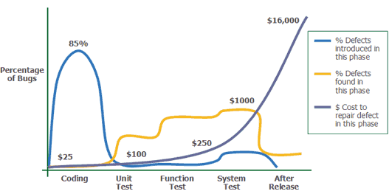
Testing: why?
Source: Applied Software Measurement, Capers Jones, 1996

Slide 7
Development Testing
Bug and defect testing during development
Carried out by the team developing the system
Types
Unit testing
Individual units or object classes are tested
Functionality of objects or methods
Component testing
Several individual units are integrated to create composite components
Focus on component interfaces
System testing
Some/all components are integrated and the system is tested as a whole
Focus on testing component interactions

Slide 8
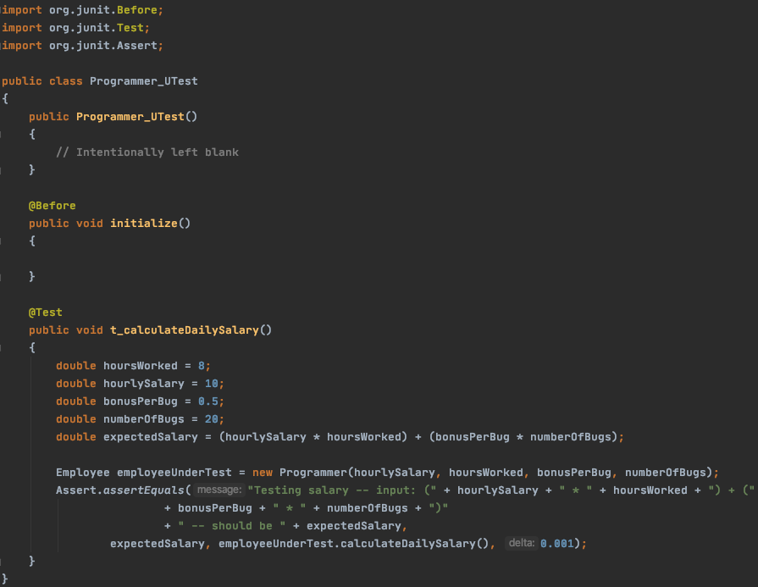
Unit Testing

Slide 9
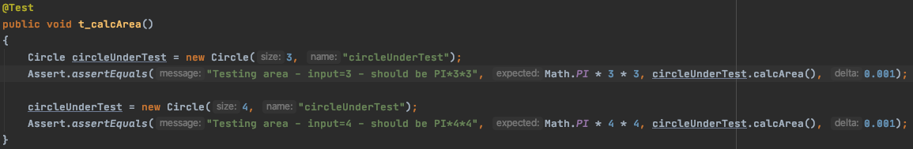
Unit Testing

Slide 10
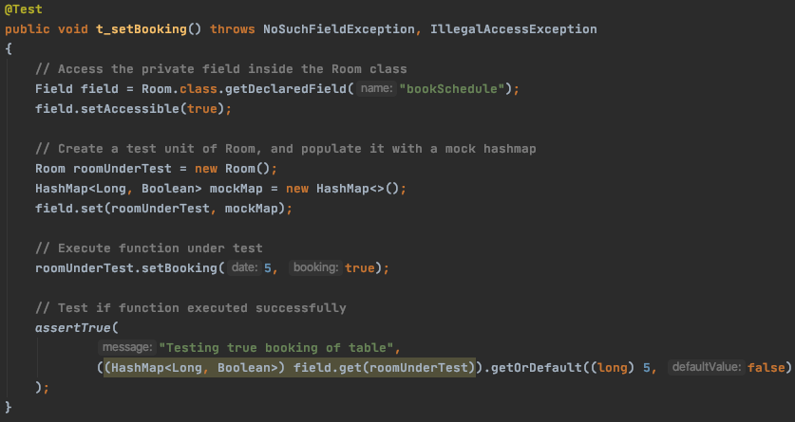
Unit Testing

Slide 11
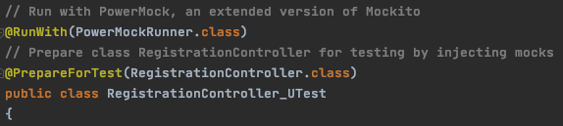
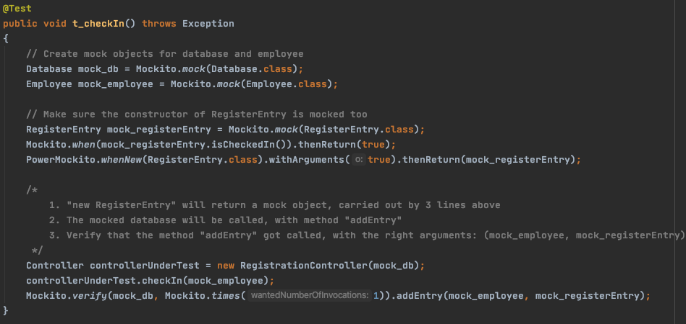
Unit Testing

Slide 12
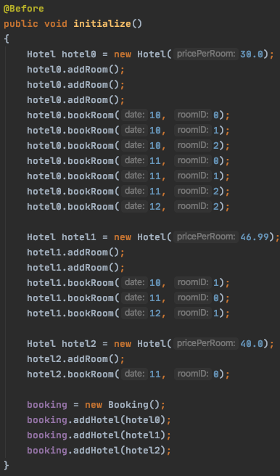
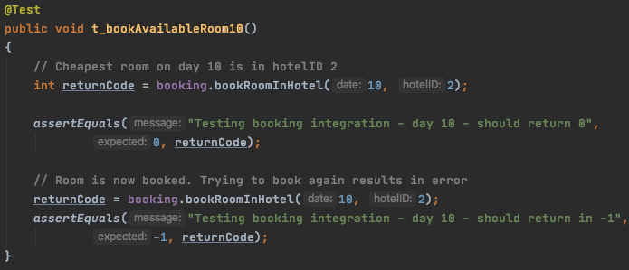
Integration Testing

Slide 13
Part B: Design Patterns
Model-View-Controller Pattern

Slide 14

MVC Pattern
Used for developing user interfaces that divides the related program logic into three interconnected elements
Separates internal representations of information from the ways information is presented to and accepted from the user

Slide 15
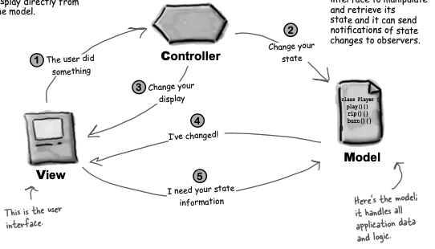
MVC Pattern
Head First Design Patterns: page 529
https://www.tutorialspoint.com/design_pattern/mvc_pattern.htm
https://www.edureka.co/blog/mvc-architecture-in-java/
Google is your best friend

Slide 16
Assignments
MVC Pattern

Slide 17
Assignment
MVC
Continue on last session: time registration
Given:
Your own controller and database (model)
A GUI in ‘view’ package and renewed Main class
To do: glue them together
Make the ViewFrame an observer that observes your model
Add the controller into your ViewFrame such that the buttons do their thing
Non-mandatory but highly recommended extras:
Add extra database & controller for employees, add extra panel to your ViewFrame
Play around with the GUI program: try different layouts, names, titles, colors, …

