Slide 1
5 – Software Design
Tijs Van Alphen

Slide 2
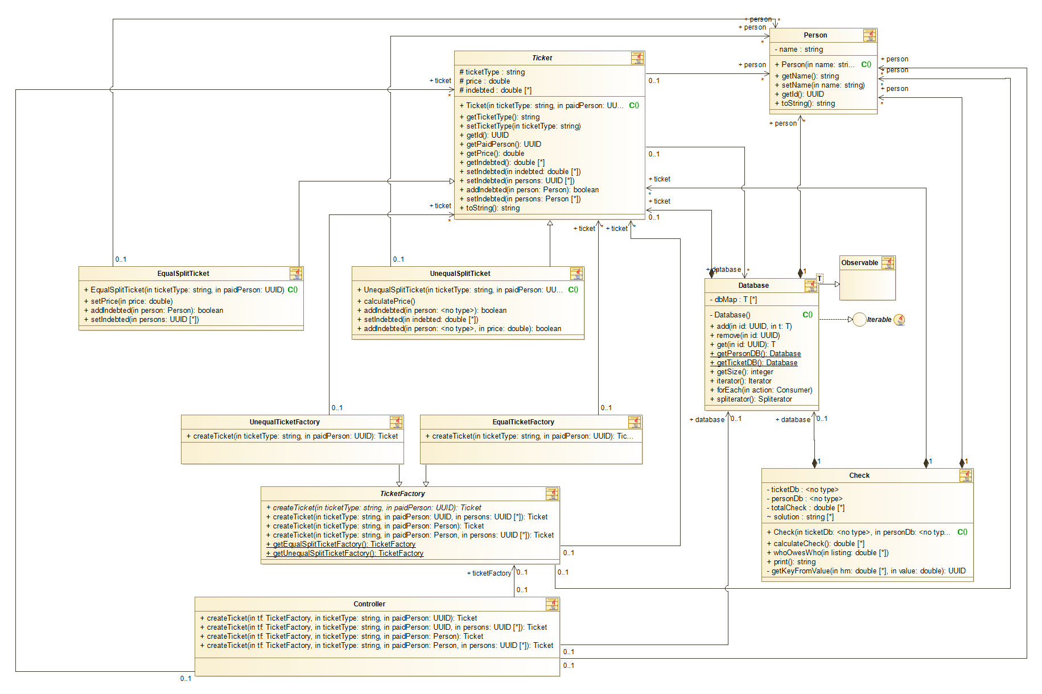
UML schema’s
Class diagram

Slide 3
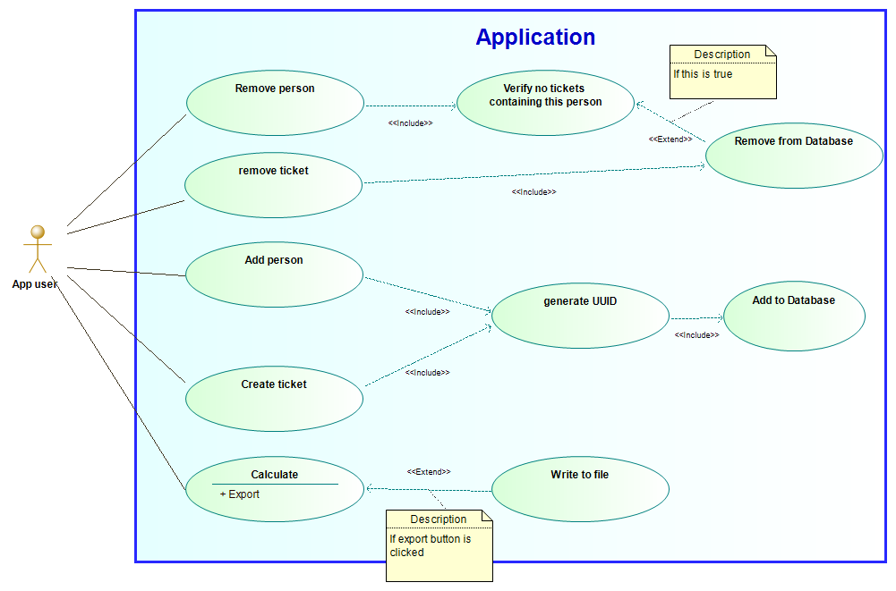
UML schema’s
Use case diagram

Slide 4
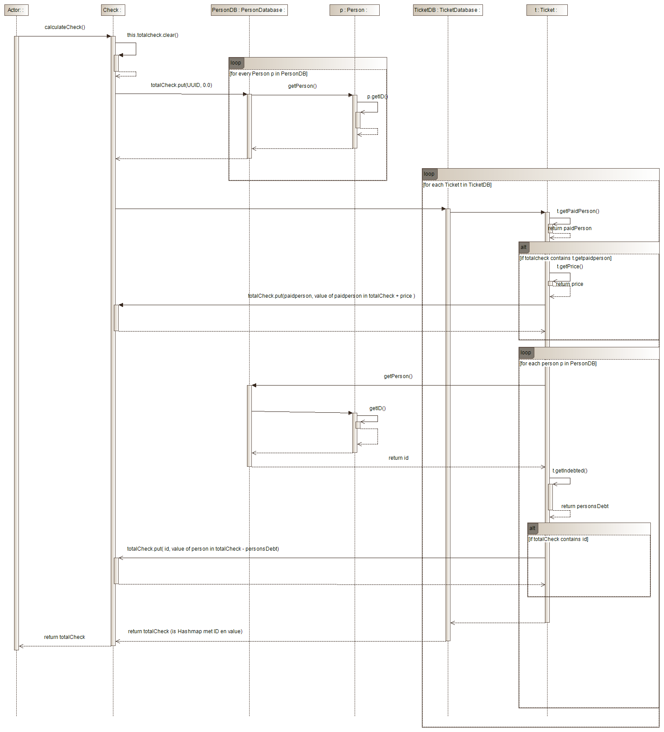
UML schema’s
Sequence diagram
Calculate

Slide 5
Implemented patterns
Singleton
Database
Observer
Database, UI
Abstract Factory
TicketFactory
MVC
UI
Iterator
Database

Slide 6
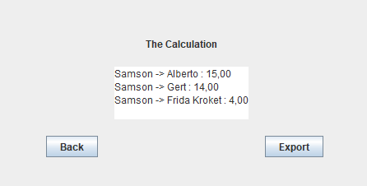
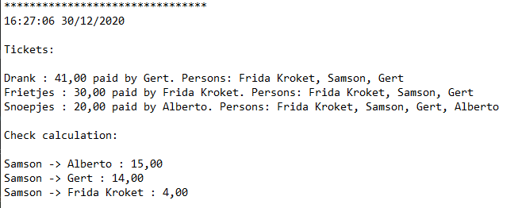
Extra
Export Feature
https://github.com/TissieVA/Software_Design

Slide 7


