Slide 1
Honors Track: Competitive Programming & Problem Solving Effective Programming
Kevin Verbeek

Slide 2

Track information
Coordinator: dr. Kevin Verbeek, MF 4.106,
k.a.b.verbeek@tue.nl
Coaches: dr. Kevin Verbeek
ir. Arthur van Goethem, MF 4.104b,
a.i.v.goethem@tue.nl
Web page: http://www.win.tue.nl/~kverbeek/CPPS/index.html
Book: S. Halim and F. Halim
Competitive Programming 3
not mandatory

Slide 3
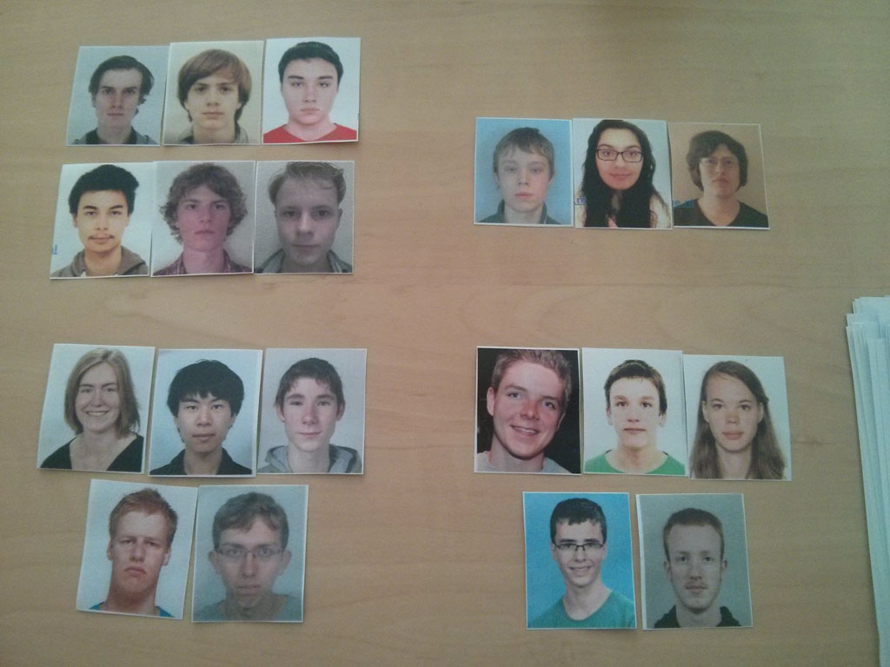
Groups
a
2
1
b
a
a
3
4
b
b
Plan a weekly meeting with your coach ASAP!

Slide 4
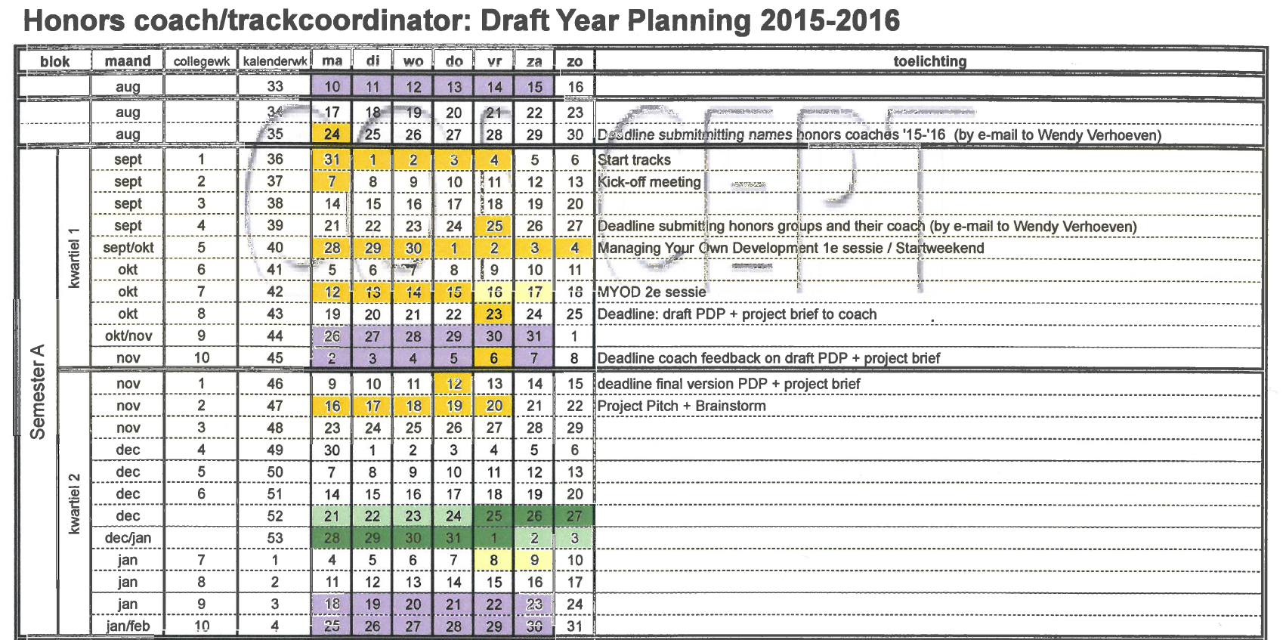
Honors academy schedule

Slide 5
Planning
PDP: Personal development plan
What do you want to achieve?
How do you plan to achieve it?
Technical skills (programming, problem solving)
Soft skills (teamwork, speaking in public, etc.)
MYOD: Managing your own development
Two sessions in Q1
Will help you write PDP
Project plan
Which contests to participate?
What needs to be learned?
How to train?

Slide 6
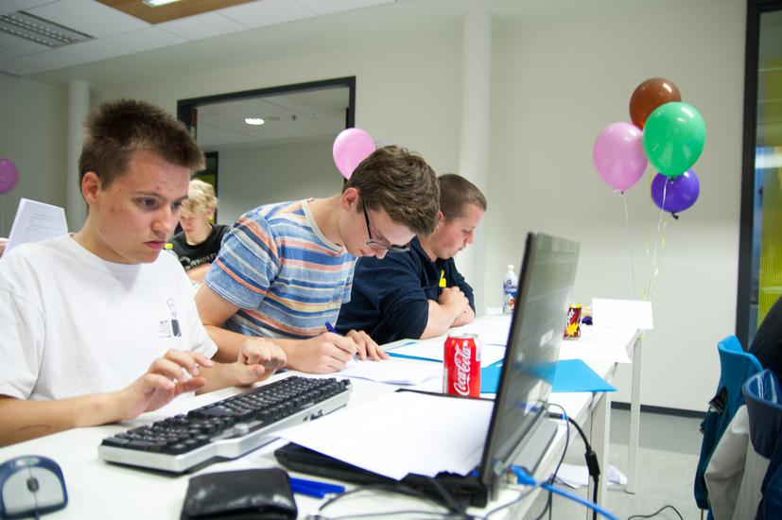
Track schedule
19 September
Eindhoven Algorithmic Programming Contest
Time to start practicing!
Use our training server: compprog.win.tue.nl
Make an account on TopCoder: www.topcoder.com
Make an account on Codeforces: codeforces.com
Check the web page for other contests and practice opportunities
http://www.win.tue.nl/~kverbeek/CPPS/index.html

Slide 7
Cheatsheet
Cheatsheet
Document of at most 25 pages
Preferably with actual code in preferred language (C++ or Java)
Common standard algorithms
Algorithms you don’t know by heart
Also put in helpful tips/pointers
Tips: http://www.win.tue.nl/~kverbeek/CPPS/tips.php
Start making your cheatsheet ASAP!

Slide 8
Today…
Effective Programming

Slide 9
Golden rules
Golden rules of programming
Think before you code
Always choose the simplest solution that is fast enough
Code carefully rather than fast

Slide 10
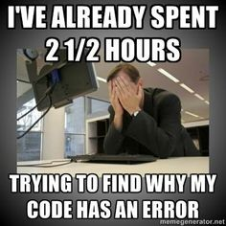
Code carefully
Code carefully rather than fast
Why?
Easy to make mistakes when coding fast
Mistakes are hard to find and take long to fix
Really try to avoid making mistakes
Coding carefully is actually faster in the end!
How to avoid mistakes?
No matter how careful, you will make mistakes
It helps to know common mistakes
Helps finding, correcting, and avoiding mistakes

Slide 11
Common mistakes
Loop bounds
Think carefully about all loop bounds (especially with dynamic prog.)
Array bounds
Check if all arrays are big enough
Initialization
Initialize all data again for every testcase (clear vectors/lists/etc.)
This only gives errors for multiple testcases
Incorrect output format
Use correct spelling, capitals and endlines
Wrong nesting
Check whether the nesting is correct (use indentation)
Precision
Always use doubles when you need floating point numbers
For many multiplications, use log: log (a * b) = log(a) + log(b)
Use the correct precision for output (setprecision)

Slide 12
Common mistakes
Overflow
Check how large the numbers can get
Use long long or something similar (remember for C: scanf(“%lld”))
Invalid expression
Sqrt(-1) or log(0), etc.
Index offset
A[i] or A[i-1]? Often important for dynamic programming
Rounding
Read the problem carefully and round as prescribed
Read the complete input
Sometimes the answer is clear before you’ve read the complete input
Read it anyway! Output the answer only after reading complete input!
Boundary cases
These cases often cause problems, make some testcases
Wrong variable / copying mistakes / etc.

Slide 13
Simplest solutions
Always choose the simplest solution that is fast enough
Why?
So you can do it faster? The contest jury doesn’t care…
Simpler → easier to code
Really think about simplifying your code
Important aspects
How to come up with the simplest solution?
What is fast enough?

Slide 14
Simplest solution
How to come up with the simplest solution?
Using standard libraries
Standard libraries are easy to use and should be correct
Design your code to make use of libraries
Example: median finding
Could implement linear-time median finding…
Or simply sort and return middle element
Or C++: nth_element
Know your libraries!
C++ STL
Java standard libraries

Slide 15
Standard Data structures
Standard data structures
Linked list
Priority queue
Binary search tree
Etc.
Data structure | C++ (STL) | Java
Array | vector<T> | ArrayList<T>
Linked list | list<T> | LinkedList<T>
Priority queue | priority_queue<T> | PriorityQueue<T>
Sets (BST) | set<T> | TreeSet<T>
Associative container (BST) | map<T> | TreeMap<T>
Union find | ? (cheatsheet) | ? (cheatsheet)

Slide 16
Standard algorithms
Standard algorithms
Sorting
C++: sort (use operator overloading <)
Java: Collections.sort (use Comparable interface)
Check all permutations
C++: next_permutation
Java: ?
Split string
C++: ?
Java: split function of String
There are many more!
Learn as many as you can!

Slide 17
Fast enough
What is fast enough?
Know the asymptotic running times of standard algorithms
Estimate the worst case number of steps of your program
If #steps < ~10 000 000, then start implementing
Example
You’re given a graph with n vertices and m edges
with n ≤ 10³ and m ≤ 10⁶. Can we use Dijkstra’s algorithm?
Dijkstra’s algorithm runs in O((m+n) log n) time
That is approximately 10⁶ log 10³ ≈ 10⁷ steps in worst case
So … Yes!

Slide 18
Estimating algorithm
But we can also do it the other way around!
Given the bounds on the input
What could possibly be the asymptotic running time?
Which algorithms run in this time?
n ≤ 10⁹ → O(1), O(log n) or O(√n) → Function, BS?
n ≤ 10⁶ → O(n) or O(n log n) → Greedy, sorting, BS + Greedy, D&C?
n ≤ 10³, W ≤ 10³ → O(nW) → dynamic prog. with table n x W?
n ≤ 10² → O(n³) → All-pairs shortest path, Gaussian elimination?
n ≤ 16 → O(2^{n}) or O(n 2^{n}) → Brute-force on all bitstrings of length n
n ≤ 8 → O(n!) → Brute-force on all permutations of n objects

Slide 19
Think about it
Think before you code
Why?
Can think about simplest code
Unforeseen changes may mess up code structure
No thinking → messy code → many bugs
What to think about?
Which variables / arrays / structs / classes do I use?
Which data structures do I need?
Which standard algorithms do I use?
Which functions should I make?
The structure of the code should be in your head before you start!

Slide 20
Practice
Practice
EAPC 2012 A – Annoying Mosquitos
EAPC 2013 C – Cracking the Safe
EAPC 2012 C – Cubing
Try yourself: EAPC 2011 E – Rolling Dice

