Slide 1
Doomsday Project
CMSC 2201-22 Database Modeling II
(Final Week)
Presented by: Unubold Bayarsaikhan, Jacob Anderson, Nathan Hibbison, Amanda Hoheisel, Ahmed Dahir

Slide 2





Group 1: Members
Unubold Bayarsaikhan
Recorder/Submitter
Jacob Anderson
Version Control
Nathan Hibbison
Reality Checker
Amanda Hoheisel
Facilitator
Ahmed Dahir
Spokesperson

Slide 3
Overview
Re-introducing the problem
Details of solutions
How data interacts
Data Integrity
Security Solution
Queries, Triggers and SPROC
End Results
Lessons Learned

Slide 4
Re-Introduction of a Problem
Setting: year 2030 in Florda after a devastating category 8 hurricane.
Location: Approached from the Atlantic Ocean and hit the entire state.
Damage: resulting in roughly 20,349,000 deaths, most of infrastructure was lost, and all governmental infrastructure was lost.
Task: build database to manage resources, operations, inventory, and people in Florida to aid in rebuilding efforts.

Slide 5
Details of Solution

Slide 6
Food, Power, Water
The Food table is used to track what type of food we have, how much of it and when it expires
Connects to the linking table with the inventory table for complete tracking of just how much food is available
The Power Table is used to track notable power sources that are working, their power type, fuel type and how much power they have available
Connects to the linking table with location to show where our power sources are in the world
The Water table is used to track water sources, what level of cleanliness that source has and how much water there is
Connects to the linking table with location to show where the water source is

Slide 7
People, Skills, Locations, Lodging
People is used to keep track of peoples' first and last name, along with their age
People links to 2 different linking tables, Skills and Lodging.
Skills is used to keep track of certain skills and, using the linking table, how good that individual is at a certain skill
Skills links to the linking table PeopleSkills, to keep track of what skills people have and how good each person is at that skill
Lodging is used to keep track of living locations
Lodging connects to the Location table and the PeopleLodging table to keep track of what people are living in that lodging
Location is a central table in the database
Location is used to keep track of almost every entry in the database as it is important to know exactly where important items are in a crisis

Slide 8
Inventory and Currency
Inventory is used to track our item quantity, category, value, and measurement. This was we can track what resources we have in our possession.
Inventory is connected to two linking tables which are Location_Inventory, and Inventory_Food which helps to track what and where items are.
Currency tracks our currency type which can be categorized as ammo, good, water, etc.
The Currency table connects to the Inventory table through a FK relationship, and here we can see the quantity and value level of our currency items.

Slide 9
Allies and Adversaries
The Adversary table is used to track anything that is a threat to our group, it tracks their location, Their name, How threatening we think they are, and when they were last encountered
Adversaries' location is tracked with a foreign key from location
The Allies table is used to keep track of their first and last name, and how much we trust them
Like the Adversaries table, we keep track of their location using a foreign key from the location table

Slide 10
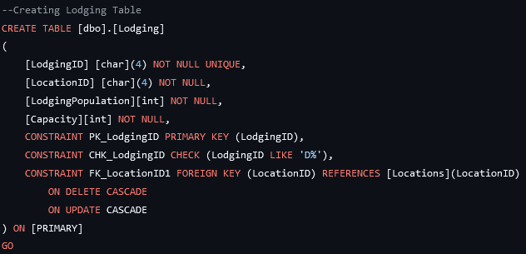
Data Integrity
"Data integrity is a concept and process that ensures the accuracy, completeness, consistency, and validity of an organization's data."
To ensure data integrity we did the following:
Created an in depth data dictionary
Created an ERD to go with data dictionary to ensure consistency and show relations
Specified data requirements
Used linking tables to connect data
Have a cascade in Lodging to update connected tables
Implement PK and FK to connect tables

Slide 11
Security Solutions
Our security schema is essentially divided into four tiers of access:
Guest user. These users have access to view, but not edit, small sections of information.
This primarily consists of survivors and other unaffiliated individuals who may need access to the database to find family members, shelter, etc.
Authorized User. These users are able to view the full database, but not make changes.
Most staff members will be given this level of access; it will contain information and functionality they need to perform their duties.
Specialty Access. These users will have a large amount of modifying access to a specific section of the database.
Access is divided according to the individual user's role.
Administrator. Users with this role will have full access to large or full portions of the database.

Slide 12
Security Solution Videos
https://mediaspace.minnstate.edu/media/group1_DoomsdaySecurityDemonstration/1_deyvbnj8

Slide 13
Queries
Purpose: To extract, analyze, and manage data from the database for various reports and decisions.
Scope: Includes queries ranging from basic data retrieval to advanced analysis involving joins and aggregations.
Goal: To ensure efficient handling of large amount of data, identify trends, and support operations during the doomsday scenario.

Slide 14
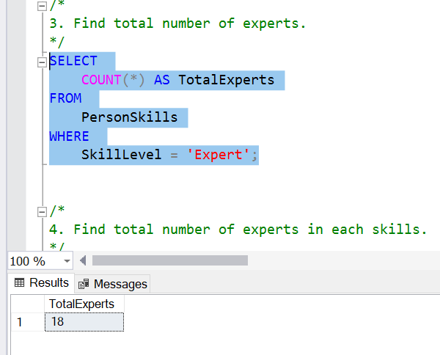
Query 1: Find total number of Experts
Purpose: This query counts how many individuals have the "Expert" skill level.
Usage: It is useful for determining the total number of people with expert-level skills across the population.
Result: Display the total number of "Expert" skill-level people, offering a quick view of expertise within the population.

Slide 15
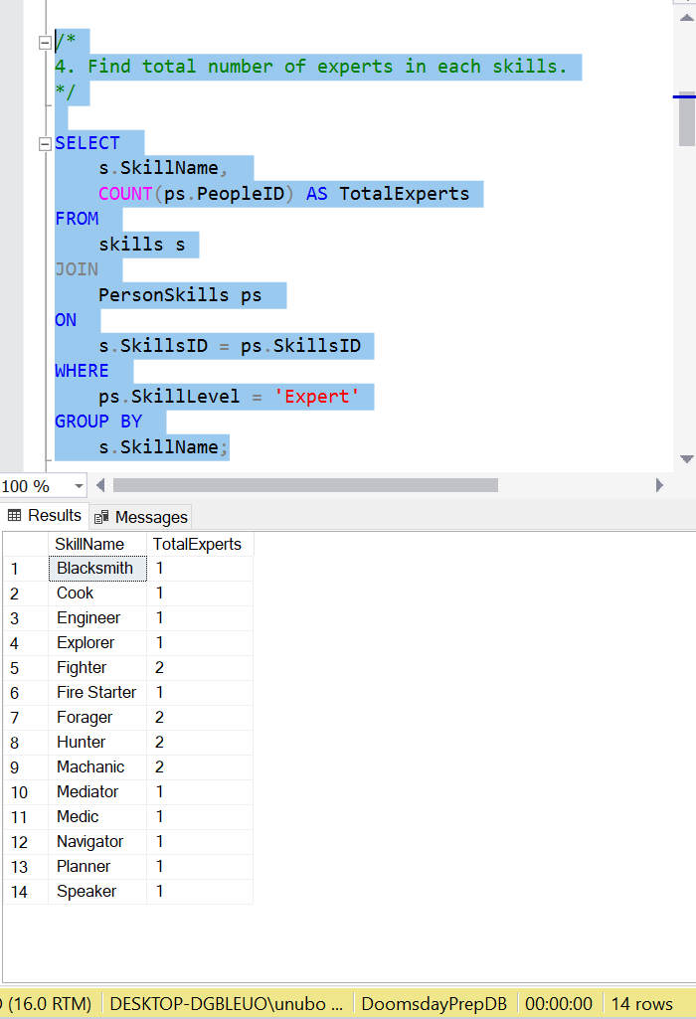
Query 2: Find total number of experts in each skill
Purpose: Identifies how many people are classified as "Experts" for each specific skill, providing a breakdown of expertise across different skills.
Usage: Useful for understanding which skills have the most "Expert" level professionals.
Result: Display the total number of "Expert" skill-level people, offering a quick view of expertise within the population.

Slide 16
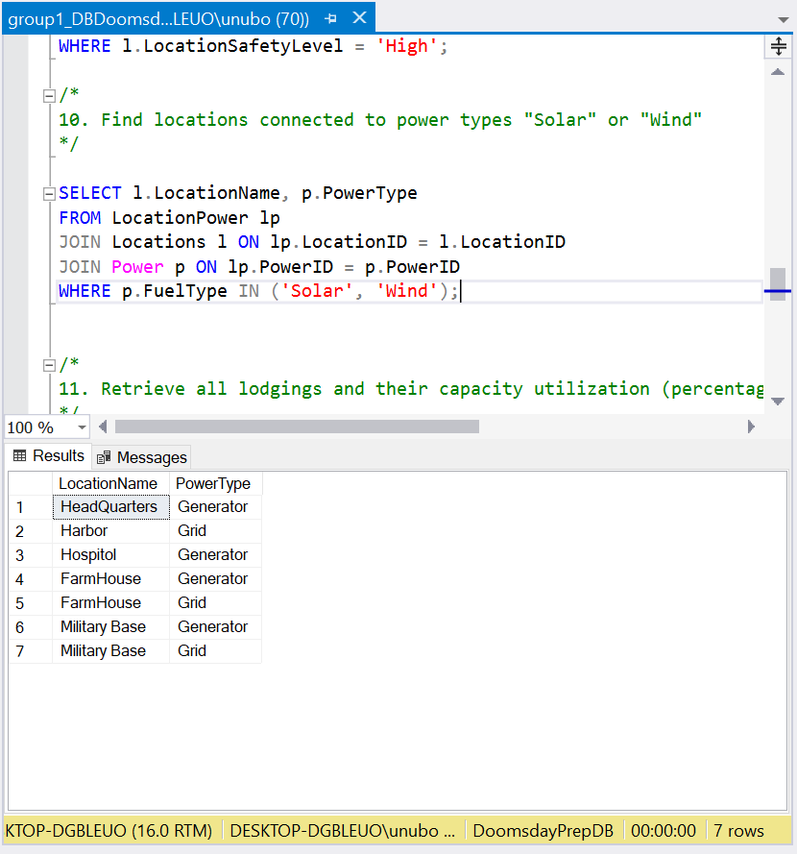
Query 3: Find locations connected to solar or wind power
Purpose: This query retrieves locations that are utilizing renewable energy sources, specifically solar or wind power.
Usage: Helps identify regions or areas that have sustainable energy sources in place.
Result: The result will list the names of locations along with the power types they are connected to.

Slide 17
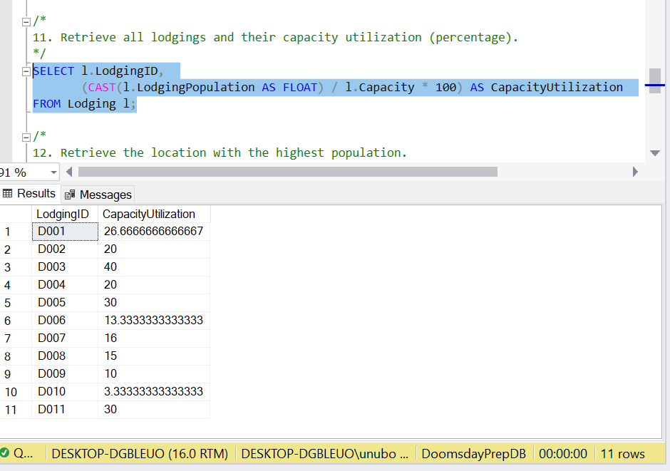
Query 4: Retrieve lodgings and capacity utilization
Purpose: This query calculates the percentage of a lodging's capacity that is currently being utilized by dividing the current population by the maximum capacity and multiplying by 100.
Usage: Useful for analyzing the occupancy and utilization of each lodging.
Result: The result will list each lodging along with its corresponding capacity utilization percentage.

Slide 18
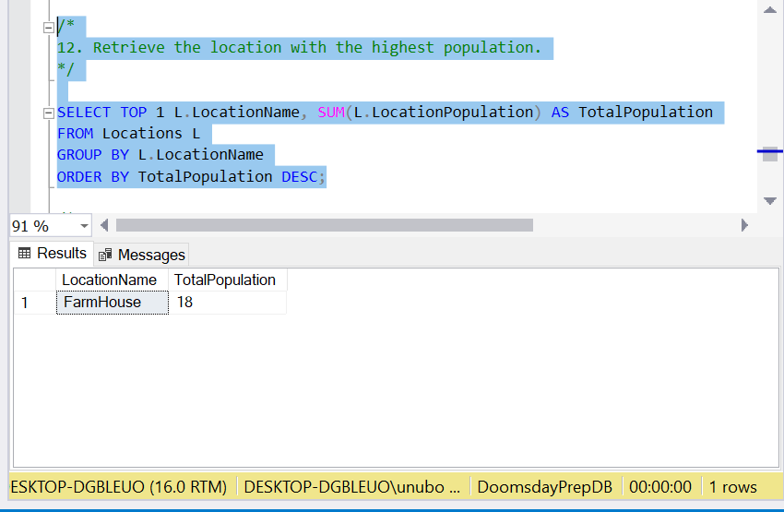
Query 5: Retrieve the Location with the Highest Population
Purpose: This query calculates the total population of each location and retrieves the location with the highest population.
Usage: This helps to identify which location has the most people at.
Result: The result will show the name of the location with the highest population and the corresponding total population.

Slide 19
Triggers
Purpose: To assist with frequent actions in a database to make them automatic. Helps to maintain data integrity through consistency and reliability.
Importance: Triggers are important for a number of reasons such as: speeding up processes and maintaining consistent data.

Slide 20
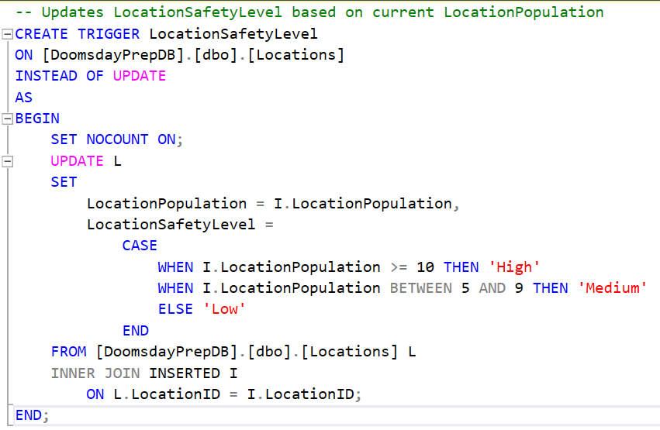
Triggers
LocationSafetyLevel trigger
Updated a locations safety level based on how many people are currently stationed there.

Slide 21
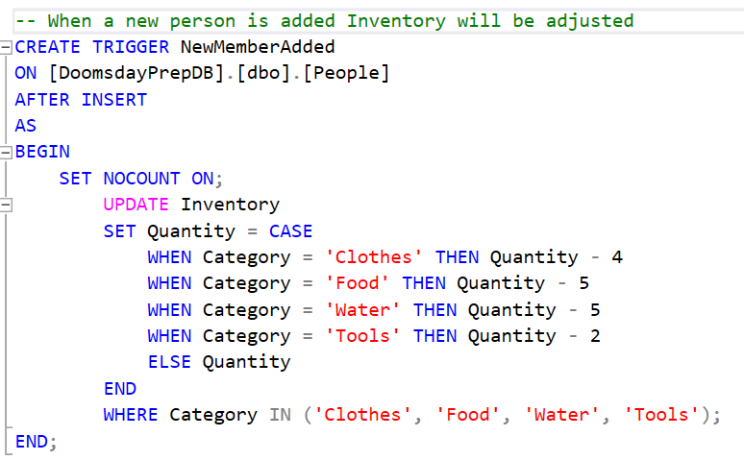
Triggers
NewMemberAdded trigger:
Updates the Inventory table whenever someone new is added to the database.

Slide 22
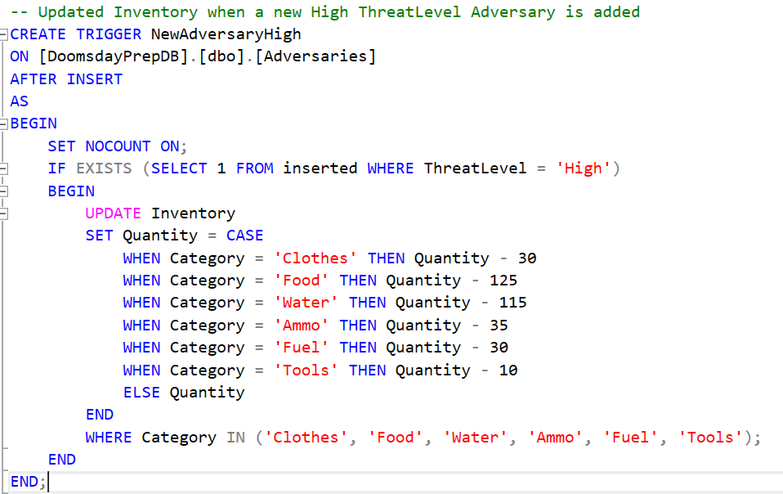
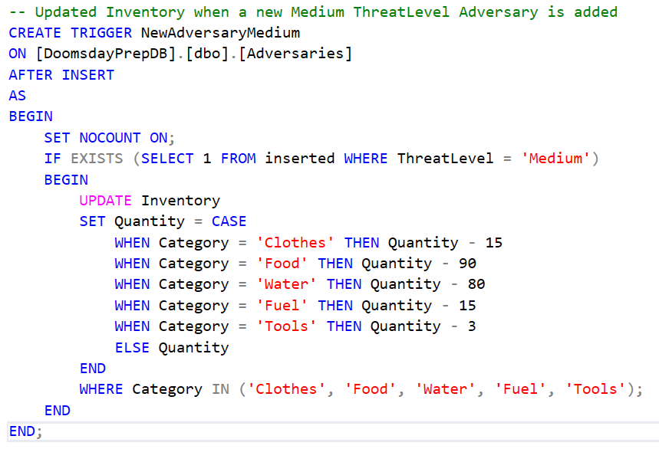
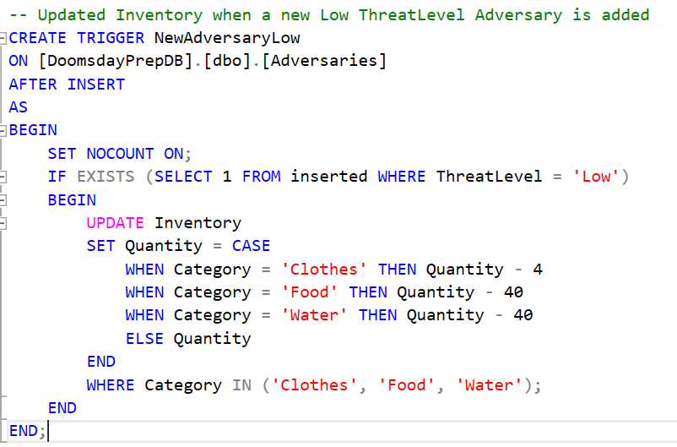
Triggers
NewAdversary triggers:
Based on the ThreatLevel of a new adversary when it is added to the database, categories in the inventory table will be decreased accordingly.

Slide 23
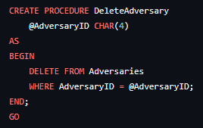
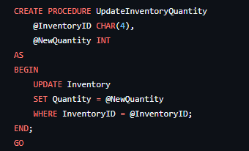
Stored Procedures
This procedure updates the quantity of an item in the Inventory table.
This procedure removes an adversary from the Adversaries table based on the AdversaryID.

Slide 24
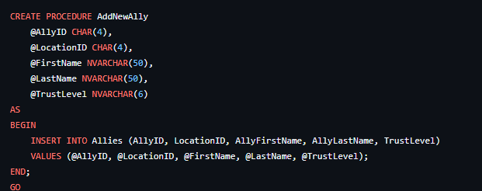
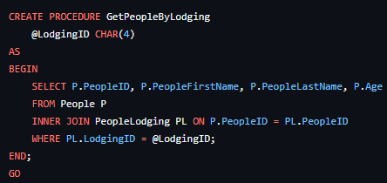
Stored Procedures
This procedure retrieves all people staying in a specific lodging.
This procedure adds a new ally to the Allies table.

Slide 25
End Result
(Jacob) The database is secured from outside threats while still granting reliable access to important info as needed.
(Unubold) These queries allow us to manage data effectively, saving time in data retrieval and analysis, and ultimately supporting more informed decision-making.
(Amanda) By using triggers we allow for more efficiency when it comes to adding, updating, and deleting data.
(Ahmed Dahir) We discussed the project's stored procedures, ensuring everyone contributed to analyzing their functionality, performance, and areas for improvement.
(Nathan) Using improvements to our original ERD the database structure is running more efficiently and without errors.

Slide 26
Lessons Learned
(Jacob) Security design necessarily includes a lot of accounting for edge cases and niche scenarios.
(Unubold) Through this project, I learned how to optimize database queries for improved efficiency and time-saving.
(Amanda) Learned about the importance of planning out a project of this size, and how much a solid foundation will help in the long run.
(Nathan) Learned how each topic learned throughout the semester fit together to make a whole complete database
(Ahmed Dahir) We reflected on the entire project, recognizing the importance of clear communication, thorough planning, adaptability to challenges, and the value of teamwork in achieving successful outcomes.
Notes:
Everyone must participate.

