Slide 1


Pluggable Applications DjangoCon 2009 Nowell Strite Shawn Rider
Notes:
Welcome and introductions
Today we want to present to you a design pattern that has been useful to us at PBS. This pattern allows applications to be presented by other objects or applications and at multiple contextualized URLs.

Slide 2
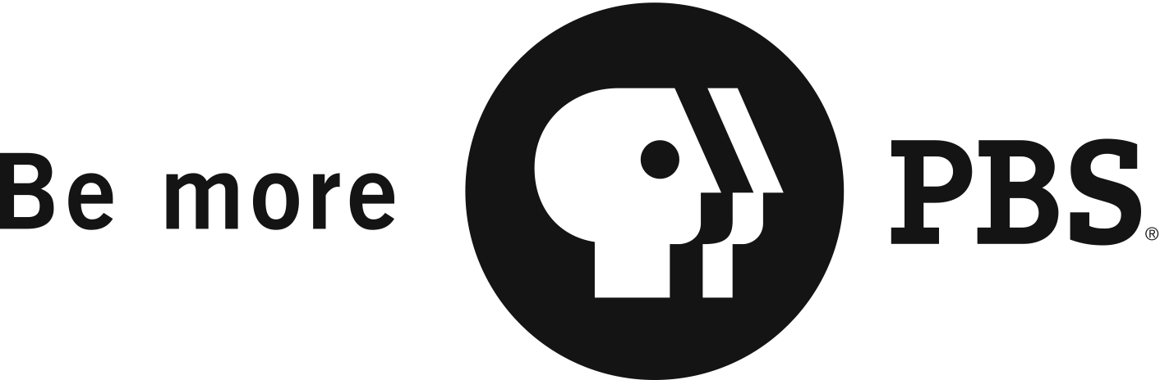
Road Map
Background
Current Approaches
Our Use Case / Requirements
A Proposed Solution
Some Live Examples
Q & A
Notes:
Since 2006, PBS has been using Django
Django helps us solve problems in a variety of ways
For all the reasons listed here, Django is a useful framework for us
PBS was initially built largely on Perl scripts outputting static HTML
But there was also some mix-in of Java and earlier Python frameworks such as Zope/Plone
As we move forward, we must be able to support existing functionality while we build new functionality
Django is flexible enough to allow us to do this
Django has also allowed us to begin building components that can be leveraged by stations and producers building their own Django sites

Slide 3









A little background
PBS manages several major internal sites:
and more…
Notes:
PBS manages a lot of websites
Some of these are created internally by PBS project teams
Of the sites created internally many contain some significant Django component
(switch to next slide as you’re saying this)

Slide 4






A little background
And many of these use Django to some degree:
Notes:
This is not to say that all of these sites are solely powered by Django,
but all of these sites rely on Django-based components.
And some of them are completely powered by Django.

Slide 5






A little background
Notes:
PBS also hosts sites for independent producers, such as ken burns or weta or itvs
Of these sites, some also use Django. (proceed as saying this)

Slide 6


A little background
Notes:
Again, not all of these sites use Django exclusively, but they use Django to varying degrees, mostly to supply specialty content and functionality.

Slide 7
PBS needs Django
Serving a diverse array of sites
Built on a diverse technical architecture
Many repetitive components desired by producers and users
Ease of implementation is crucial
But highly specific implementation details and goals are often more important to producers
Notes:
Since 2006, PBS has been using Django
Django helps us solve problems in a variety of ways
For all the reasons listed here, Django is a useful framework for us
PBS was initially built largely on Perl scripts outputting static HTML
But there was also some mix-in of Java and earlier Python frameworks such as Zope/Plone
As we move forward, we must be able to support existing functionality while we build new functionality
Django is flexible enough to allow us to do this
Django has also allowed us to begin building components that can be leveraged by stations and producers building their own Django sites

Slide 8

Reusable Apps Save the Day
The Reusable App design pattern helps us:
Easy to share functionality with other projects
Quick to get features up and running
Possible to expand and enhance functionality
Notes:
(N) Historically, reusable apps have been very helpful for spreading around similar functionality across different websites and projects.

Slide 9

Reusable Apps Save the Day… Sort of…
The Reusable App design pattern has some limitations
Apps are expected to live at one URL (e.g. http://example.com/discussions/)
Current convention of adding ‘extra_context’ params are not satisfactory
Conventional template replacement is not always flexible enough
Notes:
Reusable apps have a few limitations:
They are designed to live at a single URL location
To supply extra context info one must overload the URLconf, which gets messy quickly
To have a reusable app appear to be styled like a different part of the site can require many different templates.

Slide 10

Template Tags to the Rescue
Template Tags allow apps to expose functionality inside templates for other apps and site components
Notes:
Template Tags are often used to combine functionality from different apps into single pages.

Slide 11
Template Tags to the Rescue … Sort of…
But template tags are also limited:
Form posting becomes complicated
Generic insertion of data into page context can be dangerous
Additional logic, such as complex permissions checks, are difficult to enforce or bypass via generic template tags
Notes:
Template Tags are also very useful, but have some drawbacks:
Form posts and handling errors in form posts are especially problematic. The user experience of submitting a post and being taken to a standalone error resolution or preview page is unacceptable.
Context data can be added and manipulated with Template tags, but only if the tag has been written that way (many reusable apps template tags do not have the ability to accept arbitrary context data – and why should they?)
Additional logic can be difficult to enforce or bypass

Slide 12

The Use Case: PBS TeacherLine Peer Connection
Peer Connection features:
Access to a robust database of curated resources
Community features to allow educators to share and discuss these resources
Because discussion is so important in this setting, many objects in Peer Connection support discussions.
Given that the purpose of the site is partially to learn to use technology, a clean user experience is essential.
Notes:
(S) It’s helpful to look at a real-world example. In this case, we will examine a use case we were confronted with during the development of our social networking tool for educators’ professional development, PBS TeacherLine Peer Connection.
Peer Connection is a social site that helps educators fulfill professional development requirements. It provides two major features: Access to curated content and community features.
The site is designed to support real-world instructional coaching and mentoring programs in place at many schools, and it is intended to both help teachers become more comfortable with modern networked technologies as well as helping them develop their teaching practice.

Slide 13

The Use Case: PBS TeacherLine Peer Connection
Our Requirements:
Sensible URLs that follow our patterns elsewhere on the site
Allow discussions app to interact with other apps and objects in expected ways
Allow posting of data and error handling in the same location – no redirects to stand-alone pages to fix a message post.
Flexibility to enforce permissions and other variations of display in an ad-hoc way.
Notes:
So as we set out to add a discussions feature to almost every object in the site (Networks, Groups, Learning Modules, Resources), we needed to adhere to a set of requirements.
These were essential requirements, not all of which can be fulfilled with the traditional approaches.

Slide 14
Our Solution: Make the Reusable App Pluggable
By making an app “pluggable” we gain some extra features:
Apps can be presented at various URLs throughout the site
Each presentation can define context in a clean, DRY manner
Form posting and error handling can happen in the logical location for the user
Notes:
By making an app “pluggable” we gain extra features:

Slide 15
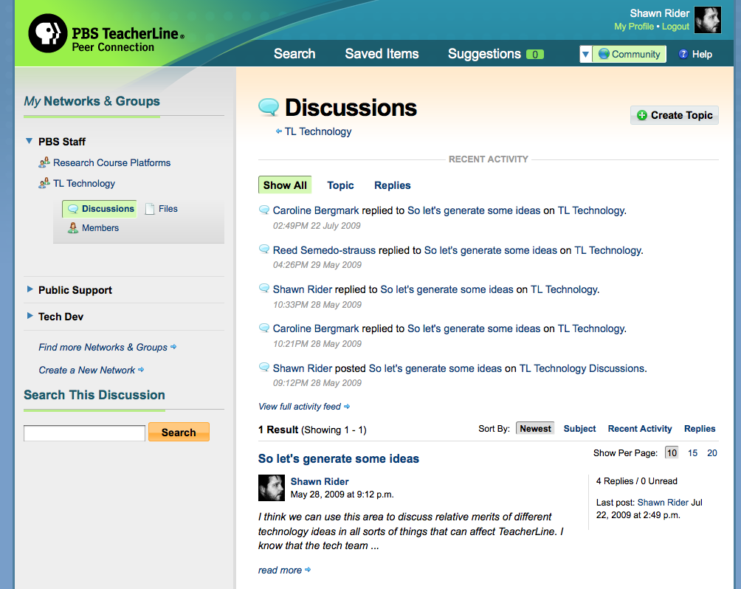
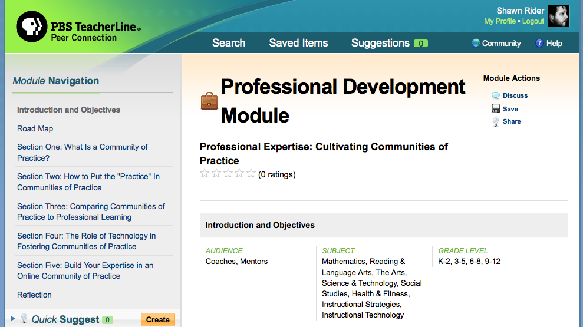
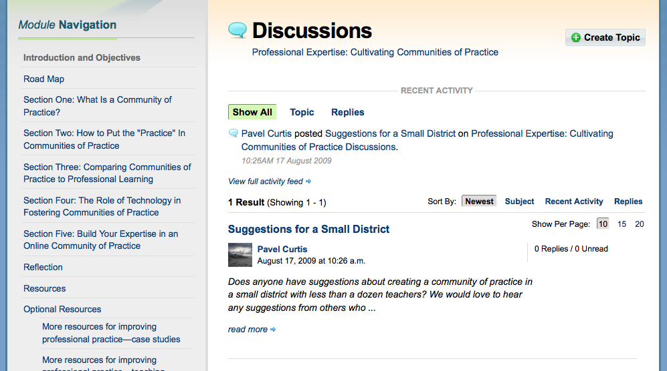

The Use Case: PBS TeacherLine Peer Connection
Two examples of how discussions appear in Peer Connection:
/community/network/pbs-staff/group/tl-technology/discuss/
/content/module/216/discuss/
Notes:
These are two examples of how discussions appear in Peer Connection.
One discussion area is attached to a Group, which is a subset of a Network.
The other discussion area is attached to a Professional Development Module, which is a piece of curated content from the PBS team.
It is essential that these discussions display under the URL hierarchy set up for displaying Networks, Groups, instructional Modules, etc.

Slide 16

The Use Case: PBS TeacherLine Peer Connection
Two examples of how discussions appear in Peer Connection:
/community/network/pbs-staff/group/tl-technology/discuss/
/content/module/216/discuss/
Notes:
As you can see, the presentation of the pluggable discussion app’s functionality on these pages is surrounded by differentiated navigation that fits with the presenting application.
So in this example, you can see that Discussions are a first-class link under the left sidebar navigation of your Group listing.

Slide 17

The Use Case: PBS TeacherLine Peer Connection
Two examples of how discussions appear in Peer Connection:
/community/network/pbs-staff/group/tl-technology/discuss/
/content/module/216/discuss/
Notes:
However, when presented as a part of an instructional Module, the discussion area is accessed through a sub-navigation that is not part of the first-class navigation structure for the instructional Module.

Slide 18
The Use Case: PBS TeacherLine Peer Connection
Content generated by the pluggable app:
/content/module/216/discuss/
/community/network/pbs-staff/group/tl-technology/discuss/
Notes:
This content is generated by the pluggable app.
The pluggable app knows nothing about the presenting application And the presenting app knows nothing about the pluggable application or its required context.

Slide 19
The Use Case: PBS TeacherLine Peer Connection
Content required by the presenting app templates:
/content/module/216/discuss/
/community/network/pbs-staff/group/tl-technology/discuss/

Slide 20

Make it So
By making our discussions app pluggable, we solved our problems and fulfilled our requirements.
But what kind of work does it take to get there?

Slide 21
Make it So
Parts of Pluggable Apps
Pluggable URL definition
Pluggable application views definition
Subclass / instantiation of Pluggable application

Slide 22
Pluggable URL Definition
from pluggables import PluggableApp, url, include, patterns
class ComplaintsApp(PluggableApp):
urlpatterns = patterns('complaints.views.traditional',
url(r'^$', 'index', name='complaints_index'),
url(r'^create/$', 'edit', name='complaints_create'),
url(r'^(?P<complaint_id>\d+)/edit/$', 'edit', name='complaints_edit'),
url(r'^(?P<complaint_id>\d+)/delete/$', 'delete', name='complaints_delete'),
)
Notes:
This is the URL conf
Similar to traditional, but embedded in an class that inherits form PluggableApp
This definition is only required once – any other app or object in my site project could present this application using this URL configuration

Slide 23
Pluggable Application Views Definition
def view(request, complaint_id):
complaints = Complaint.objects.get(pk=complaint_id)
return render_to_response(request.pluggable.config.get('template', 'complaints/index.html'), {
'complaints': complaints,
'form': form,
'base_template': request.pluggable.config.get('base_template', 'base.html'),
}, context_instance=RequestContext(request))
Notes:
By default any common Django design approach will work fwith the Pluggables pattern.
However, pluggable applications also support class-based views, which might provide even more flexibility to your project.

Slide 24
Subclass / Instantiation of Pluggable Application
class SillyWalkComplaintsApp(ComplaintsApp):
def pluggable_config(self, request, walk_slug=None):
return {'base_template': 'sillywalks/view.html'}
def pluggable_view_context(self, request, walk_slug):
try:
sillywalk = SillyWalk.objects.get(slug=walk_slug)
except SillyWalk.DoesNotExist:
raise Http404
return sillywalk
def pluggable_template_context(self, request, walk_slug):
return {'sillywalk': request.pluggable.view_context}
complaints_app = SillyWalkComplaintsApp('sillywalks')
Notes:
For each app that presents a pluggable application, there are three points at which you may customize behavior. If customization is required, you must create one of these classes for every application that will present a pluggable application.
In this example we are looking at the configuration for presenting the Complaints app within the Silly Walks application.
The pluggable_config defines a dictionary of configuration parameters that can be customized.
The pluggable_view_context supplies any expected objects that the pluggable application needs to work. In this case, the pluggable application requires an object to attach complaints to, and we are giving it a SillyWalk to use for that object, anchoring your complaint to this object.
This is a common use case, but certainly not required by every pluggable application.
Finally, the pluggable_template_context determines which data should be passed through to the template itself. This may be required for rendering various aspects of the template that are dependent on the presenting application.

Slide 25

And Now For Something Completely Different
Let’s see some live examples…

Slide 26
Pros and Cons of This Solution
Things We Like
Room to Improve
Consolidates extra_content generation in adherence to DRY principals
Non-intrusive and non-destructive to apps made pluggable
Loose coupling of apps requires few points of contact
Still requires same amount of work as traditional reusable app approach; would be nice to lessen implementation hassle
Django URL namespace needs to be fixed to expose current namespace to request object. Once in place, we can remove current “prefix” system

Slide 27

Thank You For Your Time
Code referenced in this presentation is available at:
http://bit.ly/django-pluggables
Nowell Strite
Twitter: @nowells
Email: nowell@strite.org
Shawn Rider
Twitter: @shawnr
Email: shawn@shawnrider.com

