Slide 1


Pluggable, Reusable Applications DjangoCon 2009 Nowell Strite Shawn Rider
Notes:
Welcome and introductions

Slide 2









A little background
PBS manages several major internal sites:
and more…
Notes:
PBS manages a lot of websites
Some of these are created internally by PBS project teams
Of the sites created internally many contain some significant Django component
(switch to next slide as you’re saying this)

Slide 3






A little background
And many of these use Django to some degree:
Notes:
This is not to say that all of these sites are solely powered by Django,
but all of these sites rely on Django-based components.
And some of them are completely powered by Django.

Slide 4






A little background
Notes:
PBS also hosts sites for independent producers, such as ken burns or weta or itvs
Of these sites, some also use Django. (proceed as saying this)

Slide 5


A little background
Notes:
Again, not all of these sites use Django exclusively, but they use Django to varying degrees, mostly to supply specialty content and functionality.

Slide 6

PBS needs Django
Serving a diverse array of sites
Built on a diverse technical architecture
Many repetitive components desired by producers and users
Ease of implementation is crucial
But highly specific implementation details and goals are often more important to producers
Notes:
Since 2006, PBS has been using Django
Django helps us solve problems in a variety of ways
For all the reasons listed here, Django is a useful framework for us
PBS was initially built largely on Perl scripts outputting static HTML
But there was also some mix-in of Java and earlier Python frameworks such as Zope/Plone
As we move forward, we must be able to support existing functionality while we build new functionality
Django is flexible enough to allow us to do this
Django has also allowed us to begin building components that can be leveraged by stations and producers building their own Django sites

Slide 7

Reusable Apps Save the Day
The Reusable App design pattern helps us:
Easy to share functionality with other projects
Quick to get features up and running
Possible to expand and enhance functionality
Notes:
Historically, reusable apps have been very helpful for spreading around similar functionality across different websites and projects.

Slide 8

Reusable Apps Save the Day… Sort of…
The Reusable App design pattern has some limitations
Apps are expected to live at one URL (e.g. http://example.com/discussions/)
Current convention of adding ‘extra_context’ params are not satisfactory
Conventional template replacement is not always flexible enough
Notes:
Reusable apps have a few limitations:
They are designed to live at a single URL location
To supply extra context info one must overload the URLconf, which gets messy quickly
To have a reusable app appear to be styled like a different part of the site can require many different templates.

Slide 9

Template Tags to the Rescue
Template Tags allow apps to expose functionality inside templates for other apps and site components
Notes:
Template Tags are often used to combine functionality from different apps into single pages.

Slide 10
Template Tags to the Rescue … Sort of…
But template tags are also limited:
Form posting becomes complicated
Generic insertion of data into page context can be dangerous
Additional logic, such as complex permissions checks, are difficult to enforce or bypass via generic template tags
Notes:
Template Tags are also very useful, but have some drawbacks:
Form posts and handling errors in form posts are especially problematic. The user experience of submitting a post and being taken to a standalone error resolution or preview page is unacceptable.
Context data can be added and manipulated with Template tags, but only if the tag has been written that way (many reusable apps template tags do not have the ability to accept arbitrary context data – and why should they?)
Additional logic can be difficult to enforce or bypass

Slide 11

The Use Case: PBS TeacherLine Peer Connection
Peer Connection features:
Access to a robust database of curated resources
Community features to allow educators to share and discuss these resources
Because discussion is so important in this setting, many objects in Peer Connection support discussions.
Given that the purpose of the site is partially to learn to use technology, a clean user experience is essential.
Notes:
It’s helpful to look at a real-world example. In this case, we will examine a use case we were confronted with during the development of our social networking tool for educators’ professional development, PBS TeacherLine Peer Connection.
Peer Connection is a social site that helps educators fulfill professional development requirements. It provides two major features: Access to curated content and community features.
The site is designed to support real-world instructional coaching and mentoring programs in place at many schools, and it is intended to both help teachers become more comfortable with modern networked technologies as well as helping them develop their teaching practice.

Slide 12

The Use Case: PBS TeacherLine Peer Connection
Our Requirements:
Sensible URLs that follow our patterns elsewhere on the site
Allow discussions app to interact with other apps and objects in expected ways
Allow posting of data and error handling in the same location – no redirects to stand-alone pages to fix a message post.
Flexibility to enforce permissions and other variations of display in an ad-hoc way.
Notes:
So as we set out to add a discussions feature to almost every object in the site (Networks, Groups, Learning Modules, Resources), we needed to adhere to a set of requirements.
These were essential requirements, not all of which can be fulfilled with the traditional approaches. But for the moment, let’s consider how we might provide this functionality.

Slide 13
Our Solution: Make the Reusable App Pluggable
By making an app “pluggable” we gain some extra features:
Apps can be presented at various URLs throughout the site
Each presentation can define context in a clean, DRY manner
Form posting and error handling can happen in the logical location for the user
Notes:
By making an app “pluggable” we gain extra features:
Explain… then go into a real-world example.

Slide 14
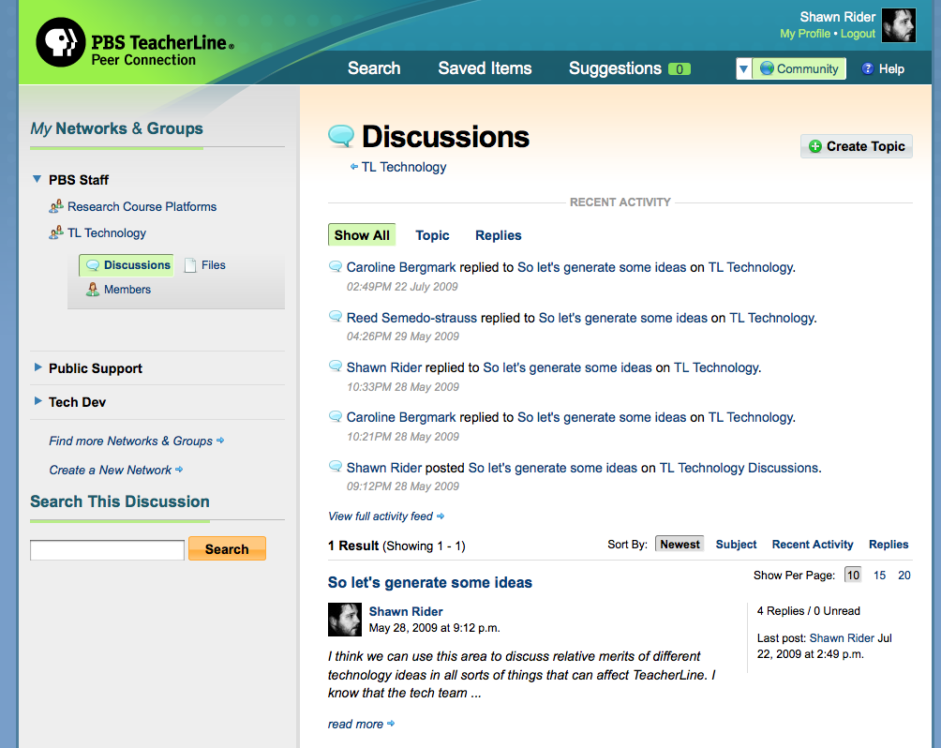
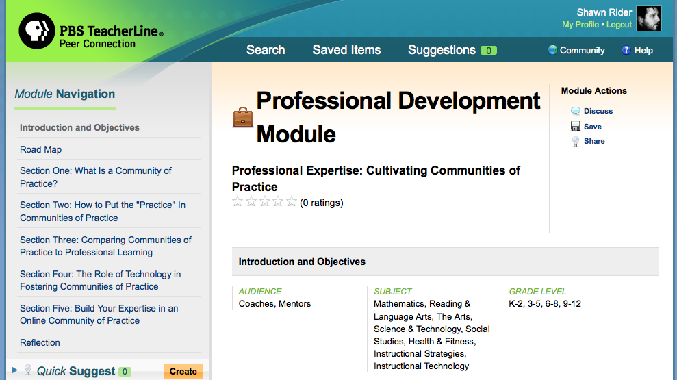
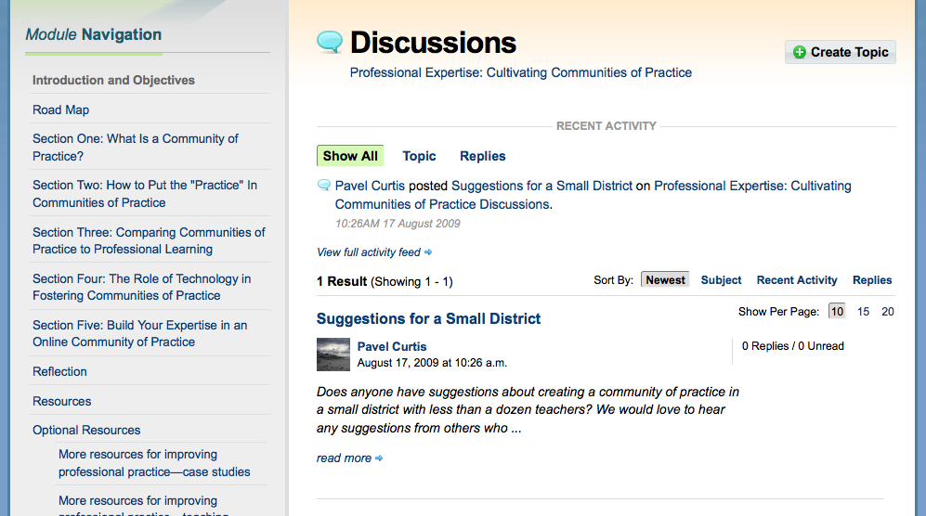

The Use Case: PBS TeacherLine Peer Connection
Two examples of how discussions appear in Peer Connection:
/community/network/pbs-staff/group/tl-technology/discuss/
/content/module/216/discuss/
Notes:
These are two examples of how discussions appear in Peer Connection.
One discussion area is attached to a Group, which is a subset of a Network.
The other discussion area is attached to a Professional Development Module, which is a piece of curated content from the PBS team.
It is essential that these discussions display under the URL hierarchy set up for displaying Networks, Groups, instructional Modules, etc.

Slide 15

The Use Case: PBS TeacherLine Peer Connection
Two examples of how discussions appear in Peer Connection:
/community/network/pbs-staff/group/tl-technology/discuss/
/content/module/216/discuss/
Notes:
As you can see, the presentation of the pluggable discussion app’s functionality on these pages is surrounded by differentiated navigation that fits with the presenting application.
So in this example, you can see that Discussions are a first-class link under the left sidebar navigation of your Group listing.

Slide 16

The Use Case: PBS TeacherLine Peer Connection
Two examples of how discussions appear in Peer Connection:
/community/network/pbs-staff/group/tl-technology/discuss/
/content/module/216/discuss/
Notes:
However, when presented as a part of an instructional Module, the discussion area is accessed through a sub-navigation that is not part of the first-class navigation structure for the instructional Module.

Slide 17
The Use Case: PBS TeacherLine Peer Connection
/content/module/216/discuss/
/community/network/pbs-staff/group/tl-technology/discuss/
Notes:
For each different presentation of the discussion application, which has been made reusable,

Slide 18
The Use Case: PBS TeacherLine Peer Connection
Content generated by the pluggable app:
/content/module/216/discuss/
/community/network/pbs-staff/group/tl-technology/discuss/

Slide 19
The Use Case: PBS TeacherLine Peer Connection
Content required by the presenting app templates:
/content/module/216/discuss/
/community/network/pbs-staff/group/tl-technology/discuss/

Slide 20

Make it So
By making our discussions app pluggable, we solved our problems and fulfilled our requirements.
But what kind of work does it take to get there?

Slide 21
Make it So
Parts of Pluggables
URLconf definition
View configuration
View context definition
Template context definition
Reverse Pluggable URL template tag

Slide 22

And Now For Something Completely Different
Let’s look at code…

Slide 23
Pros and Cons of This Solution
Things We Like
Room to Improve
Consolidates extra_content generation in adherence to DRY
Non-intrusive and non-destructive to apps made pluggable
Loose coupling of apps requires few points of contact
Still requires same amount of work as traditional reusable app approach; would be nice to lessen implementation hassle
Django URL namespace needs to be fixed to expose current namespace to request object. Once in place, we can remove current “prefix” system

Slide 24

Thank You For Your Time
Code referenced in this presentation is available at:
http://github.com/nowells/django-pluggables/
Nowell Strite:
Twitter: @nowells
Email: nowell@strite.org
Shawn Rider:
Twitter: @shawnr
Email: shawn@shawnrider.com

