Slide 1
TITANBURG*
*tHE dEFAULT nAME fOR tHIS lAYOUT iS BeRlIN

Slide 2
You Have Problem …
50-100 People with an varying physical shapes and sizes
Responsible for allocating to each of them a proper uniform
An antiquated inventory system … a piece of paper with handwritten notes …
A reference guide
Time constraints
Inability to communicate in a civil nature

Slide 3
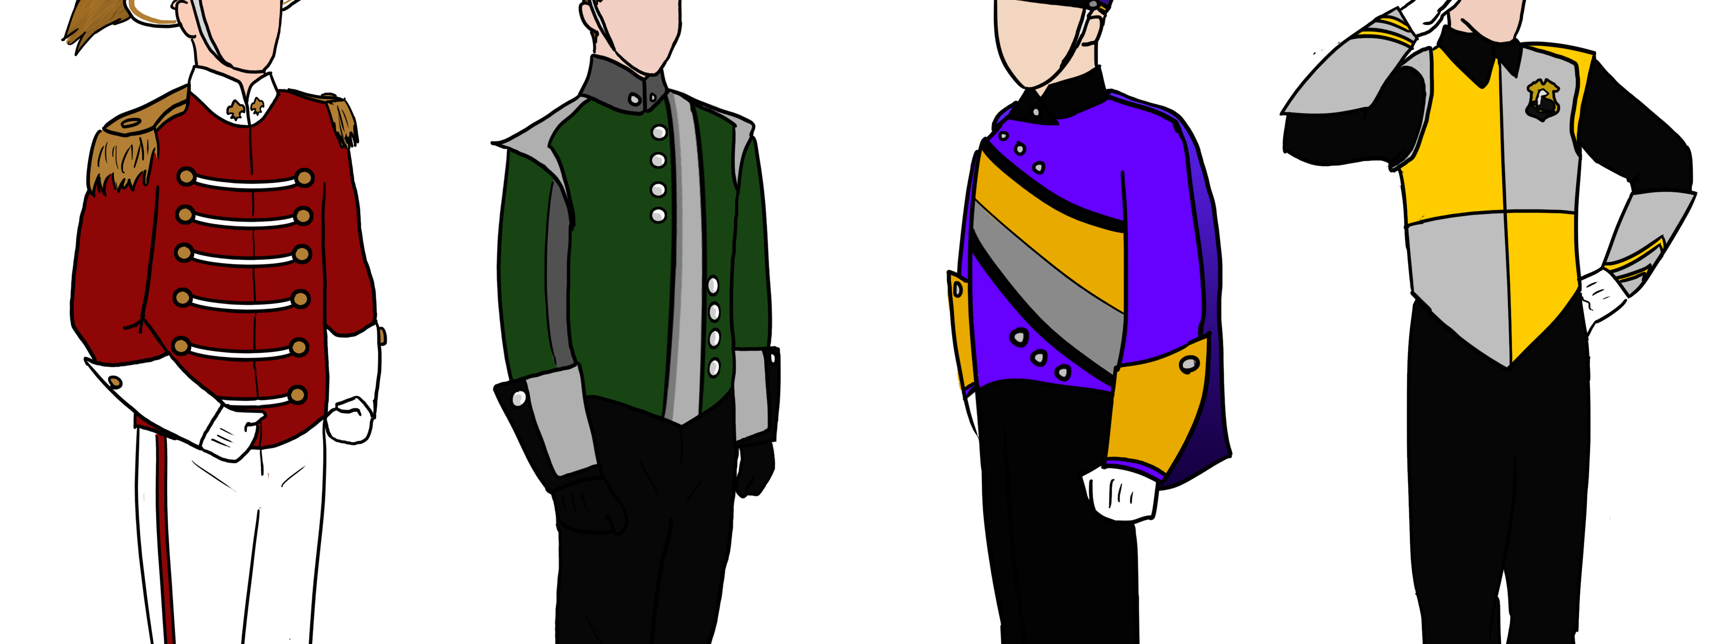
You didn’t even KNOW you had this problem!
Harry Potter Marching Band Uniforms

Slide 4
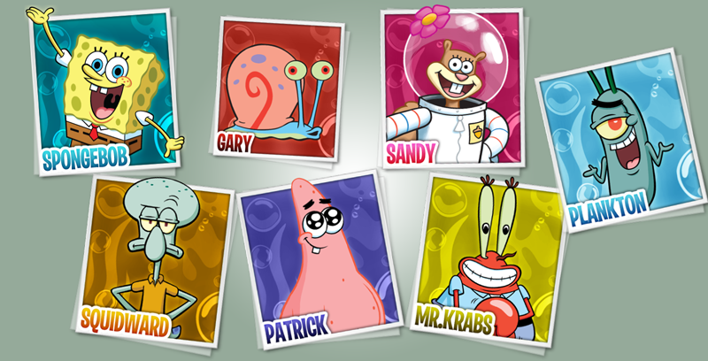
You call the experts at Titanburg!

Slide 5
Code Talent Review
Kirk Powell
Kyle Walter
Kaitlyn Jarrett
Andrew Korous

Slide 6
Android and Node
Build a website where all the band uniforms exists. Make it secure for some odd reason?? Enable the administrator to manage the inventory of uniforms from the web portal. Make the uniforms available to users on Android phones so that they can select their sizes and submit requests. Reduce overhead of operational costs, improve efficiency of allocation, eliminate shrinkage, and bring peace to the whole wide world … okay, maybe just make it look cool.

Slide 7
But what makes you different than everyone else? …
Reasons to Build this APP
Cite this on my resume
Use code from previous projects
No new team members
No pay
No glory
If I fail CS 435 I will have to work at McDonalds again
What our competition is doing
Pearl based website built in 1992
Java Server Pages that take 30+ seconds to load
Ruby on Rails
PHP + Cake = Something?
WordPress takes 45+ seconds to load a webpage
Burke-electric.com

Slide 8
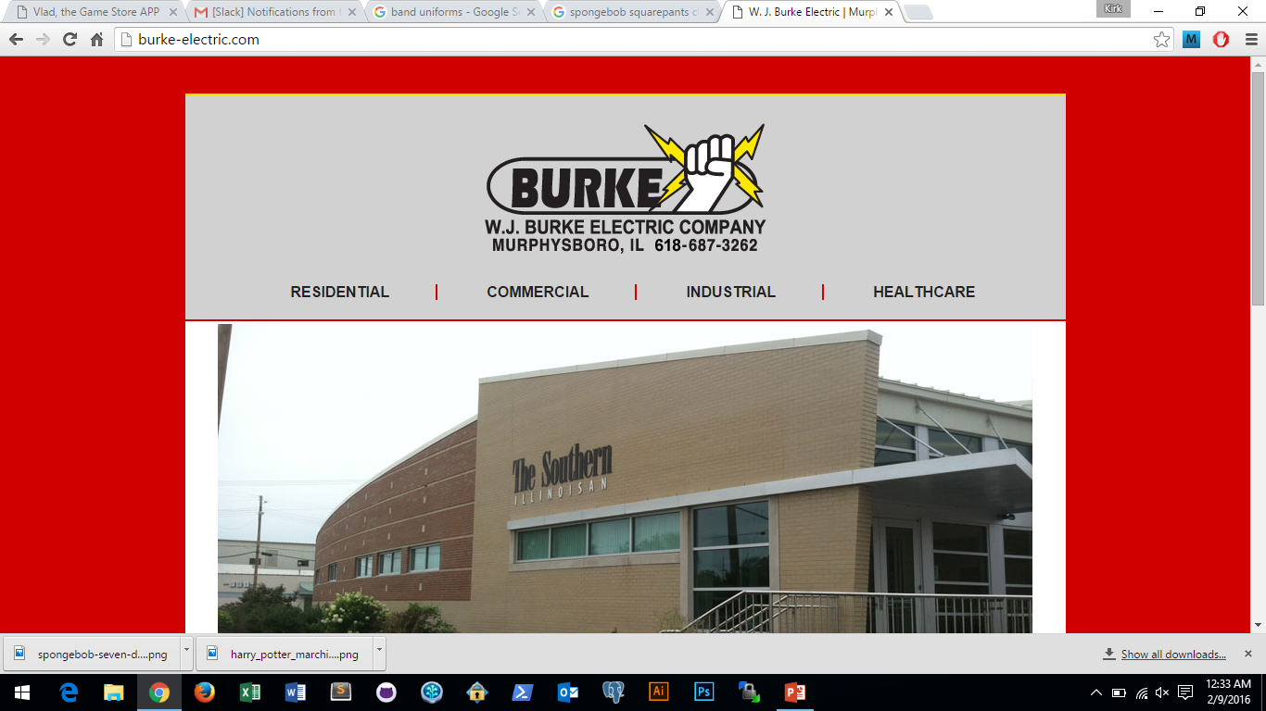
Burke-electric.com? … the world needs us!!

Slide 9
Thank you!
You may clap now …
Serious, clap. It feels really weird when people don’t clap?

