Slide 1
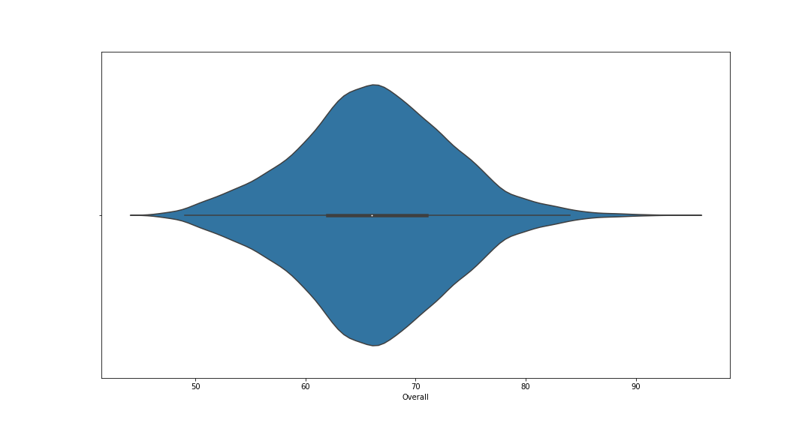
Overall rating distribution plot
Overall rating of the players are normally distributed with mean and median near 65. The distribution is left skewed

Slide 2
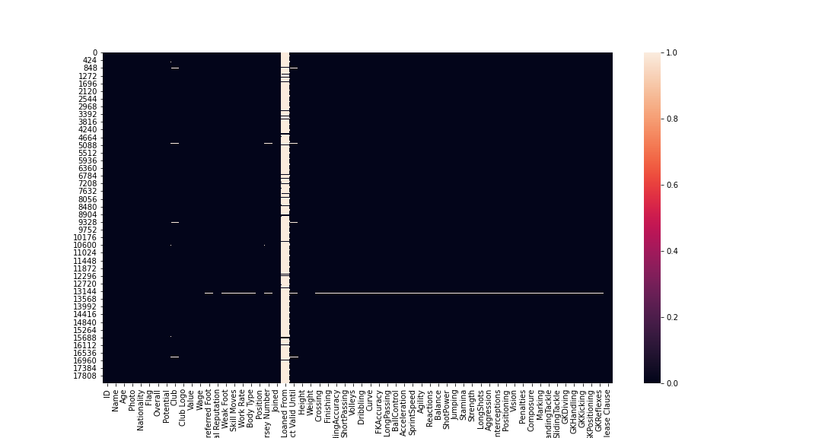
Heatmap showing null values of all variables
The white portion represents null value
After imputing the null values of the required variables, this heatmap is the final representation

Slide 3
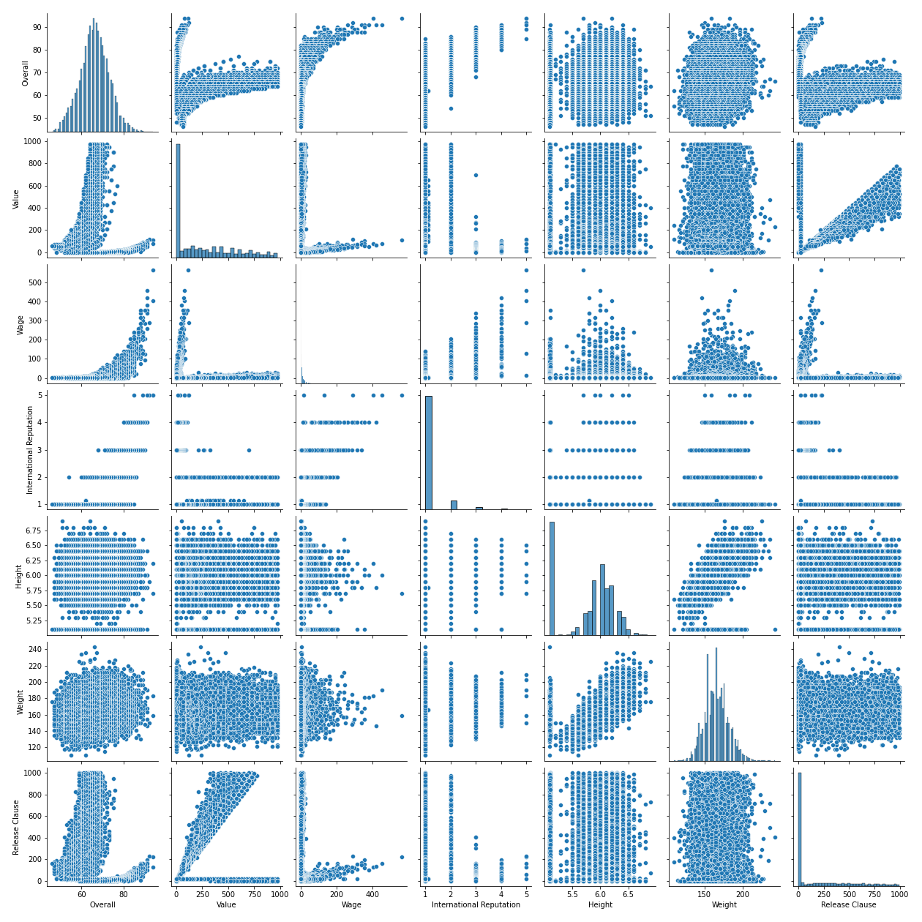
Pairplots of the variables

Slide 4
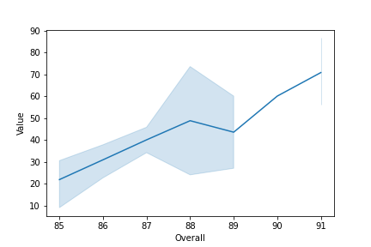
Top 20 players with contract expiring in 2020
Graph showing that with increase in overall rating value of player increases

Slide 5
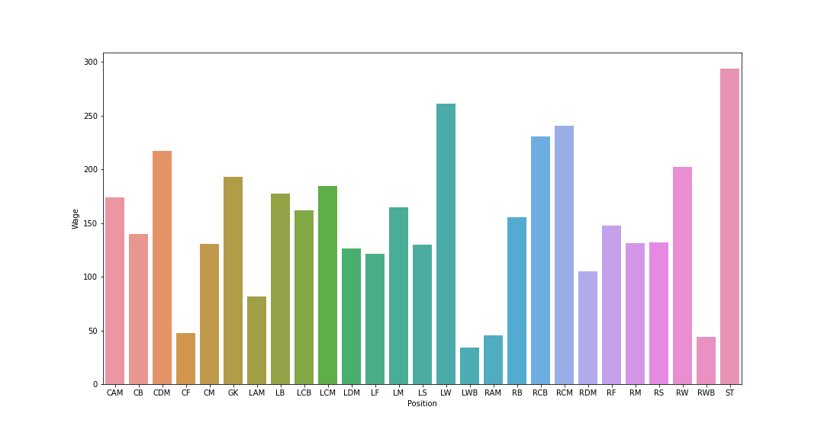
Average Wage of top 5 Players for every position

