Slide 1
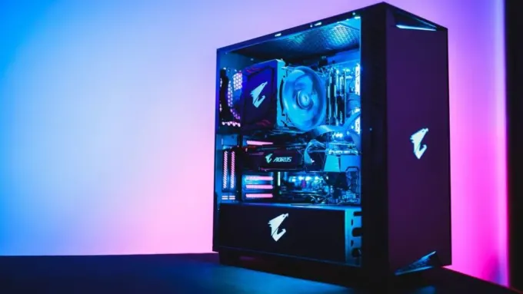


REAB PC
Group 1 :
Pann Vichika
Ngoun Mengleang
Chhun Lymeng
Dyly Tithsambath

Slide 2
Content:
Introduction to Reab PC
Problem Statement
Project Vision
Project Statement

Slide 3
Introduction to Reab PC
Computer is play an important role in today :
Study
Work : Design, Video Editor, Streamer,….
Entertainment : gaming…
Better Computer Performance is require ?

Slide 4

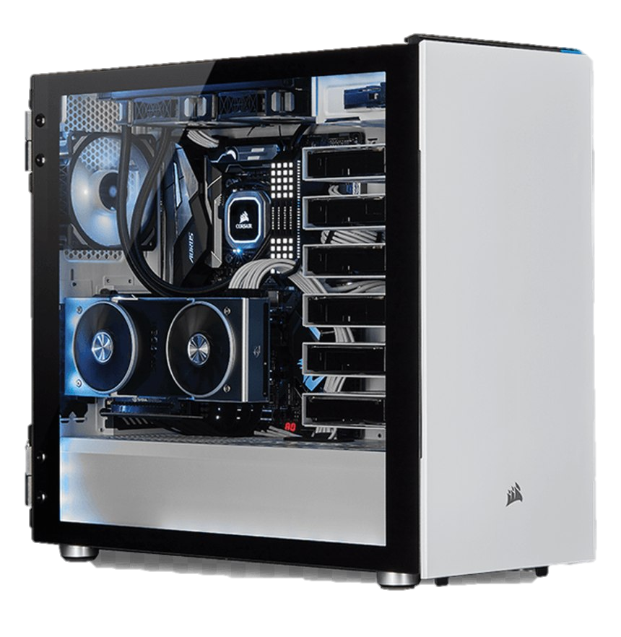
2. Problem Statement
Want to
Got Money
build PC
What spec should I build ?
Where should I go ? And Where Cheap ?

Slide 5
3. Benefits ?
To Who :
Everyone
Provide :
Save Money & Time
Know which spec should we build

Slide 6
4. Project Scope :
Collect data & information from other website
Component Mapping
Display Each data & info to user

