Slide 1


REAB PC
Group 1 :
Pann Vichika
Ngoun Mengleang
Chhun Lymeng
Dyly Tithsambath

Slide 2
Content:
1. Introduction to Reab PC
Current situation & Problem
2. Problem Statement
Problem need to be solve
3. Project Vision
Benefits
4. Project Scope :
all scopes of feature
that need to be
completed

Slide 3
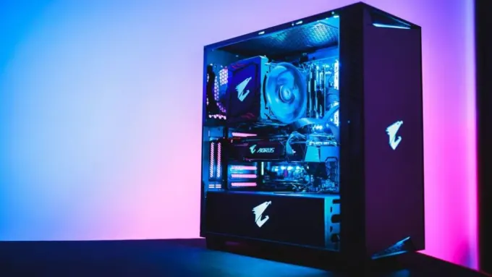
Introduction to Reab PC
Computer is play an important role in today :
Study
Work : Design, Video Editor, Streamer,….
Entertainment : gaming…
Building PC is very complex for the newer:
Requirement Budget
Component
Shop
waste time exploring

Slide 4

2. Problem Statement
Help
Them

Slide 5


3. Benefits ?
Provide :
Save Money
Save Time
Custom by own
To Who :
PC shop
Student
Designer
Gamer
...

Slide 6

4. Project Scope :
Component Mapping
Scraping price from computer shop in Cambodia
Summary and estimating

