Slide 1


REAB PC
Group 1 :
Pann Vichika
Ngoun Mengleang
Chhun Lymeng
Dyly Tithsambath

Slide 2
Content:
Introduction to Reab PC
Problem Statement
Project Vision
Project Statement

Slide 3
Introduction to Reab PC
Computer is play an important role in today :
Study
Work : Design, Video Editor, Streamer,….
Entertainment : gaming…
Building PC is very complex for the newer:
- Requirement - Budget
- Component - Shop - waste time exploring
Better Computer Performance is require ?

Slide 4

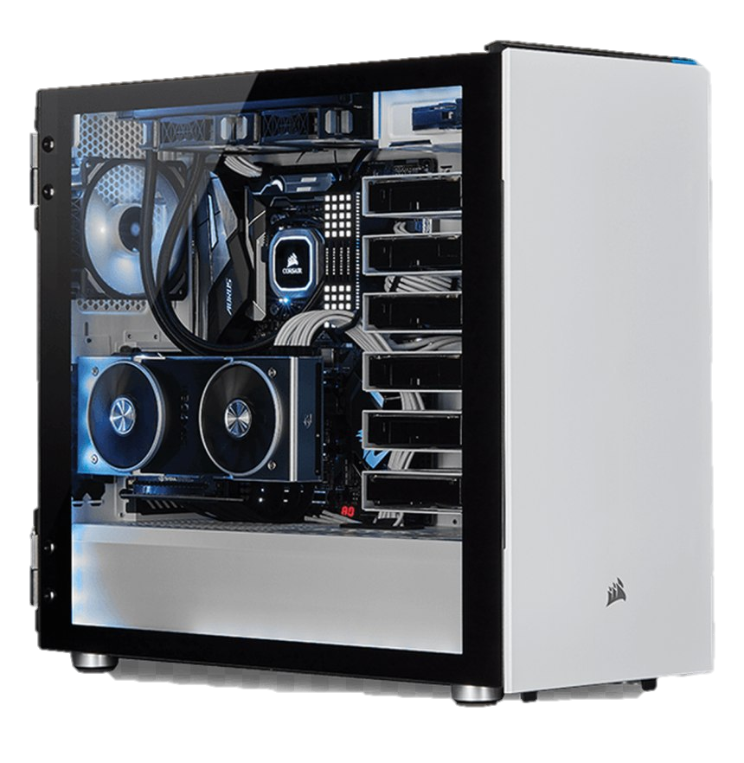
2. Problem Statement
Want to
Got Money
build PC
What spec should I build ?
Where should I go ? And Where Cheap ?
Help Explore

Slide 5
3. Benefits ?
Provide :
Save Money
Save Time
Custom by own
To Who :
PC shop
Student
Designer
Gamer
...

Slide 6
4. Project Scope :
Component Mapping
Scraping price from computer shop in Cambodia
Summary and estimating

