Slide 1

ANALYZING PIZZA SALES
Using SQL

Slide 2


ABOUT THIS
PROJECT
Introduction
IN TODAY'S DYNAMIC BUSINESS LANDSCAPE, DATA PLAYS A PIVOTAL ROLE IN DECISION-MAKING PROCESSES ACROSS INDUSTRIES.
For the food service sector, understanding consumer preferences and market trends is essential for driving growth and maintaining a competitive edge.
In this project, I delve into the world of pizza sales data to extract valuable insights using SQL queries and sub queries.

Slide 3

OBJECTIVE
THE OBJECTIVE OF THIS PROJECT IS TO UTILIZE SQL QUERIES AND SUB QUERIES TO ANALYSE A DATASET CONTAINING INFORMATION ABOUT PIZZA SALES.
THE DATASET PROVIDES A COMPREHENSIVE OVERVIEW OF VARIOUS ASPECTS OF CUSTOMER BEHAVIOR, POPULAR
PIZZA TYPES, SALES TRENDS, AND OVERALL PERFORMANCE.
THROUGH THIS PROJECT, I AIM TO EXPLORE THE DATASET, ANSWER SPECIFIC QUESTIONS RELATED TO PIZZA SALES, AND GAIN INSIGHTS INTO POPULAR PIZZA CATEGORY, BEST-SELLING ITEMS, PEAK SALES TIME, CUST AND MORE.

Slide 4
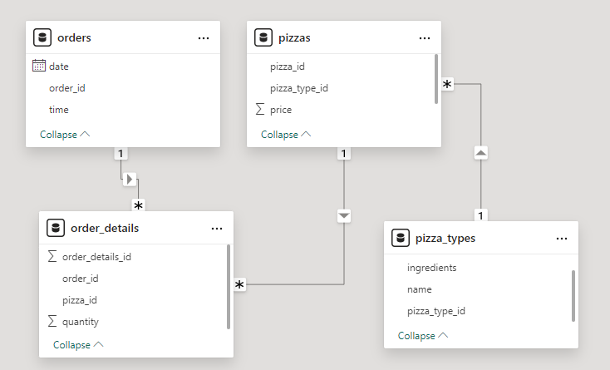
DATABASE SCHEMA
THE DATASET USED IN THIS PROJECT COMPRISES MULTIPLE TABLES, EACH CONTAINING SPECIFIC INFORMATION ABOUT DIFFERENT ASPECTS OF PIZZA SALES.
THESE TABLES INCLUDE DETAILS SUCH AS PIZZAS, ORDER DETAILS, PIZZA TYPES, PIZZA ORDERS.
THE DATASET IS RICH IN INFORMATION, PROVIDING US WITH AMPLE OPPORTUNITIES TO EXTRACT MEANINGFUL INSIGHTS THROUGH SQL QUERIES.

Slide 5
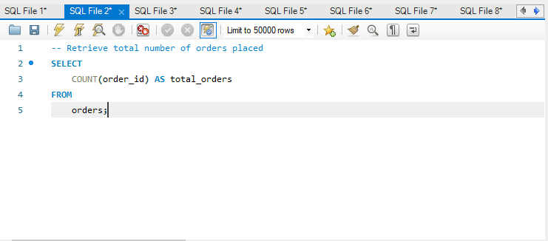
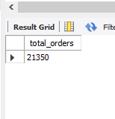
Q1: THE TOTAL NUMBER OF ORDER PLACE.

Slide 6
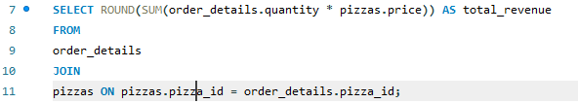
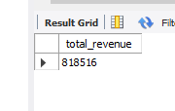
Q2: THE TOTAL REVENUE GENERATED FROM PIZZA SALES

Slide 7
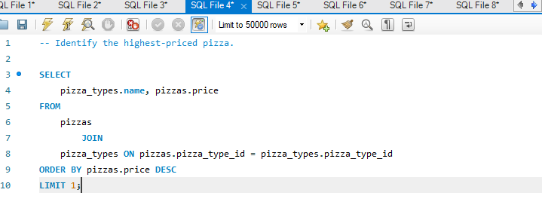
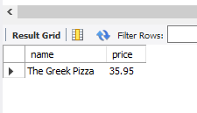
Q3: THE HIGHEST PRICED PIZZA.

Slide 8
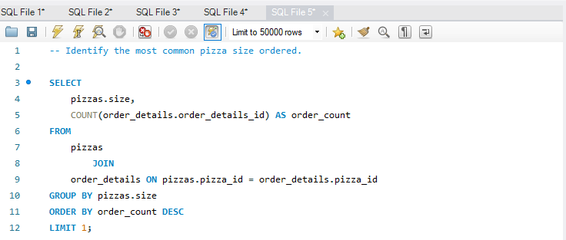
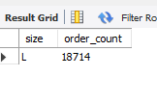
Q4: THE MOST COMMON PIZZA SIZE ORDERED.

Slide 9
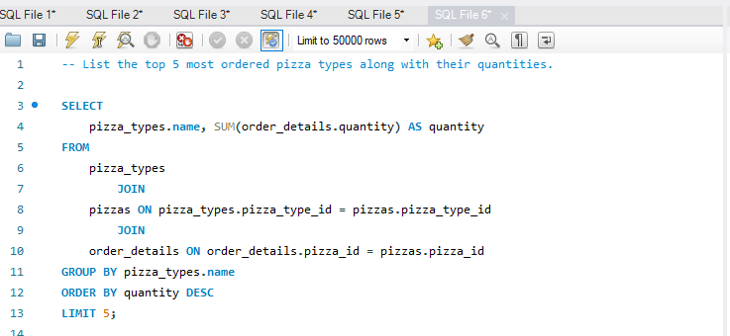
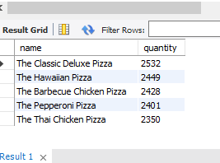
Q5: THE TOP 5 MOST ORDERED PIZZA TYPES ALONG THEIR QUANTITIES.

Slide 10
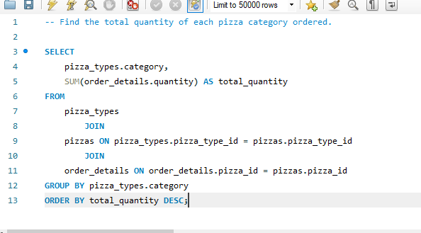
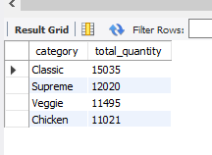
Q6: THE QUANTITY OF EACH PIZZA CATEGORIES ORDERED.

Slide 11
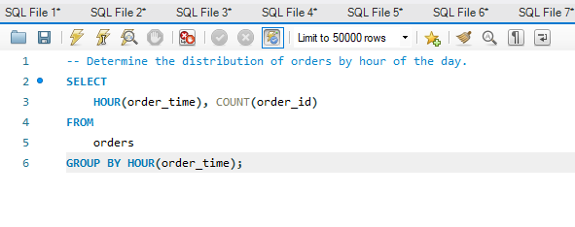
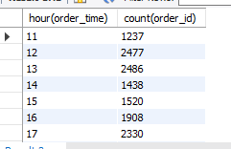
Q7: THE DISTRIBUTION OF ORDERS BY HOURS OF THE DAY.

Slide 12
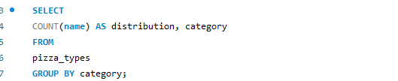
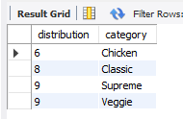
Q8: THE CATEGORY-WISE DISTRIBUTION OF PIZZAS.

Slide 13
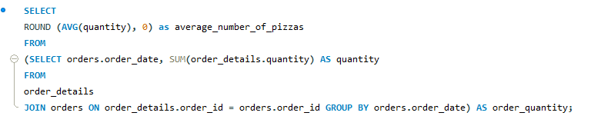

Q9: THE AVERAGE NUMBER OF PIZZAS ORDERED PER DAY.

Slide 14
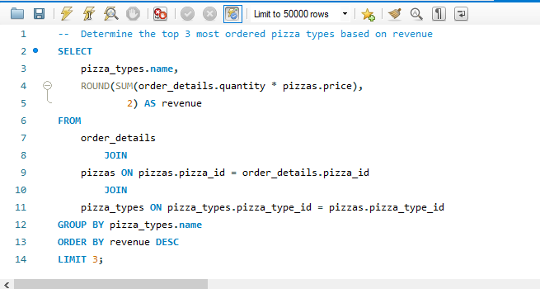
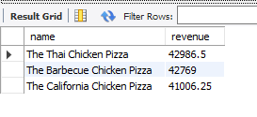
Q10: TOP 3 MOST ORDERED PIZZA TYPE BASE ON REVENUE.

Slide 15
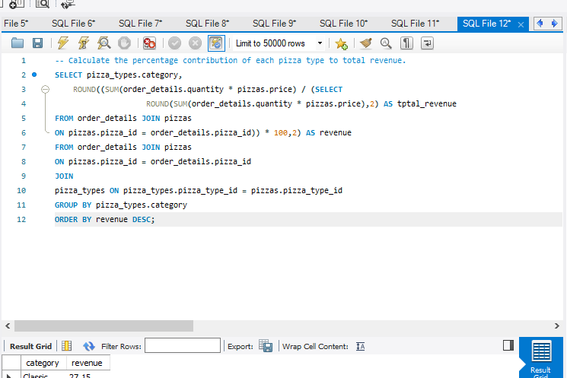
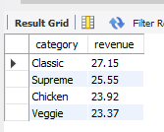
Q11: THE PERCENTAGE CONTRIBUTION OF EACH PIZZA TYPE TO REVENUE.

Slide 16
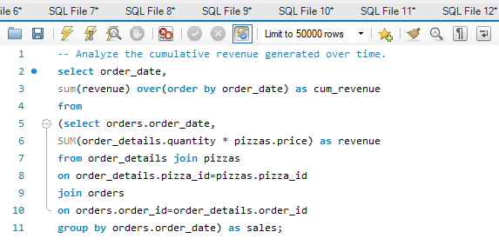
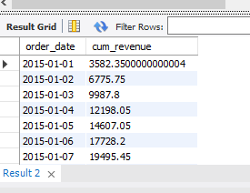
Q12: THE CUMULATIVE REVENUE GENERATED OVER TIME.

Slide 17
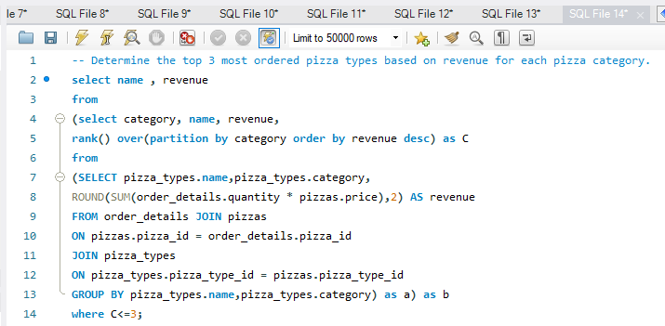
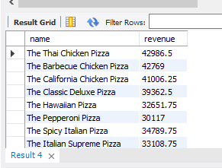
Q13: THE TOP 3 MOST ORDERED PIZZA TYPE BASED ON REVENUE FOR EACH PIZZA CATEGORY.

Slide 18
conclusion
IN CONCLUSION, THE COMPREHENSIVE ANALYSIS OF PIZZA SALES USING ADVANCED SQL QUERIES AND SUBQUERIES ACROSS FOUR RELATIONAL TABLES HAS PROVIDED VALUABLE INSIGHTS INTO CUSTOMER PREFERENCES, SALES TRENDS, AND INVENTORY MANAGEMENT. BY LEVERAGING THESE SKILLS, I WAS ABLE TO IDENTIFY KEY FACTORS DRIVING SALES PERFORMANCE AND OFFER ACTIONABLE RECOMMENDATIONS FOR OPTIMIZING OPERATIONS AND ENHANCING PROFITABILITY. THIS PROJECT UNDERSCORES THE IMPORTANCE OF ROBUST DATA ANALYSIS IN MAKING INFORMED BUSINESS DECISIONS.

Slide 19
