Slide 1
Cellular Automata based Modelling of Cryptocurrency
Mentor: Dr. Souvik Roy
Presented by Krishnendu Dasgupta
Paper Referred:
Stochastic Cellular Automata Model for Stock Market Dynamics
(By Marco Bartolozzi and Anthony William Thomas)

Slide 2
Introduction:
A 2D Grid of 512 x 128 is taken where each cell can have 3 states (0,+1,-1).
0 denotes an Active Trader.
+1 Denotes an Active Trader Buying Stocks.
-1 Denotes an Active Trader Selling Stocks.
Von Neumann Neighbourhood is considered while simulation.

Slide 3
Simulation Rules:
Rule-1:
If a Cell in State 0 has at least 1 of its Neighbours in State 1, then with PH Probability, it gets converted to State (+1 or -1) .
Rule-2:
If a Cell in State 1 has at least 1 of its Neighbours in State 0, then with PD Probability, it gets converted to State 0.
Rule-3:
A Cell in State 0 can get converted to State(+1 or -1) with PC Probability.

Slide 4
Graphical Analysis of the Model:
We Fix the Values of PD = 0.05 and PC = 0.0001
We adjust the Values of PH and take 5 of its values as [0.0493, 0.0490, 0.0488, 0.0485, 0.0475]
We start the simulation and take about 40,000 Generations under consideration and for each Generation, we consider the Number of Active Traders and plot both of these quantities in the form of a Graph.

Slide 5
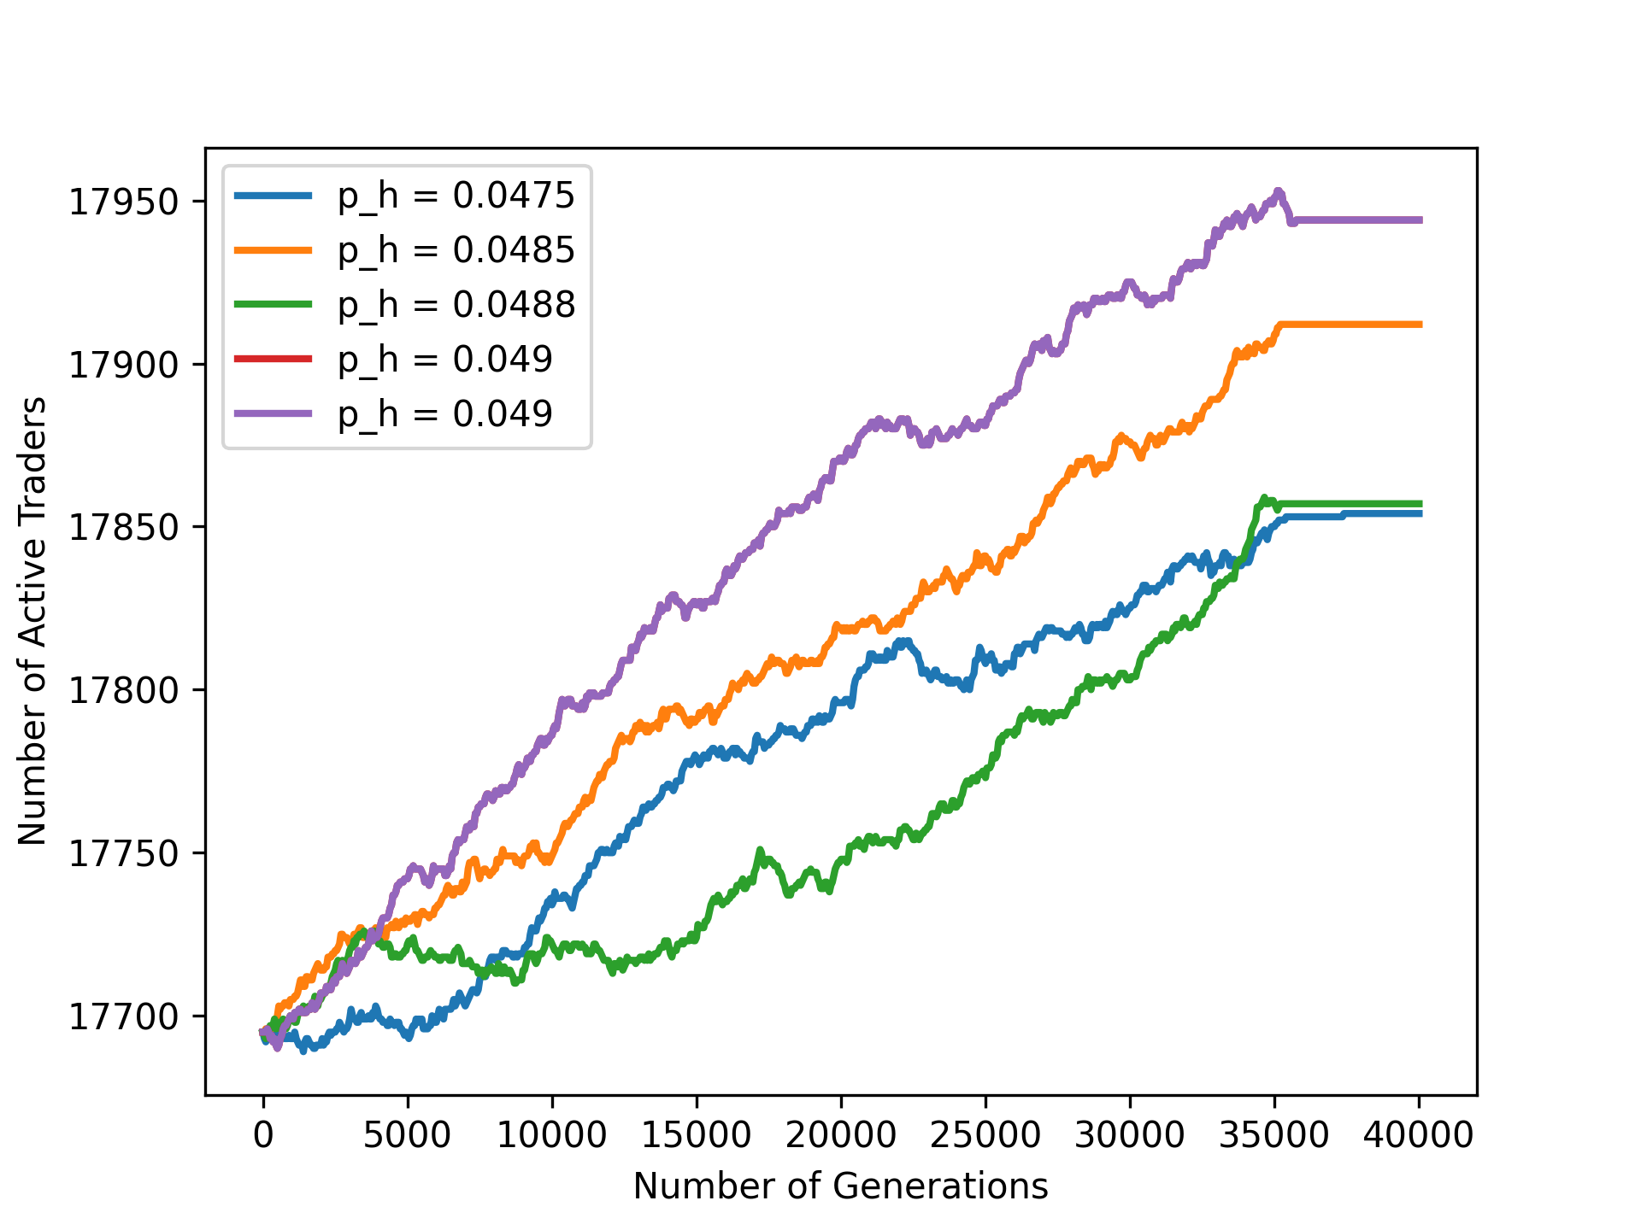
Graph of the Model:
Here, the Graph is Strictly Increasing till 35,000 to 40,000 and after that it stabilises and becomes almost parallel to X-Axis.
So, it can be concluded that upto 35,000 to 40,000 Generations, the Number of Active Traders keep on Increasing and finally after that, becomes almost Constant.

Slide 6
Changing the Simulation Rules:
In Rule-1 and Rule-2, we consider only 1 Neighbour for the Toggling Conditions.
But what if we increased or decreased it??
Let’s take ‘K’ and ‘l’ for Rule-1 and Rule-2 Respectively where K,l ∈ {1,2,3,4} instead of 1.
So,
Modified Rule-1:
If a Cell in State 0 has at least ‘K’ of its Neighbours in State 1, then with PH Probability, it gets converted to State (+1 or -1) .
Modified Rule-2:
If a Cell in State 1 has at least ‘l’ of its Neighbours in State 0, then with PD Probability, it gets converted to State 0.

Slide 7
Analysis of the Model with the Modified Rules:
After changing the Simulation Rules, we observe a very Interesting result in the model.
The Graph (of the most Initial Model) which was Strictly Increasing now sometimes becomes Strictly Decreasing for some values , especially when ‘K’ or ‘l’ is >=2.
That implies, with the Change in the Rules, the Number of Active Traders decrease with time for some specific values of ‘K’ and ‘l’ instead of always Increasing (as it was in the Initial Model).

Slide 8
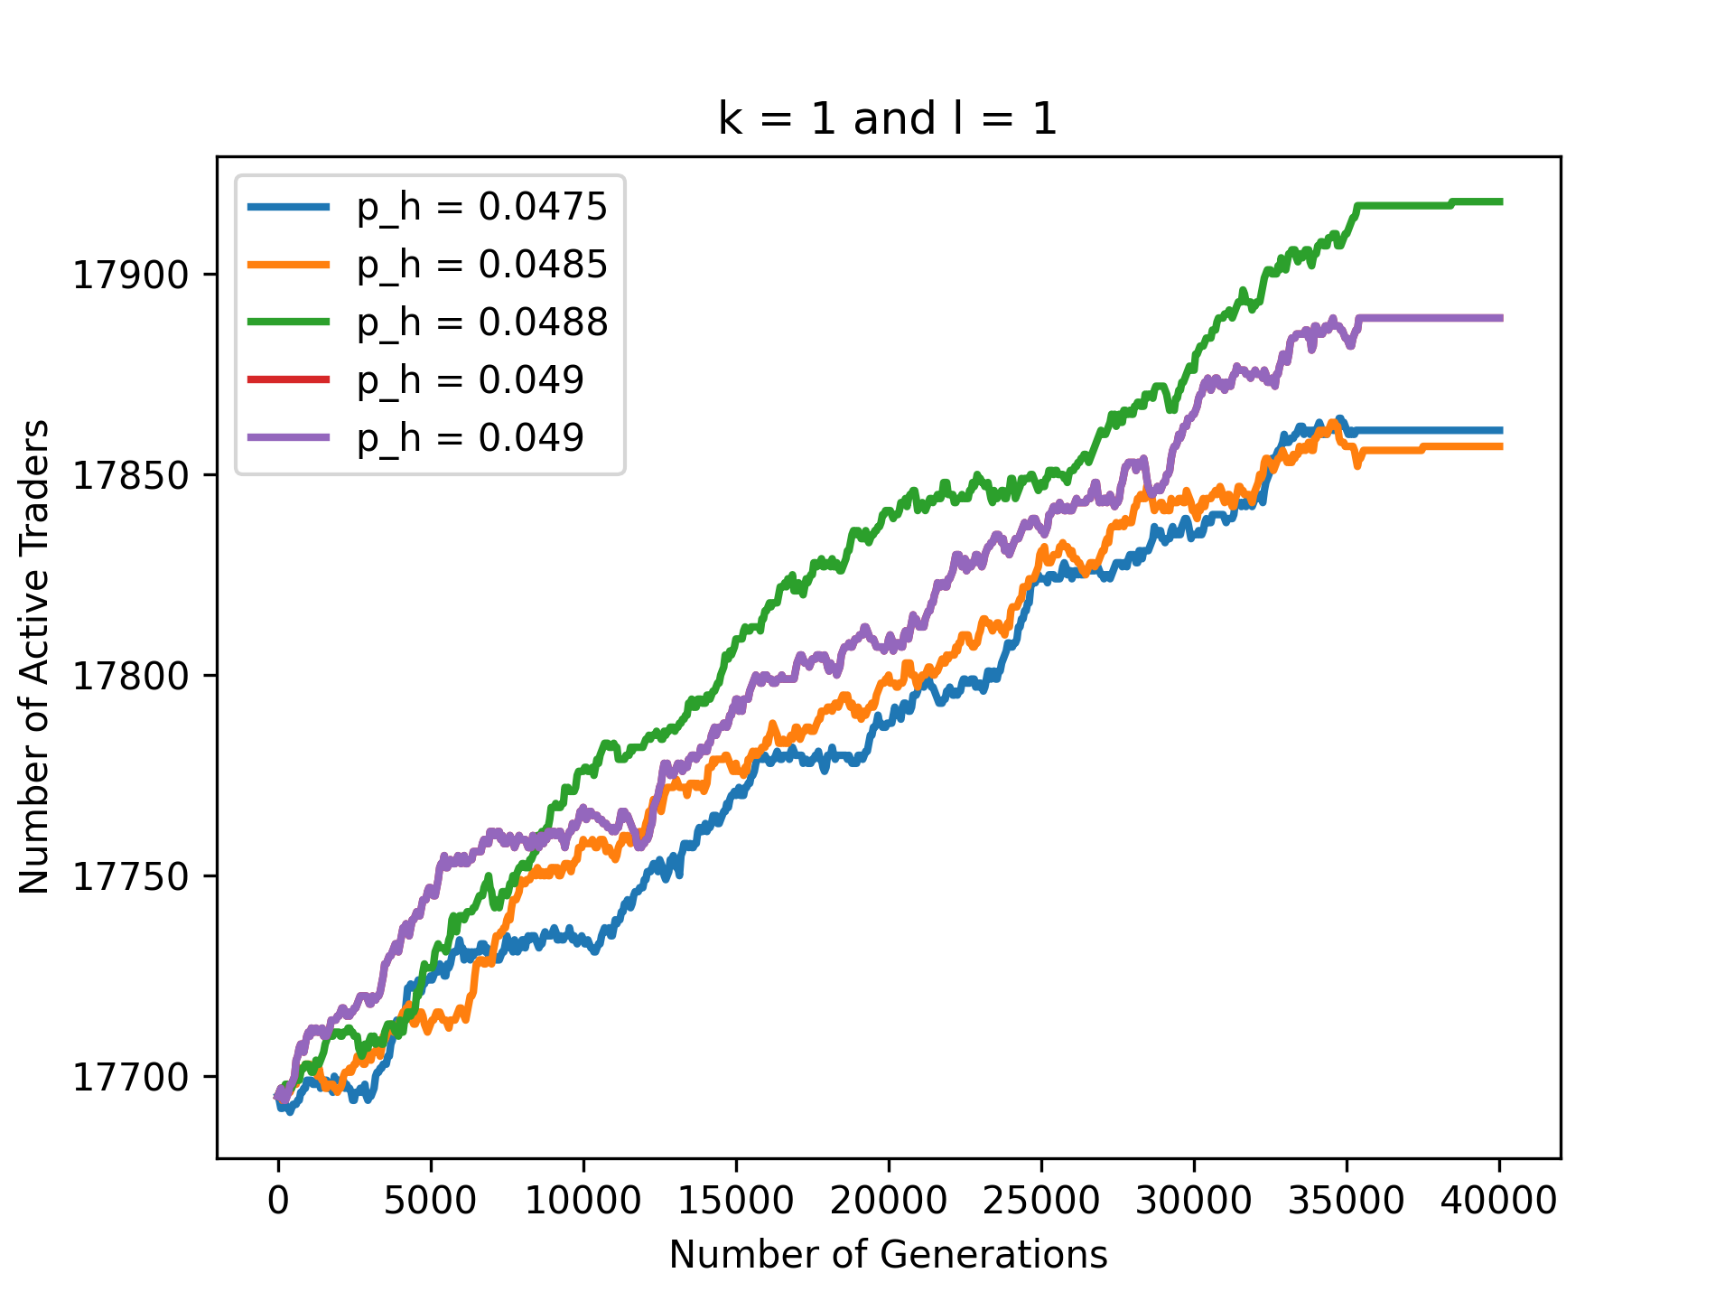
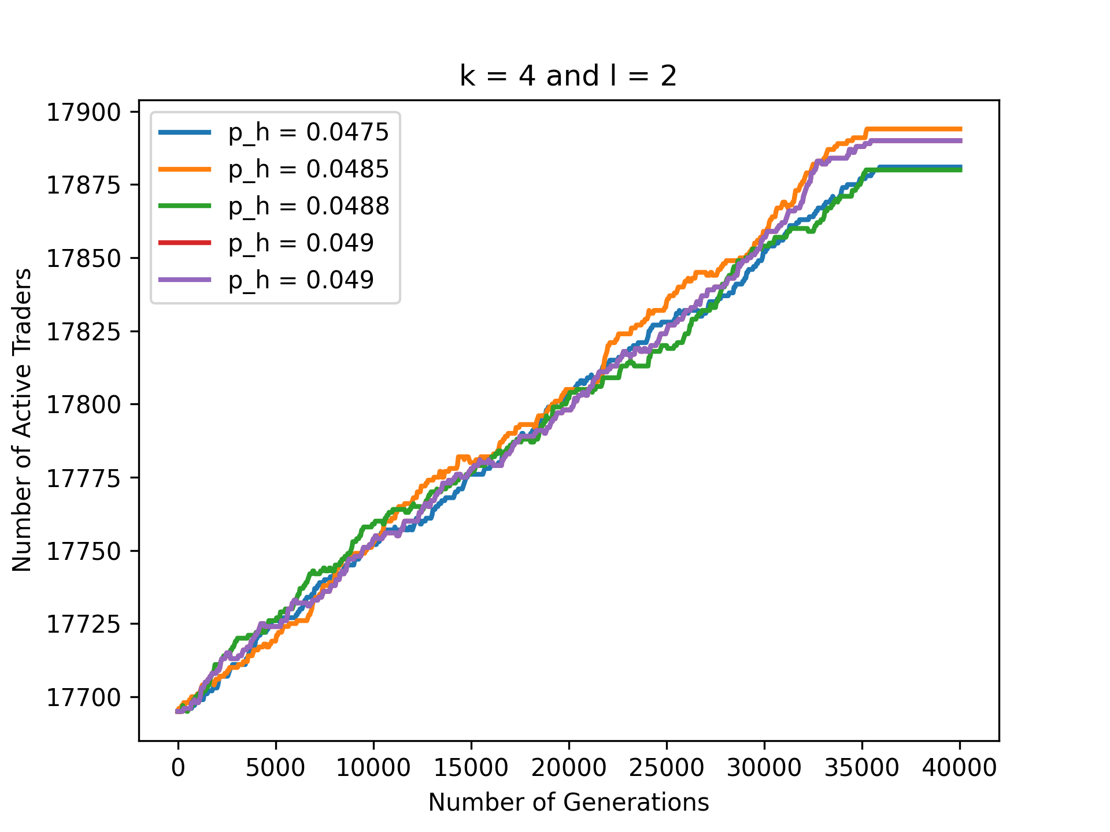
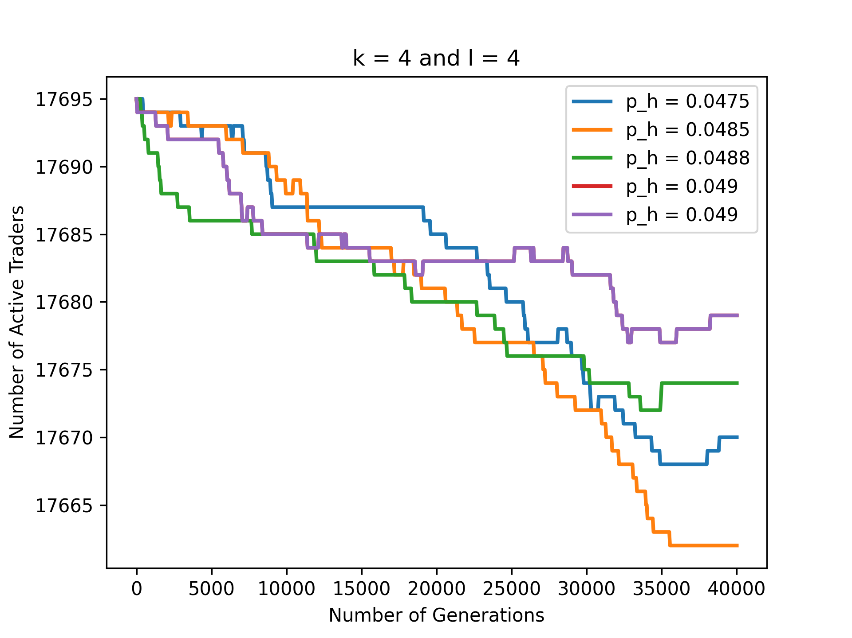
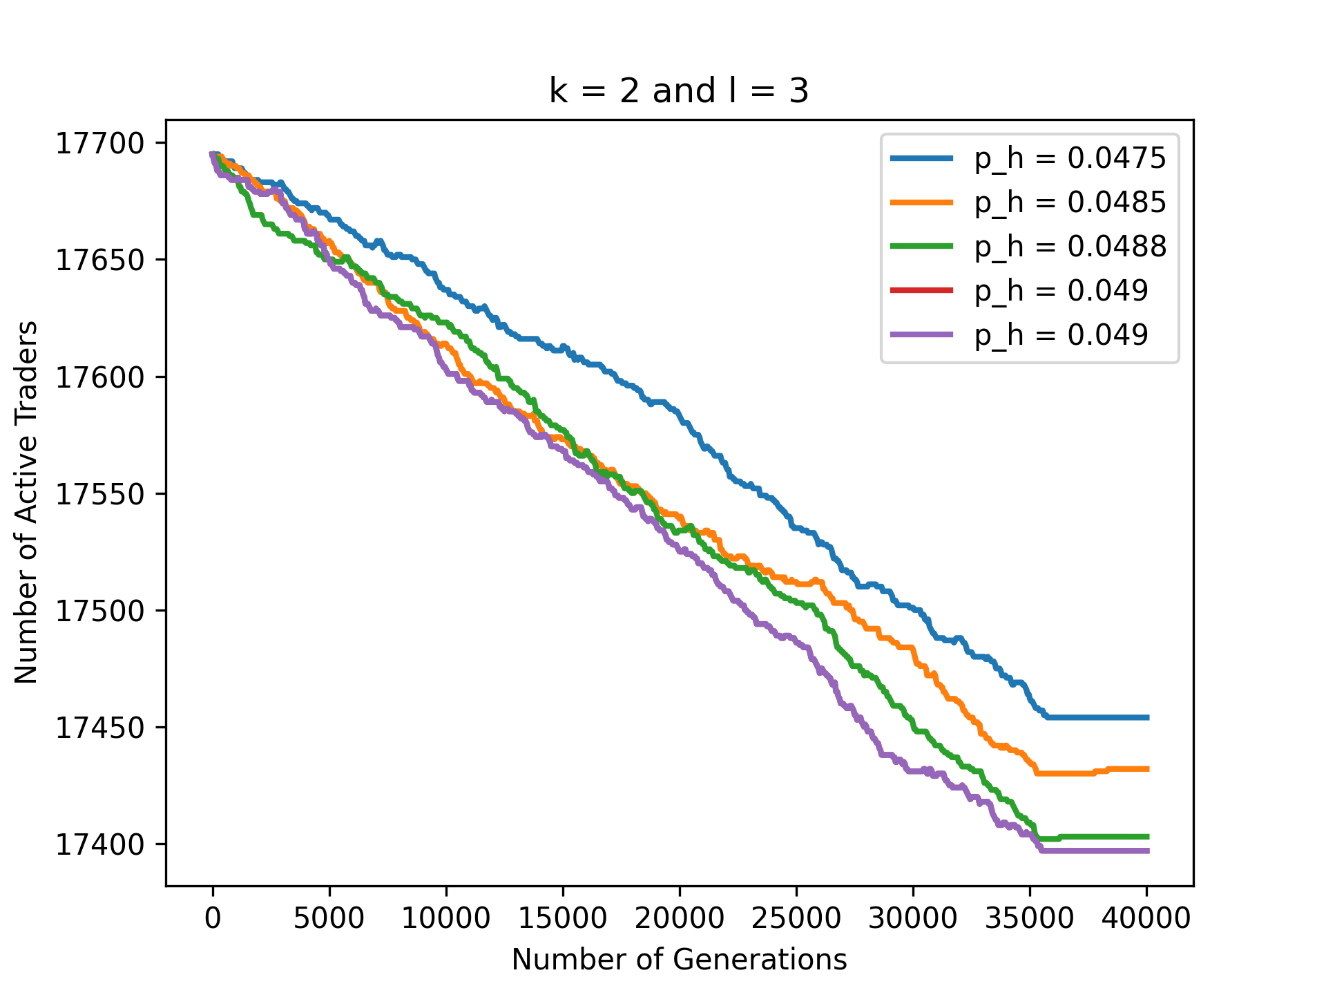
Some Graphs of the Modified Model:

Slide 9
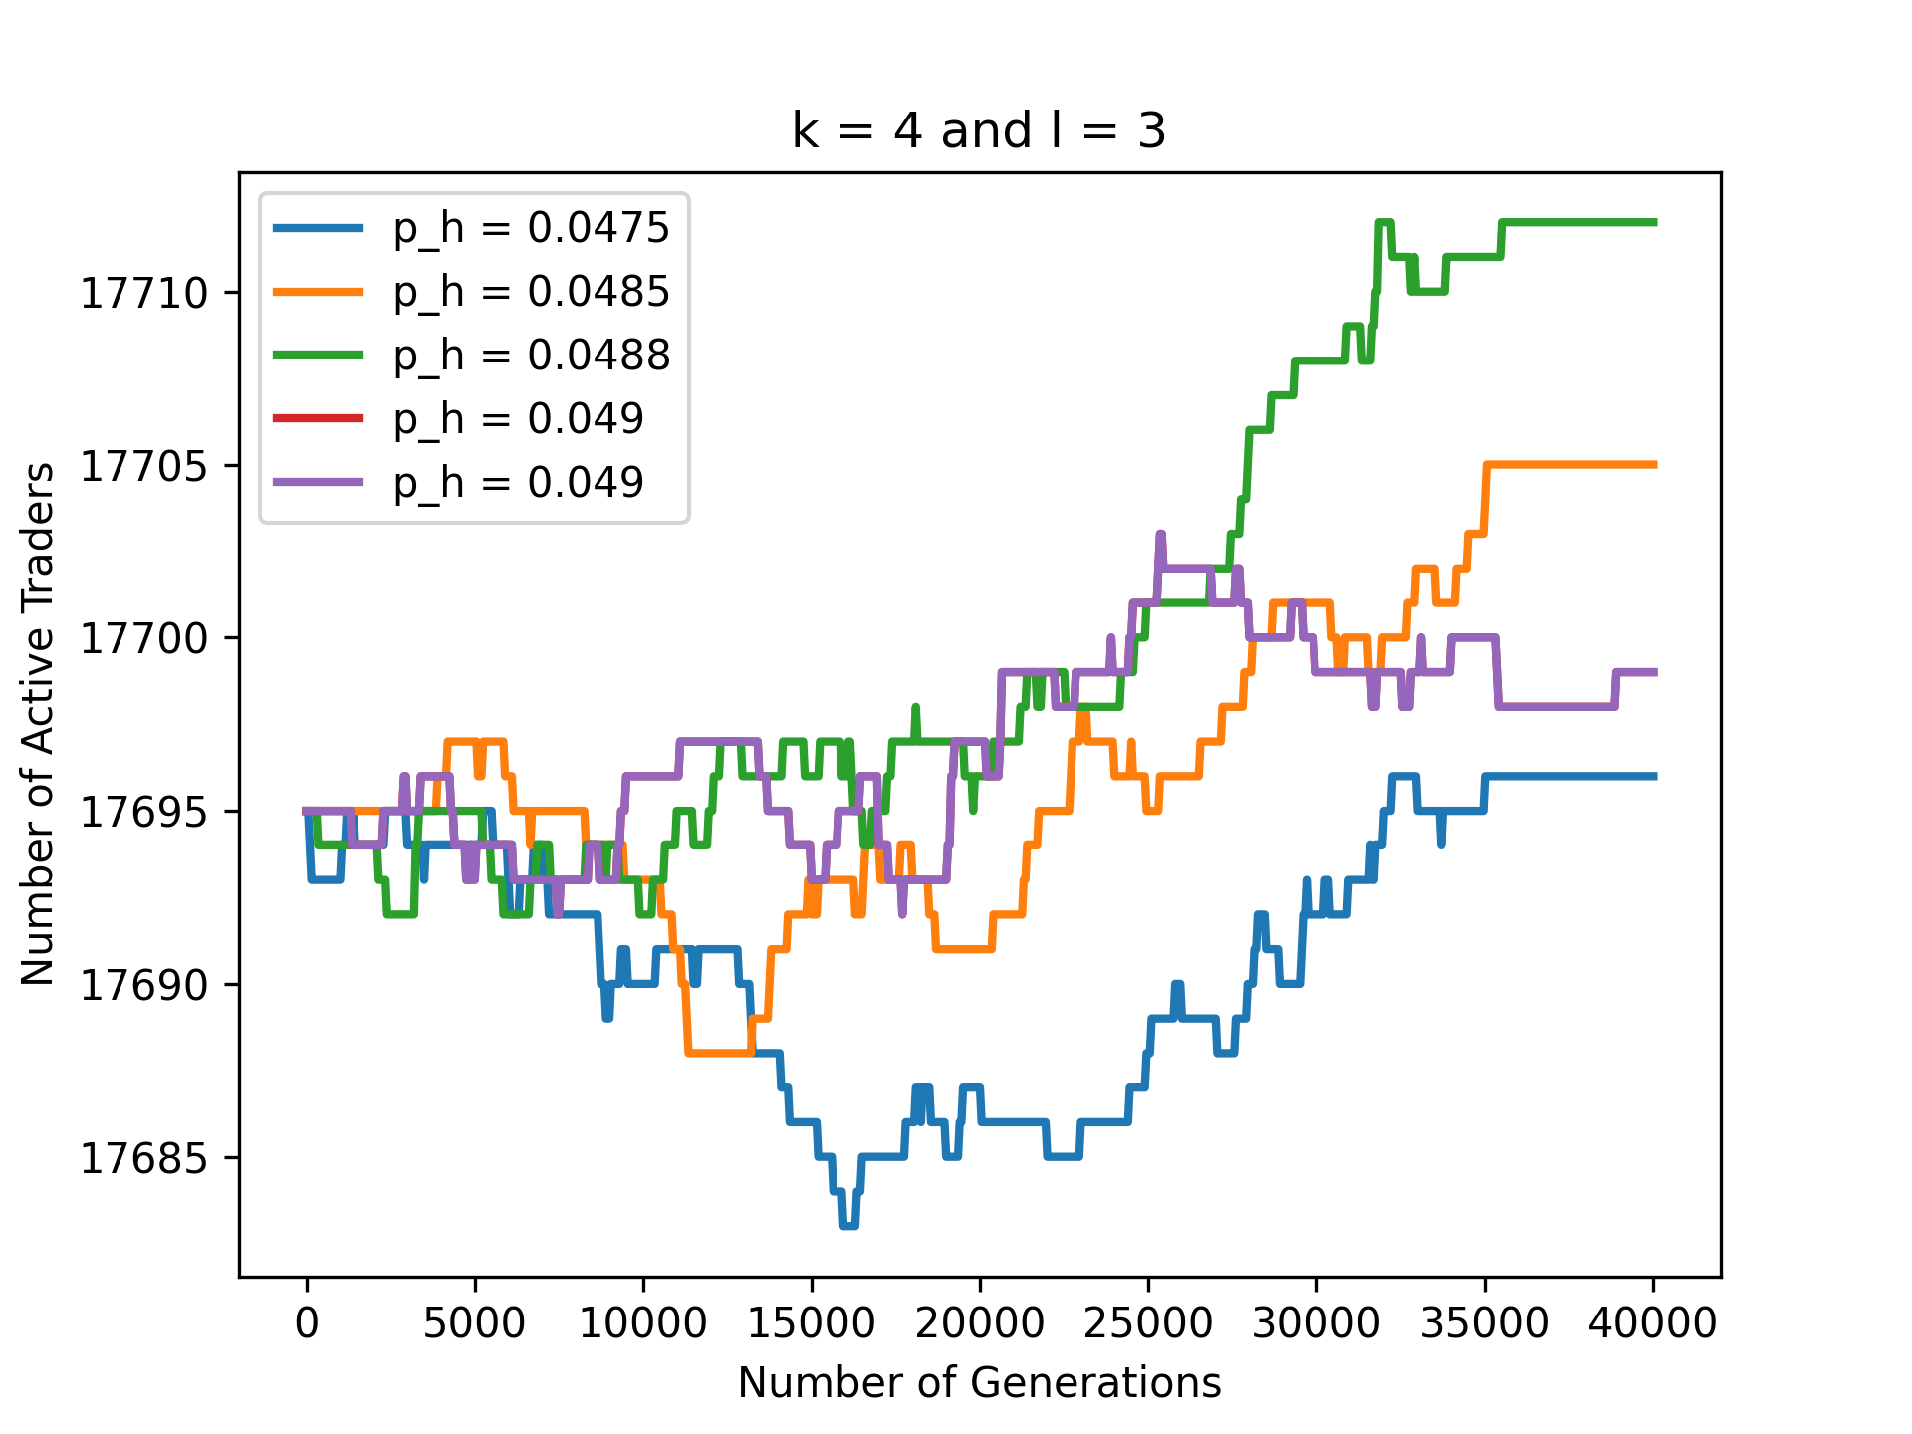
Case of K=4 and l = 3:
The Graph of K = 4 and l = 3 shows some Unstable Behaviour.
First, it decreases.
Then it Increases and then Stabilises.
The Graph of K = 4 and l = 3 shows some Unstable Behaviour.
First, it decreases.
Then it Increases and then Stabilises.

Slide 10
Introducing Global Neighbours:
In a Stock Market, a Trader is influenced not only by its Immediate Neighbours(Traders) but also through the Other Traders in the Market.
Likewise, if we have to make the Model Real life, we have to use the Global Neighbours along with the Local Neighbours for the Simulation.
Conditions of Choosing a Global Neighbour:
We are considering a 2D Grid of 512 x 128 which means it has 65,536 Cells. Out of these cells, we choose a cell completely at random and make it a Global Neighbour for a particular cell for a particular Timestamp in the course of Simulation.
Neighbourhood Structure:
Here, we consider 2 cases for the Simulation.
  2 Global Neighbours(Chosen Randomly from the whole Grid) and 2 Local Neighbours(Chosen Randomly from the 4 Von Neumann Neighbours).
  1 Global Neighbours(Chosen Randomly from the whole Grid) and 3 Local Neighbours(Chosen Randomly from the 4 Von Neumann Neighbours).

Slide 11
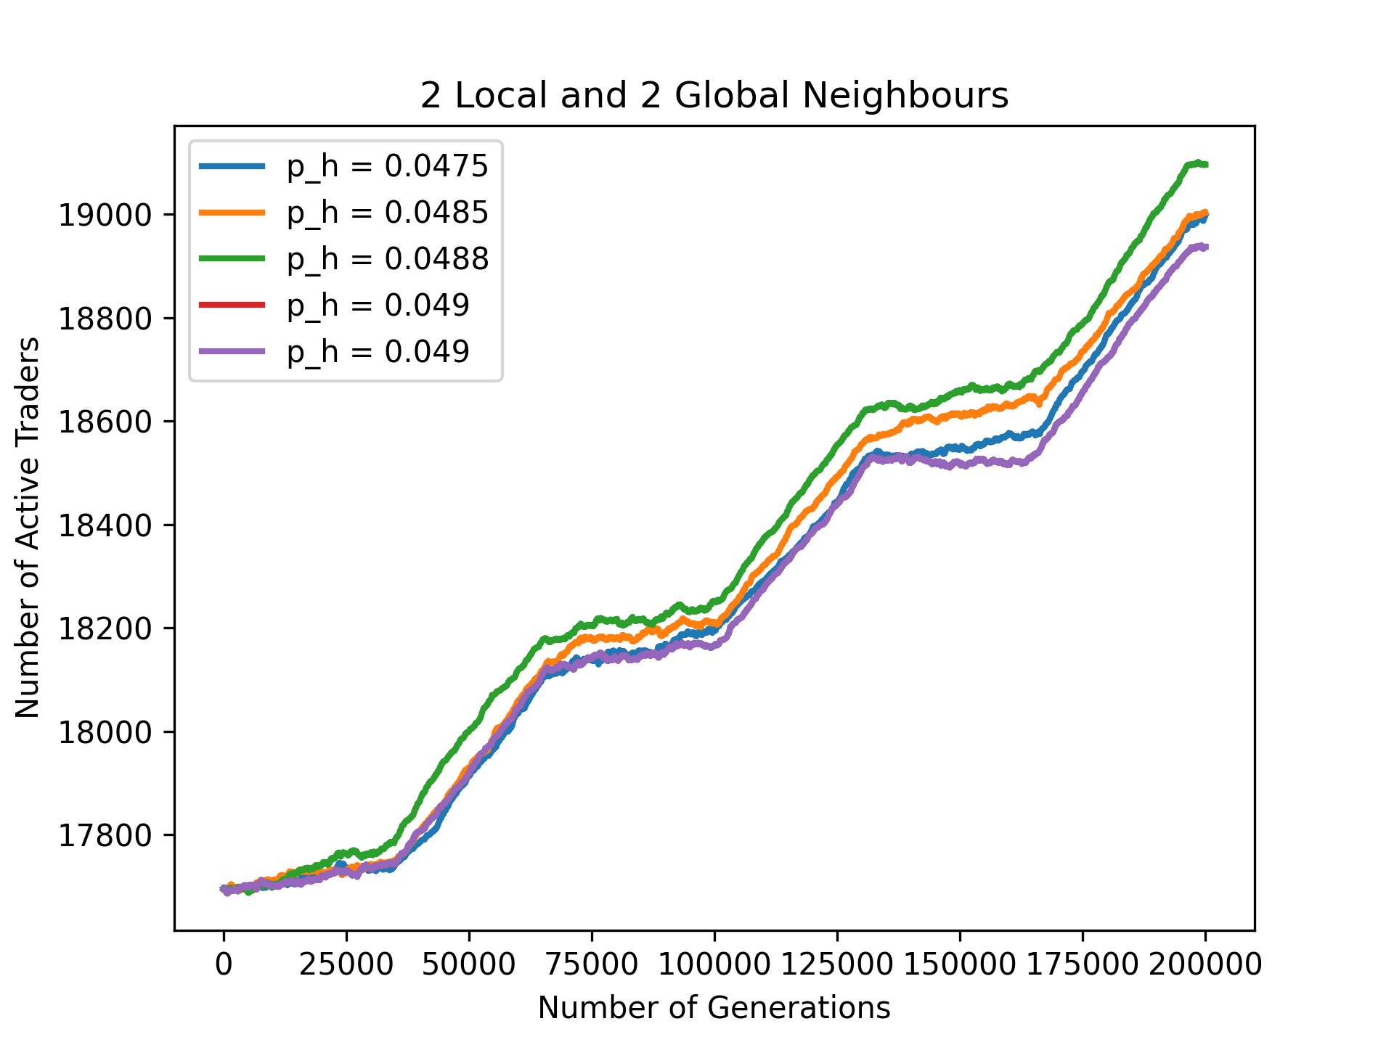
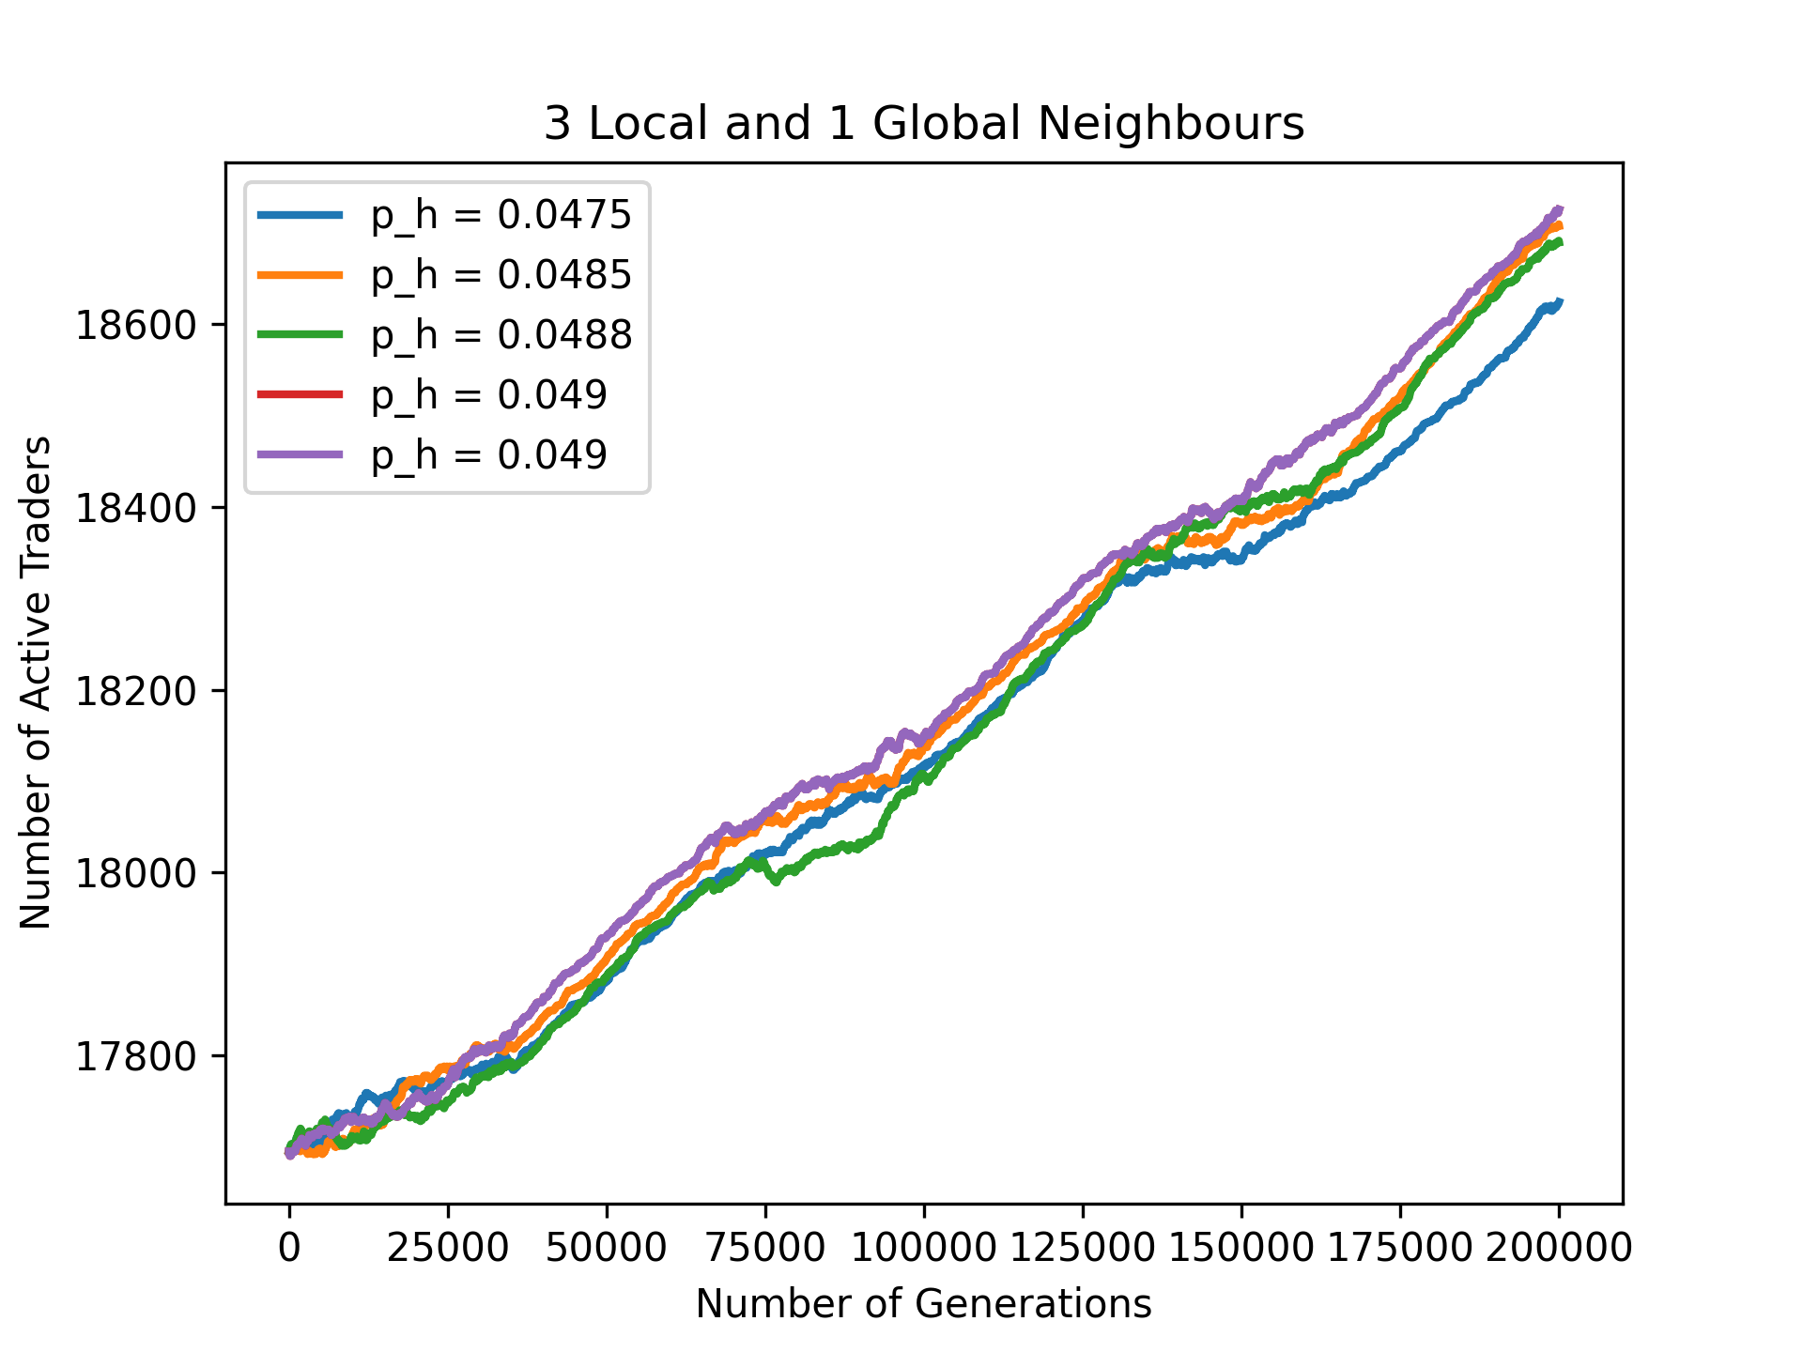
Graphical Analysis of the Global Cases:
Here, considering the Global Neighbourhood Case, 2 Graphs are obtained, both of which exhibit some Interesting Feature.
The Graphs of the Initial Models (be it Increasing or Decreasing) stabilised within the Range of 35,000 to 40,000.
But when the Global Neighbours are introduced, the Graphs keeps Increasing Strictly for a much longer extent (2,00,000 here) and does not stabilise.
The key takeaway is that if we mix the Global Neighbours in the scenario, the Number of Active Traders keeps on increasing for a very large Number of Generations and does not necessarily becomes constant.
Through this graph, We clearly see the effect of the Global Traders of the Market on any of another Trader of the same market and how they keep on increasing.

Slide 12
Conclusion:
Through his whole course of the experiment, it can be concluded that a CA can be used for modelling the Stock Market in a very efficient manner.
Through the Main Model and then the model with some modifications in the Rule of the Simulation, we can clearly visualise the Dynamics of the Stock Market, how a Trader becomes active from Inactive and vice versa just based on the influence of its neighbours.
Since, the Traders in the Stock Market in Real Life is influenced not only by its Immediate Neighbours but also by the Global Neighbours(or Traders to be precise), we have also used some Global Neighbour Condition (Choosing the Global Neighbours at random) in the last part of the analysis and there we can see some Drastic Changes from the main model.
In future, we plan on testing the Behaviour of our Model on the S&P500 dataset as mentioned in the Paper Referred.

