Slide 1






UpCycle: DIY & Recycling Guide
Theme : Sustainability

Slide 2


Presented By:
Team: Neosis
Name: Tithi Paul
ID: 2021-2-60-057
Name: Nirzona Binta Badal
ID: 2021-2-60-051
Name: Adnan Mahmud
ID: 2018-3-60-023
Name: Marzan Billah Shefa
ID: 2018-3-60-112

Slide 3

Presented To:
Yasin Sazid
Lecturer
Department of Computer Science Engineering
East West University

Slide 4




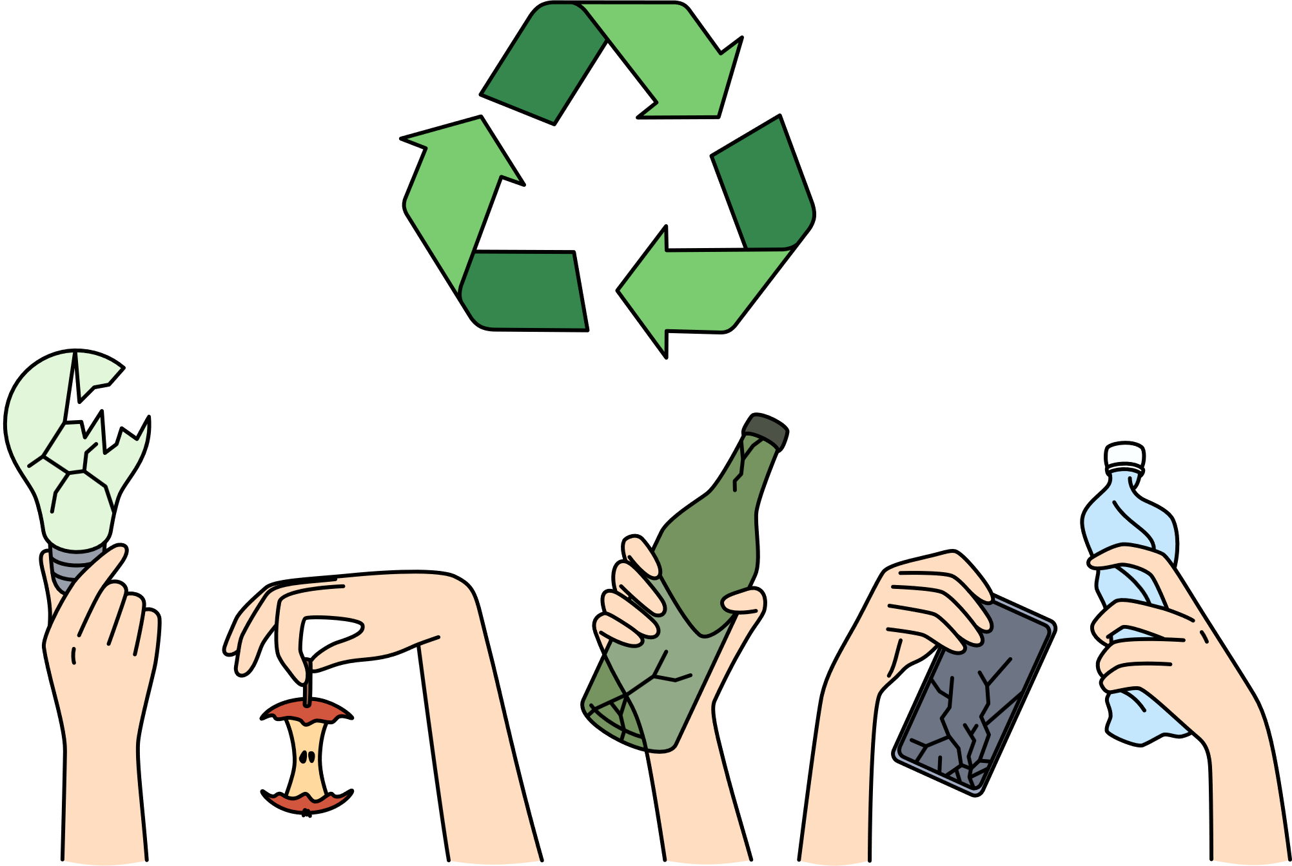

What is the project?
A mobile app that teaches users creative ways to upcycle old clothes, furniture, and other waste materials. ♻️👗🛋️

Slide 5


What is the purpose?
Reduces waste by encouraging reuse and creativity in repurposing materials. 🌍💡
How does it relate to sustainability?
Supports a circular economy by minimizing waste and promoting sustainable repurposing. 🔄🌿

Slide 6

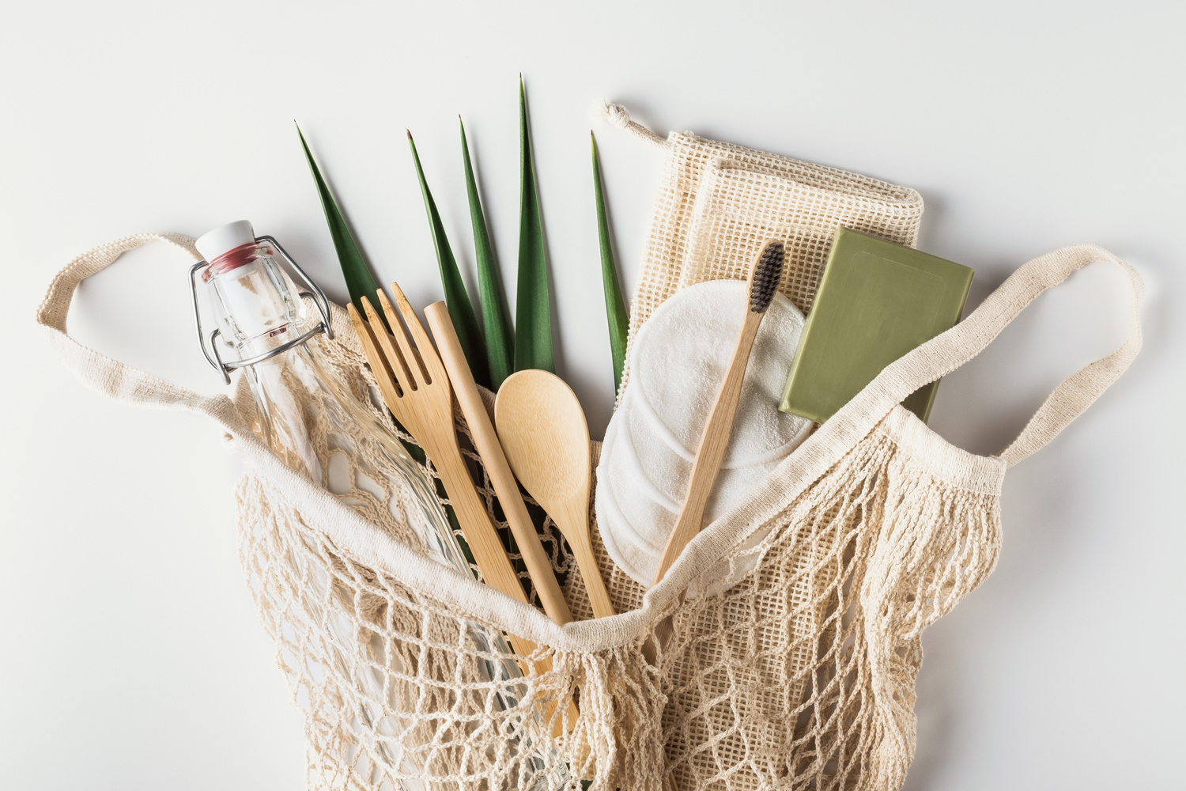


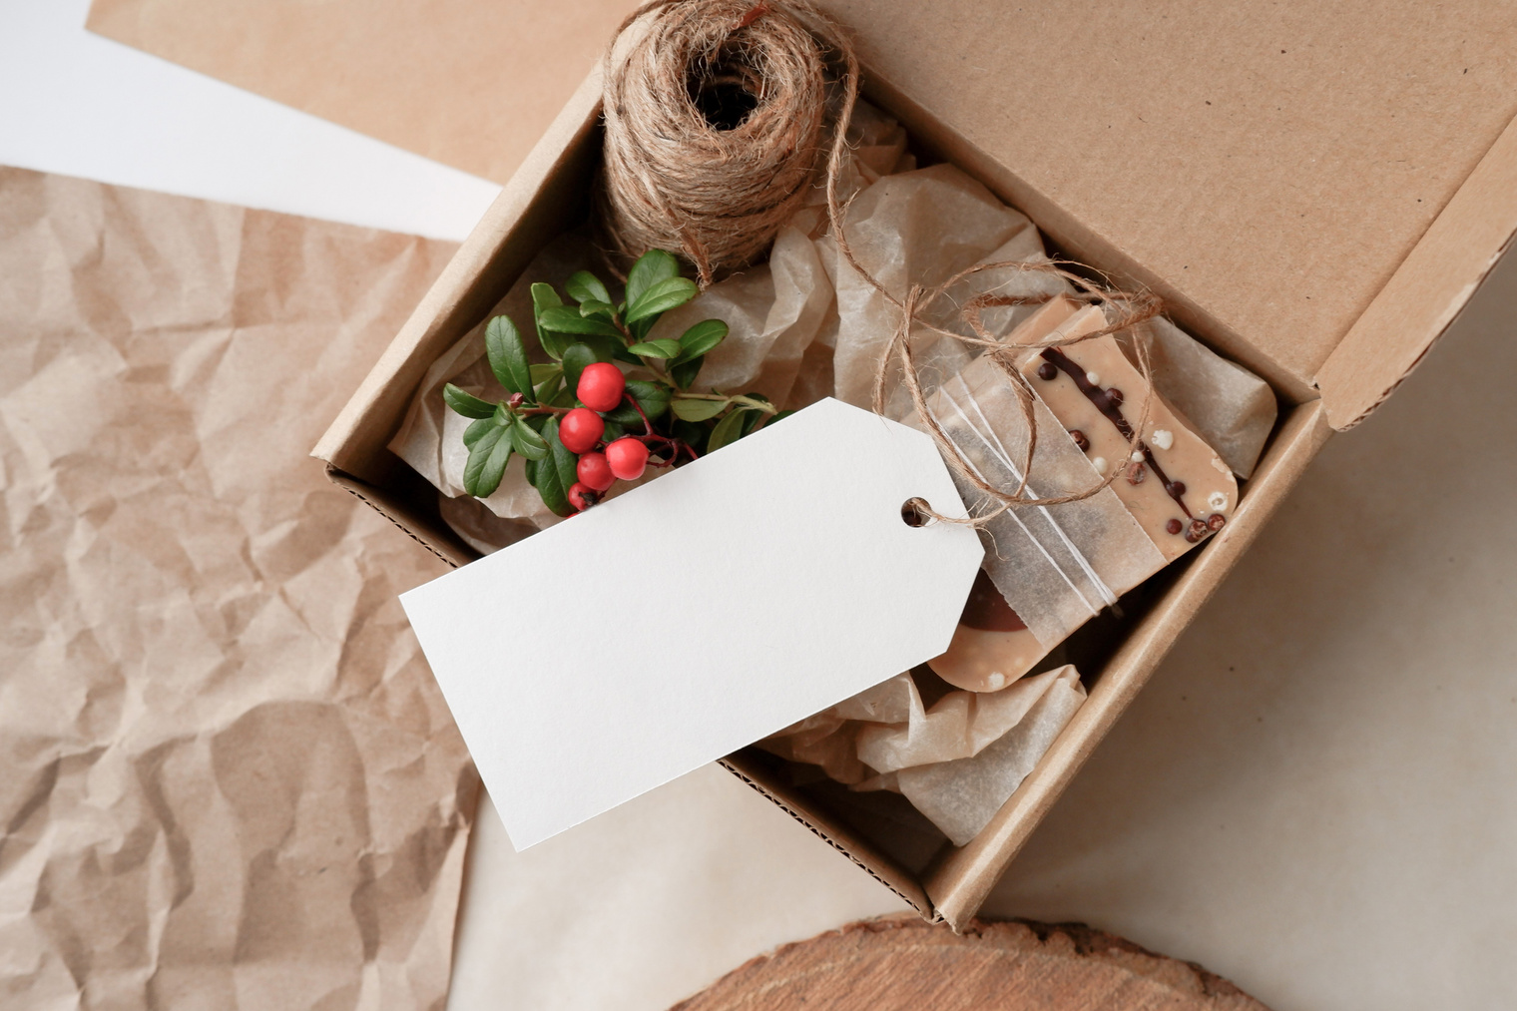
Key Features
🤖 AI-Powered Suggestions .
📚 Step-by-Step DIY Tutorials
🔄 Material Swap
🛒Marketplace

Slide 7
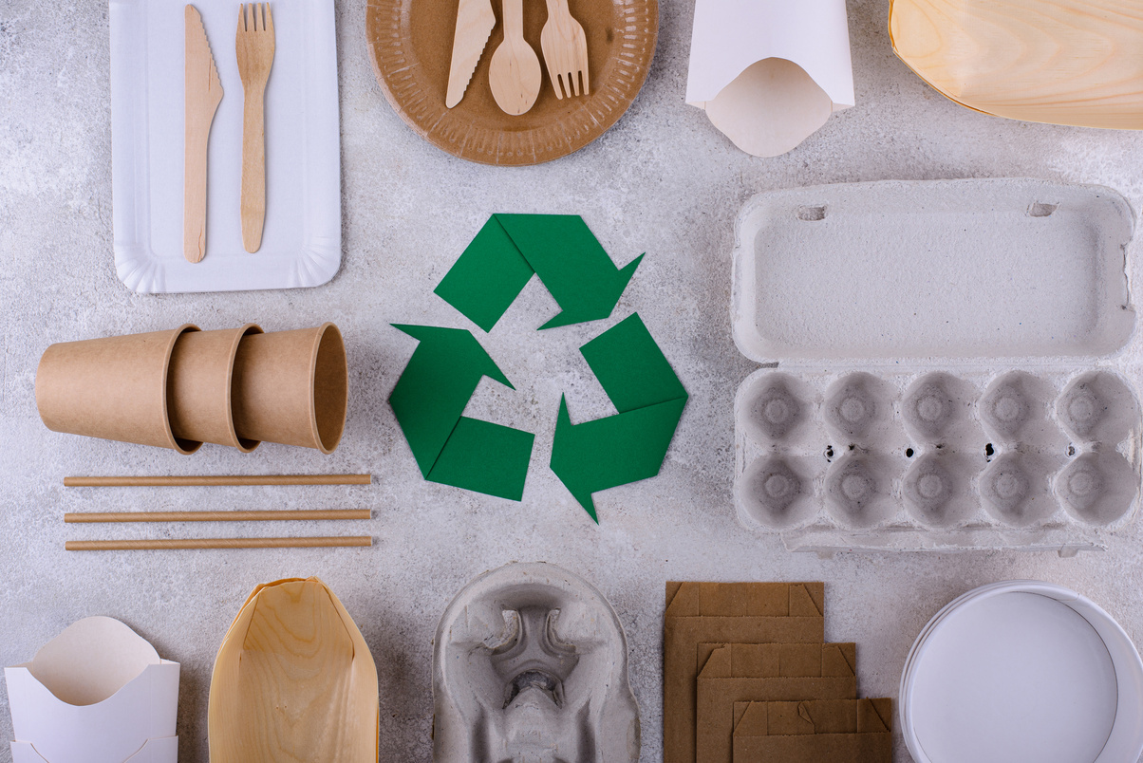

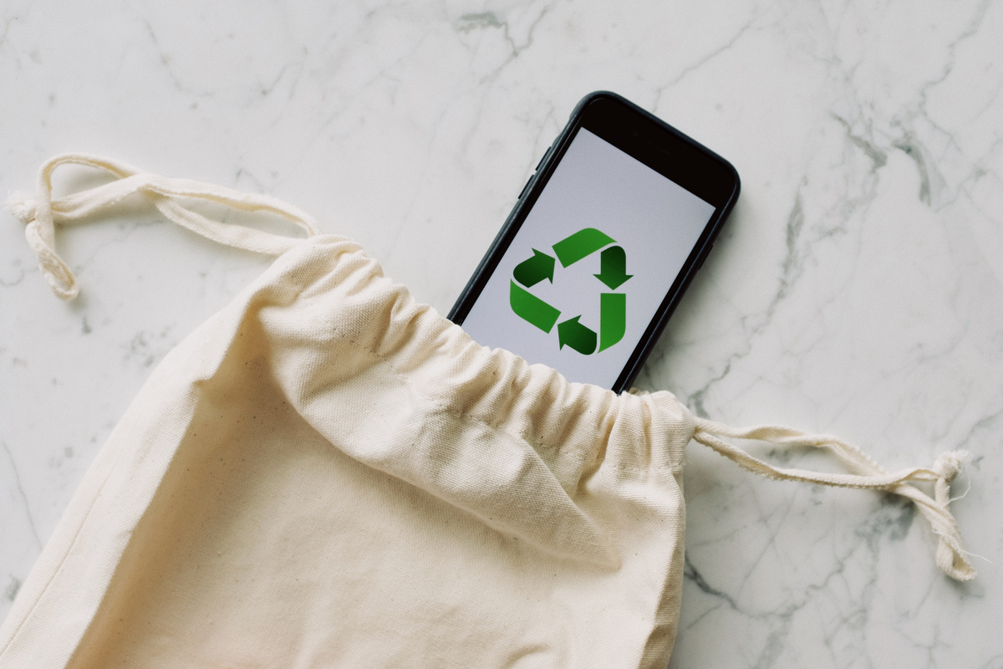
Key Features
🌟 Community Showcase
📍 Recycling Center Locator
💡Personalized Recommendations
♻️ Connect with Eco-Friendly Shops & Partners

Slide 8




Impact of UpCycle
🌱 Encourages Sustainable Consumption
🔄 Supports Circular Economy
🤝 Strengthens Community Engagement
🏪 Supports Local Businesses

Slide 9

Impact of UpCycle
🌍 Promotes Green Shopping
🏪 Empowers Local Eco-Businesses
🔄 Strengthens the Upcycling Movement

Slide 10

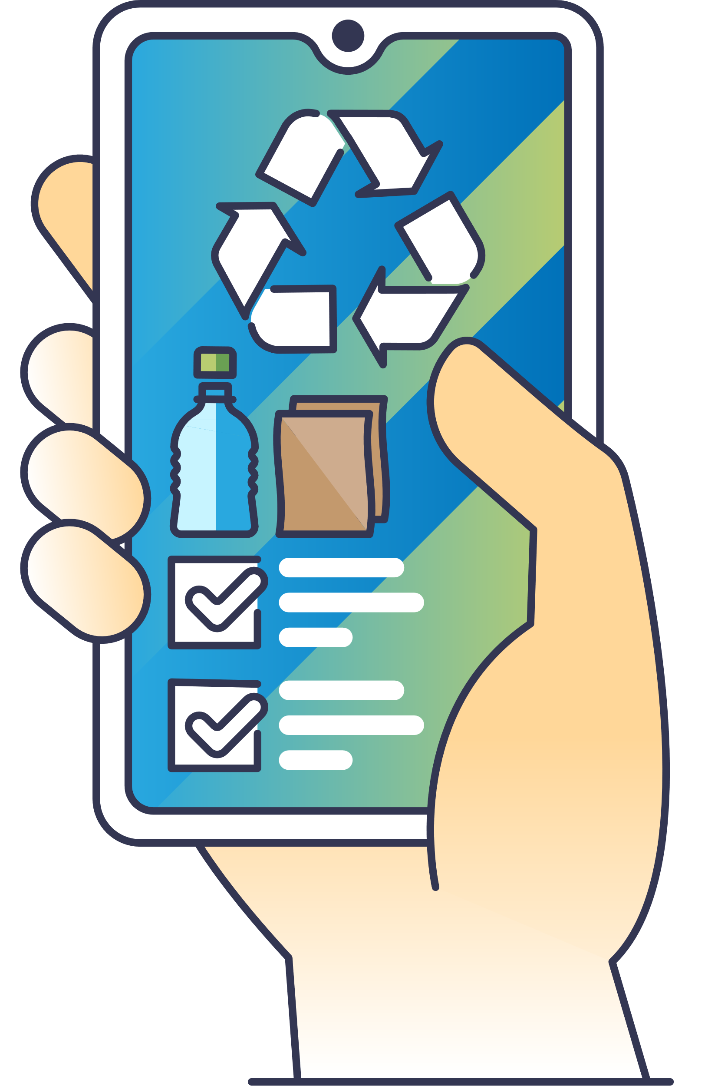

Why UpCycle Matters?
Reduces waste and encourages sustainable living. ♻️
Empowers people with DIY skills and creative solutions. 🎨🔧
Builds a community passionate about eco-friendly practices. 🤝
Bridges the gap between individual action and environmental impact. 🌍

Slide 11




🌿 "Small steps in upcycling can lead to big changes for our planet!" 🌍

