Slide 1

Database-11 assignment
Tithira Withanaarachchi (Batch 4)

Slide 2


Content
ER Diagram
Relational Schema
SQL Statements
Interfaces
Normalization

Slide 3
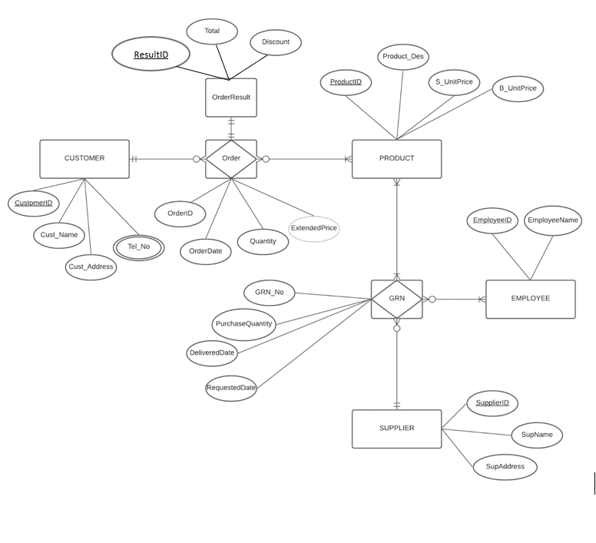
ER Diagram

Slide 4
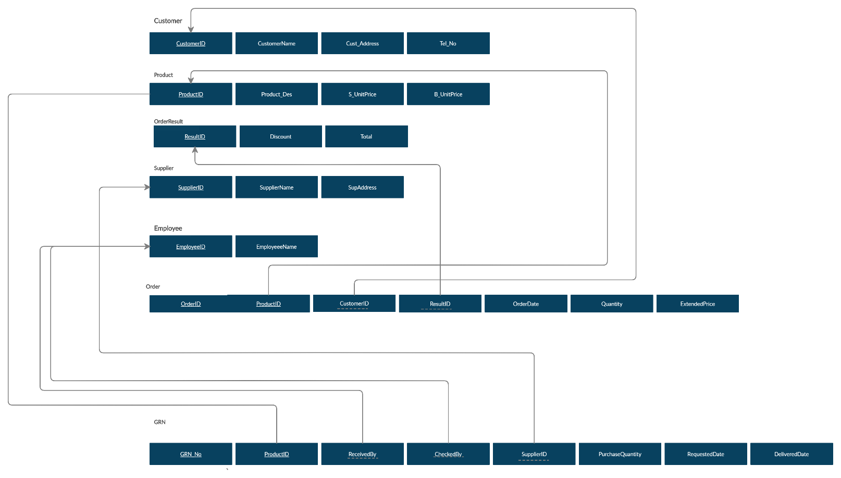
Relational Schema

Slide 5
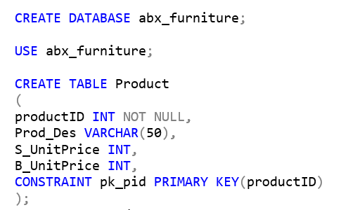
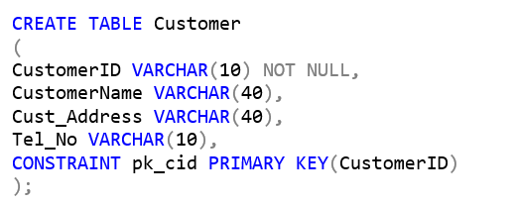
SQL Statements

Slide 6
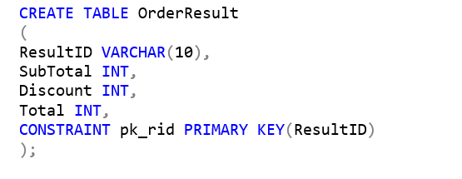
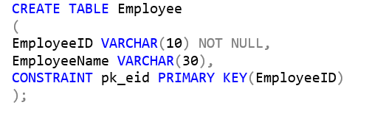
SQL Statements

Slide 7
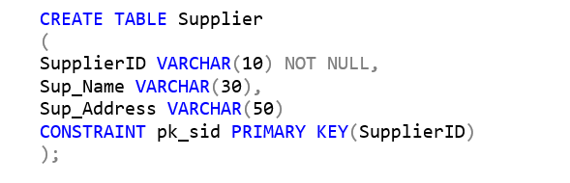
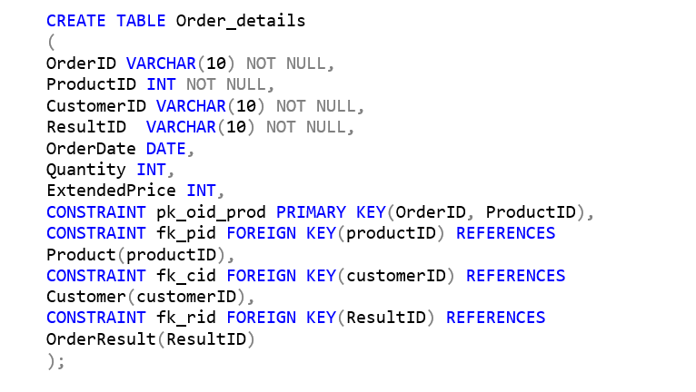
SQL Statements

Slide 8
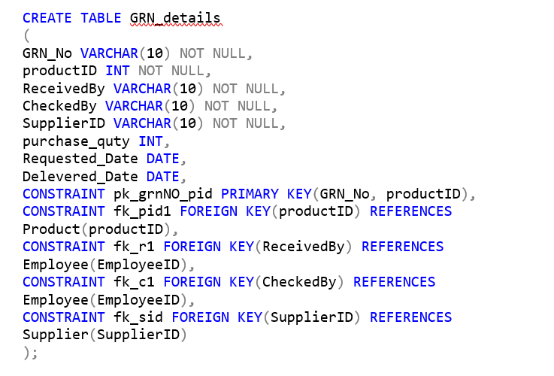
SQL Statements

Slide 9
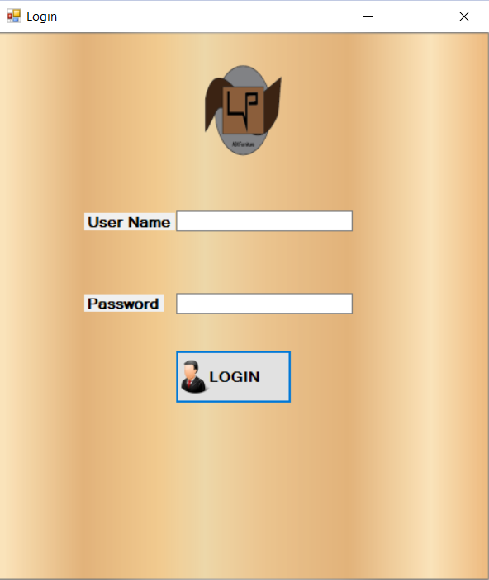
Interfaces – Login

Slide 10
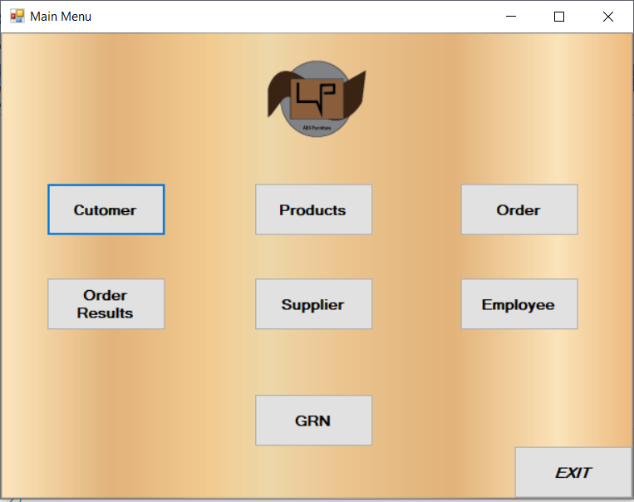
Interfaces – Main Menu

Slide 11
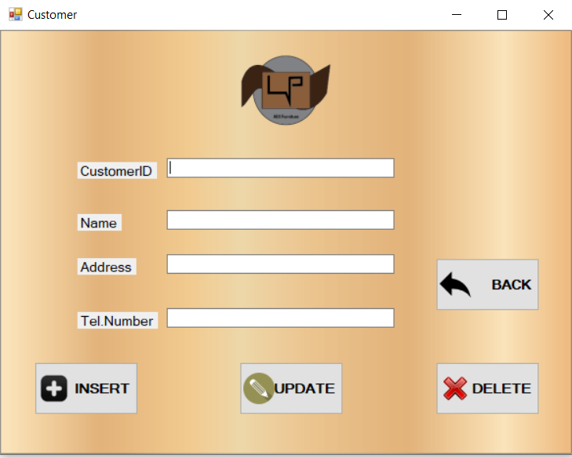
Interfaces- Customer

Slide 12
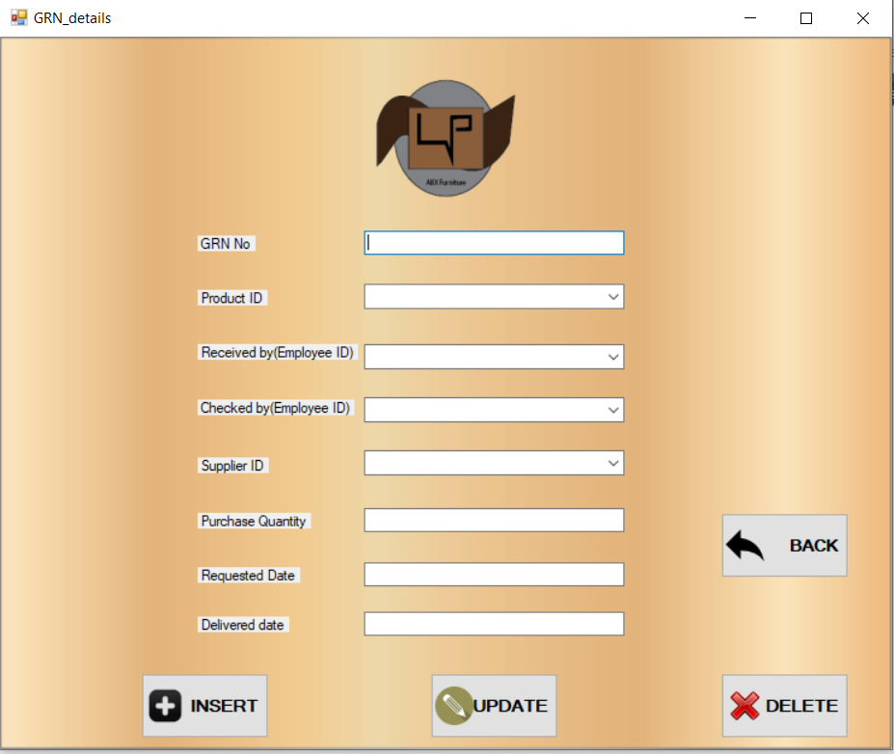
Interfaces- GRN Details

Slide 13
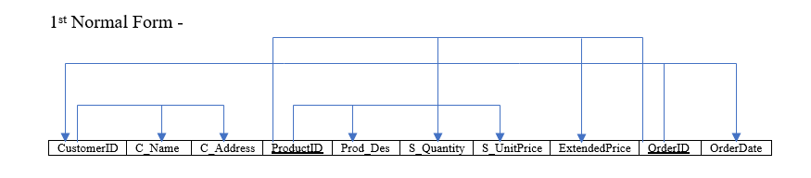
Normalization- Customer Invoice

Slide 14
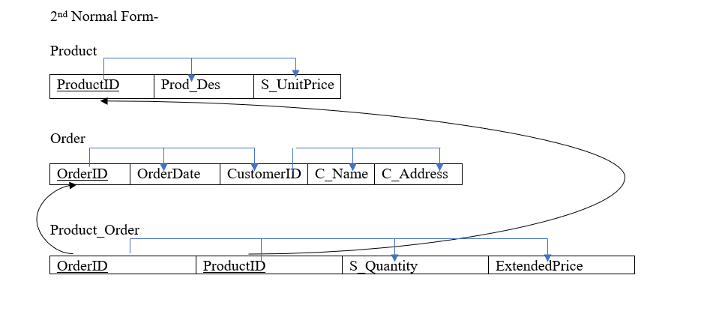
Normalization- Customer Invoice

Slide 15
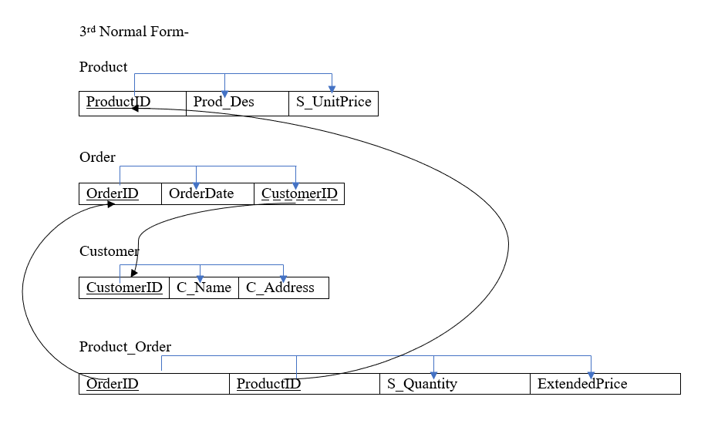
Normalization- Customer Invoice
Since there are no prime attributes which depends on a non-prime attribute, this set of tables satisfies the Boyce Codd Normal form as well.

Slide 16
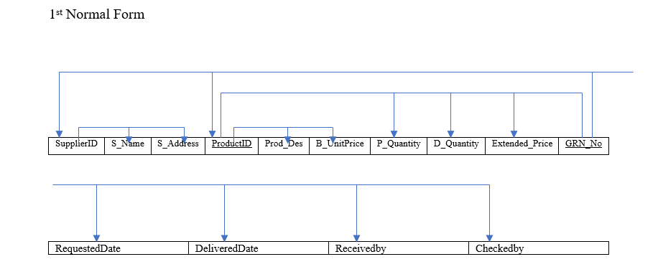
Normalization- GRN

Slide 17
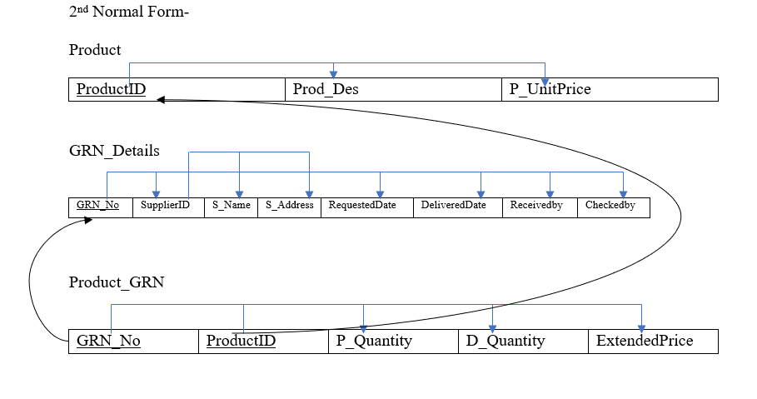
Normalization- GRN

Slide 18
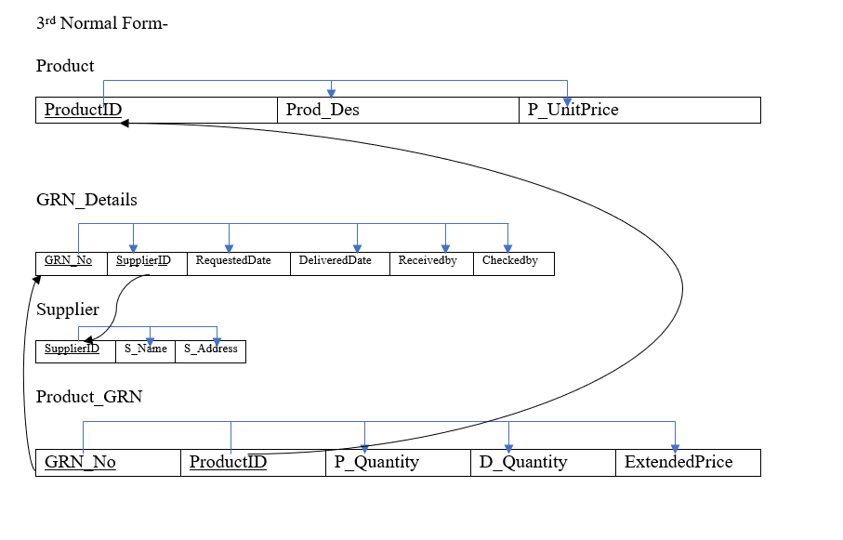
Normalization- GRN
Since there are no prime attributes which depends on a non-prime attribute, this set of tables satisfies the Boyce Codd Normal form as well.

Slide 19

Thank you
Thank You

