Slide 1

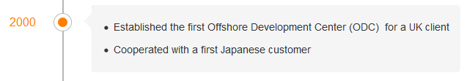

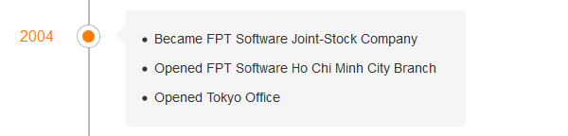
FPT SoftWare History
Notes:
Introduce about fpt-software history.
FPTSoftware was established since 1999 and launched software oursourcing business.
2000: My compary established the first offshore development center for UK client and work with a first Japanese customer.
2001: Worked with IBM company.
2004: My compary opened two branches at Tokyo and HCM

Slide 2
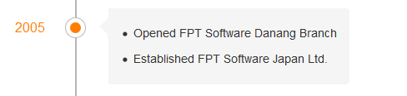


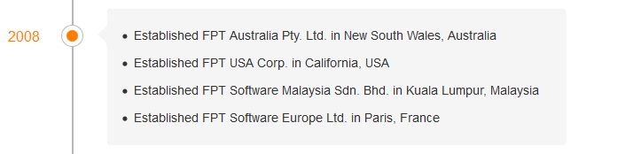
FPT SoftWare History
Notes:
2005: we opened branch at DaNang. So From 1999 to 2005, FPT fsoft-ware opened three braches in VN: HN, DN, HCM.
We worked with Japan customer since 2004 and 2005 we established FPT Software Japan.
2006: We became a Gold Certified Partner of Microsoft.
2007: New department named FPT Software Asia Pacific was opened in Singapore.
2008: FPT Software continued expanding in 4 countries: FPT Australia in in New South Wales, Australia ; FPT USA in California, USA; FPT Software Malaysia in Kuala Lumpur, Malaysia ; FPT Software Europe in Paris, France

Slide 3
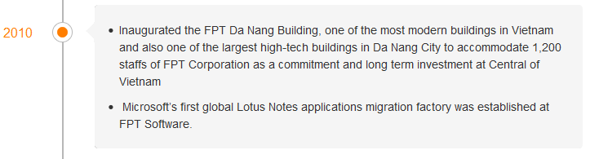
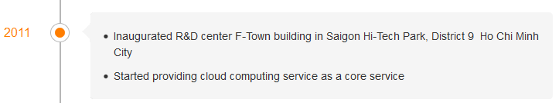

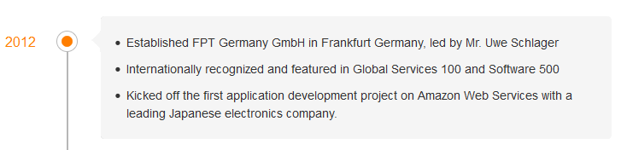
FPT SoftWare History
Notes:
2010: New office was built as one of the most modern buildings in Vietnam and also one of the largest high-tech buildings in Da Nang City to accommodate 1,200 staffs.
- 2011: F-Town building was built in Saigon Hi-Tech Park, District 9 Ho Chi Minh City
FPT Software started providing cloud computing service as a core service
- 2012: FPT Germany GmbH was established in Frankfurt Germany, led by Mr. Uwe Schlager
Internationally recognized and featured in Global Services 100 and Software 500
Kicked off the first application development project on Amazon Web Services with a leading Japanese electronics company.

