Slide 1

DRAFT — FOR INTERNAL REVIEW
An Invitation
to Invest.
SOCIII Inc. · Investor Onboarding Deck · For [Investor Name]
What we’ve built. The numbers. Why we’d like you in this round.
1,000+
8
$99
$0
Workers (state-augmented)
Live Industries
Business in a Box
Outside Capital
sociii.ai · CONFIDENTIAL · SOCIII Inc. (Delaware C-Corp) · May 2026

Slide 2

THE PROBLEM
Regulated Industries
Are Underserved by AI.
✗
✗
✗
Generic AI fails compliance
Professionals can't build
their own tools
Compliance is disconnected
from AI
ChatGPT gives confident answers that violate FAA regulations. A pilot gets wrong approach minima. A nurse gets a dosing error. No one is liable. Everyone is exposed.
A flight nurse with 20 years of expertise has no way to encode her knowledge into something her community can use. That expertise disappears when she retires.
Aviation, healthcare, real estate, legal — real rules with real consequences. No AI platform structurally enforces those rules. They add disclaimers. We enforce rules.
sociii.ai · CONFIDENTIAL · SOCIII Inc. (Delaware C-Corp) · May 2026

Slide 3
THE SOLUTION
RAAS — Rules + AI-as-a-Service
Four-tier compliance architecture baked into every Digital Worker. Aviation, real estate, auto, and banking digital workers live in production today, all RAAS-compliant.
TIER 0
TIER 1
TIER 2
TIER 3
Platform Safety
Industry Regulations
Operator Policies
User Preferences
Universal rules. Violence, PHI, harmful content blocked on every worker. Cannot be overridden by anyone.
Real statutes — FAR/AIM, NCLEX, state RE law, HIPAA, Reg D. Compiled once, immutable. A wrong answer in aviation is a safety issue.
Hospital protocols, dealership SOPs, company operations manuals. Creator-editable. Specific to this operator's deployment.
Individual settings within all tiers above. Pro Tips. Personal context. Subscriber-editable. Makes every worker feel personal.
sociii.ai · CONFIDENTIAL · SOCIII Inc. (Delaware C-Corp) · May 2026

Slide 4
WHAT SOCIII IS
Business in a Box. Starting at $29/month.
Basic Cable + Premium Cable + HBO. The more you use it, the more it's worth — and the more you spend.
Basic Cable — from $29/mo
Premium Cable — add-on
Creator HBO — marketplace
Platform layer. Included for everyone.
3-5 specialized workers per industry.
Domain experts build. Community subscribes.
• Alex Chief of Staff (daily brief, pipeline, investor tracking)
• Aviation: PC12 CoPilot, Flight Planning, Logbook, FRAT
• Any professional builds a worker in one session
• Control Center (revenue, burn, cash position)
• Healthcare: Nursing Assessment, Protocol Advisor
• High school football team in a box
• Accounting (statement ingestion, P&L, invoicing)
• Auto Dealer: F&I Closer, VIN Decode, Deal Desk
• A QB coach builds a worker for student athletes
• HR & People (offers, onboarding, compliance)
• Real Estate: CRE Analyst, Cap Rate, Lease Analyzer
• Creator keeps 75% of subscription revenue
• Marketing & Content (brand voice, social, campaigns)
• Banking: Investor Relations, Reg D Compliance
• SOCIII earns 25% + Data Credits on every session
• Studio Locker + Document Control
• Web3: DAO Governance, Treasury, Token Analytics
• Network effects: more creators → more subscribers
• 1,000 Data Credits/month included
Data Credits run out ~weekly for active users. Alex notifies. End of month Alex recommends bulk purchase. Individual workers $29 / $49 / $79; Business in a Box $99; all workers $299. Average active user spend $99+/mo with compute.
sociii.ai · CONFIDENTIAL · SOCIII Inc. (Delaware C-Corp) · May 2026

Slide 5
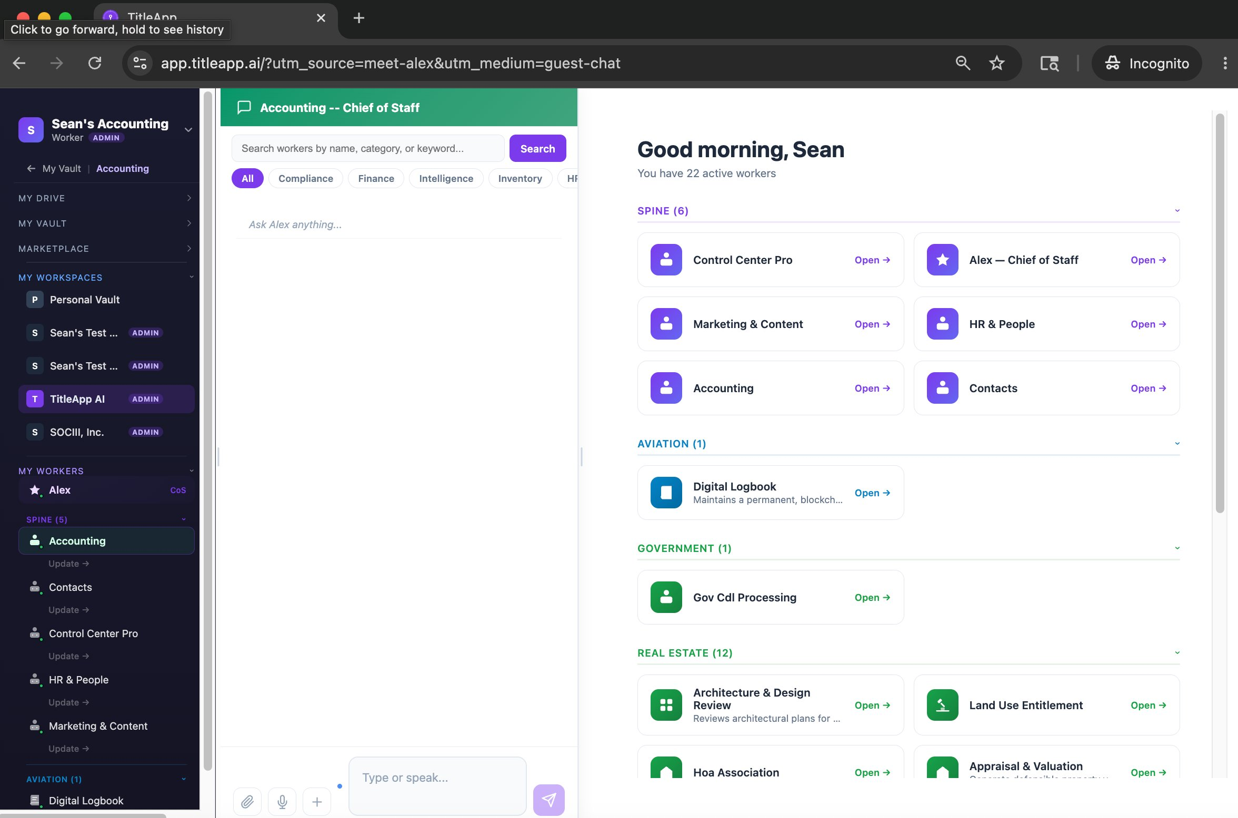
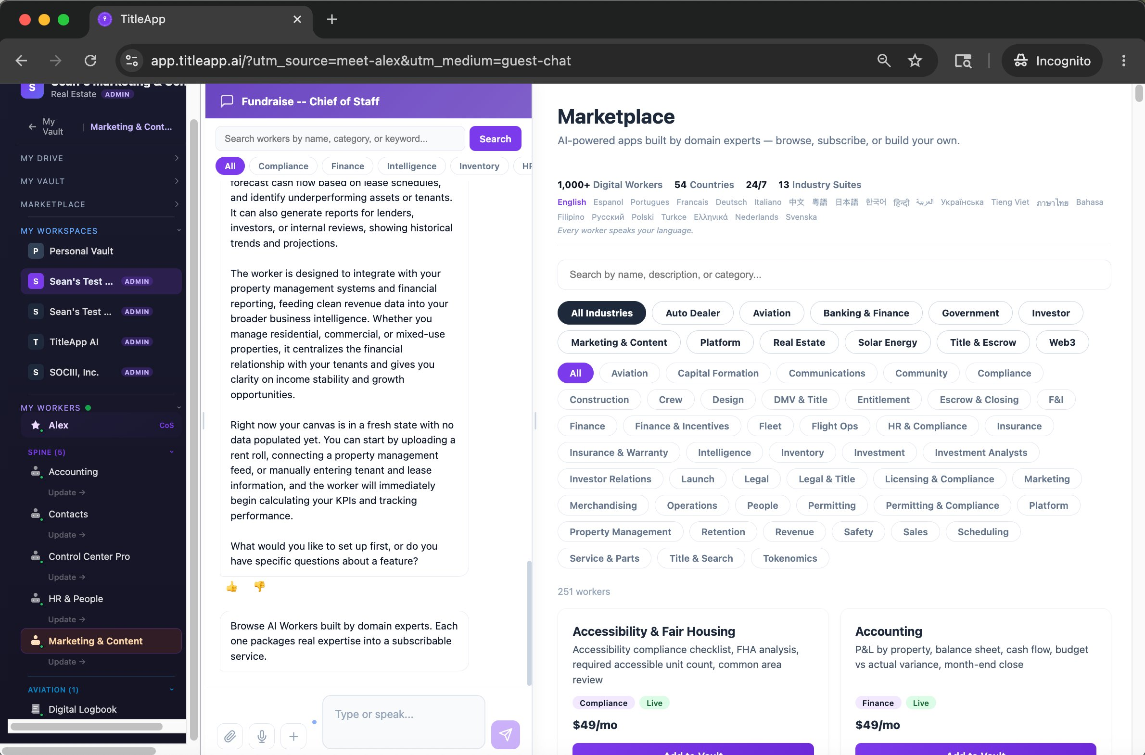
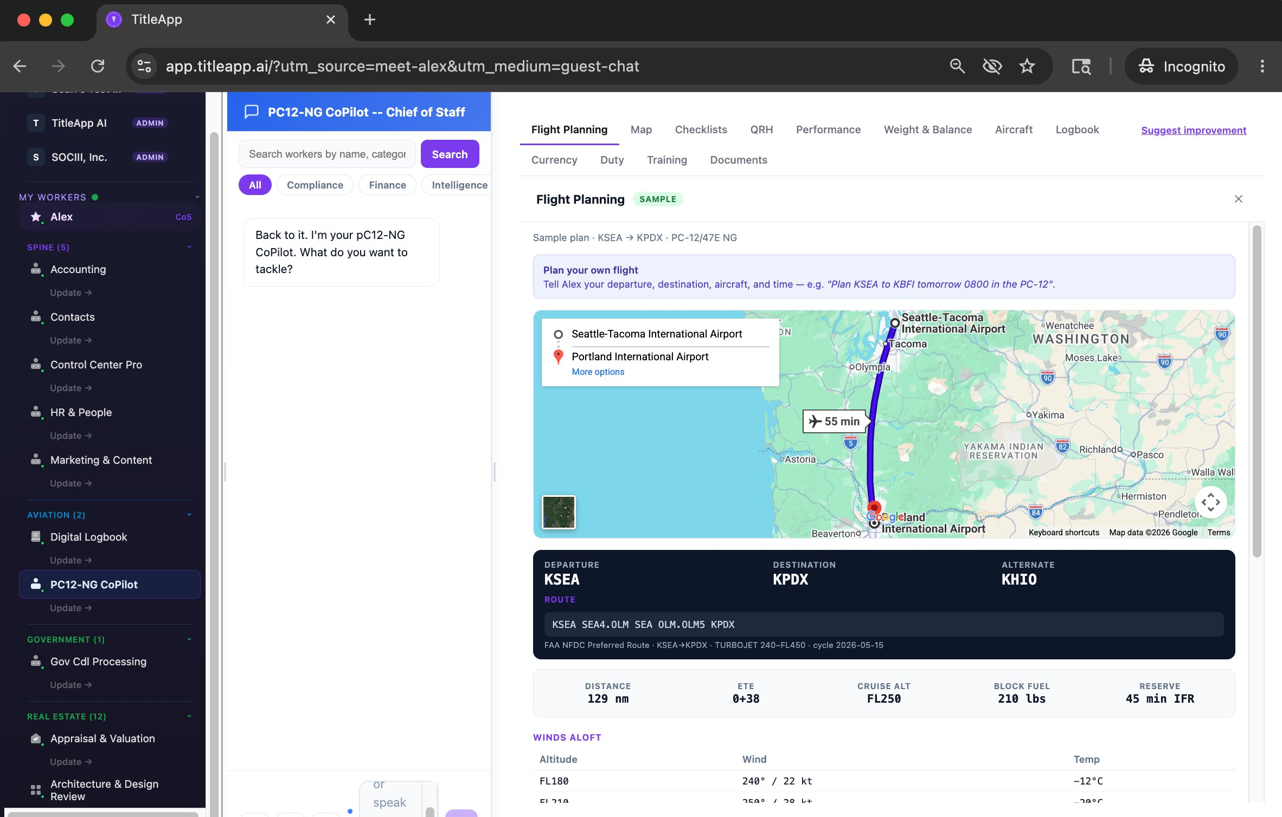
THE PRODUCT — LIVE
Not a mockup. Not a demo.
This runs every day.
Real workspace. Real marketplace. Real worker. Three views of the live product.
Workspace · 22 active workers across 6 categories
Marketplace · 1,000+ workers · 13 industries · 54 countries
PC12-NG CoPilot · Flight planning, sample KSEA→KPDX
Every worker built on the platform is a recurring revenue line we operate. Built once, operated forever, governed for compliance.
sociii.ai · CONFIDENTIAL · SOCIII Inc. (Delaware C-Corp) · May 2026

Slide 6
COMPETITIVE LANDSCAPE
SOCIII Is Not a SaaS Tool.
It's the SaaS Replacement.
OpenClaw
ChatGPT
Harvey AI
Legacy SaaS
SOCIII
Acquired
for Billions
$157B+ company
$3B+
$40-300B
Now
THE SIGNAL
NOT OUR MARKET
VALIDATES THESIS
WE REPLACE THEM
WHERE WE PLAY
Consumer AI. No compliance. Proves the category is real and worth billions.
Brilliant at everything. Accountable for nothing. Cannot move into compliance without rebuilding from scratch.
Vertical AI done right — one industry, deep compliance, massive valuation. Harvey owns legal. We own the rest.
$300+/hr consultants stitching single-purpose tools. SOCIII replaces the entire stack.
RAAS compliance. 1,000+ workers (state-augmented). The Ledger. Studio Locker. Creator economy. Built. Deployed. Running.
sociii.ai · CONFIDENTIAL · SOCIII Inc. (Delaware C-Corp) · May 2026

Slide 7
THE MOAT
Four Interlocking Moats.
Structural compliance + document lock-in + governed creator economy + patented audit trail. Build one and you have a product. Build all four and you have a platform.
01
PATENT PENDING
02
PATENT PENDING
03
04
PATENT PENDING
RAAS
Studio Locker
The Codex
The Ledger
Structural Compliance Architecture
Document-Driven Outputs
Governed Creator Economy
Immutable Blockchain Audit Trail
Four-tier compliance hierarchy built into every output. Competitors can build AI products. They cannot easily replicate a governed compliance layer without rebuilding everything from scratch.
A worker trained on this operator's specific POH, protocols, and policies produces outputs no generic AI can match. Documents compound the moat. Switching cost grows with every file uploaded.
Every worker auto-generates a living record of its rules, connectors, and compliance posture. Transparent. Auditable. Version-controlled. The regulatory paper trail regulators will eventually require.
Patent pending. Every significant output minted on-chain automatically. The only cryptographic proof of what an AI said in a regulated context. Patent pending. First and only filing of its kind.
sociii.ai · CONFIDENTIAL · SOCIII Inc. (Delaware C-Corp) · May 2026

Slide 8
BUSINESS MODEL
Five Revenue Streams.
Three Are Near-100% Margin.
Revenue Stream
Pricing
Margin
Creator Gets
Scales With
Subscription
$29-$99/mo
~75%
75%
Creator + subscriber growth
Data Credits
$0.02/credit
~90%
0%
Usage — Alex upsells bulk purchase
API Pass-Through
2× cost floor
50-85%
75%
Data richness per session
Audit Trail
$0.005/record
~95%
0%
Regulated industry sessions
Creator License
$49/yr
~100%
0%
Total creator population
Free tier gets you in. Data Credits grow with usage. Alex recommends top-ups. Active subscribers average $99+/mo with compute.
sociii.ai · CONFIDENTIAL · SOCIII Inc. (Delaware C-Corp) · May 2026

Slide 9
THE NUMBERS
Three Scenarios. One Model.
All scenarios: $99/mo blended base. Differ only by growth rate and churn. $25K/mo fixed overhead post-raise. Footers reflect a $5M reference raise; the current raise is $1–2M.
WORST
BASE
BEST
5% monthly growth · 5% churn
10% monthly growth · 2% churn
20% monthly growth · 0.5% churn
Month 12:
47 subs · $4,871 MRR
Month 12:
213 subs · $25,087 MRR
Month 12:
987 subs · $151,811 MRR ✓
Month 24:
133 subs · $13,782 MRR
Month 24:
872 subs · $102,724 MRR ✓
Month 24:
9,772 subs · $1.5M MRR
Month 36:
278 subs · $28,809 MRR
Month 36:
2,938 subs · $346,099 MRR
Month 36:
88K subs · $13.5M MRR
$4.1M of raise remaining
$6.5M at M36 — made money
$71M at M36
Series A: needs more traction
Series A trigger: Month 18
Series A: Month 10. Don't need it.
✓ = $150K MRR Series A trigger ($1.8M ARR). Base case hits this at Month 18.
Illustrative model only — not a projection, promise, or forward-looking statement. See Important Notices.
sociii.ai · CONFIDENTIAL · SOCIII Inc. (Delaware C-Corp) · May 2026

Slide 10
TRACTION
Built to Prove the Thesis.
Not to Raise a Round.
1,000+
8
RAAS
$5K
Workers (state-augmented)
8 live industries
Industries Live
Workers in production
Live in production
all industries
Monthly AI burn
Replaces ~25-person dev team
1,000+ workers (state-augmented) shipped on $35K of operating burn in 5 months. RAAS live in production. Alex briefs the team every morning.
Real users: Platform live across 8 industries today. Workers in production. RAAS deployed across aviation, real estate, auto, and banking workers in production today.
Every tool we build for professionals, we use to build SOCIII. The product is the proof.
sociii.ai · CONFIDENTIAL · SOCIII Inc. (Delaware C-Corp) · May 2026

Slide 11
THE FOUNDER’S JOURNEY
Three Chapters.
Why This Time Will Work.
01
HOM DAO (~2022-2024)
Distributed ownership of real-regulated assets. Decentralized governance. 167 contributors put capital, time, and network in.
SOCIII is the third chapter. HOM DAO (2022-2024) built real-estate dApps in a token-distributed structure — and burned $35K every week doing it.
TitleApp LLC (2024-2026) productized the title-search insight, but the LLC structure was wrong for institutional capital. The worker platform that emerged from building it became the real product.
SOCIII Inc. (May 2026) shipped 1,000+ workers (state-augmented) across 8 industries on $35K of operational burn in 5 months — the same dollar figure HOM DAO spent every single week, now stretched across the entire build.
The structural lessons from both prior chapters are baked into this one. Delaware C-corp. Sole-manager governance. Day 0 IP assignment. Ready for the institutional capital the prior structures couldn’t take.
02
TitleApp LLC (~2024-2026)
Productized title search inside a Delaware LLC. The worker platform that emerged became the real product.
03
SOCIII Inc. (2026 →)
Governed AI worker platform. 1,000+ workers live across 8 industries. Delaware C-corp.
SOCIII, Inc. · CONFIDENTIAL · DRAFT — NOT AN OFFER · Contact: alex@sociii.ai · www.sociii.ai

Slide 12
THE TEAM
Not Headcount. An AI Shop.
SOCIII runs on SOCIII. 8 humans set strategy. These are the workers running the company.
HUMANS — 8 (STRATEGY)
WORKERS — RUN THE COMPANY
Sean Combs — Aviation · RE Development · Technology
Spine
Alex (CoS), Marketing, Accounting, HR, Contacts, Control Center
Kent Redwine — BofA · Thomas Weisel · capital markets
Fundraising & Investor Reporting
Fundraise worker, IR, cap table, data room
Scott Eschelman — BuildSF · CA mixed-use developer
Development & Security
Claude Code dev workers + security scanning, $5K/mo replaces ~25-person dev shop
Ruthie Clearwater, PhD — UH Nursing · EMS flight
Creator Community
Onboarding, support, payouts, marketplace ops
Elise van der Bel — EU ecommerce · DPP regulation
Sandbox — No-Code Authoring
Domain experts build workers by conversation
Eric Altshuler — Naval Aviator · FedEx 777 Pilot
Terminal & Open Source
Engineers pair-program with AI, OSS contributions
Kim Bennett — PropertyRadar · RE data pioneer
Patent & IP
Provisional drafting, prior art search, claim management
Robert Rosenberg — Oracle · infra · legal · compliance
+ New workers on demand
Author whatever the day requires
This is not a SaaS platform with ChatGPT bolted on. SOCIII is built on SOCIII. The platform builds the platform. We scale without friction.
sociii.ai · CONFIDENTIAL · SOCIII Inc. (Delaware C-Corp) · May 2026

Slide 13
WHY YOU
Why You, [Investor Name].
Why we want this round to include you specifically. Personalized per lead-investor candidate.
WHAT YOU BRING
WHAT YOU UNLOCK
THE ROUND ROSTER
[Investor Name]
What your check + reputation unlock.
Who else has been invited / is in / leads.
• [Specific thesis fit: e.g., regulated-industry depth]
• Anchor the round as lead investor
• [Lead investor / candidate 1]
• [Governance and operational rigor expectation]
• Open doors to enterprise customers in target industries
• [Follow-on candidate 2]
• [Track record of similar bets at this stage]
• Governance partnership: board observer, quarterly cadence
• [Follow-on candidate 3]
• [Sector network they can open]
• Signal effect: your name draws follow-on capital
• [Strategic angel / candidate 4]
• [Specific portfolio or platform connections]
• Strategic introductions to Series A leads
• [Follow-on candidate 5]
• [Domain expertise relevant to SOCIII industries]
• Honest reporting cadence: monthly + quarterly deep-dives
• [Specialist / angel candidate 6]
Round: $1–2M seed. Pricing TBD with lead. 30% equity pool reserved (advisors + future hires + creator-path). Sole-manager governance through Series A trigger ($150K MRR).
SOCIII, Inc. · CONFIDENTIAL · DRAFT — NOT AN OFFER · Contact: alex@sociii.ai · www.sociii.ai

Slide 14
THE ASK
Raising $1–2M.
Let's Own This Category.
First $250K clears inherited debt obligations. Remaining $1.5-1.75M funds commercial launch, community activation, and 18-month runway. Profitable at month 24 with or without this check.
$250K
Debt Service
$500K
Trade Conferences & Industry Presence
Honors outstanding obligations: Robert Rosenberg ($100K), Chris Dunn ($15K), HOM DAO inherited AP (~$100K). Clears the deck before commercial launch.
Ruthie at NurseCon. Pilots at NBAA. Dealers at NADA. The rooms where professionals gather. We send domain experts, not salespeople.
$500K
Professional Network Activation
$500K
18-Month Runway + Operations
Identify and activate 200+ domain experts across all industries — The Nurse, the pilot, the dealer, the inspector. Each one has a trusted community. Includes connector integrations and specialized industry API access.
$25K/mo overhead × 18 months = $450K. Balance covers legal, accounting, and cap table restructuring. We build with AI, not headcount.
sociii.ai · CONFIDENTIAL · SOCIII Inc. (Delaware C-Corp) · May 2026

Slide 15
CLOSING
If This Is a Round
You Want to Lead…
There’s a link in your email. Click it to schedule the next conversation.
What the Link Does
1
2
3
4
Schedule a 60-minute deep-dive with Sean.
Schedule the Call
Data Room
Term Sheet
Close Fast
We send data room access and the financial model.
60-minute deep-dive. Sean walks the platform, the metrics, the roadmap. Bring your hardest questions.
Full data room access: financial model, cap table, customer letters, product demos, IP filings.
If there is mutual interest, term sheet within a week. Clean structure, sole-manager governance, institutional-friendly.
We close in 30 days from term sheet. Then monthly metrics, quarterly deep-dives, and a board observer seat for the lead.
Or pass on this round — we’ll keep you on the quarterly update list.
— Alex · Chief of Staff · alex@sociii.ai · SOCIII, Inc.
SOCIII, Inc. · CONFIDENTIAL · DRAFT — NOT AN OFFER · Contact: alex@sociii.ai · www.sociii.ai

Slide 16
IMPORTANT NOTICES — READ CAREFULLY
This is not an offer.
This deck is a draft for investor conversations. Formal subscription agreement and security documentation come with full risk factors and disclosures.
Not an offer to sell securities. This presentation describes SOCIII Inc., a Delaware C-corporation, and is provided for discussion with prospective investors. Nothing in this document constitutes an offer or solicitation to buy or sell any securities. Any formal offering of SOCIII securities will be made separately under Reg D 506(b) with full risk factor disclosures and subscription documents to accredited investors only.
No projections. No promises. No forward-looking statements. Any dollar figures, multipliers, subscriber counts, MRR projections, or scenario models in this deck (including all conservative/base/best-case scenarios on slide 11) are illustrative models of how the business could perform under stated assumptions. They are not predictions, promises, or forward-looking statements. Actual results will differ. SOCIII Inc. may succeed or fail. Investment in any SOCIII security may end up worthless.
Investment risk and accreditation. Investment in early-stage private companies is high-risk and illiquid. Securities may have no trading market and may be diluted in future rounds. SOCIII Inc. has not generated significant revenue and may never achieve profitability. Investors must be accredited and will be required to make representations to that effect. Before investing, review the full risk factors and disclosures provided with the formal offering documents and consult your own legal and financial advisors.
Confidential. Do not distribute. This deck is sent in confidence to a specific named investor with whom SOCIII Inc. has a pre-existing relationship. It is not for public distribution, social media, or forwarding outside that conversation.
SOCIII, Inc. · CONFIDENTIAL · DRAFT — NOT AN OFFER · Contact: alex@sociii.ai · www.sociii.ai

Slide 17
APPENDIX · GO-TO-MARKET
20 Years of Clinical
Experience Beats a
20-Year-Old With None.
The professional community is the distribution. Domain expertise is the marketing.
How It Spreads
1
2
3
4
The Nurse demos her worker at NurseCon.
The Nurse
The Room
The Network
The Flywheel
200 nurses pull out their phones.
20 years expertise. One afternoon. Worker published.
200 professionals watch it work. They share it. Their networks share it.
Followers build their own workers. Faculty build curriculum tools. The community grows itself.
10 experts per industry. 8 live industries. Network effects compound.
They post. Their networks see it.
By midnight, nurses across the country
are building workers for their units,
their students, their communities.
This kind of community-led adoption can’t be bought. It compounds when it’s earned.
This is how Harvey AI grew. This is how Figma grew. Community-led, expert-seeded, network-compounded.
sociii.ai · CONFIDENTIAL · SOCIII Inc. (Delaware C-Corp) · May 2026

Slide 18
APPENDIX · TECH STACK
Built on AI, Not Headcount.
1,000+ workers (state-augmented) shipped on $35K of operating burn in 5 months. Lead developer: Anthropic Claude.
LAYER 1
LAYER 2
LAYER 3
LAYER 4
AI Executors
Productivity & Identity
Platform Backbone
Commerce, Data & Distribution
Anthropic Claude (lead developer + chat executor). OpenAI GPT (alternate + embeddings). Rules engine validates output. No vendor lock-in.
Google Workspace (Drive, Calendar, Gmail, OAuth). Stripe Identity for KYC. Dropbox Sign for e-signature.
Firebase (Auth, Firestore, Functions, Storage). Cloudflare Workers for edge. Sentry for observability.
Stripe for billing + Connect payouts. Crossmint for blockchain anchor. Apollo, SendGrid, Twilio for distribution. GA4 for analytics.
sociii.ai · CONFIDENTIAL · SOCIII Inc. (Delaware C-Corp) · May 2026

