Slide 1

Digital Workers,
governed by design.
Investor Memorandum
Where SOCIII actually stands today — corrected and source-verified.
RAAS
4 Verticals
24 Industries
Open-SDK
The moat generic AI can’t copy
Real product, demo-verified
Not a single-vertical bet
The catalog grows itself
sociii.ai · CONFIDENTIAL · SOCIII Inc. (Delaware C-Corp) · Sep 2026

Slide 2

THE PROBLEM
Regulated Industries
Are Underserved by AI.
✗
✗
✗
Generic AI fails compliance
Professionals can't build
their own tools
Compliance is disconnected
from AI
ChatGPT gives confident answers that violate FAA regulations. A pilot gets wrong approach minima. A nurse gets a dosing error. No one is liable. Everyone is exposed.
A flight nurse with 20 years of expertise has no way to encode her knowledge into something her community can use. That expertise disappears when she retires.
FAA Part 135/91, state nursing boards, county-recording statutes, the EU Battery Regulation — real rules, not AI hype. No platform structurally enforces them. We enforce rules.
sociii.ai · CONFIDENTIAL · SOCIII Inc. (Delaware C-Corp) · Sep 2026

Slide 3
WHAT SOCIII IS
Digital Workers, Three Ways In.
Built because a real regulation or license requires it — priced three ways to fit how you use it.
Back-Office — Free
Single Worker — $29/mo
Business in a Box
Standalone, or bundled free with any paid worker.
One specialized worker — back-office included free.
$99/mo + $5/seat — the full program for your team.
• Alex Chief of Staff (daily brief, pipeline, investor tracking)
• Aviation: PC12 CoPilot, Flight Planning, Logbook, FRAT
• Multiple specialized workers across your team
• Control Center (revenue, burn, cash position)
• Healthcare: Nursing Assessment, Protocol Advisor
• Per-seat pricing scales with headcount
• Accounting (statement ingestion, P&L, invoicing)
• Auto Dealer: F&I Closer, VIN Decode, Deal Desk
• Back-office suite included free
• HR & People (offers, onboarding, compliance)
• Real Estate: CRE Analyst, Cap Rate, Lease Analyzer
• Same governed RAAS rules engine
• Marketing & Content (brand voice, social, campaigns)
• Banking: Investor Relations, Reg D Compliance
• Studio Locker + Document Control
• Web3: DAO Governance, Treasury, Token Analytics
All tiers run on the same governed RAAS rules engine. See Business Model for the creator-marketplace revenue split.
sociii.ai · CONFIDENTIAL · SOCIII Inc. (Delaware C-Corp) · Sep 2026

Slide 4
THE CREATOR ECONOMY
The Flywheel
Compounds:
More Experts, More Workers.
The person who knows the job builds the tool — not a software engineer guessing at a domain they've never worked in.
How It Compounds
1
2
3
4
A domain expert builds and publishes a
The Creator
The Income
The Network
The Flywheel
Digital Worker, then earns real income every
A domain expert builds and publishes a Digital Worker to the marketplace.
They earn real income every time someone subscribes to or uses that worker.
More published workers means more reason for the next expert to become a creator.
More creators, a deeper catalog, more revenue flowing back to creators.
time someone subscribes to or uses it.
More workers published means more reason for the next expert to join — the flywheel compounds.
The thesis, not yet proven at scale — today's catalog is built mainly by our own team and advisors.
sociii.ai · CONFIDENTIAL · SOCIII Inc. (Delaware C-Corp) · Sep 2026

Slide 5
THE MOAT
Two Core Moats. Two Compounders.
The two core moats: governed compliance (RAAS) and an immutable audit trail (The Ledger). Document lock-in and the creator economy compound around them.
01
PATENT PENDING
02
PATENT PENDING
03
04
PATENT PENDING
RAAS
Studio Locker
The Codex
The Ledger
Structural Compliance Architecture
Document-Driven Outputs
Governed Creator Economy
Immutable Blockchain Audit Trail
Four-tier compliance hierarchy built into every output. Competitors can build AI products. They cannot easily replicate a governed compliance layer without rebuilding everything from scratch.
A worker trained on this operator's specific POH, protocols, and policies produces outputs no generic AI can match. Documents compound the moat. Switching cost grows with every file uploaded.
Every worker auto-generates a living record of its rules, connectors, and compliance posture. Transparent. Auditable. Version-controlled. The regulatory paper trail regulators will eventually require.
Patent pending. Every significant output minted on-chain automatically. The only cryptographic proof of what an AI said in a regulated context. Patent pending. First and only filing of its kind.
sociii.ai · CONFIDENTIAL · SOCIII Inc. (Delaware C-Corp) · Sep 2026

Slide 6
COMPETITIVE LANDSCAPE
Three Alternatives. None Combine This.
None of them pair governed compliance with a provable audit trail, built by the people who do the job.
Horizontal AI
Vertical AI
Vertical SaaS Incumbents
ChatGPT, Copilot, NanoClaw, LangChain/AutoGen — general-purpose assistants and agent-building frameworks.
Harvey AI and similar AI-native tools built for one regulated profession (e.g. legal).
ForeFlight, Jeppesen, legacy nursing-ed and title platforms.
• Broad, general-purpose reasoning or agent-building frameworks
• Deep AI-native reasoning in one profession
• Deep in one workflow, one industry
• No domain-specific compliance built in
• Built by AI-first teams, not domain-expert creators
• Little to no AI-native reasoning
• No audit trail of what was said or why
• No creator economy — the vendor builds every tool
• Closed, vendor-built — no creator economy
• Built by engineers, not domain experts
• A real, proven vertical-AI category — Harvey is the closest single comp to SOCIII’s positioning
• Real incumbents, real switching cost
• Fast to adopt, hard to hold accountable
Our claim: nobody we’re aware of combines RAAS, The Ledger, and domain-expert-built workers. If that changes, this slide changes.
sociii.ai · CONFIDENTIAL · SOCIII Inc. (Delaware C-Corp) · Sep 2026

Slide 7
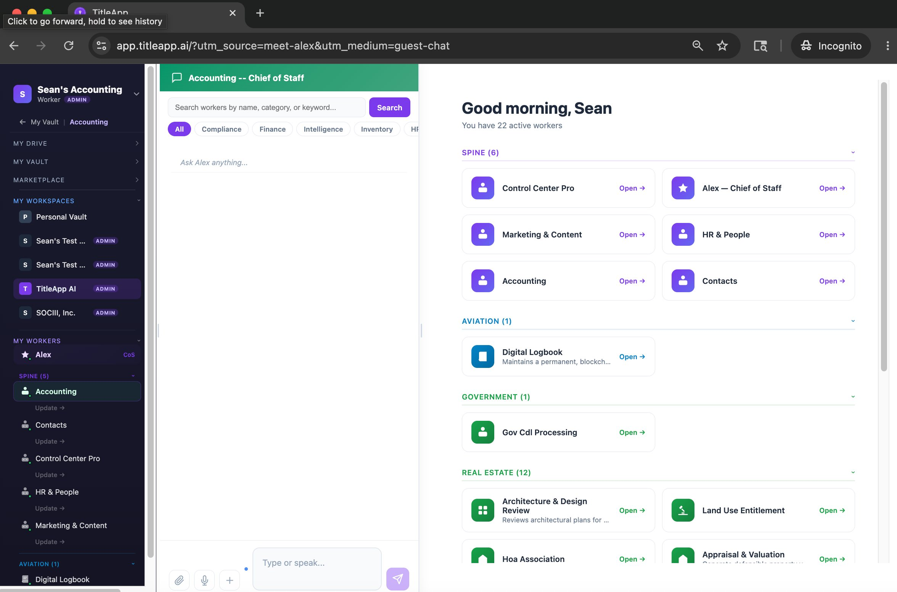
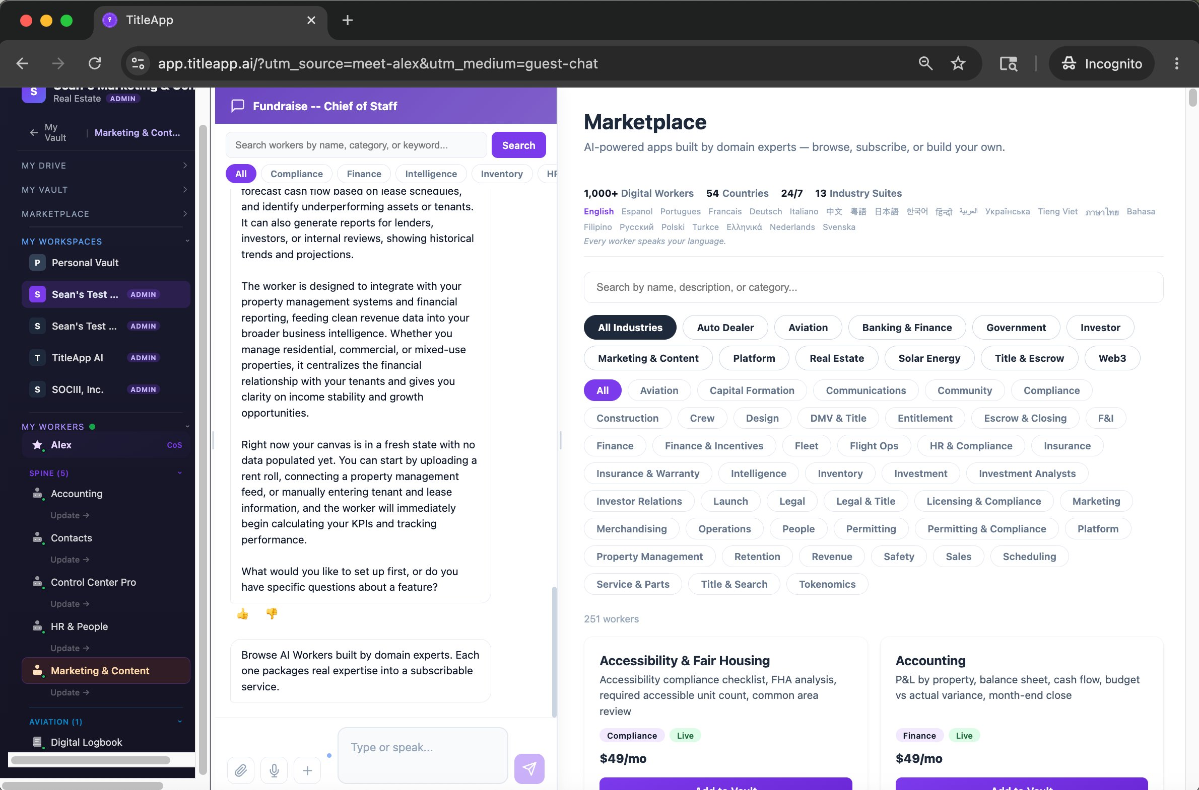
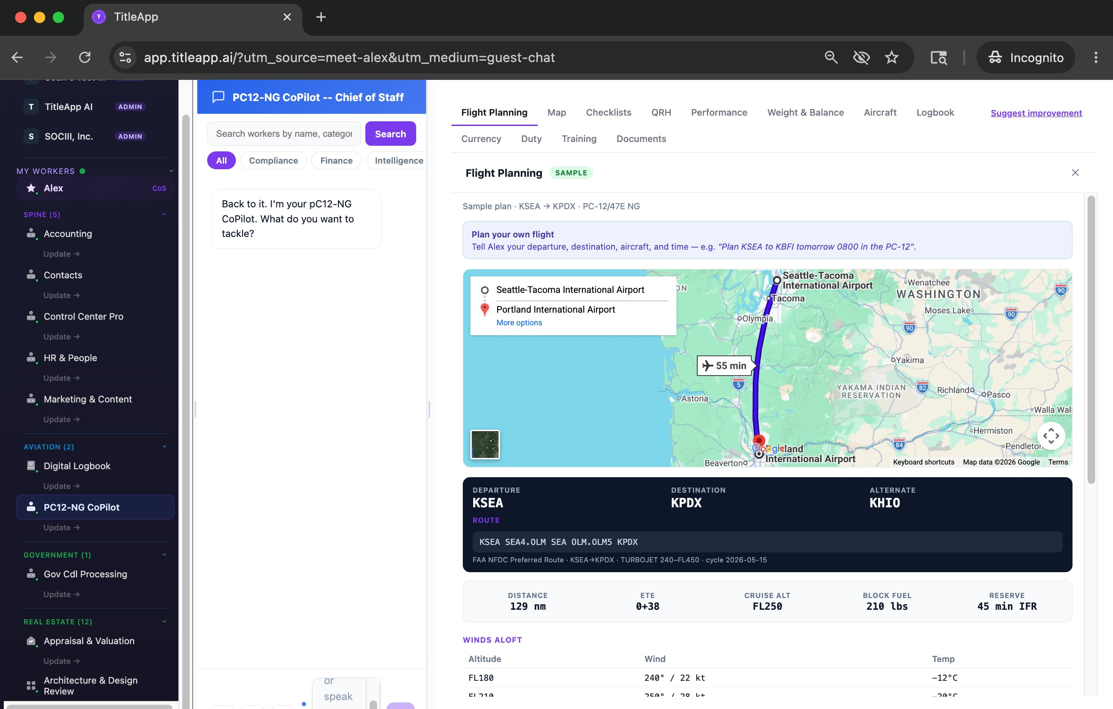
PRODUCT ROADMAP
Built to work
with the human.
No onboarding, no consultants, no dashboards — just talk to it.
TODAY: JUST TALK TO IT
No integration project. No consultants to hire. No dashboard to learn. A person talks, the worker listens, reasons, and acts — governed by the same RAAS rules engine as every other worker, from day one.
NEXT: WEARABLES + NATIVE APPS
IN DEVELOPMENT — NOT AVAILABLE NOW
RealWear Navigator 500 hands-free hardware
The same conversation, hands-free: a mechanic under an aircraft, a nurse mid-exam — they talk, the worker listens and logs, governed by the same RAAS rules engine. Target workflows: Aviation MX and Nursing charting. Ordering the hardware now, priced at retail for the client — not shipped, not promised for a date. iOS/Android native apps are also in development, not yet published.
sociii.ai · CONFIDENTIAL · SOCIII Inc. (Delaware C-Corp) · Sep 2026

Slide 8
BUSINESS MODEL
Five Revenue Streams.
Three Are Near-100% Margin.
Revenue Stream
Pricing
Margin
Creator Gets
Scales With
Subscription
$29-$99/mo
~75%
75%
Creator + subscriber growth
Data Credits
$0.02/credit
~90%
0%
Usage — Alex upsells bulk purchase
API Pass-Through
2× cost floor
50-85%
75%
Data richness per session
Audit Trail
$0.005/record
~95%
0%
Regulated industry sessions
Creator License
$49/yr
~100%
0%
Total creator population
Free tier gets you in. Data Credits grow with usage. Alex recommends top-ups. Active subscribers average $99+/mo with compute.
sociii.ai · CONFIDENTIAL · SOCIII Inc. (Delaware C-Corp) · May 2026

Slide 9
MARKET CONTEXT
Where Seed-Stage AI Is Actually Pricing.
External, third-party data — not our own model. Shown here to ground round-sizing, not to project our own outcome.
$7.6–7.7M
$17.9M
+42%
US pre-seed median pre-money, Q1 2026
AI-specific seed median pre-money (vs. ~$14–16M general B2B SaaS)
AI seed rounds price above non-AI SaaS, on average
Source: Carta 2026 seed-stage data, via Pitchwise/Value Add VC reporting. An internal management-estimate valuation memo ($3–8M pre-money, cost- and comparable-based) exists as supplementary internal analysis and is available on request — the sourced external figures above lead this deck.
sociii.ai · CONFIDENTIAL · SOCIII Inc. (Delaware C-Corp) · Sep 2026

Slide 10
WHERE WE ARE
Pre-revenue, real product,
real governance.
345
4
Univ. of Hawaii
Traitly
workers in the catalog
across 24 industries
live verticals
demo-verified today
Nursing education
live partnership
EU DPP compliance
status TBD
Everything here is stated the way we'd want a CPA to say it — sourced, dated, and corrected where the old numbers didn't hold up.
345 is the real, code-verified catalog count. Four verticals carry a live product today — each adopted because a real regulation forced it: Aviation (FAA Part 135/91), Nursing Ed (state licensure, with Ruthie Clearwater/UH), Real Estate (county-recording statutes), DPP (EU Battery Regulation). Plus the back-office suite every workspace runs on.
See the four live verticals yourself: sociii.ai/demo/skye · /demo/nursing · /demo/title · /demo/dpp
The open-SDK architecture means the catalog keeps growing as outside creators publish workers too — it isn't only SOCIII's own team building it.
sociii.ai · CONFIDENTIAL · SOCIII Inc. (Delaware C-Corp) · Sep 2026

Slide 11
SOURCES & USES
What The Capital Does.
$500K minimum viable close (1.2yr runway) — $2M base target (2.9yr runway) + $200 existing cash. Open to $5M+ strategic capital.
$140,017.88
Debt Service
$500K
Trade Conferences & Industry Presence
All four outstanding notes, bank-verified. Clears the balance sheet before scaling into regulated compliance work.
Funds the Q4 2026 Aviation and Title/RE B2B pilot push — planned experimentation, no existing sales signal yet in either vertical (see What’s Next).
$500K
Professional Network Activation
$859,982
Runway + Operations (~34 mo)
Same Q4 push as conference spend — direct outreach into Aviation and Title/RE. Not blended with the UH partnership or Traitly engagement.
At $25K/mo fixed overhead, ~34 months of runway at the $2M base raise. Also binds cyber/tech E&O insurance (TBD), deferred until funded.
sociii.ai · CONFIDENTIAL · SOCIII Inc. (Delaware C-Corp) · Sep 2026

Slide 12
THE TEAM
The Team & Advisors, Named.
Real people, real status — where each relationship actually stands today.
PEOPLE & VERTICALS
STATUS & REAL OUTCOME
Sean Lee Combs — Founder & CEO
Sole full-time operator
Product + platform architecture
Ruthie Clearwater — Advisor · Nursing Education
Live — Real partnership
University of Hawaii Nursing School
Elise van der Bel — Advisor · EU Compliance
Live — engagement structure TBD
Traitly, DPP EU — revenue vs. validation status unconfirmed
Mike Lee — Title and Mortgage Lending
Early stage
Compliance vertical concept — scoping, build not yet started
Scott Eschelman — BuildSF, Pilot Program
In progress
Mixed-use development pilot in progress — details to follow.
Kent Redwine — Fundraising
Cofounder
Manages investor relations and fundraising strategy
Every relationship above is named and current as of this report — no aggregate headcount claims, no undisclosed status.
sociii.ai · CONFIDENTIAL · SOCIII Inc. (Delaware C-Corp) · Sep 2026

Slide 13
WHY THIS IS FOR YOU
Why This Is For You.
What we’re looking for, what a lead unlocks, and how we work.
WHO WE’RE LOOKING FOR
WHAT YOU UNLOCK
HOW WE WORK TOGETHER
Not a personalized pitch — general criteria
What your check + reputation unlock.
Direct access, honest numbers, your pace.
• Experience in a regulated industry
• Anchor the round as lead investor
• Direct access to Sean — no layers
• Comfort with early-stage, single-operator governance
• Open doors to enterprise customers in target industries
• Numbers sourced and dated, corrected when wrong
• Conviction in vertical AI + governed compliance as a category
• Governance partnership: board observer, quarterly cadence
• No inflated claims — see this whole memo
• A network into our four live verticals
• Signal effect: your name draws follow-on capital
• You set the pace of diligence
• Patience for honest, unglamorous reporting
• Strategic introductions to Series A leads
• Honest reporting cadence: monthly + quarterly deep-dives
See Sources & Uses for the raise structure and deal terms.
SOCIII, Inc. · CONFIDENTIAL · INVESTOR MEMO · Contact: sean@sociii.ai · www.sociii.ai

Slide 14
NEXT STEPS
Let’s Talk.
Raising $1–2M to convert catalog breadth — 345 workers, 24 industries — into deployed, revenue-generating verticals.
TALK TO SEAN
SEE THE PLATFORM
sean@sociii.ai
sociii.ai
Founder & CEO, sole operator. Every number in this memo is sourced and dated — happy to walk through any of it directly.
The catalog, the live verticals, the work — see what 345 workers across 24 industries actually looks like.
Sean Lee Combs · Founder & CEO · SOCIII, Inc.
SOCIII, Inc. · CONFIDENTIAL · INVESTOR MEMO · Contact: sean@sociii.ai · www.sociii.ai

Slide 15
APPENDIX · TECH STACK
The Tech Stack.
What the platform actually runs on — four layers, no vendor lock-in on the reasoning layer. Lead developer: Anthropic Claude.
LAYER 1
LAYER 2
LAYER 3
LAYER 4
AI Executors
Productivity & Identity
Platform Backbone
Commerce, Data & Distribution
Anthropic Claude (lead developer + chat executor). OpenAI GPT (alternate + embeddings). Rules engine validates output. No vendor lock-in.
Google Workspace (Drive, Calendar, Gmail, OAuth). Stripe Identity for KYC. Dropbox Sign for e-signature.
Firebase (Auth, Firestore, Functions, Storage). Cloudflare Workers for edge. Sentry for observability.
Stripe for billing + Connect payouts. Crossmint for blockchain anchor. Apollo, SendGrid, Twilio for distribution. GA4 for analytics.
sociii.ai · CONFIDENTIAL · SOCIII Inc. (Delaware C-Corp) · Sep 2026

Slide 16
APPENDIX · FINANCIAL SUMMARY
The Numbers, Condensed.
Illustrative model only — not a projection, promise, or forward-looking statement. Worst = $500K minimum close; Base = $2M base raise. Full model with Best case in the Data Room.
MONTH 12 MRR
MONTH 24 MRR
MONTH 36 MRR
SERIES A TRIGGER
Worst: $4.9K
Base: $25.1K
Worst: $13.8K
Base: $102.7K
Worst: $28.8K
Base: $346.1K
Worst: Month 36
Base: Month 18
sociii.ai · CONFIDENTIAL · SOCIII Inc. (Delaware C-Corp) · Sep 2026

Slide 17
DISCLAIMER
Disclaimer.
This is an investor memorandum, not a securities offer. Formal subscription agreement and security documentation, with full risk factors, come separately.
Not an offer to sell securities. This presentation describes SOCIII Inc., a Delaware C-corporation, and is provided for discussion with prospective investors. Nothing in this document constitutes an offer or solicitation to buy or sell any securities. Any formal offering of SOCIII securities will be made separately under Reg D 506(b) with full risk factor disclosures and subscription documents to accredited investors only.
No projections. No promises. No forward-looking statements. Any dollar figures, subscriber counts, or market data in this deck are historical, sourced, or illustrative context, not predictions, promises, or forward-looking statements. Actual results will differ. SOCIII Inc. may succeed or fail. Investment in any SOCIII security may end up worthless.
Investment risk and accreditation. Investment in early-stage private companies is high-risk and illiquid. Securities may have no trading market and may be diluted in future rounds. SOCIII Inc. has not generated significant revenue and may never achieve profitability. Investors must be accredited and will be required to make representations to that effect. Before investing, review the full risk factors and disclosures provided with the formal offering documents and consult your own legal and financial advisors.
Confidential. Do not distribute. This deck is sent in confidence to a named prospective investor with whom SOCIII Inc. has a pre-existing relationship. It is not for public distribution, social media, or forwarding outside that conversation.
SOCIII, Inc. · CONFIDENTIAL · INVESTOR MEMO · Contact: sean@sociii.ai · www.sociii.ai

