Slide 1

Statistical Measure of Similarity between Protein 3-D Structures
A Project Submitted in Partial Fulfillment of the Requirements for the Course: Information Storage and Retrieval
Project URL: https://github.com/TitliSarkar/CSCE-561-Final-Project
Rashida Hasan (CLID# rxh5385, rxh5385 @louisiana.edu)
Titli Sarkar (CLID# txs7980, txs7980@louisiana.edu)
Supervised By: Dr. Vijay Raghavan
The Center for Advanced Computer Studies
University of Louisiana at Lafayette, USA
December 2016

Slide 2
Protein-Key Matrix
 | K E Y S
P R O T E I N S |  | k1 | k2 | K3 | K4 | k5 |  |  |  |  |  |  |  |  |  |  |  |  |  | km
 | p1
 | p2
 | p3
 | pn
n = 172
m = 108091

Slide 3
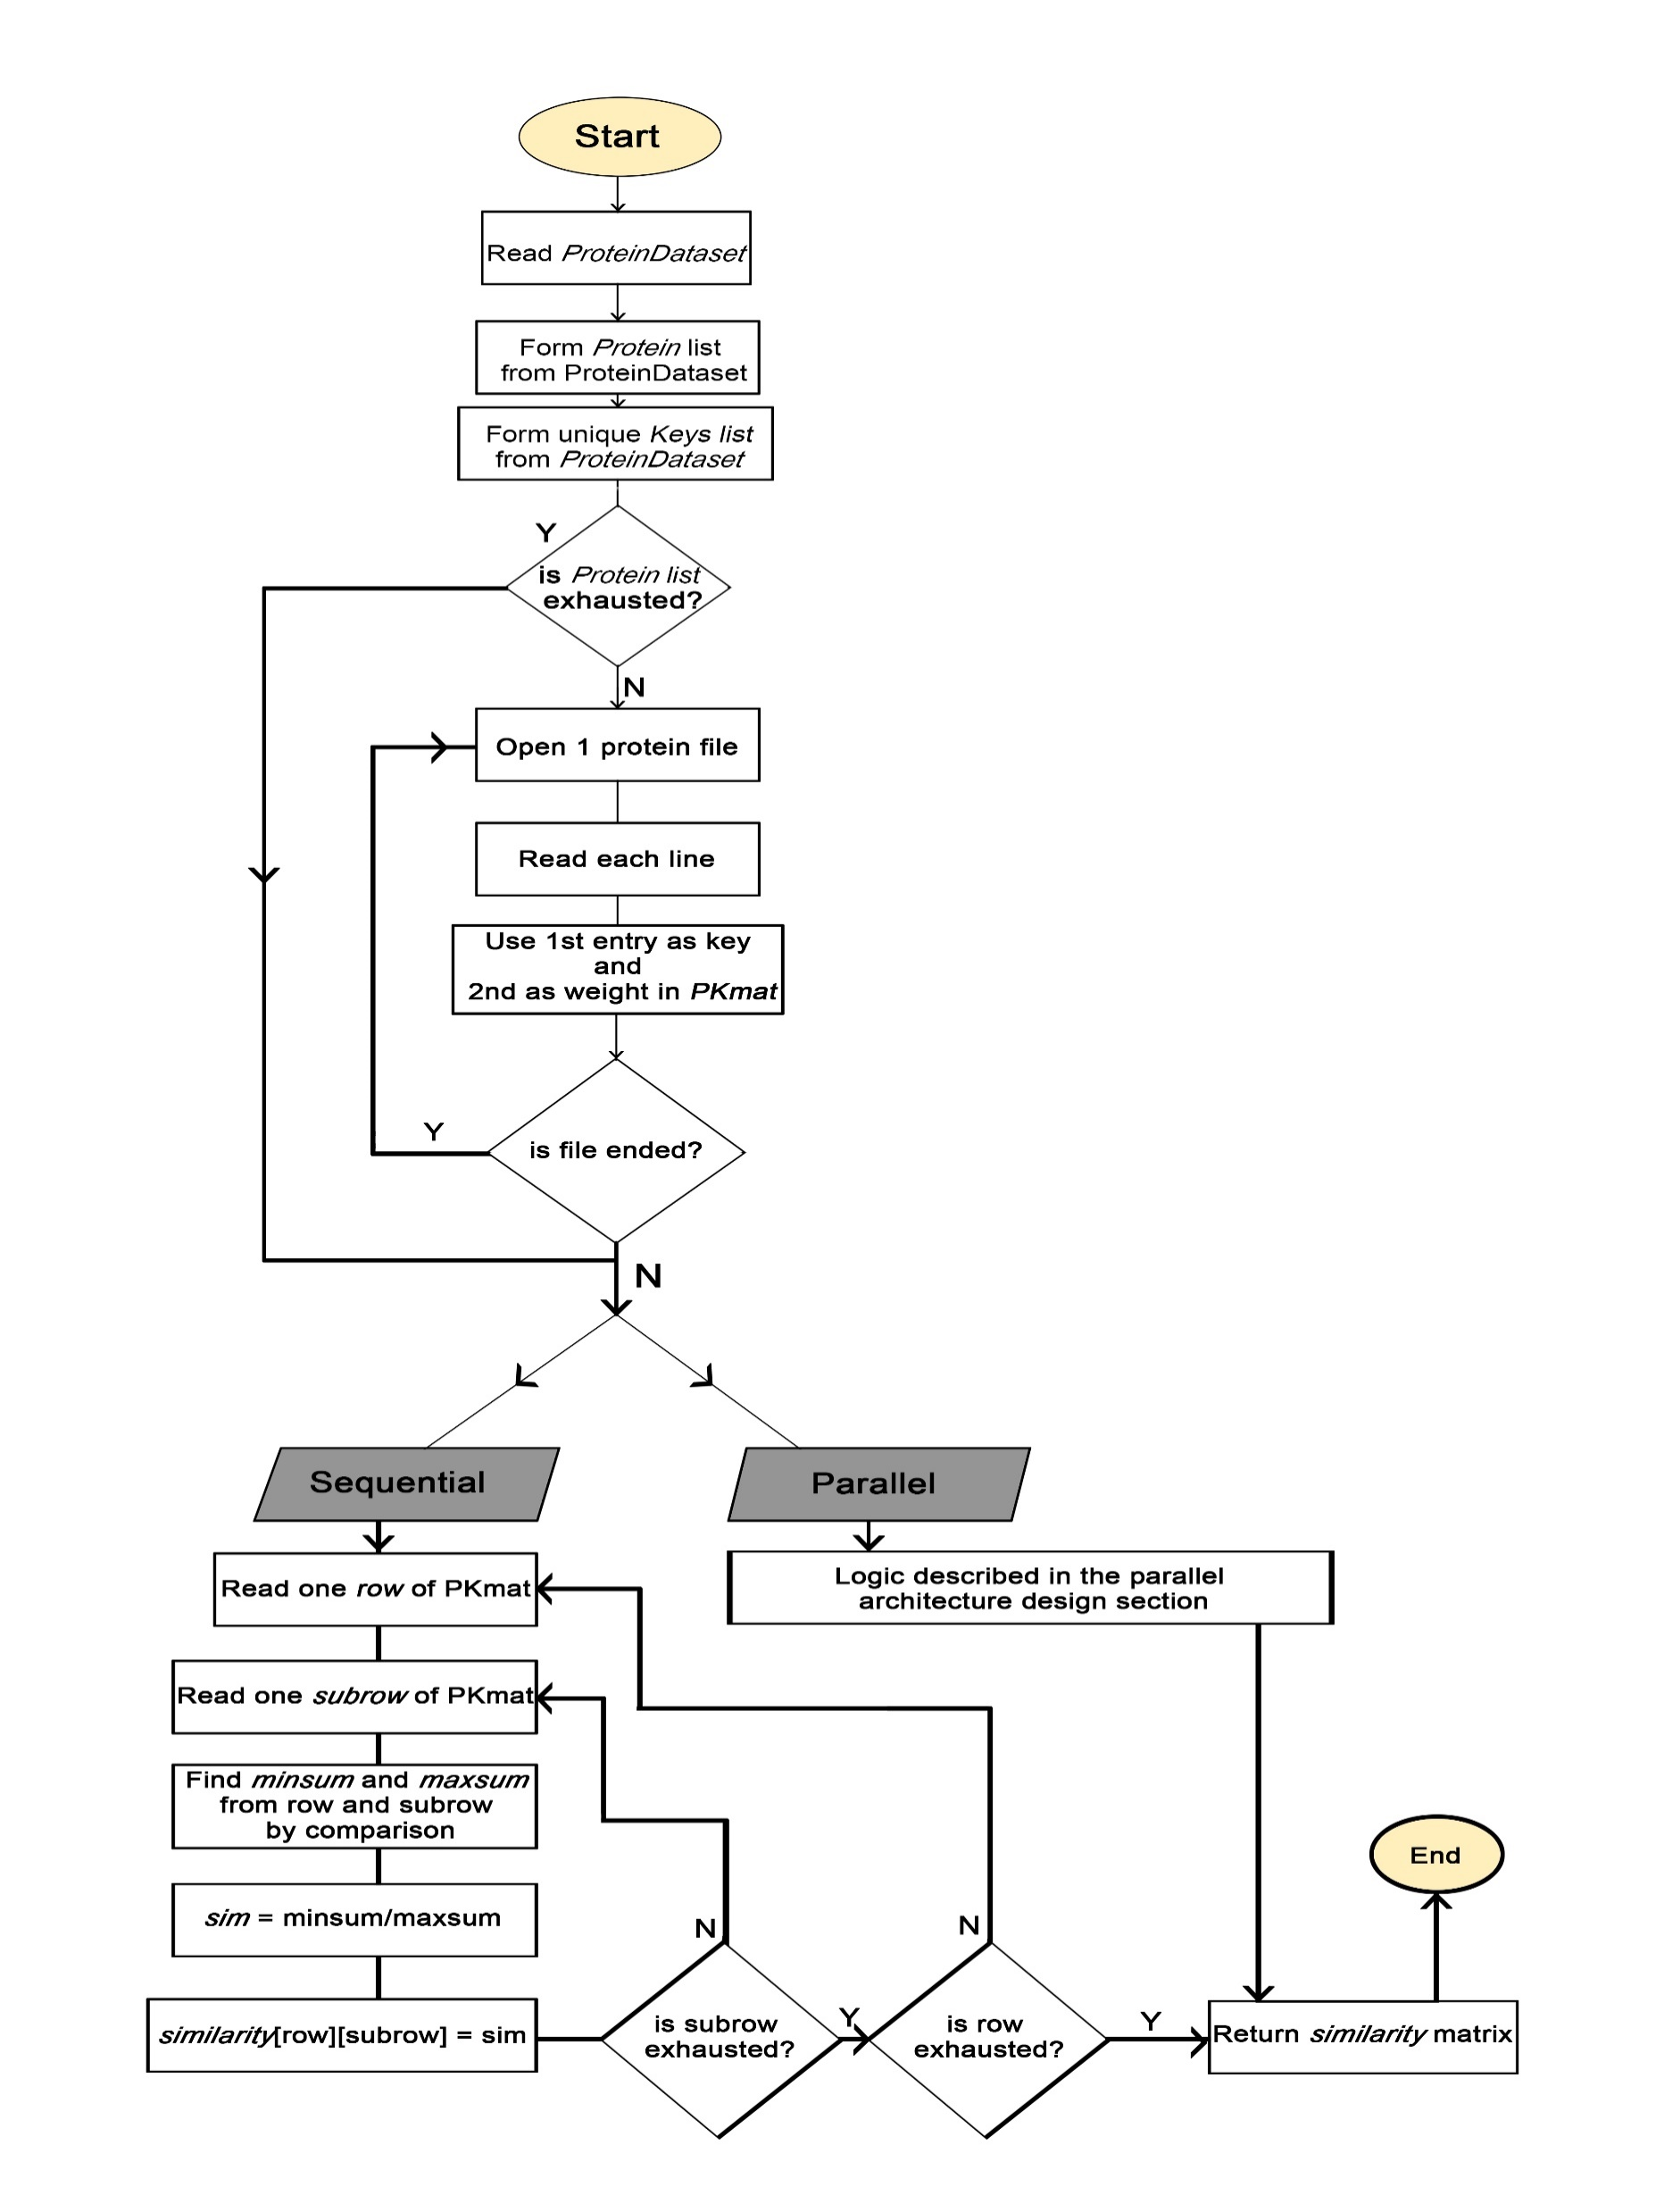
Logic Flow

Slide 4
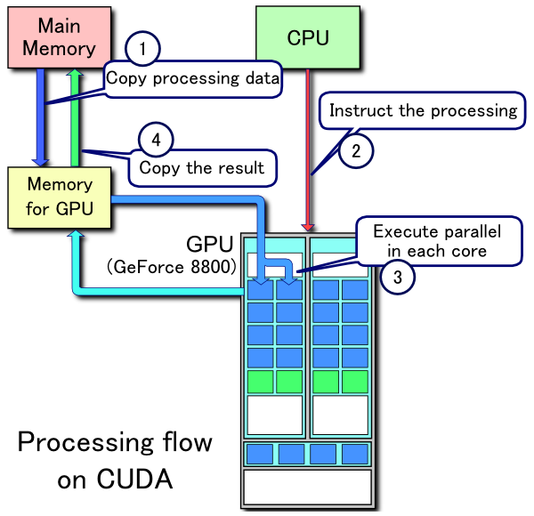
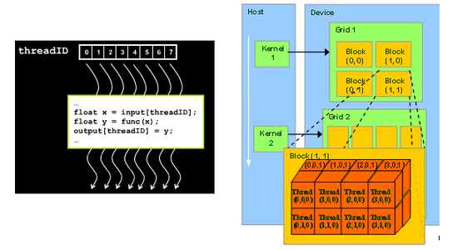
CUDA Architecture

Slide 5
Protein-Key Similarity Measure: Parallel
Showing the logic flow for one protein pairs and then how these results of one-all protein pairs are accumulated by GPU

Slide 6
Showing Calculation for one protein pair(p1,p2) comparison
Pass 1(comparison of p1 with all proteins): (ranges from 1 to 172)
SubPass 2(comparison of p1 with p2): (ranges from 1 to 172):
column slice 1 for p1 & p2
#proteins = n = 172
#keys = m = 108091
# column slices for each protein = 108091/5689 = 19
Logic:
for each protein rows (1 to 172):
for each protein subrows (1 to 172):
take two protein row and subrow together at a time
do 19 times:
slice columns at size 5689, pass them to mini_gpu & maxi_gpu
Invoke GPU kernel once for:
Calculate maxsum and minsum for two proteins
Add them to previous maxsum and minsum and return these to CPU
Invoke GPU kernel again for:
In each of 172 threads, compute minsum/maxsum and insert the value at result[row][threadIdx]
 | K E Y S
P R O T E I N S |  | k1 | k2 | K3 | K4 |  |  |  |  |  |  |  |  |  |  |  |  |  |  | km
 | p1
 | p2
 | p3
 | pn
 | K1 | K2 |  |  |  | k5689
a1_gpu
a2_gpu
 | Mini_gpu | Maxi_gpu
p1
p2 | Minsum | Maxsum
p172
Minsum = Minsum + Minsum of current column slice of P1 & p2 for pass (1,2)
Maxsum = Maxsum + Maxsum of current column slice of P1 & p2 for pass (1,2)

Slide 7
Showing Calculation for one protein pair(p1,p2) comparison
Pass 1(comparison of p1 with all proteins): (ranges from 1 to 172)
SubPass 2(comparison of p1 with p2): (ranges from 1 to 172)
column slice 2 for p1 & p2
#proteins = n = 172
#keys = m = 108091
# column slices for each protein = 108091/5689 = 19
Logic:
for each protein rows (1 to 172):
for each protein subrows (1 to 172):
take two protein row and subrow together at a time
do 19 times:
slice columns at size 5689, pass them to mini_gpu & maxi_gpu
Invoke GPU kernel once for:
Calculate maxsum and minsum for two proteins
Add them to previous maxsum and minsum and return these to CPU
Invoke GPU kernel again for:
In each of 172 threads, compute minsum/maxsum and insert the value at result[row][threadIdx]
 | K E Y S
P R O T E I N S |  | k1 | k2 | K3 | K4 |  |  | K 5690 |  |  |  |  | k11378 |  |  |  |  |  |  | km
 | p1
 | p2
 | p3
 | pn
 | K 5690 |  |  |  |  | K 11378
a1_gpu
a2_gpu
 | Mini_gpu | Maxi_gpu
p1
p2 | Minsum | Maxsum
p172
Minsum = Minsum + Minsum of current column slice of P1 & p2 for pass (1,2)
Maxsum = Maxsum + Maxsum of current column slice of P1 & p2 for pass (1,2)

Slide 8
Showing Calculation for one protein pair(p1,p2) comparison
Pass 1(comparison of p1 with all proteins): (ranges from 1 to 172)
SubPass 2(comparison of p1 with p2): (ranges from 1 to 172)
column slice 19 for p1 & p2
#proteins = n = 172
#keys = m = 108091
# column slices for each protein = 108091/5689 = 19
Logic:
for each protein rows (1 to 172):
for each protein subrows (1 to 172):
take two protein row and subrow together at a time
do 19 times:
slice columns at size 5689, pass them to mini_gpu & maxi_gpu
Invoke GPU kernel once for:
Calculate maxsum and minsum for two proteins
Add them to previous maxsum and minsum and return these to CPU
Invoke GPU kernel again for:
In each of 172 threads, compute minsum/maxsum and insert the value at result[row][threadIdx]
 | K E Y S
P R O T E I N S |  | k1 | k2 | K3 | K4 |  |  |  |  |  |  |  |  |  | k11379 |  |  |  |  | k108091
 | p1
 | p2
 | p3
 | pn
 | K 11379 |  |  |  |  | K 108091
a1_gpu
a2_gpu
 | Mini_gpu | Maxi_gpu
p1
p2 | Minsum | Maxsum
p172
Minsum = Minsum + Minsum of current column slice of P1 & p2 for pass (1,2)
Maxsum = Maxsum + Maxsum of current column slice of P1 & p2 for pass (1,2)

Slide 9
Showing Calculation for one protein pair(p1,p2) comparison
Pass 1(comparison of p1 with all proteins): (ranges from 1 to 172)
SubPass 2 completed(comparison of p1 with p2): (ranges from 1 to 172)
#proteins = n = 172
#keys = m = 108091
# column slices for each protein = 108091/5689 = 19
Logic:
for each protein rows (1 to 172):
for each protein subrows (1 to 172):
take two protein row and subrow together at a time
do 19 times:
slice columns at size 5689, pass them to mini_gpu & maxi_gpu
Invoke GPU kernel once for:
Calculate maxsum and minsum for two proteins
Add them to previous maxsum and minsum and return these to CPU
Invoke GPU kernel again for:
In each of 172 threads, compute minsum/maxsum and insert the value at result[row][threadIdx]
 | Mini_gpu | Maxi_gpu
p1
p2 | Minsum of all 19 column slices of P1 & p2 for pass (1,2) | Maxsum of all 19 column slices of P1 & p2 for pass (1,2)
p172
 | PROTEINS
P R O T E I N S |  | p1 | p2 |  |  |  | p172
 | p1
 | p2
 | p172
Protein-Protein Similarity Matrix
Jaccard’s Similarity = Minsum / Maxsum
*After subpass 172, all locations of Mini_gpu and Maxi_gpu will be filled,
invoke kernel once again for calculation of Jaccard’s Similarity (p1, pj) 1<=j<=172, thus we get p1 row of Similarity matrix by one kernel invocation.

Slide 10
Showing Result accumulation for one protein-all (p1-[p1 to p172]) comparison
Pass 1 completed(comparison of p1 with all proteins): (ranges from 1 to 172)
- After subpass 172, all locations of Mini_gpu and Maxi_gpu will be filled,
invoke kernel once again for calculation of Jaccard’s Similarity (p1, pj) 1<=j<=172, thus we get p1 row of Similarity matrix by one kernel invocation.
Core1
Core2
Core i
Core172
Mini_gpu 1
Mini_gpu 2
Mini_gpu i
Mini_gpu 172
Maxi_gpu 1
Maxi_gpu 2
. . .
Maxi_gpu i
. . .
Maxi_gpu 172
Similarity [1][1] filled
Similarity [1][2] filled
Similarity [1][i] filled
Similarity [1][172] filled
GPU structure
 | Mini_gpu | Maxi_gpu
p1
p2
pi
p172
 | PROTEINS
P R O T E I N S |  | p1 | p2 |  | Pi |  | p172
 | p1
 | p2
 | pi
 | p172

Slide 11
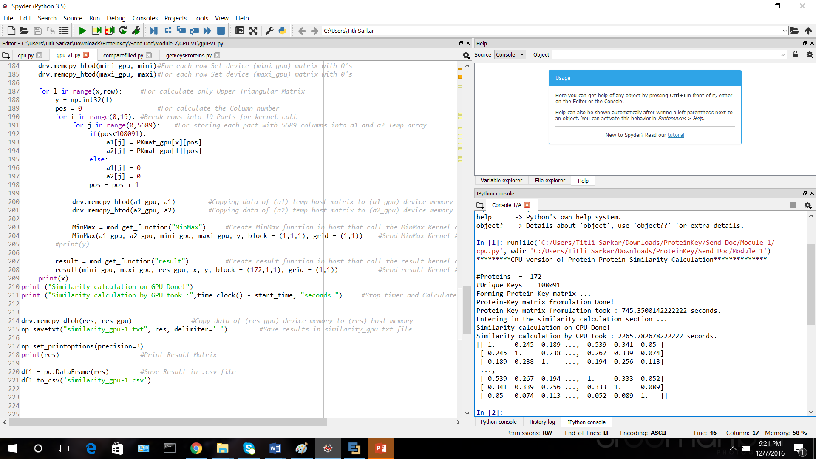
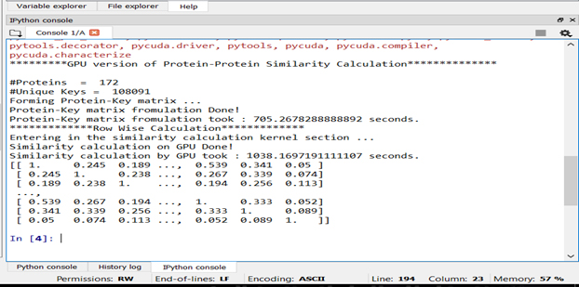
Time Comparison Result
a. Similarity Calculation by CPU
b. Similarity Calculation by GPU

Slide 12
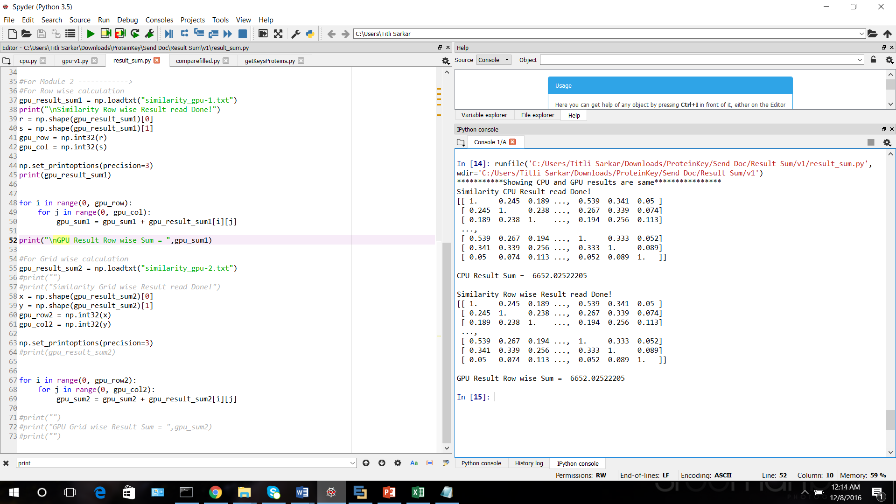
Element comparison Result

Slide 13
Conclusion
challenge is to handle huge dataset in an efficient manner is addressed
parallel algorithm invocation gives almost double speedup on sequential version
Different approach of parallel algorithms can be used to invoke kernel more efficiently and better performance.

Slide 14
References
Sing, Sumi, “Protein 3-D Structure Representation for Alignment-Free Comparison and Structural Motif Discovery of Proteins, and Hierarchical Protein Classification”, University of Louisiana at Lafayette, ProQuest Dissertations Publishing, 2015. 10003582
https://developer.nvidia.com/cuda-education-training, Last accessed Dec 01, 2016
https://docs.python.org/3/tutorial/, Last accessed Dec 01, 2016
https://www.ibm.com/developerworks/community/blogs/jfp/entry/Installing_PyCUDA_On_Anaconda_For_Windows?lang=en

Slide 15
Thank You

