Slide 1
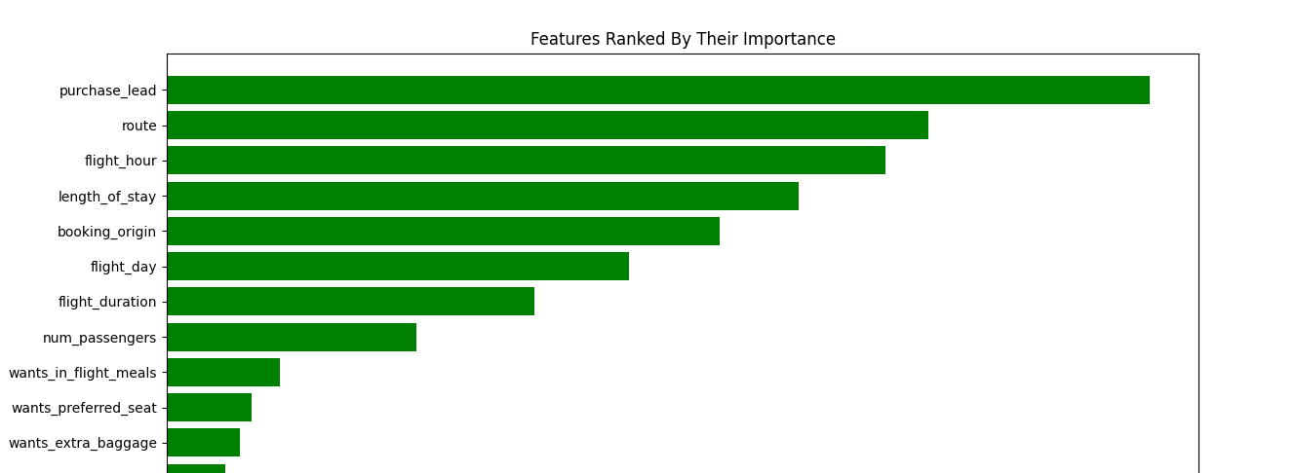
Results
The top 5 features that encourage customers to book tickets are: 1. Purchase leads
2. Route
3. Flight hours
4. Length of their stay
5. Booking origin
Provided by Scikit-Learn Machine Model, which has an 85% accuracy

