Slide 1

Analysis and Insights for Lyft Bike Sharing
TEAM – 5
AKSHAY MADAR | RAHUL MADHU | TIRTHANKAR MUKHOPADHYAY | VARUN SINGH | XEMA PATHAK

Slide 2

About Lyft Bike Sharing
1
Bike sharing to get around the city, rides starting at $2 per ride
2
Started in 2017, currently operating at 440 stations in the Bay area with 4000+ bikes
3
Offers monthly and annual membership for regular users. Approximately, 80% of their users are subscribers
4
170,000+ average monthly trips, with plans to expand to more areas and set up more stations in Bay area.
Analyze the data to gain insights on user behavior and current operations

Slide 3
Inventory management for Bikes and demand-supply gap analysis

Slide 4
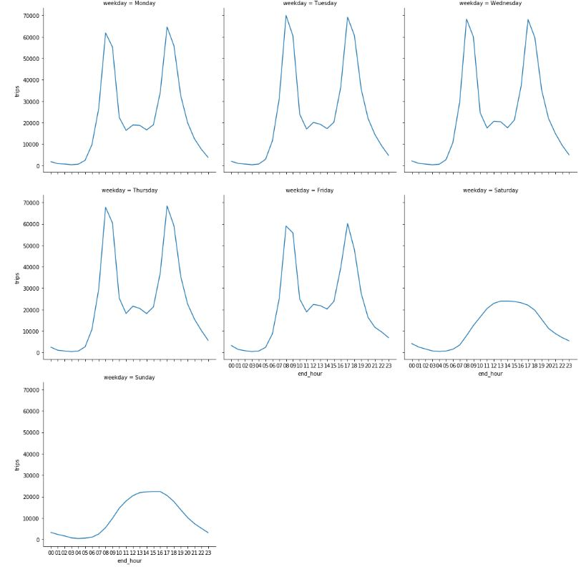
A prominent pattern exists in usage during weekdays
The peak hours overlap with the working hours – suggesting that people might be availing bike sharing service to commute to work.
Trend of day-wise average Trips started and ended at each hour

Slide 5
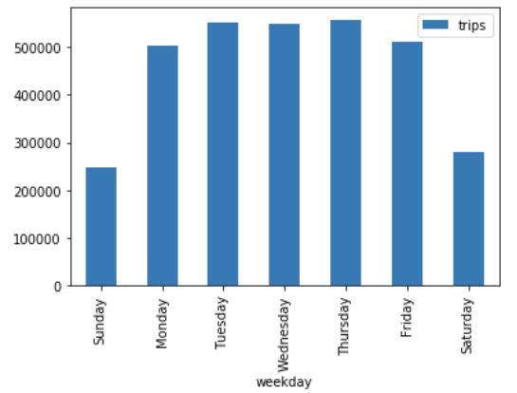
Average Trips per day in a week
Monday to Friday are the busiest days

Slide 6
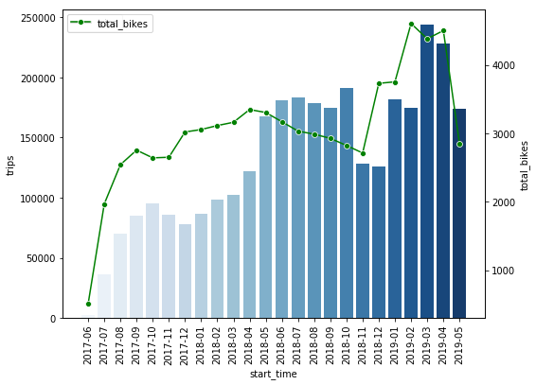
Average Trips and Bikes in use per month
Increase in number of bikes does not necessarily lead to increase in the number of trips.
Upward yearly trend with seasonality in months

Slide 7
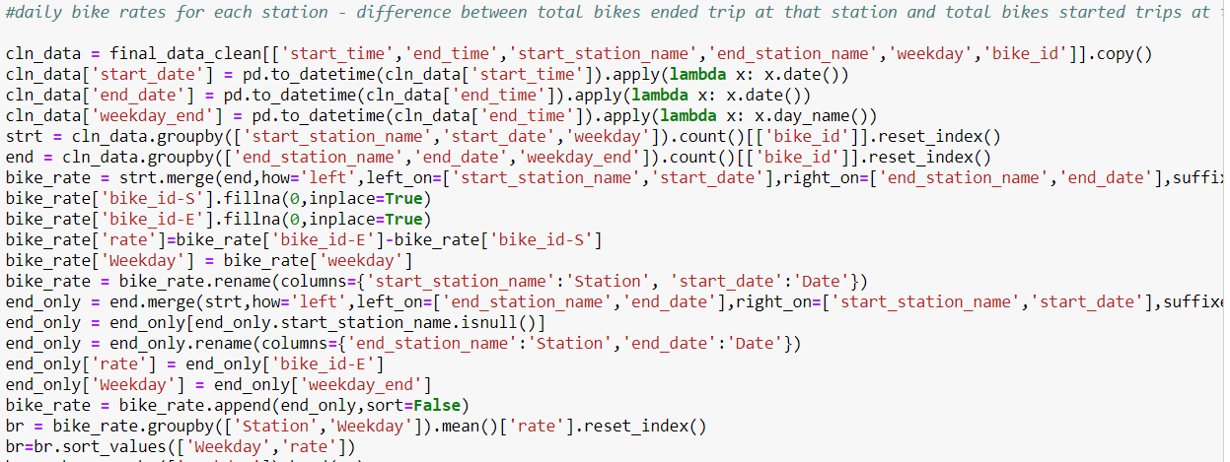
Objective: To reduce the cost by efficient inventory planning, to study current demand-supply gap
Step 1:
Slice data from main dataframe (station names, timestamps and bike IDs)
Step 2:
Group for number of bikes for each start and end stations for each weekday and each hour
Step 3:
Merge to resulting dataframes
Step 5:
Group it by days/ hours to get average inventory status
Step 4:
Take the difference to get end of day/ end of hour inventory status

Slide 8
Sample result of average daily Station rates
Station | Weekday | Rate |  | Station | Weekday | Rate
San Francisco Caltrain (Townsend St at 4th St) | Monday | 40.7 |  | Bancroft Way at College Ave | Tuesday | -24.8877551
San Francisco Caltrain Station 2 (Townsend St at 4th St) | Monday | 39.52 |  | Haste St at College Ave | Tuesday | -15.85714286
San Francisco Ferry Building (Harry Bridges Plaza) | Monday | 22.14 |  | McAllister St at Baker St | Tuesday | -11.5483871
Montgomery St BART Station (Market St at 2nd St) | Monday | 16.78 |  | Howard St at Beale St | Tuesday | -11.21
The Embarcadero at Sansome St | Monday | 8.63 |  | Hearst Ave at Euclid Ave | Tuesday | -10.93939394
8th St at Brannan St | Monday | 8.425925926 |  | Lake Merritt BART Station | Tuesday | -9.568421053
Civic Center/UN Plaza BART Station (Market St at McAllister St) | Monday | 6.67 |  | Broderick St at Oak St | Tuesday | -9.542553191
San Francisco Caltrain Station 2 (Townsend St at 4th St) | Wednesday | 45.45 |  | Bancroft Way at College Ave | Thursday | -27.13131313
San Francisco Caltrain (Townsend St at 4th St) | Wednesday | 21.69306931 |  | Haste St at College Ave | Thursday | -13.44
Montgomery St BART Station (Market St at 2nd St) | Wednesday | 20.31683168 |  | Hearst Ave at Euclid Ave | Thursday | -11.46268657
San Francisco Ferry Building (Harry Bridges Plaza) | Wednesday | 19.93069307 |  | McAllister St at Baker St | Thursday | -10.87096774
8th St at Brannan St | Wednesday | 10 |  | Howard St at Beale St | Thursday | -10.69306931
The Embarcadero at Sansome St | Wednesday | 9.851485149 |  | Leavenworth St at Broadway | Thursday | -9
19th Street BART Station | Wednesday | 9.545454545 |  | Central Ave at Fell St | Thursday | -8.914893617
San Francisco Caltrain Station 2 (Townsend St at 4th St) | Friday | 39.57425743 |  | Bancroft Way at College Ave | Saturday | -12.35051546
Montgomery St BART Station (Market St at 2nd St) | Friday | 18.27722772 |  | Haste St at College Ave | Saturday | -9.306122449
San Francisco Ferry Building (Harry Bridges Plaza) | Friday | 17.41584158 |  | Hearst Ave at Euclid Ave | Saturday | -7.227272727
San Francisco Caltrain (Townsend St at 4th St) | Friday | 11.58415842 |  | Pierce St at Haight St | Saturday | -5.4375
8th St at Brannan St | Friday | 9.454545455 |  | McAllister St at Baker St | Saturday | -5.434782609
The Embarcadero at Sansome St | Friday | 9.089108911 |  | Jones St at Post St | Saturday | -5.193548387
Folsom St at 3rd St | Friday | 8.237623762 |  | Central Ave at Fell St | Saturday | -3.808510638

Slide 9
Managing dynamic inventory at Stations
High average daily rates indicates an inventory build up at the end of the day while a negative rate implies a decrease in inventory size
Identify stations with the highest average rates and those with the lowest on subsequent days
The excess bike inventory from the first set of stations can be moved to the stations with decreased inventories and help satisfy greater demands
Marketing offers such as reduced rates for people taking routes from the high to low inventory stations could be set up

Slide 10
Studying hourly demand for required Docks at stations
Sample result
Station | Hour | Rate
San Francisco Caltrain Station 2 (Townsend St at 4th St) | 17 | 26.26
San Francisco Caltrain (Townsend St at 4th St) | 16 | 19.04
San Francisco Ferry Building (Harry Bridges Plaza) | 17 | 13.96
19th Street BART Station | 8 | 11.89
MacArthur BART Station | 8 | 10.33
Montgomery St BART Station (Market St at 2nd St) | 8 | 9.46
Identify highest average hourly rates for stations
This gives the expected number of incoming bikes over the existing bikes at the station
This number can be used as an estimate for the minimum number of free docks to be maintained at the station

Slide 11
Studying hourly demand for required Docks at stations
Sample result
Station | Hour | rate
San Francisco Caltrain (Townsend St at 4th St) | 8 | -12.3
San Francisco Caltrain Station 2 (Townsend St at 4th St) | 9 | -12.3
San Francisco Ferry Building (Harry Bridges Plaza) | 8 | -9.36
2nd St at Folsom St | 17 | -7.25
19th Street BART Station | 18 | -7.12
Salesforce Transit Center (Natoma St at 2nd St) | 17 | -6.92
The negative average hourly rates of each station shows the expected additional bikes being taken after accounting for returned bikes
We can use this data to identify the stations where a possible increase in bike inventory is required

Slide 12
Determine Customer segment for expansion

Slide 13
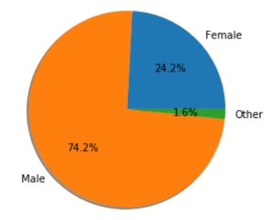
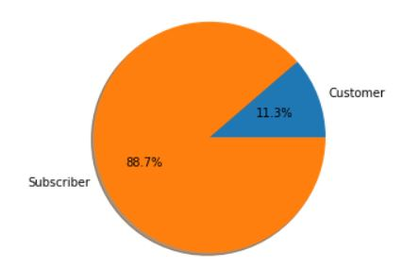
Distribution of Trips across gender and customer/ subscriber
Prominent user category: Males
Majority of the users are Subscribers

Slide 14
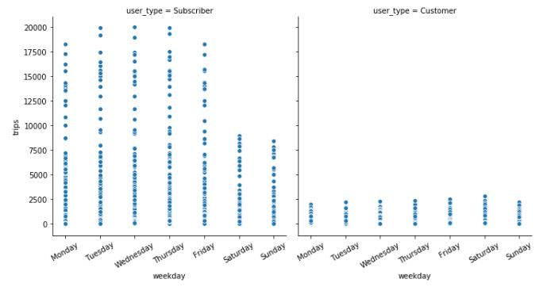
Day-wise Trips for Subscribers and Customers
Stark difference in usage patterns of subscribers and customers
Subscribers use the service as a daily routine - Monday to Friday

Slide 15
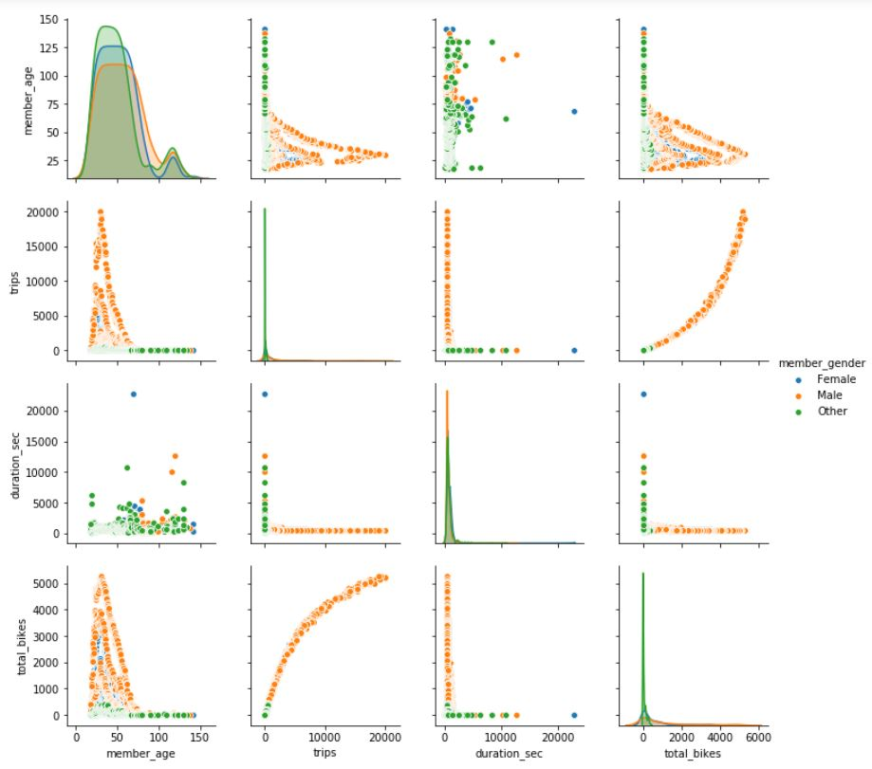
Relation between Trips stats and Gender
Males in the age group of 18 years to 50 years have taken the most number of trips
Less female users availing the service

Slide 16
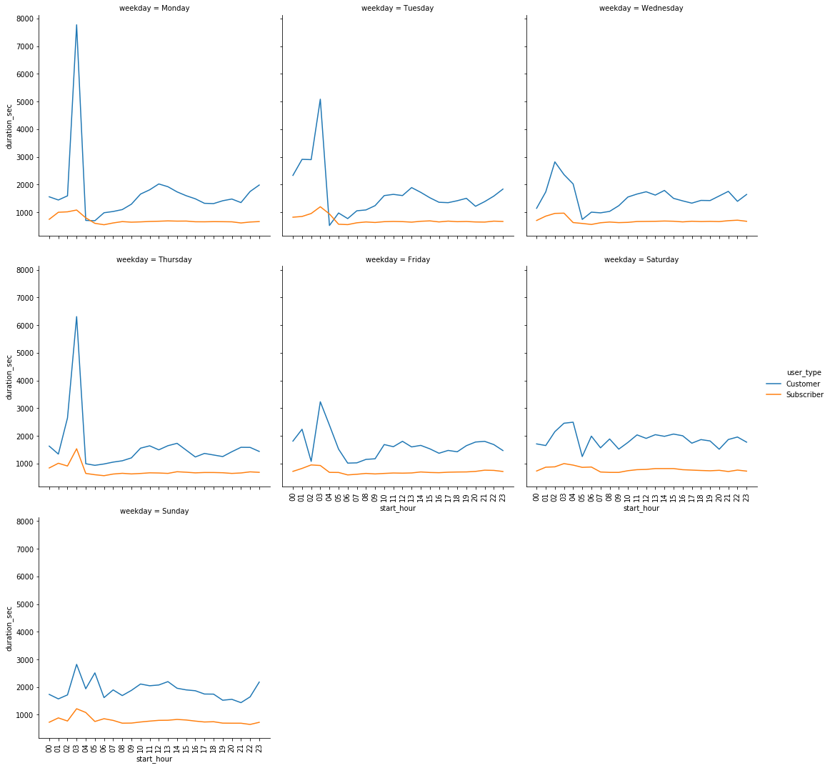
Comparison of Trip duration for customers and subscribers
Customers, even though take less number of trips overall, have a higher trip duration in comparison to subscribers.

Slide 17
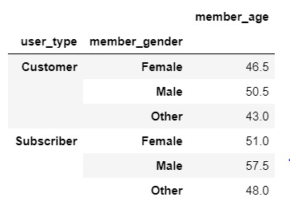
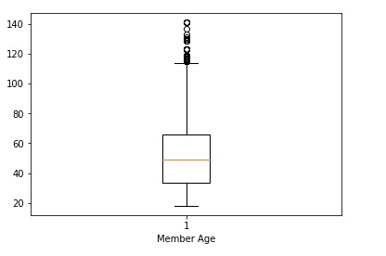
Objective: Target the look-alikes of highly engaged existing user-base for marketing
Males in the age group of 33 years and 66 years (in the range of 25th percentile to 75th percentile)
Working professionals (preferably startups) looking for an affordable everyday commute to work

Slide 18
Determine Areas for in-person enrollment

Slide 19
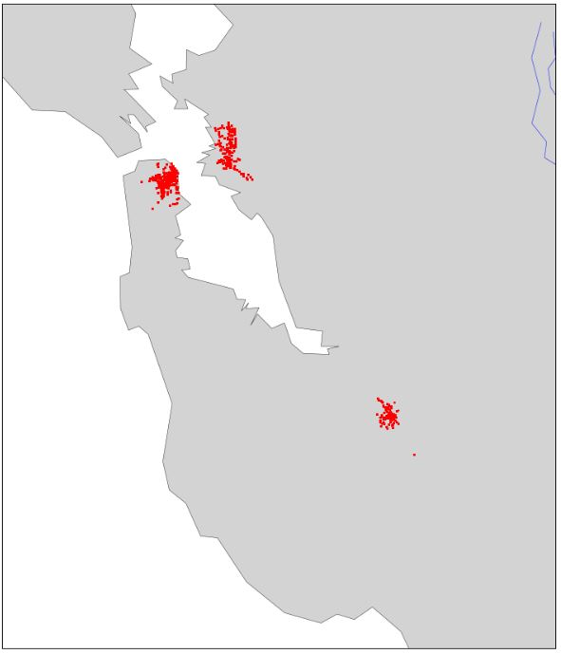
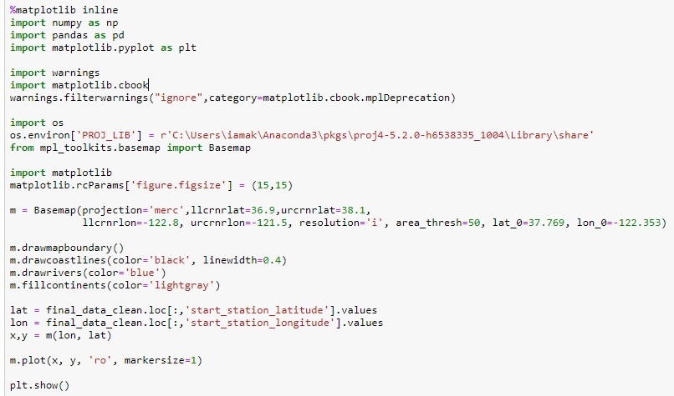
Distribution of the Stations in Bay area
All the stations of the Bay area are clustered in three major areas.

Slide 20
Objective: To increase new-user acquisition, converting them to the subscribers.
Target the top 20 stations for in-person enrollment for the acquisition of new users
Since most stations are in the same area, fewer people need to be deployed
If in-person enrollment works out in these stations, more people can be deployed in the other 2 zones as we can observe stations are mainly present in three clusters.

Slide 21
Forecasting minimum Bikes (fleet size) to be maintained in inventory

Slide 22
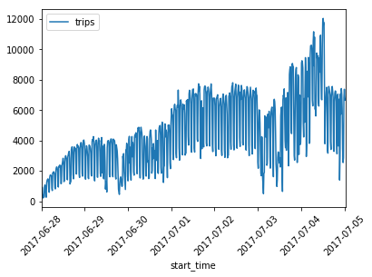
Time series plot of number of Trips
The time series plot for the total trips has an upward trend of Year-on-Year growth and month-wise seasonality.

Slide 23
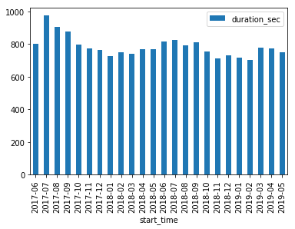
Trend of duration of Trips
The duration of a trip do not vary much with change in the seasons (months)

Slide 24
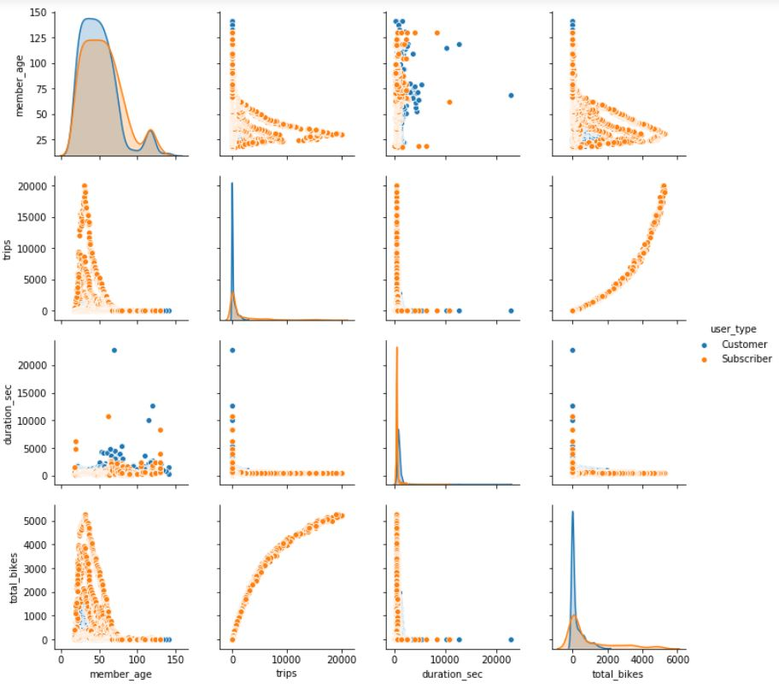
Relation between Trips stats and User type
The customers are sparsely distributed
The duration of the trip for a customer is higher than that of a subscriber.

Slide 25
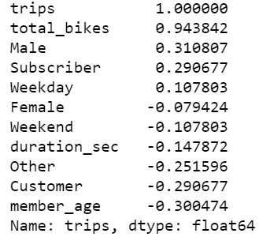
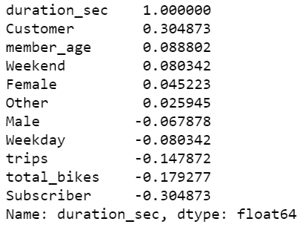
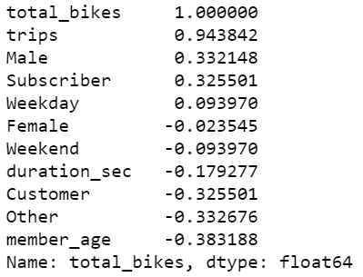
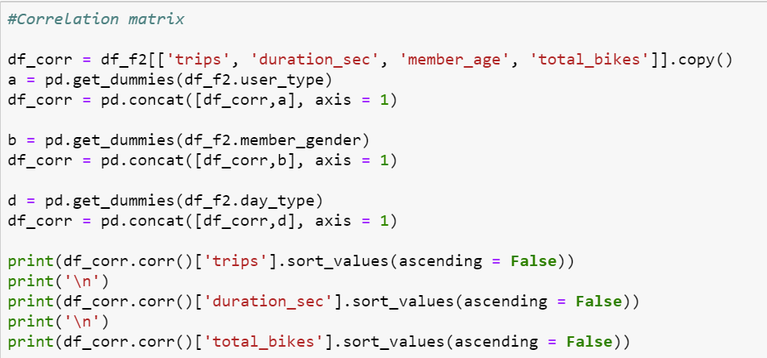
Correlation stats for Trips parameters

Slide 26
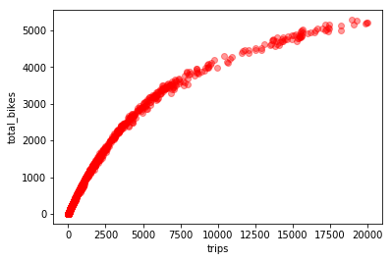
Relation between Trips and total bikes in use
The bikes in use increase with increase in the number of trips to a certain extent and then the trend stabilizes

Slide 27
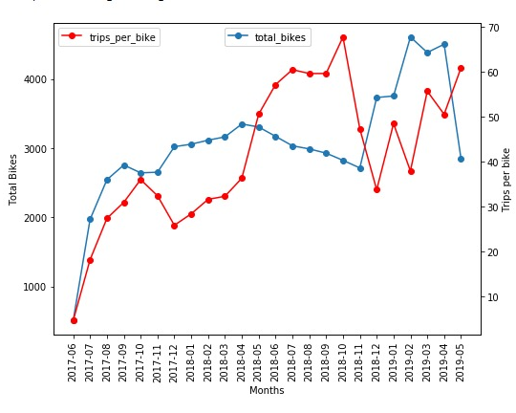
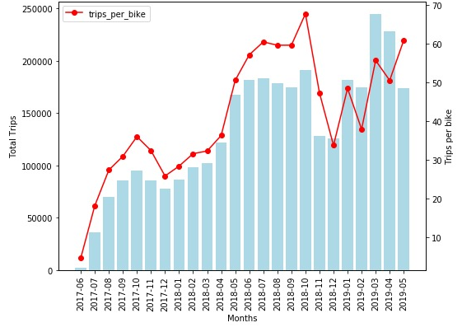
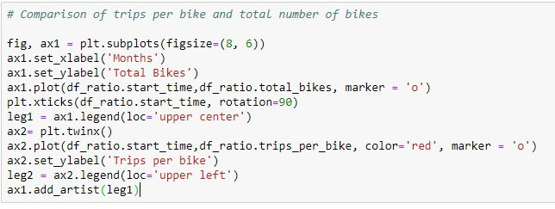
Trend of Trips, trips per bike and bikes in use
The inventory is steadily increasing after launch
Trips per bike ratio is set to stabilize post Oct’18.

Slide 28
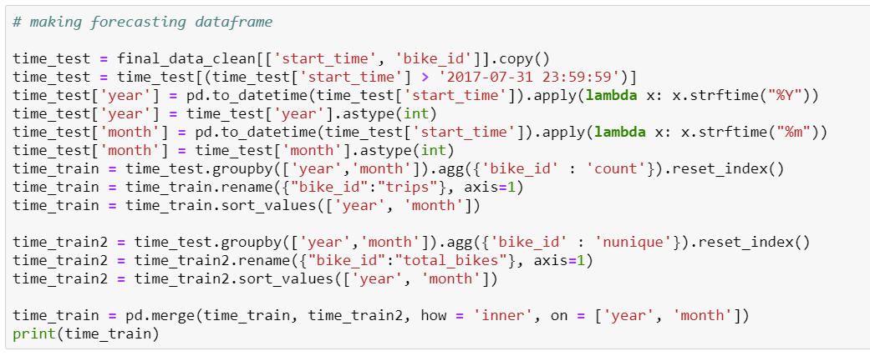
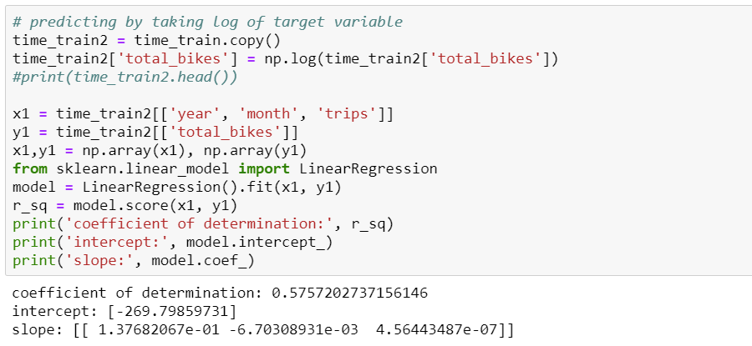
Objective: To maintain an optimum fleet size depending upon the trips
Step 1:
Slice data from main dataframe (timestamps and bike IDs)
Step 2:
Group for number of bikes in use and total trips for each month
Step 3:
Model fit as total bikes as target variable

Slide 29
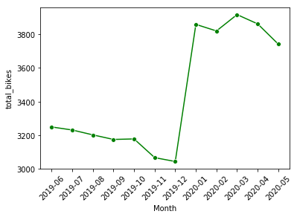
Predicted Bikes for next one year
The bikes to be in use to maintain an average of 60 trips per bike ranges from 3044 to 3916
It follows the trend as per the current usage – dull winter months and peak in spring and summer

Slide 30
fin.

Slide 31
References
Dataset from Lyft website: https://www.lyft.com/bikes/bay-wheels/system-data

