Slide 1

F
FixMate
Report. Track. Verify.
A civic complaint reporting & accountability platform
PUNE, INDIA
Independent student civic-tech project — not affiliated with or endorsed by Pune Municipal Corporation

Slide 2
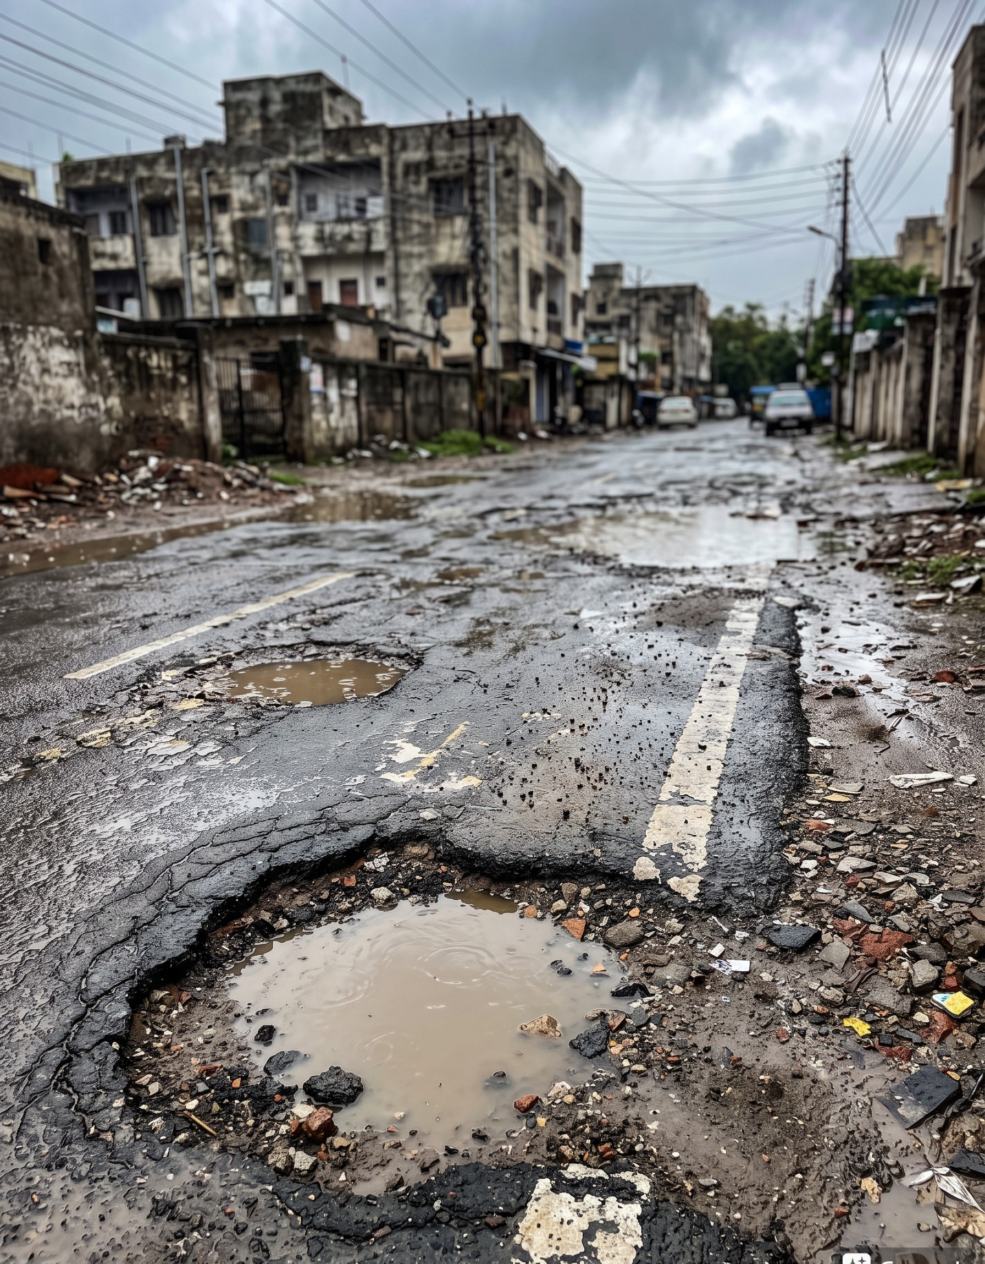
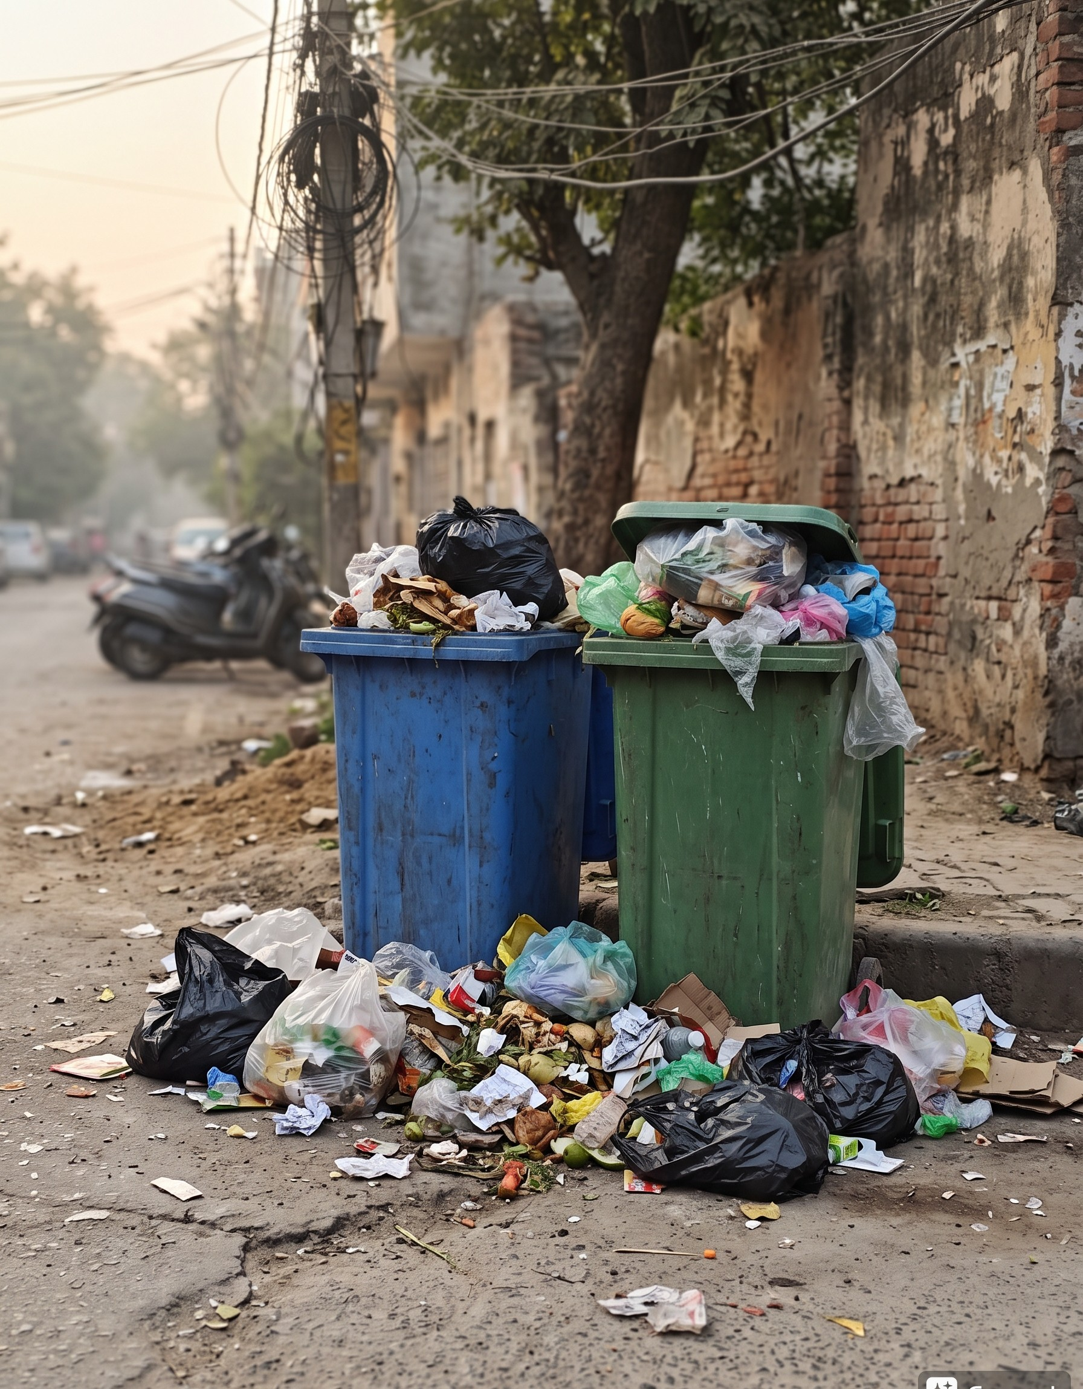
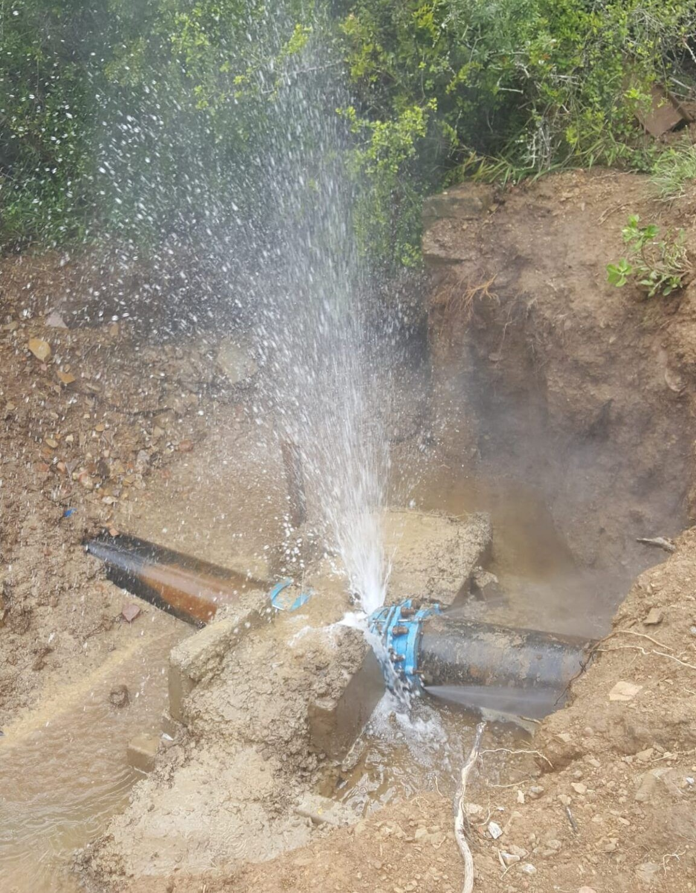
THE PROBLEM
Everyday civic
failures, invisible
until someone
reports them.
• Damaged roads
• Overflowing garbage
• Drainage & water leaks
No easy way to track a fix.
Damaged Roads
Overflowing Garbage
Drainage & Water Leaks
Photo: illustrative
Photo: illustrative
Photo: illustrative
FixMate · Pune, India
02

Slide 3
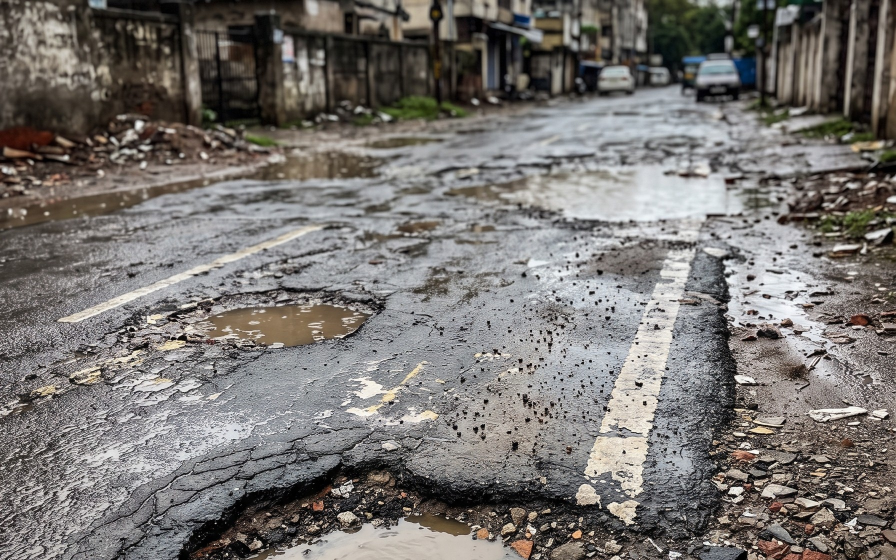
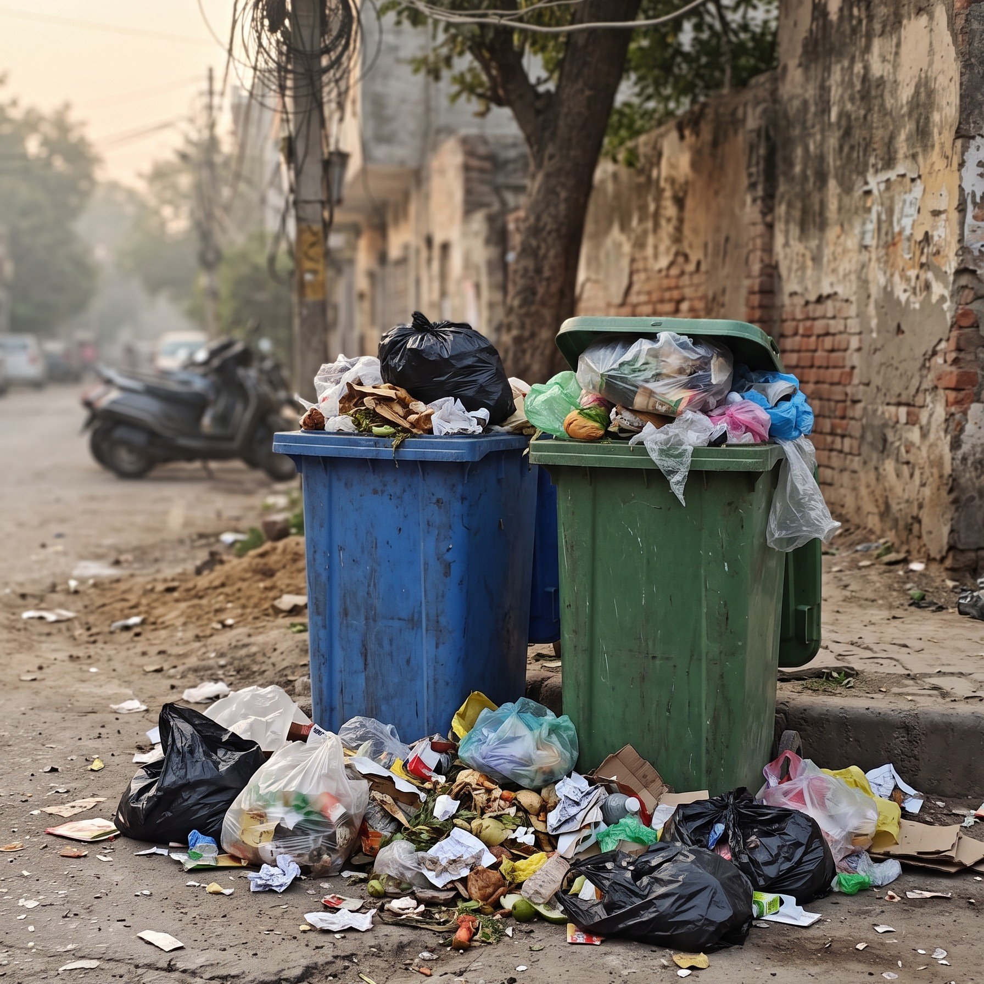
THE SOLUTION
fixmate.app/complaints
One platform.
Clear tracking.
Complaints
LIVE FEED
Road — large pothole
IN REVIEW
Category
Roads & Potholes
📷
Snap a photo, pick a category, submit.
Locality
[Ward / locality name]
Reported
[date] · ID #—
🔎
Every complaint gets a status that citizens can verify.
Garbage — bin overflowing
UNRESOLVED
Category
Waste Management
Locality
[Ward / locality name]
Complaint dashboard — illustrative mockup →
Reported
[date] · ID #—
ILLUSTRATIVE MOCKUP
FixMate · Pune, India
Sample entries use placeholder fields — no real complaint data
03

Slide 4
HOW IT WORKS
Four steps, one clear loop of accountability.
1
2
3
4
📷
🧭
🔍
✅
Report
Route
Review
Verify
Snap & submit
Sent to department
Department acts
Citizen confirms
Only a citizen confirmation closes the loop.
FixMate · Pune, India
04

Slide 5
KEY FEATURES
Built around evidence and visibility.
📷
Photo Reporting
📍
Locality Tracking
🧭
Department Routing
Evidence attached at source
Ward-level visibility
Right desk, first time
🔄
Status Updates
🔐
Official Access Controls
✅
Citizen Verification
Every step visible
Role-based permissions
Reporter confirms the fix
All six features are part of the platform design; Gemini AI assistance is planned, not yet built.
FixMate · Pune, India
05

Slide 6
TECHNOLOGY
A simple, proven stack.
🎨
HTML / CSS / JavaScript
IMPLEMENTED
PLANNED AI INTEGRATION
Citizen-facing web interface
Gemini
⚙️
Django
◇ Auto-suggest category
IMPLEMENTED
Python backend · routing · access control
◇ Detect duplicates
◇ Summarize reports
🗄️
Database
IMPLEMENTED
Complaints, media, statuses, audit trail
Not yet implemented — design stage
Standard web technologies — no proprietary lock-in.
FixMate · Pune, India
06

Slide 7
TRUST & ACCOUNTABILITY
Status you can see. Closure you must confirm.
Unresolved
Awaiting Confirmation
Rejected / Uncertain
Citizen-Verified
Reported, not yet addressed
Fix claimed — citizen to verify
Could not be verified
Reporter confirmed the fix
🔒
Officials cannot mark complaints completed without citizen confirmation.
The citizen who reported it holds the final say.
FixMate · Pune, India
07

Slide 8
IMPACT & VISION
Civic issues, seen through to the end.
📤
👁️
🤝
Easier reporting
Transparent progress
Verified resolution
One photo, one form, one platform
Status visible at every step
Closed only when citizens agree
Better reporting. Clearer accountability.
A better Pune.
Independent student civic-tech project — not affiliated with or endorsed by Pune Municipal Corporation

