Slide 1
Presentation Basics

Slide 2

Video clip #1

Slide 3
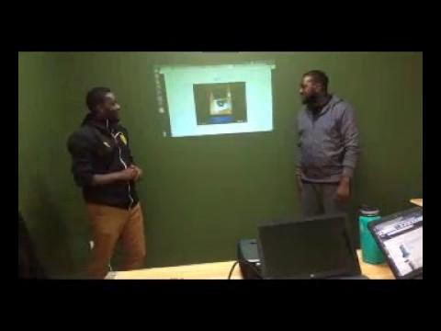
Video clip #2

Slide 4
Differences between Video Clip 1 & 2

Slide 5
Presentation structure

Slide 6
Step 1: Introductions by name and individual roles played in building the product.
Step 2: Introduce the name of the project and state what purpose/objective the product fulfills.
Step 3: Demonstration explaining how your product works.

Slide 7
STEP 4: Team Development Process. How you worked in a team from the design process to having a complete product.
Step 5: Challenges faced and how you conquered them
STEP 6: Questions & Feedback from the audience

Slide 8
Group Activity

Slide 9
The End

