Slide 1
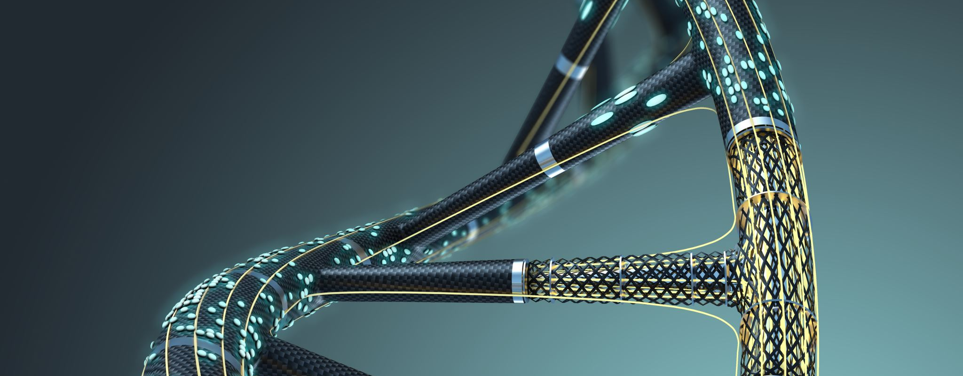
DNAlytics Stage 1 Presentation
Colby Coffman (Team Lead), Joshua Josey, Micah Johnson, Titus Kinnear

