Slide 1

Techno Engineering College Banipur
Project Presentation:
“PetOFur”
Mentor:
Mrs. Sulekha Das, Assistant Professor, Techno Engineering College Banipur
Group Members:
Prantika Baidya, 24400219003
Yoshita Chakraborty, 24400219004
Shubhadip Raj, 24400219008
Priya Tiwari, 24400219006

Slide 2
Contents:
Abstract
Introduction
Project Overview
User Requirements
Website Flow Diagram
Entity Relationship Diagram(ERD)
Data Flow Diagram(DFD)
Conclusion

Slide 3
Abstract:
Pets are a true gift. It only comes to the fortunate. They are the only ones who genuinely care about us. They give us whatever they have without expecting anything in return. A pet is a worthy object of affection. People now treat them like their children. They do a lot of things for them, like dress them up, go on outings with them, and celebrate their birthdays. The fluffy member of the family never gives up trying to assimilate family customs. He always makes an effort to uplift his family and make his parents proud. That little one teaches people how to be devoted, how to cheer us up when we're down, and what loyalty truly is.
In addition, pets can make excellent friends. Man's best companion is often referred to as a dog. The best demonstrators of this are dogs. The finest therapy to improve their friend's mood is them.
Who doesn't enjoy having a cute, fluffy pet that is on par with or even superior to other people?
Adopting pets is something that a lot of people do around the world. Every year, 4.1 million pets are adopted from animal shelters. In terms of adoption rates, dogs unquestionably lead the way. Pet adoption is growing in popularity on a daily basis. Between 2006 and 2014, it climbed by 3 million in this nation.
Having a pet is both a joy and a responsibility. In addition, they require care by being walked, having check-ups, etc. People who work 9 to 6 every day might not always be able to give them the full attention they require.
Our website, "PetOFur," is made specifically for this purpose. This website will assist busy parents in raising their fluffy children. They can reserve a reliable pet sitter, a pet walker, and many more services on this website.

Slide 4
Introduction:
Having a pet is not an easy task. It comes with the huge responsibility
For a working owner, sometimes it may be difficult to dedicate the time.
Our website goal is to provide the care, the attention that the little buddies deserve on the day the owners are busy.
It will also help the owner to find out nearby creches and clinics.
The main audience is people who own pets
The website has the following activities:
Pet Walker
Pet Sitter
Pet Groomer
Pet Trainer
Nearby creche
Nearby Clinics
Not only that person who wants to take care of the pet can register as pet carer to provide his/her care to them who need it the most

Slide 5
Project Overview:
The website PetOFur was created to provide pet owners with a platform to find at-home pet care services.
The website provides facilities like booking a pet walker, a pet sitter, a pet trainer, and at-home pet grooming.
The website provides facilities like booking a pet walker, a pet sitter, a pet trainer, and at-home pet grooming.
Users can also check nearby clinics and nearby pet crèche from the website itself.
People can also register as a pet caregiver

Slide 6
User Requirements:
Primary target users: busy pet owners who can’t devote enough time to their pets.
Process of booking a service:
access the website
Browse the services
Select the one according to choice
Submit their personal and pets’ details
Pick a date and time
Choose a pet carer
Make payment
To ensure safety throughout the service period, the service provider will keep the pet owner informed about their pet by giving videos, images, or making video calls.

Slide 7
User Requirements:
Process of becoming a pet carer:
Fill out an online form available on the website
One must possess a certificate in pet training or relevant work experience.
Once a client has received service, the client has the option to give feedback so that future clients can choose that service provider based on the feedback.

Slide 8
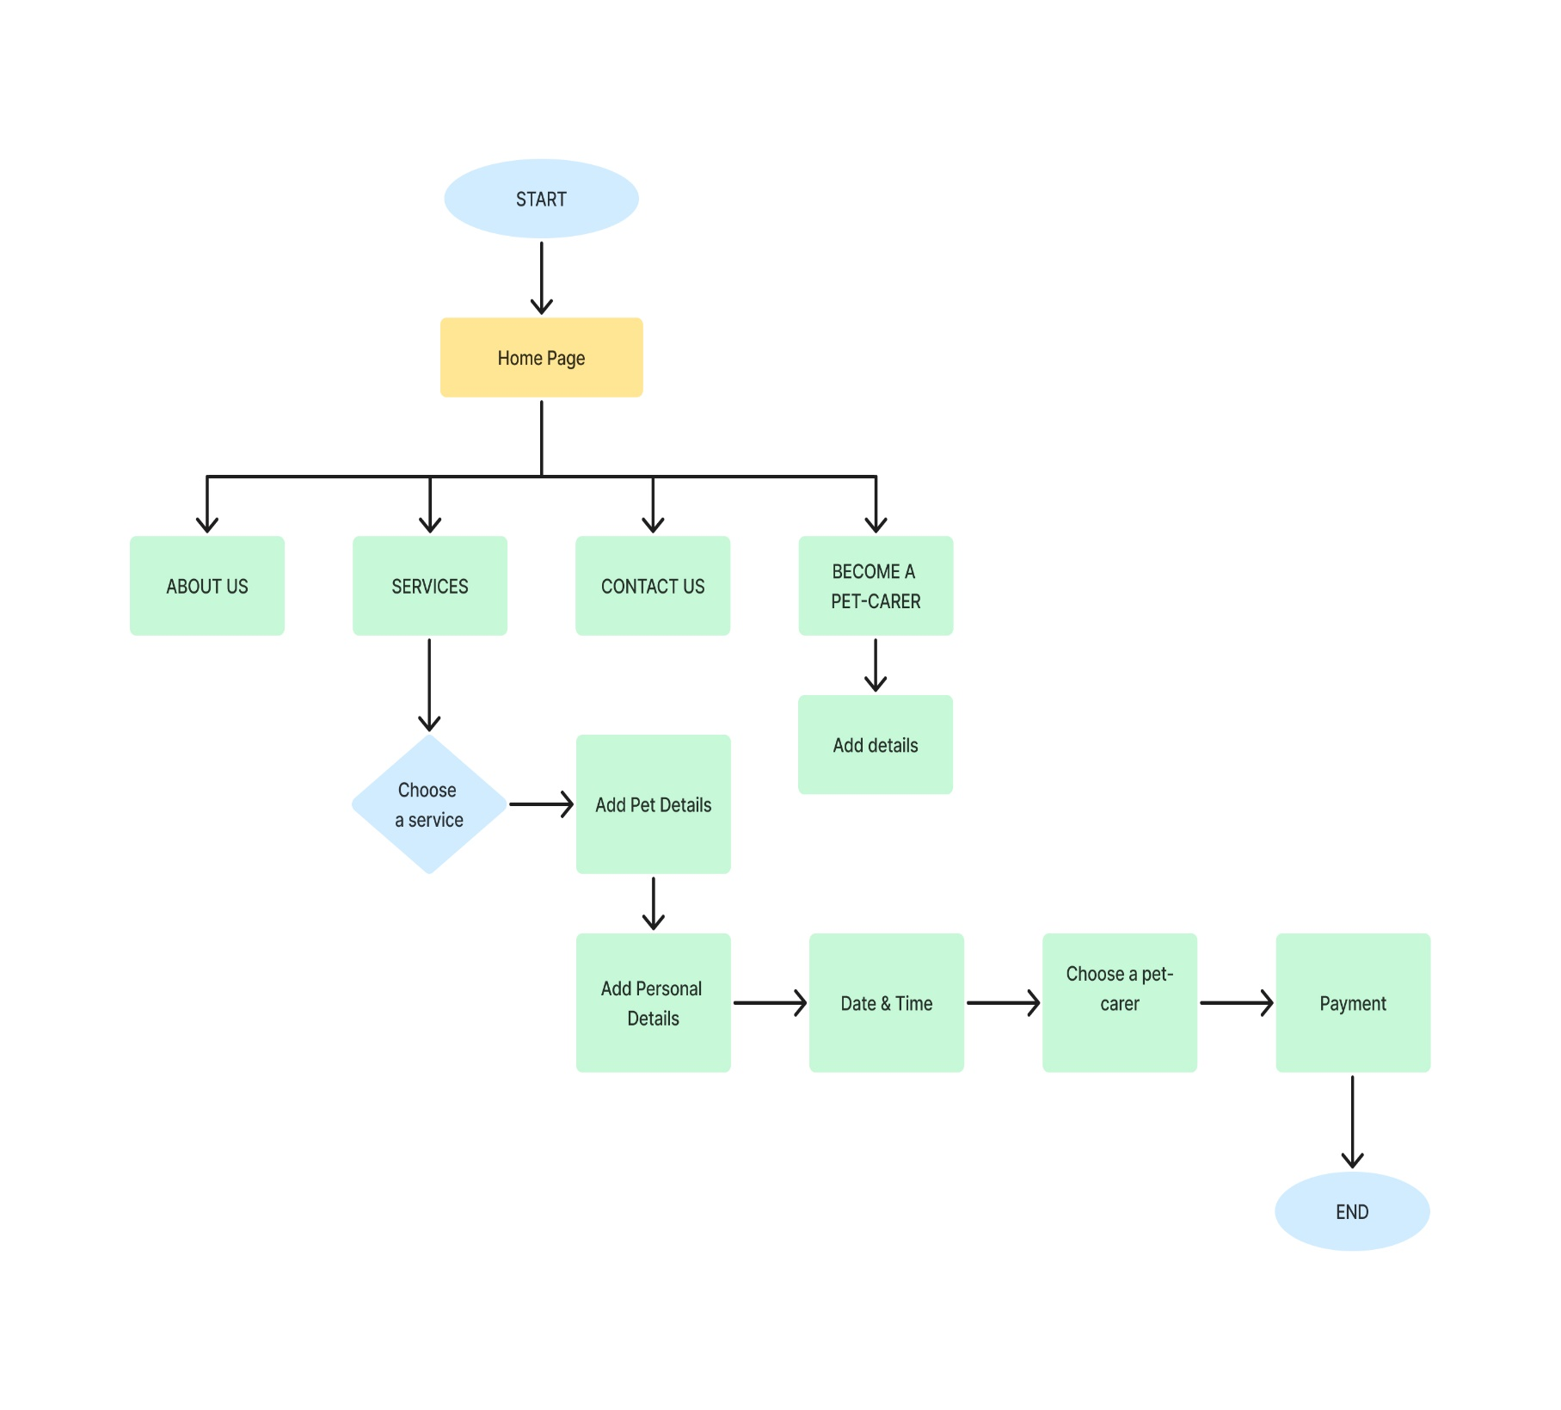
Website Flow Diagram

Slide 9
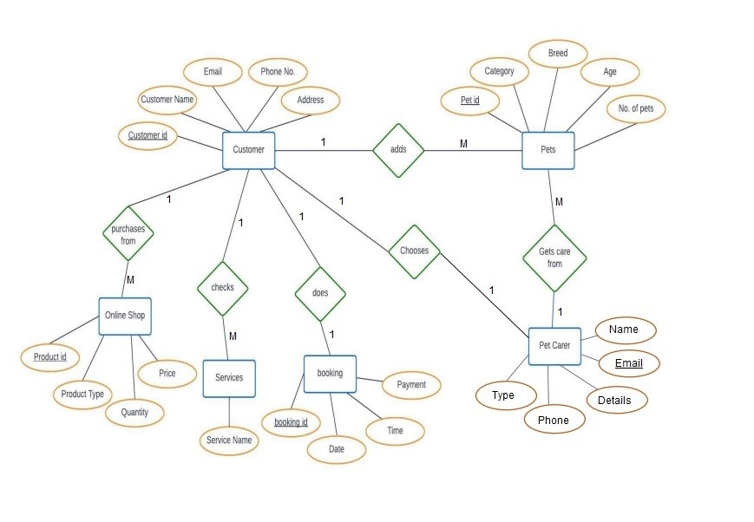
Entity Relationship Diagram (ERD)

Slide 10
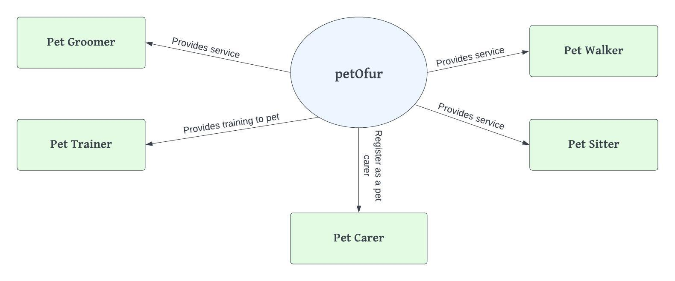
Data Flow Diagram (DFD)
Level 0 DFD

Slide 11
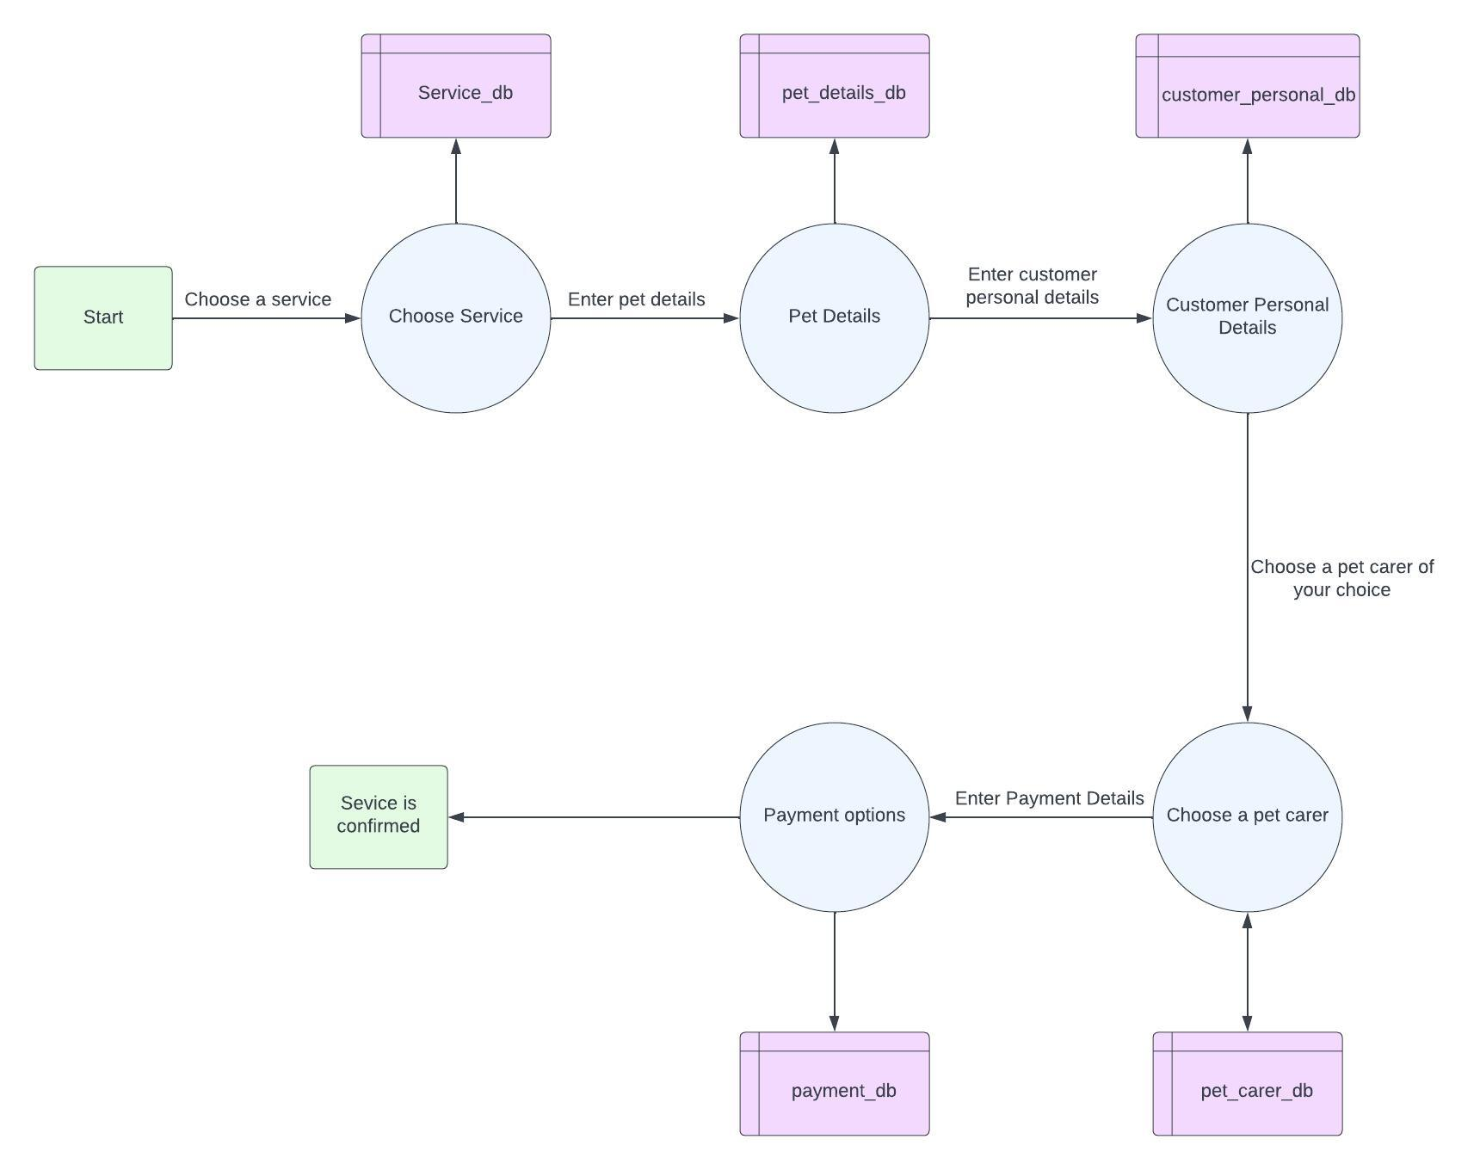
DFD
Level 1 DFD

Slide 12
Conclusion:
In conclusion, PetOFur is an online pet care service booking web development project that aims to help pet owners who require dependable, practical, and trustworthy services for their animals. A pet care service website may assist pet owners in meeting their pets' requirements while also giving them peace of mind by offering a user-friendly interface, simple booking and payment choices, and access to reliable service providers. To offer the best possible user experience and satisfaction, the website's features and capabilities, including booking, payment, and user assistance, must be carefully planned, often tested, and maintained. Overall, a pet care service website has the potential to enhance the lives of pets and their owners, and it is a valuable investment for anyone looking to provide high-quality pet care services.

