Slide 1
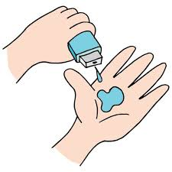
Major Project Title:-Doctors Visit
Name –
AICTE number-
College name –
Branch-

Slide 2

PROBLEM STATEMENT
Visualize the Percentage of People getting Govt. health insurance due to low income, due to old age. Also calculate the Percentage of People having Private Health Insurance.

Slide 3
Project Description
Based on the dataset analysis, this project focuses on healthcare utilization and insurance coverage patterns. The dataset contains 5,190 records with information about:
Doctor visits frequency
Demographics (age, gender)
Economic factors (income levels)
Insurance types (private, government assistance)
Health conditions (chronic illnesses)
Healthcare access and utilization
Key findings:
Gender distribution is fairly balanced (52% female, 48% male)
Multiple insurance coverage types (private, low-income assistance, elderly assistance)
Tracks both chronic and non-chronic health conditions
Includes reduced activity levels and general health indicators

Slide 4
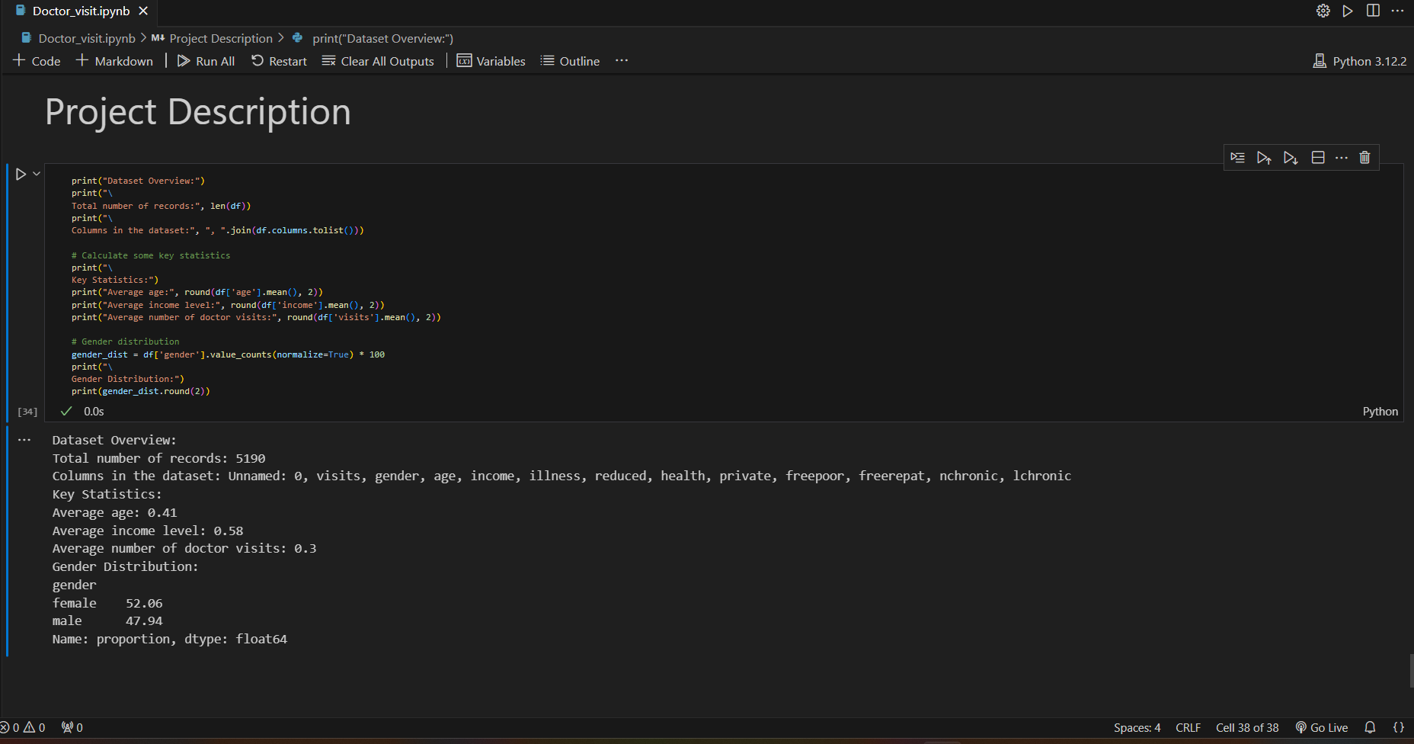

Slide 5

WHO ARE THE END USERS?
The end users are likely healthcare policymakers, insurance companies, and researchers interested in understanding healthcare utilization patterns, insurance coverage, and demographic influences on healthcare access.

Slide 6

Technology Used
Python
Pandas
Matplotlib
Seaborn
numpy
VsCode

Slide 7
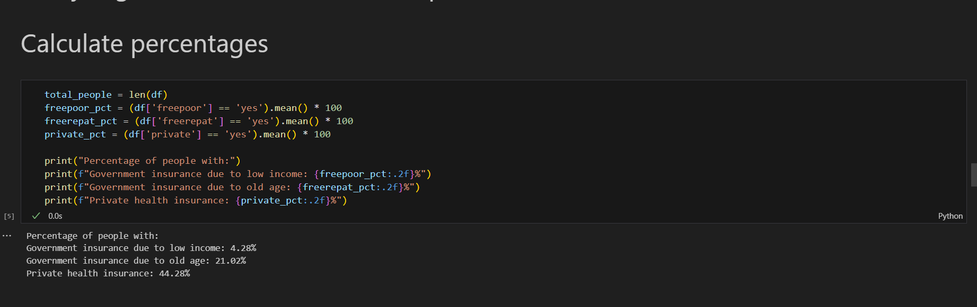
RESULTS

Slide 8
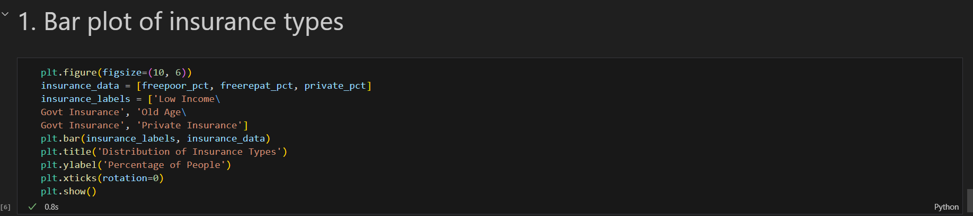
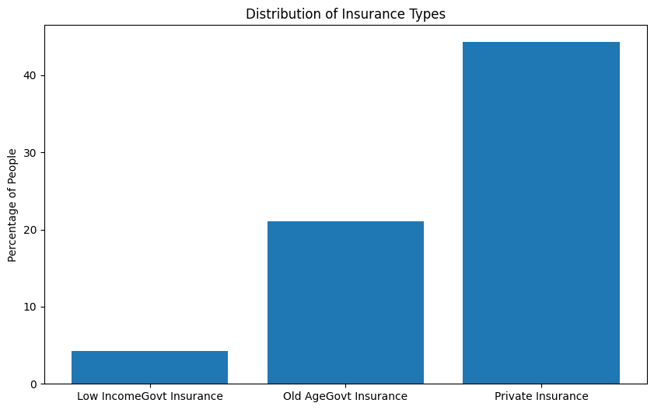

Slide 9
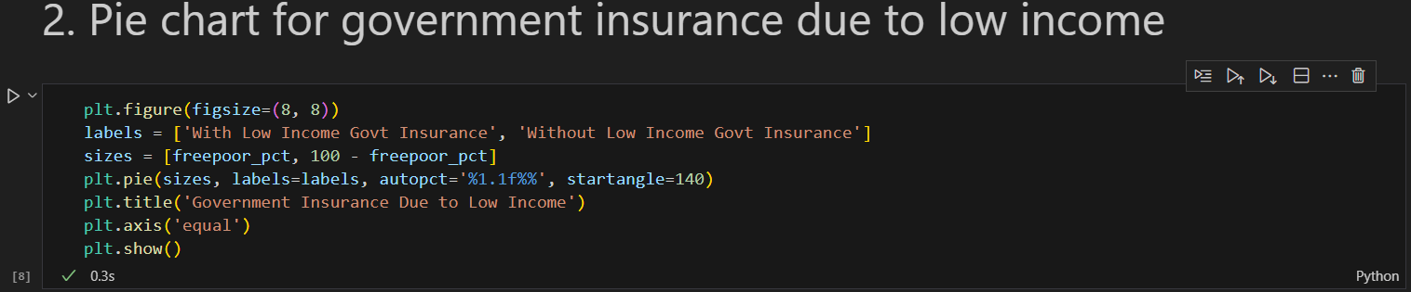
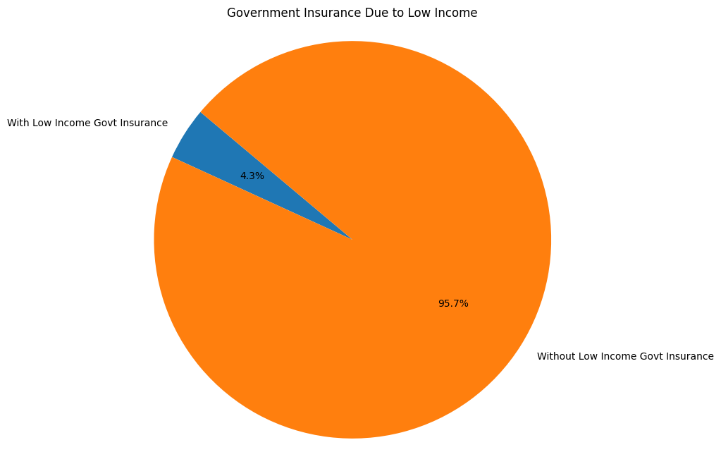

Slide 10
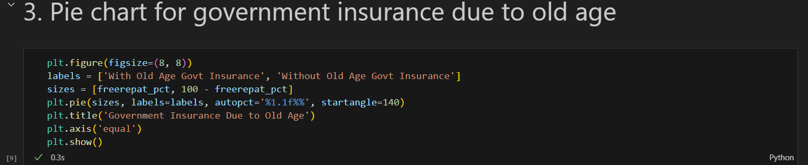
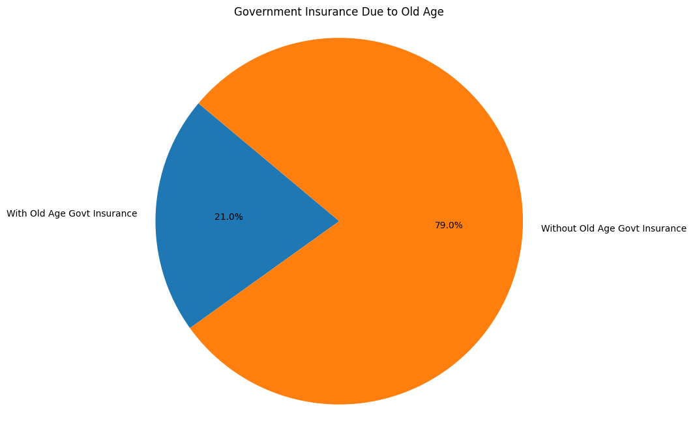

Slide 11
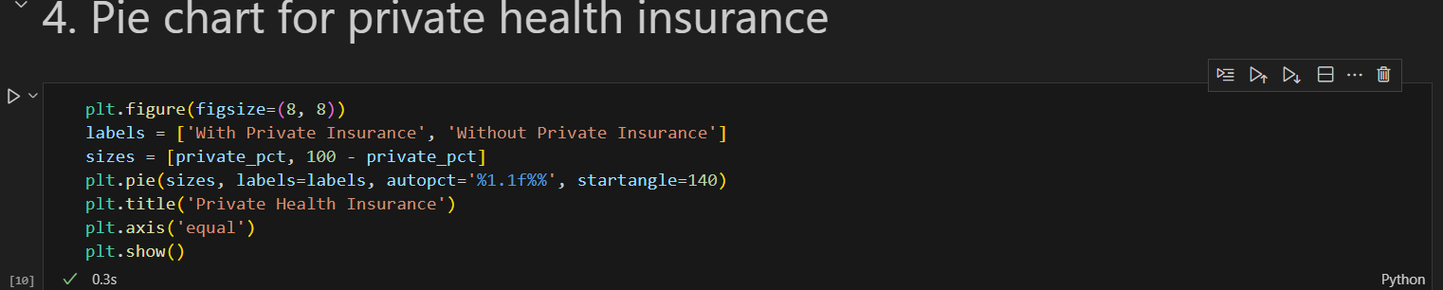
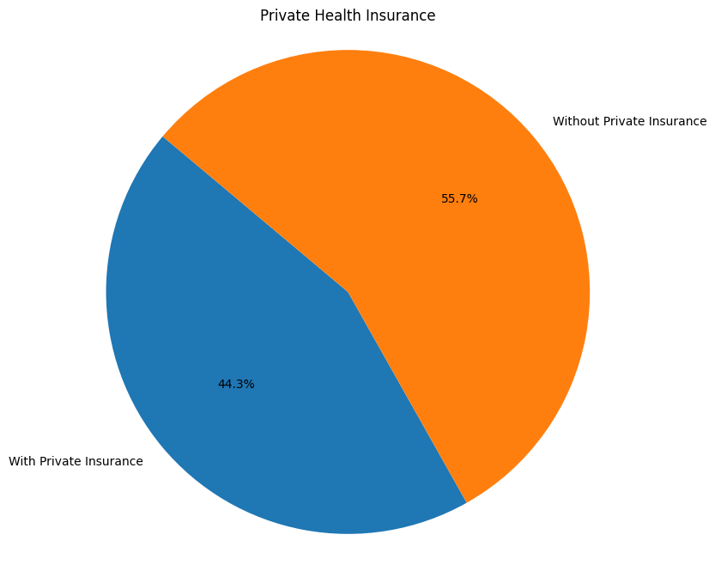

Slide 12
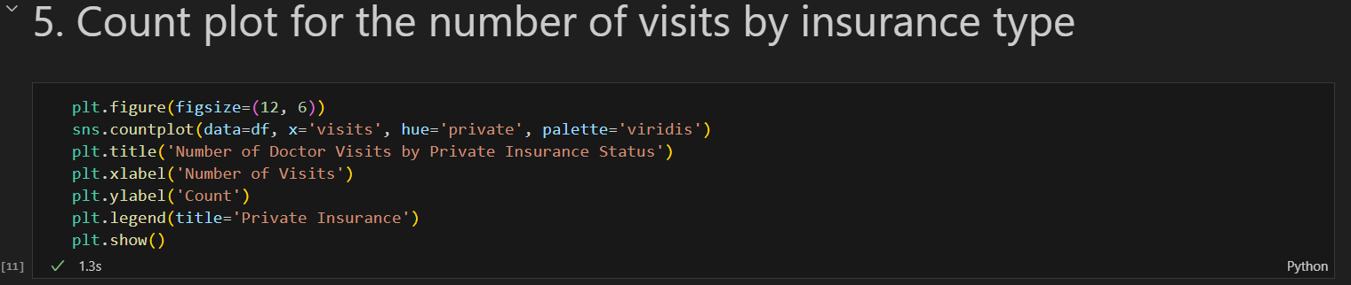
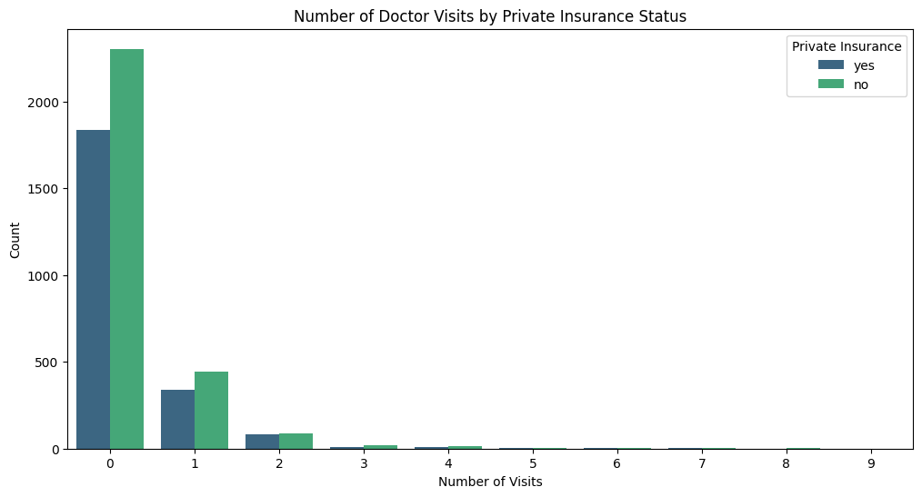

Slide 13
Thank you
.
.

