Slide 1
Future of Computing II: What’s So Special About Big Learning? 15-213 / 18-213 / 15-513: Introduction to Computer Systems 28th Lecture, December 5, 2017
Today’s Instructor:
Phil Gibbons

Slide 2

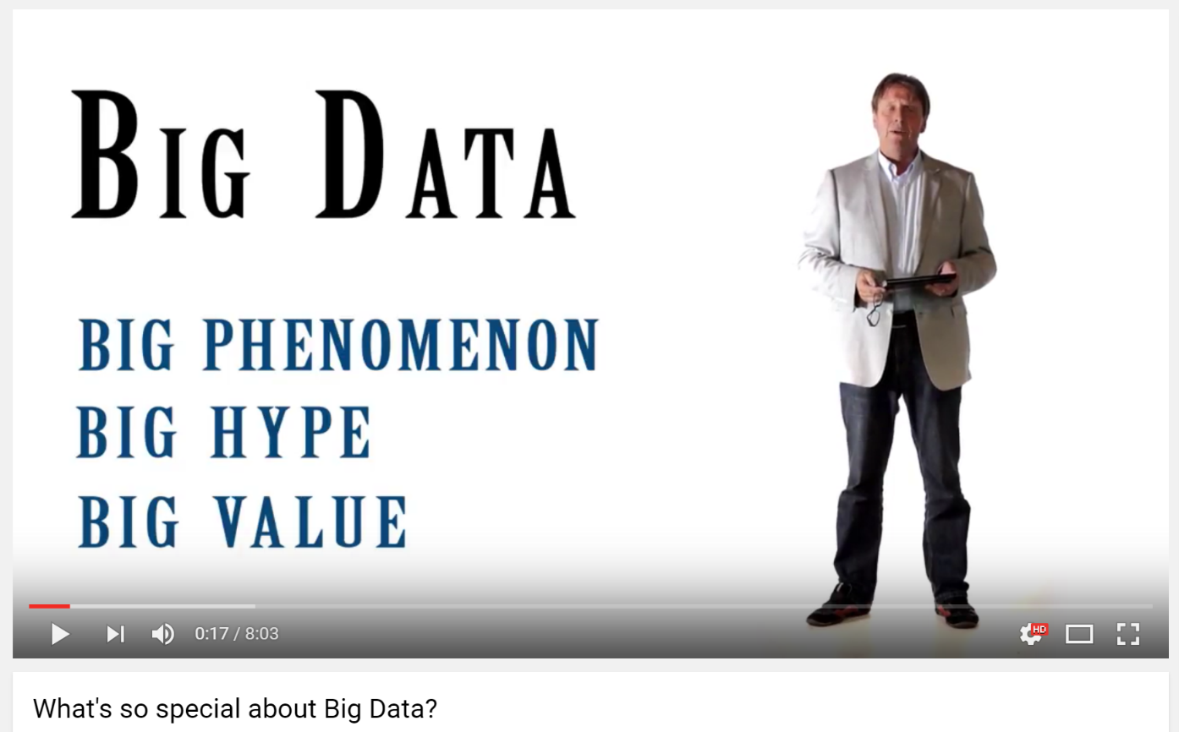

What’s So Special about…Big Data?

Slide 3
Focus of this Talk: Big Learning
Machine Learning over Big Data
Examples:
Collaborative Filtering (via Matrix Factorization)
Recommending movies
Topic Modeling (via LDA)
Clusters documents into K topics
Multinomial Logistic Regression
Classification for multiple discrete classes
Deep Learning neural networks:
Also: Iterative graph analytics, e.g. PageRank

Slide 4
Big Learning Frameworks & Systems
Goal: Easy-to-use programming framework for Big Data Analytics that delivers good performance on large (and small) clusters
A few popular examples (historical context):
Hadoop (2006-)
GraphLab / Dato (2009-)
Spark / Databricks (2009-)

Slide 5

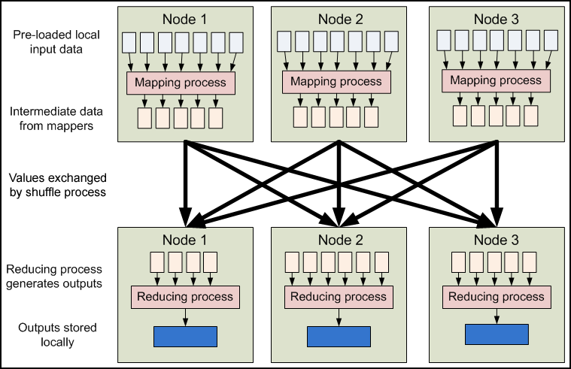
Hadoop
Hadoop Distributed File System (HDFS)
Hadoop YARN resource scheduler
Hadoop MapReduce
Image from: developer.yahoo.com/hadoop/tutorial/module4.html
Key Learning: Ease of use trumps performance

Slide 6

GraphLab
Graph Parallel: “Think like a vertex”
Graph Based
Data Representation
Update Functions
User Computation
Scheduler
Consistency Model
Slide courtesy of Carlos Guestrin
Key Learning: Graph Parallel is quite useful

Slide 7
Triangle Counting* in Twitter Graph
*How often are two of a user’s friends also friends?
Total: 34.8 Billion Triangles
40M Users 1.2B Edges
1536 Machines
423 Minutes
64 Machines, 1024 Cores
1.5 Minutes
Key Learning: Graph Parallel is MUCH faster than Hadoop!
Hadoop results from [Suri & Vassilvitskii '11]
Notes:
Hadoop [1] S. Suri and S. Vassilvitskii, “Counting triangles and the curse of the last reducer,” presented at the WWW '11: Proceedings of the 20th international conference on World wide web, 2011.

Slide 8
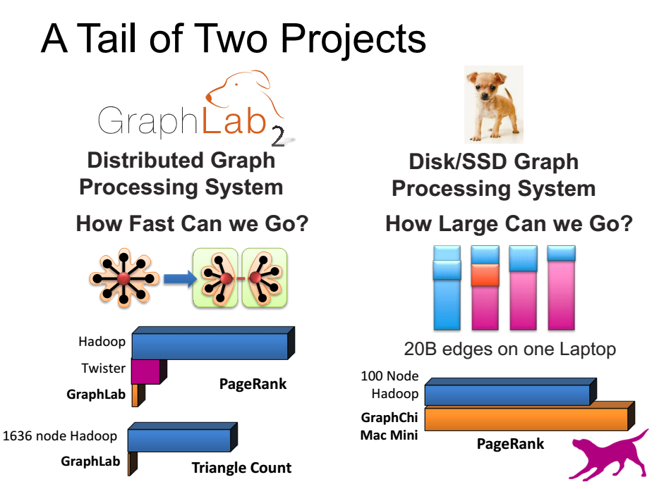
GraphLab & GraphChi
How to handle high degree nodes: GAS approach
Slide courtesy of Carlos Guestrin
Can do fast BL on a machine w/SSD-resident data

Slide 9

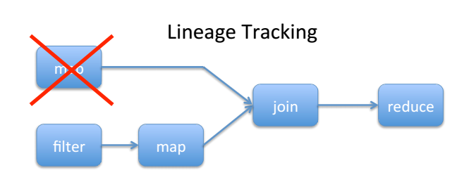
Spark: Key Idea
Features:
In-memory speed w/fault tolerance via lineage tracking
Bulk Synchronous
Resilient Distributed Datasets: A Fault-Tolerant Abstraction for In­Memory Cluster Computing, [Zaharia et al, NSDI’12, best paper]
A restricted form of shared memory, based on coarse-grained deterministic transformations rather than fine-grained updates to shared state: expressive, efficient and fault tolerant
In-memory compute can be fast & fault-tolerant

Slide 10

Spark’s Open Source Impact
Spark Timeline
Research breakthrough in 2009
First open source release in 2011
Into Apache Incubator in 2013
In all major Hadoop releases by 2014
Pipeline of research breakthroughs (publications in best conferences) fuel continued leadership & uptake
Start-up (Databricks), Open Source Developers, and Industry partners (IBM, Intel) make code commercial-grade
Fast path for Academics impact via Open Source:
Pipeline of research breakthroughs into widespread commercial use in 2 years!

Slide 11
Big Learning Frameworks & Systems
Goal: Easy-to-use programming framework for Big Data Analytics that delivers good performance on large (and small) clusters
A few popular examples (historical context):
Hadoop (2006-)
GraphLab / Dato (2009-)
Spark / Databricks (2009-)
Our Idea: Discover & take advantage of distinctive properties (“what’s so special”) of Big Learning training algorithms

Slide 12
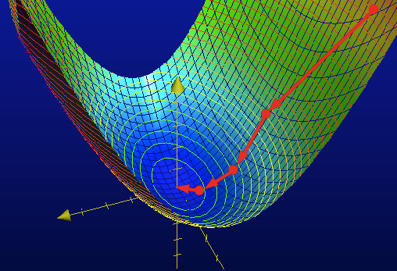
What’s So Special about Big Learning? …A Mathematical Perspective
Formulated as an optimization problem
Use training data to learn model parameters that minimize/maximize an objective function
No closed-form solution, instead algorithms iterate until convergence
E.g., Stochastic Gradient Descent
Image from charlesfranzen.com

Slide 13
Recall: Training DNNs
Model Size
Training Data
Training Effort
×
➔
Characteristics
Iterative numerical algorithm
Regular data organization
Project Adam Training
2B connections
15M images
62 machines
10 days

Slide 14
What’s So Special about Big Learning? …A Distributed Systems Perspective
The Bad News
Lots of Computation / Memory
Many iterations over Big Data
Big Models
Need to distribute computation widely
Lots of Communication / Synchronization
Not readily “partitionable”
Model Training is SLOW
hours to days to weeks, even on many machines
…why good distributed systems research is needed!

Slide 15
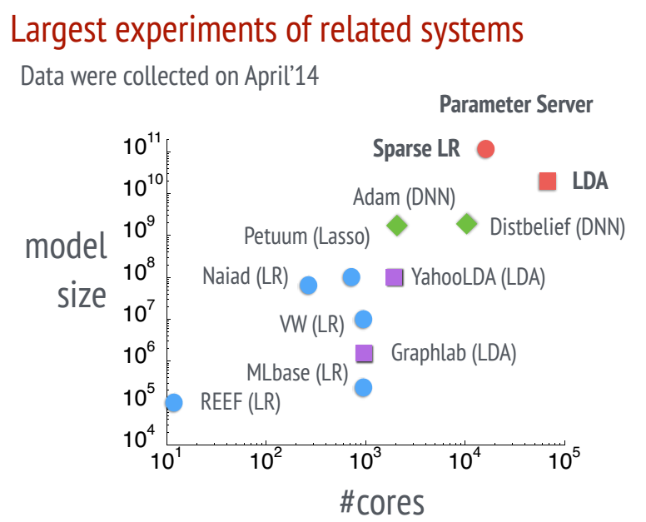
Big Models, Widely Distributed
[Li et al, OSDI’14]

Slide 16
Lots of Communication / Synchronization e.g. in BSP Execution (Hadoop, Spark)
P₁
P₂
P₃
P₄
P₅
Exchange ALL updates at END of each iteration
Frequent, bursty communication
Synchronize ALL threads each iteration
Straggler problem: stuck waiting for slowest
Compute
Communicate
Compute
Communicate
Compute
Communicate

Slide 17
What’s So Special about Big Learning? …A Distributed Systems Perspective
The Good News
Commutative/Associative parameter updates
Tolerance for lazy consistency of parameters
Repeated parameter data access pattern
Intra-iteration progress measure
Parameter update importance hints
Layer-by-layer pattern of deep learning
Most parameter updates are insignificant
…can exploit to run orders of magnitude faster!

Slide 18

Parameter Servers for Distributed ML
Provides all workers with convenient access to global model parameters
“Distributed shared memory” programming style
Single
Machine
Parallel
UpdateVar(i) {
old = y[i]
delta = f(old)
y[i] += delta }
Worker 1
Parameter
Table
Worker 2
UpdateVar(i) {
old = PS.read(y,i)
delta = f(old)
PS.inc(y,i,delta) }
(sharded across machines)
Distributed
with PS
Worker 3
Worker 4
[Power & Li, OSDI’10], [Ahmed et al, WSDM’12], [NIPS’13], [Li et al, OSDI’14], Petuum, MXNet, TensorFlow, etc

Slide 19
Problem: Cost of Bulk Synchrony
Thread 1
1
2
3
Thread 2
1
2
3
Thread 3
1
2
3
Thread 4
1
2
3
Time
Exchange ALL updates at END of each iteration
Synchronize ALL threads each iteration
Bulk Synchrony => Frequent, bursty communication & stuck waiting for stragglers
But: Fully asynchronous => No algorithm convergence guarantees

Slide 20
Stale Synchronous Parallel (SSP)
Staleness Bound S=3
Thread 1 waits until
Thread 2 has reached iter 4
Thread 1
Thread 1 will always see
these updates
Thread 2
Thread 3
Thread 1 may not see
these updates
Thread 4
0
1
2
3
4
5
6
7
8
9
Iteration
Fastest/slowest threads not allowed to drift >S iterations apart
Allow threads to usually run at own pace
Protocol: check cache first; if too old, get latest version from network
Choice of S: Staleness “sweet spot”
Exploits: 1. commutative/associative updates & 2. tolerance for lazy consistency (bounded staleness)
[NIPS’13]
[ATC’14]

Slide 21
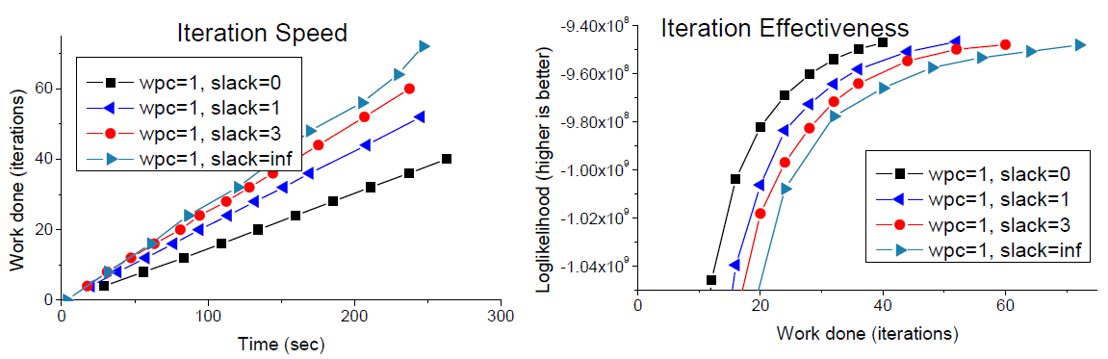
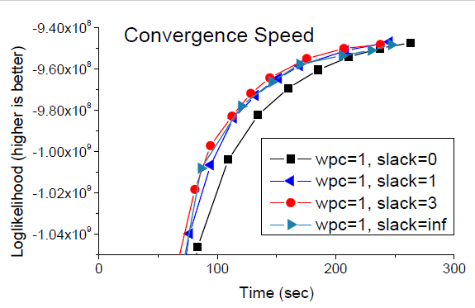
Staleness Sweet Spot
Topic Modeling
Nytimes dataset
400k documents
100 topics
LDA w/Gibbs sampling
8 machines x 64 cores
40Gbps Infiniband
[ATC’14]

Slide 22
What’s So Special about Big Learning? …A Distributed Systems Perspective
The Good News
Commutative/Associative parameter updates
Tolerance for lazy consistency of parameters
Repeated parameter data access pattern
Intra-iteration progress measure
Parameter update importance hints
Layer-by-layer pattern of deep learning
Most parameter updates are insignificant
…can exploit to run orders of magnitude faster!

Slide 23
Repeated Data Access in PageRank
Input data: a set of links, stored locally in workers
Parameter data: ranks of pages, stored in PS
Page0
Worker-0
Init ranks to random value
loop
foreach link from i to j {
read Rank(i)
update Rank(j)
}
while not converged
Link-0
Link-2
Link-3
Page2
Link-1
Page1
Worker-1

Slide 24
Repeated Data Access in PageRank
Input data: a set of links, stored locally in workers
Parameter data: ranks of pages, stored in PS
Worker-0
loop
# Link-0
read page[2].rank
update page[0].rank
# Link-1
read page[1].rank
update page[2].rank
clock()
while not converged
Page0
Worker-0
Link-0
Link-2
Link-3
Page2
Link-1
Page1
Worker-1
Repeated access sequence depends only on input data (not on parameter values)

Slide 25
Exploiting Repeated Data Access
Collect access sequence in “virtual iteration”
Enables many optimizations:
Parameter data placement across machines
Machine-0
Machine-1
ML Worker
ML Worker
PS shard
PS shard

Slide 26
Exploiting Repeated Data Access
Collect access sequence in “virtual iteration”
Enables many optimizations:
Parameter data placement across machines
Prefetching
Static cache policies
More efficient marshalling-free data structures
NUMA-aware memory placement
Benefits are resilient to moderate deviation in an iteration’s actual access pattern

Slide 27
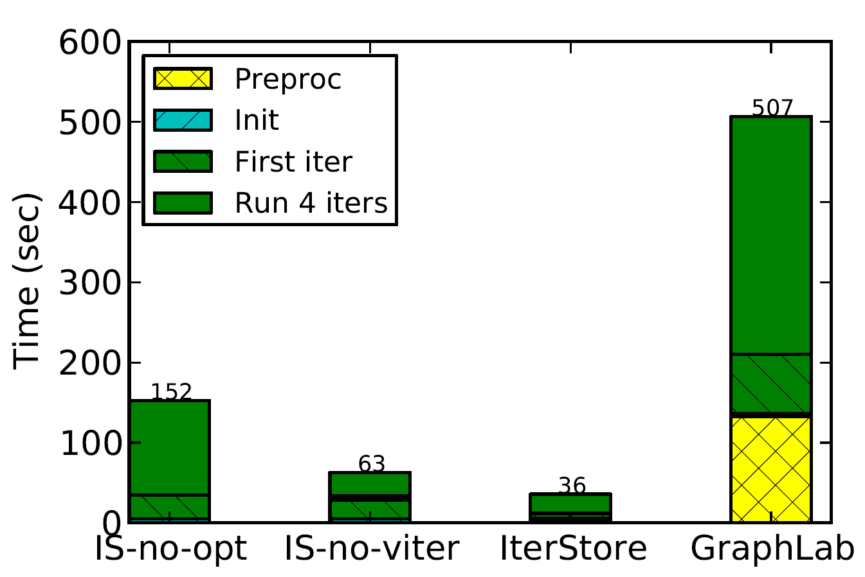
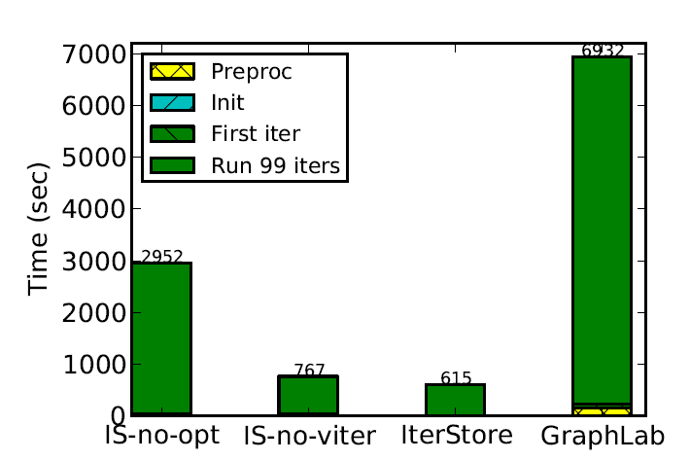
IterStore: Exploiting Iterativeness
4 iterations
[SoCC’14]
Collaborative Filtering (Matrix Factorization) NetFlix data set 8 machines x 64 cores
40 Gbps Infiniband
99 iterations
4-5x faster than baseline
11x faster than GraphLab

Slide 28
What’s So Special about Big Learning? …A Distributed Systems Perspective
The Good News
Commutative/Associative parameter updates
Tolerance for lazy consistency of parameters
Repeated parameter data access pattern
Intra-iteration progress measure
Parameter update importance hints
Layer-by-layer pattern of deep learning
Most parameter updates are insignificant
…can exploit to run orders of magnitude faster!

Slide 29
Addressing the Straggler Problem
Many sources of transient straggler effects
Resource contention
System processes (e.g., garbage collection)
Slow mini-batch at a worker
Causes significant slowdowns for Big Learning
FlexRR: SSP + Low-overhead work migration (RR) to mitigate transient straggler effects
Simple: Tailored to Big Learning’s special properties E.g., cloning (used in MapReduce) would break the algorithm (violates idempotency)!
Staleness provides slack to do the migration

Slide 30
Rapid-Reassignment (RR) Protocol
Multicast to preset possible helpees (has copy of tail of helpee’s input data)
Intra-iteration progress measure: percentage of input data processed
Can process input data in any order
Assignment is percentage range
State is only in PS
Work must be done exactly once
Ok
Fast
Slow
Ignore
(I don’t need help)
I’m this far
I’m this far
I’m behind
(I need help)
Do assignment #1
(red work
Started Working
Do assignment #2
(green work)
Cancel

Slide 31
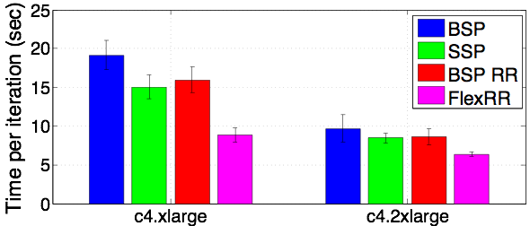
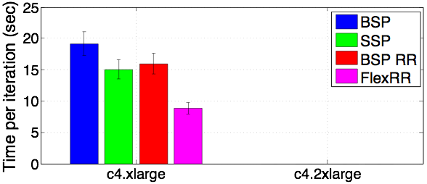
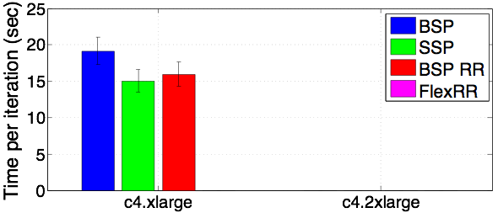
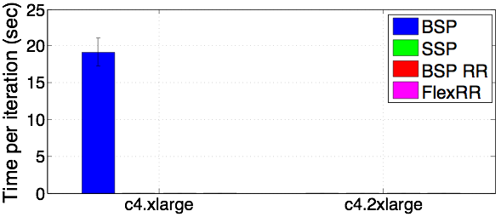
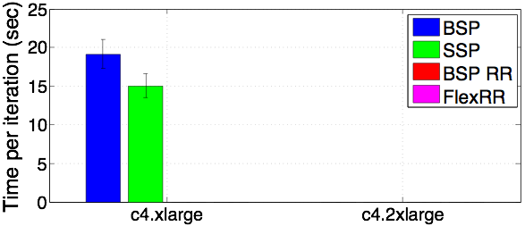
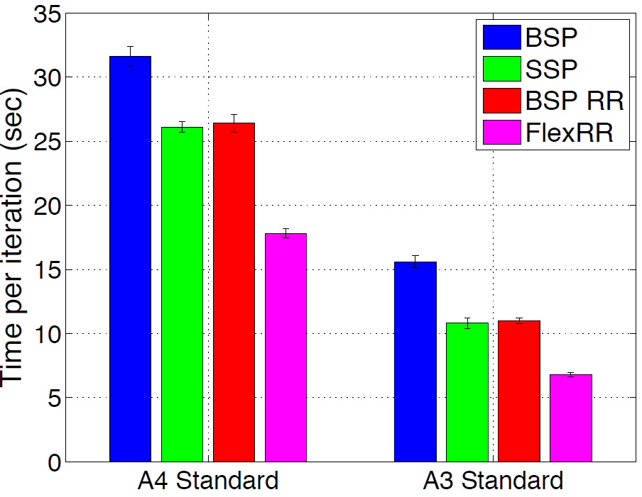
FlexRR Performance
64 EC2 Instances
64 Azure Instances
Matrix Factorization
Netflix dataset
[SoCC’16]
Both SSP & RR required.
Nearly ideal straggler mitigation

Slide 32
FlexRR Performance
64 EC2 Instances
64 Azure Instances
Matrix Factorization
Netflix dataset
[SoCC’16]
Both SSP & RR required.
Nearly ideal straggler mitigation

Slide 33
What’s So Special about Big Learning? …A Distributed Systems Perspective
The Good News
Commutative/Associative parameter updates
Tolerance for lazy consistency of parameters
Repeated parameter data access pattern
Intra-iteration progress measure
Parameter update importance hints
Layer-by-layer pattern of deep learning
Most parameter updates are insignificant
…can exploit to run orders of magnitude faster!

Slide 34
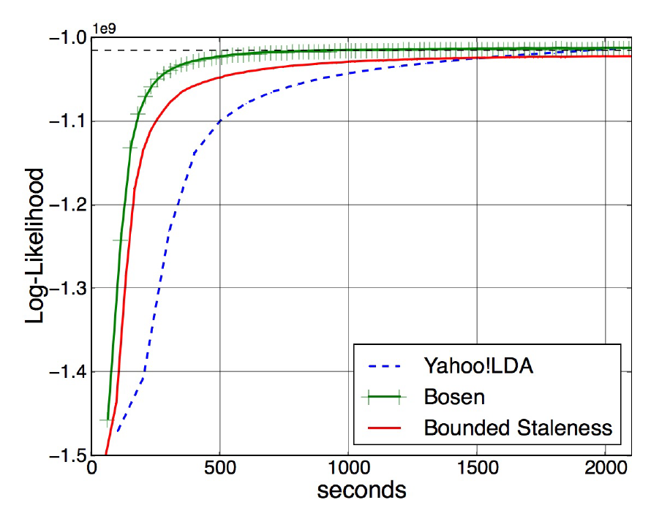
Bosen: Managed Communication
Combine SSP’s lazy transmission of parameter updates with:
early transmission of larger parameter changes
(Idea: larger change likely to be an important update)
up to bandwidth limit & staleness limit
LDA Topic Modeling
Nytimes dataset
16x8 cores
[SoCC’15]

Slide 35
What’s So Special about Big Learning? …A Distributed Systems Perspective
The Good News
Commutative/Associative parameter updates
Tolerance for lazy consistency of parameters
Repeated parameter data access pattern
Intra-iteration progress measure
Parameter update importance hints
Layer-by-layer pattern of deep learning
Most parameter updates are insignificant
…can exploit to run orders of magnitude faster!

Slide 36
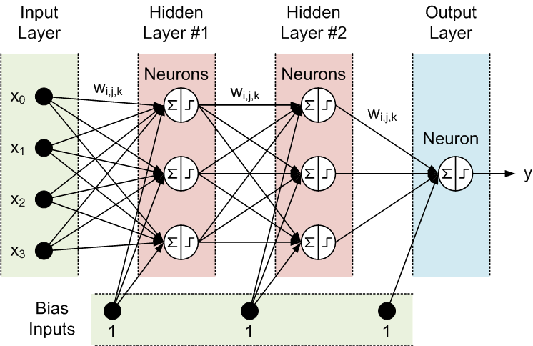
Recall: Data Analysis with Deep Neural Networks
Task:
Compute classification of set of input signals
Training
Use many training samples of form input / desired output
Compute weights that minimize classification error
Operation
Propagate signals from input to output

Slide 37


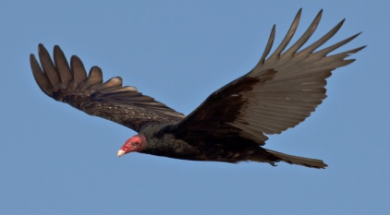

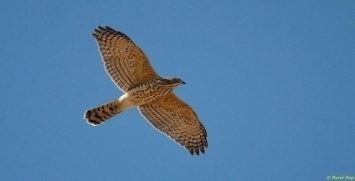
Distributed Deep Learning
Eagle
Parameter server
for GPUs
Vulture
read, update
Osprey
Accipiter
Partitioned
training data
Distributed
ML workers
Shared
model parameters

Slide 38
Layer-by-Layer Pattern of DNN
For each iteration (mini-batch)
A forward pass
Then a backward pass
Pairs of layers used at a time
Class probabilities
Training images

Slide 39
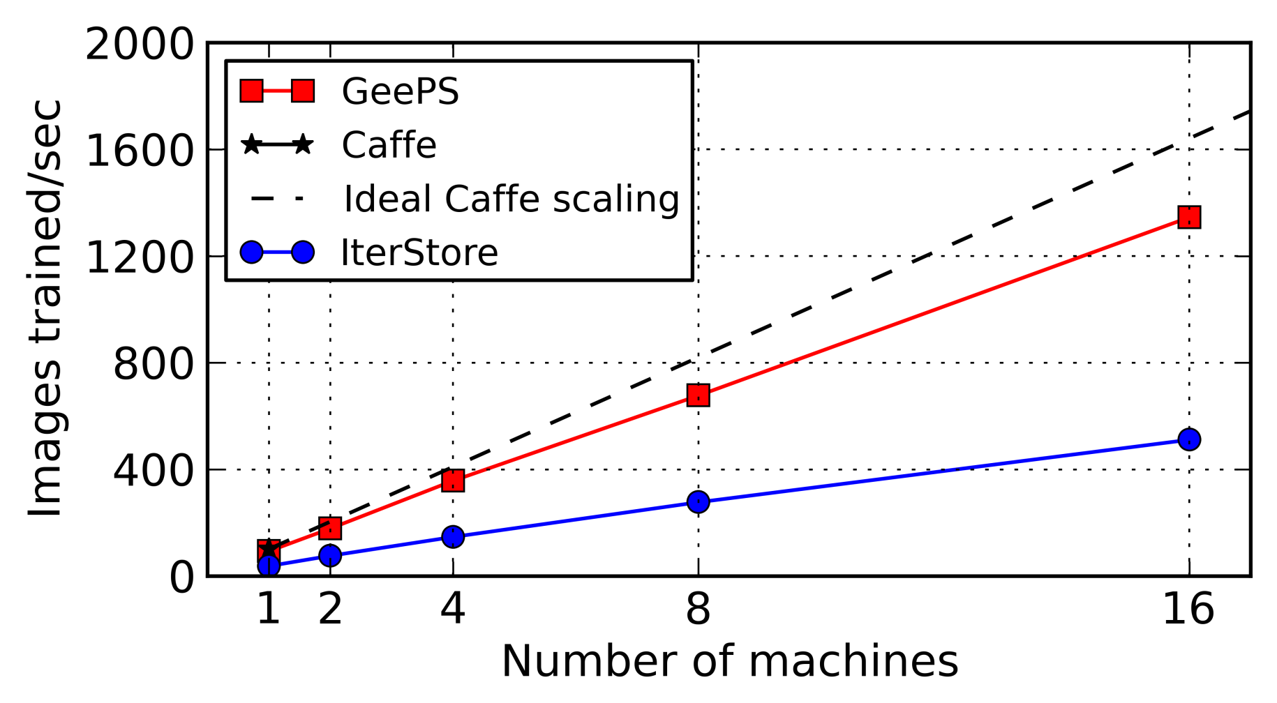
GeePS: Parameter Server for GPUs
Careful management of GPU & CPU memory
Use GPU memory as cache to hold pairs of layers
Stage remaining data in larger CPU memory
ImageNet22K
Adam model
[EuroSys’16]
GeePS is 13x faster than Caffe (1 GPU) on 16 machines, 2.6x faster than IterStore (CPU parameter server)

Slide 40
What’s So Special about Big Learning? …A Distributed Systems Perspective
The Good News
Commutative/Associative parameter updates
Tolerance for lazy consistency of parameters
Repeated parameter data access pattern
Intra-iteration progress measure
Parameter update importance hints
Layer-by-layer pattern of deep learning
Most parameter updates are insignificant
…can exploit to run orders of magnitude faster!

Slide 41
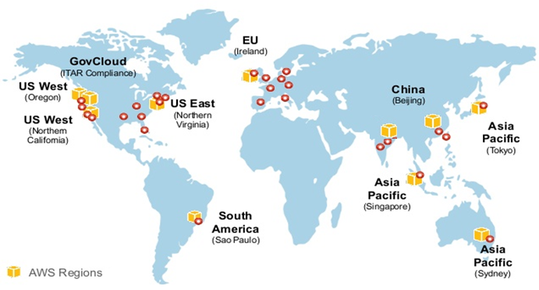

Geo-Distributed Machine Learning
Data sources are everywhere (geo-distributed)
Too expensive (or not permitted) to ship all data to single data center
ML training done across the WAN

Slide 42

Gaia System Overview
Key idea: Decouple the synchronization model within the data center from the synchronization model between data centers
Data Center 1
Data Center 2
Remote Sync
Worker Machine
…
Parameter
Server
Parameter
Server
Eliminate insignificant updates over WANs
Worker Machine
Parameter
Server
Parameter
Server
…
Worker Machine
Local Sync
Approximately Correct Model Copy
Approximately Correct Model Copy
[NSDI’17]
Notes:
Our solution, Gaia, is build on top of the parameter server architecture. The key idea of Gaia is decoupling the synchronization model within the data center from the synchronization model between data centers. This architecture allows the system to handle LAN and WAN with different approach. Here is the overview of Gaia. In Gaia, we still have worker machines in each data center to work on its data, and we have several parameter servers in each data center. The major difference is the parameter servers in each data center maintains a full approximately correct model copy. So the worker machines only need to talk to the local parameter servers to make progress. These model copies are approximately correct as we allow some acceptable difference among the model copies. We use another remote synchronization model between data centers. As we only need to ensure they are approximately correct, we can eliminate insignificant communication over WANs.

Slide 43
Performance – 11 EC2 Data Centers
Gaia achieves 3.7-6.0X speedup over Baseline
Gaia is within 1.40X of LAN speeds
Also: Gaia is 2.6-8.5X cheaper than Baseline
Baseline: IterStore for CPUs, GeePS for GPUs

Slide 44
What’s So Special about Big Learning? …A Distributed Systems Perspective
The Good News
Commutative/Associative parameter updates
Tolerance for lazy consistency of parameters
Repeated parameter data access pattern
Intra-iteration progress measure
Parameter update importance hints
Layer-by-layer pattern of deep learning
Most parameter updates are insignificant
…can exploit to run orders of magnitude faster!

Slide 45
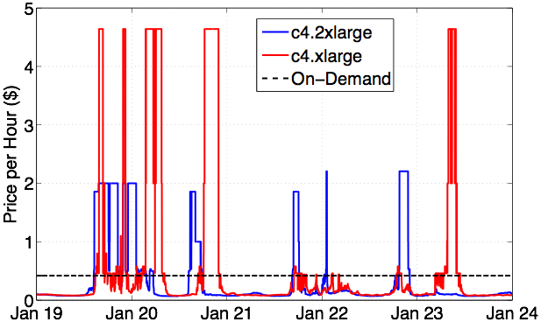
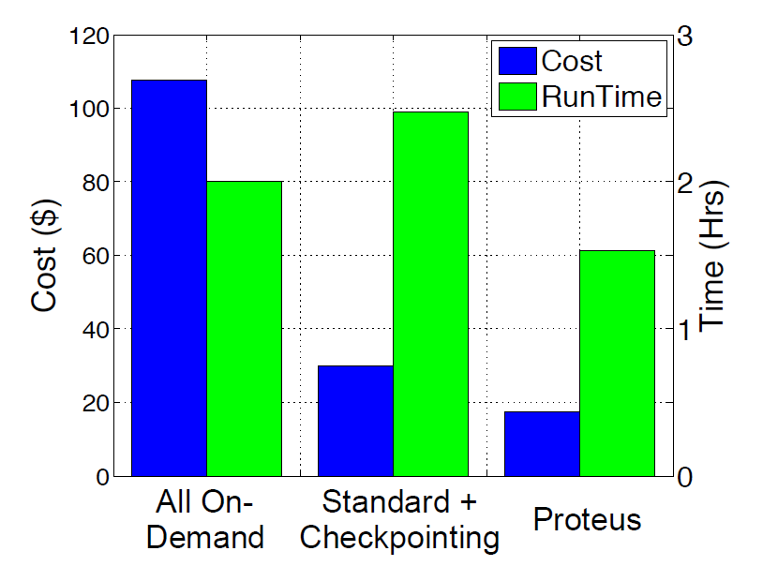
Proteus: Playing the Spot Market
Spot Instances are often 85%-90% cheaper, but can be taken away at short notice
Different machine types have uncorrelated spikes
[EuroSys’17]
Proteus uses agile tiers of reliability + aggressive bidding for cheap (free) compute

Slide 46
What’s So Special about Big Learning? …A Distributed Systems Perspective
The Good News
Commutative/Associative parameter updates
Tolerance for lazy consistency of parameters
Repeated parameter data access pattern
Intra-iteration progress measure
Parameter update importance hints
Layer-by-layer pattern of deep learning
Most parameter updates are insignificant
…can exploit to run orders of magnitude faster!

Slide 47
Thanks to Collaborators & Sponsors
CMU Faculty: Greg Ganger, Garth Gibson, Eric Xing
CMU/ex-CMU Students: James Cipar, Henggang Cui, Wei Dai, Jesse Haber-Kucharsky, Aaron Harlap, Qirong Ho, Kevin Hsieh, Jin Kyu Kim, Dimitris Konomis, Abhimanu Kumar, Seunghak Lee, Aurick Qiao, Alexey Tumanov, Nandita Vijaykumar, Jinliang Wei, Lianghong Xu, Hao Zhang
Sponsors:
PDL Consortium: Avago, Citadel, EMC, Facebook, Google, Hewlett-Packard Labs, Hitachi, Intel, Microsoft Research, MongoDB, NetApp, Oracle, Samsung, Seagate, Symantec, Two Sigma, Western Digital
Intel (via ISTC for Cloud Computing & ISTC for Visual Cloud Systems)
National Science Foundation
(Bold=first author)
(Many of these slides adapted from slides by the students)

Slide 48
References (in order of first appearance)
[Zaharia et al, NSDI’12] M. Zaharia, M. Chowdhury, T. Das, A. Dave, J. Ma, M. McCauly, M. J. Franklin, S. Shenker, and I. Stoica. Resilient Distributed Datasets: A Fault-Tolerant Abstraction for In­-Memory Cluster Computing. Usenix NSDI, 2012.
[Li et al, OSDI’14] M. Li, D. G. Anderson, J. W. Park, A. J. Smola, A. Ahmed, V. Josifovski, J. Long, E. J. Shekita, and B.-Y. Su. Scaling distributed machine learning with the parameter server. Usenix OSDI, 2014.
[Power & Li, OSDI’10] R. Power and J. Li. Piccolo: Building Fast, Distributed Programs with Partitioned Tables. Usenix OSDI, 2010.
[Ahmed et al, WSDM’12] A. Ahmed, M. Aly, J. Gonzalez, S. M. Narayanamurthy, and A. J. Smola. Scalable inference in latent variable models. ACM WSDM, 2012.
[NIPS’13] Q. Ho, J. Cipar, H. Cui, S. Lee, J. K. Kim, P. B. Gibbons, G. Gibson, G. Ganger, and E. Xing. More effective distributed ML via a state synchronous parallel parameter server. NIPS, 2013.
[Petuum] petuum.org
[MXNet] T. Chen, M. Li, Y. Li, M. Lin, N. Wang, M. Wang, T. Xiao, B. Xu, C. Zhang, and Z. Zhang. MXNet: A flexible and efficient machine learning library for heterogeneous distributed systems. arXiv:1512.01274, 2015.
[TensorFlow] tensorflow.org
[ATC’14] H. Cui, J. Cipar, Q. Ho, J. K. Kim, S. Lee, A. Kumar, J. Wei, W. Dai, G. R. Ganger, P. B. Gibbons, G. A. Gibson, and E. P. Xing. Exploiting Bounded Staleness to Speed Up Big Data Analytics. Usenix ATC, 2014.
[SoCC’14] H. Cui, A. Tumanov, J. Wei, L. Xu, W. Dai, J. Haber-Kucharsky, Q. Ho, G. R. Ganger, P. B. Gibbons, G. A. Gibson, and E. P. Xing. Exploiting iterative-ness for parallel ML computations. ACM SoCC, 2014.
[SoCC’16] A. Harlap, H. Cui, W. Dai, J. Wei, G. R. Ganger, P. B. Gibbons, G. A. Gibson, and E. P. Xing. Addressing the straggler problem for iterative convergent parallel ML. ACM SoCC, 2016.

Slide 49
References (cont.)
[SoCC’15] J. Wei, W. Dai, A. Qiao, Q. Ho, H. Cui, G. R. Ganger, P. B. Gibbons, G. A. Gibson, and E. P. Xing. Managed Communication and Consistency for Fast Data-Parallel Iterative Analytics. ACM SoCC, 2015.
[EuroSys’16] H. Cui, H. Zhang, G. R. Ganger, P. B. Gibbons, E. P. Xing. GeePS: Scalable deep learning on distributed GPUs with a GPU-specialized parameter server. EuroSys, 2016.
[NSDI’17] K. Hsieh, A. Harlap, N. Vijaykumar, D. Konomis, G. R. Ganger, P. B. Gibbons, and O. Mutlu. Gaia: Geo-Distributed Machine Learning Approaching LAN Speeds. NSDI, 2017.
[EuroSys’17] A. Harlap, A. Tumanov, A. Chung, G. R. Ganger, and P. B. Gibbons. Proteus: agile ML elasticity through tiered reliability in dynamic resource markets. ACM EuroSys, 2017.

Slide 50
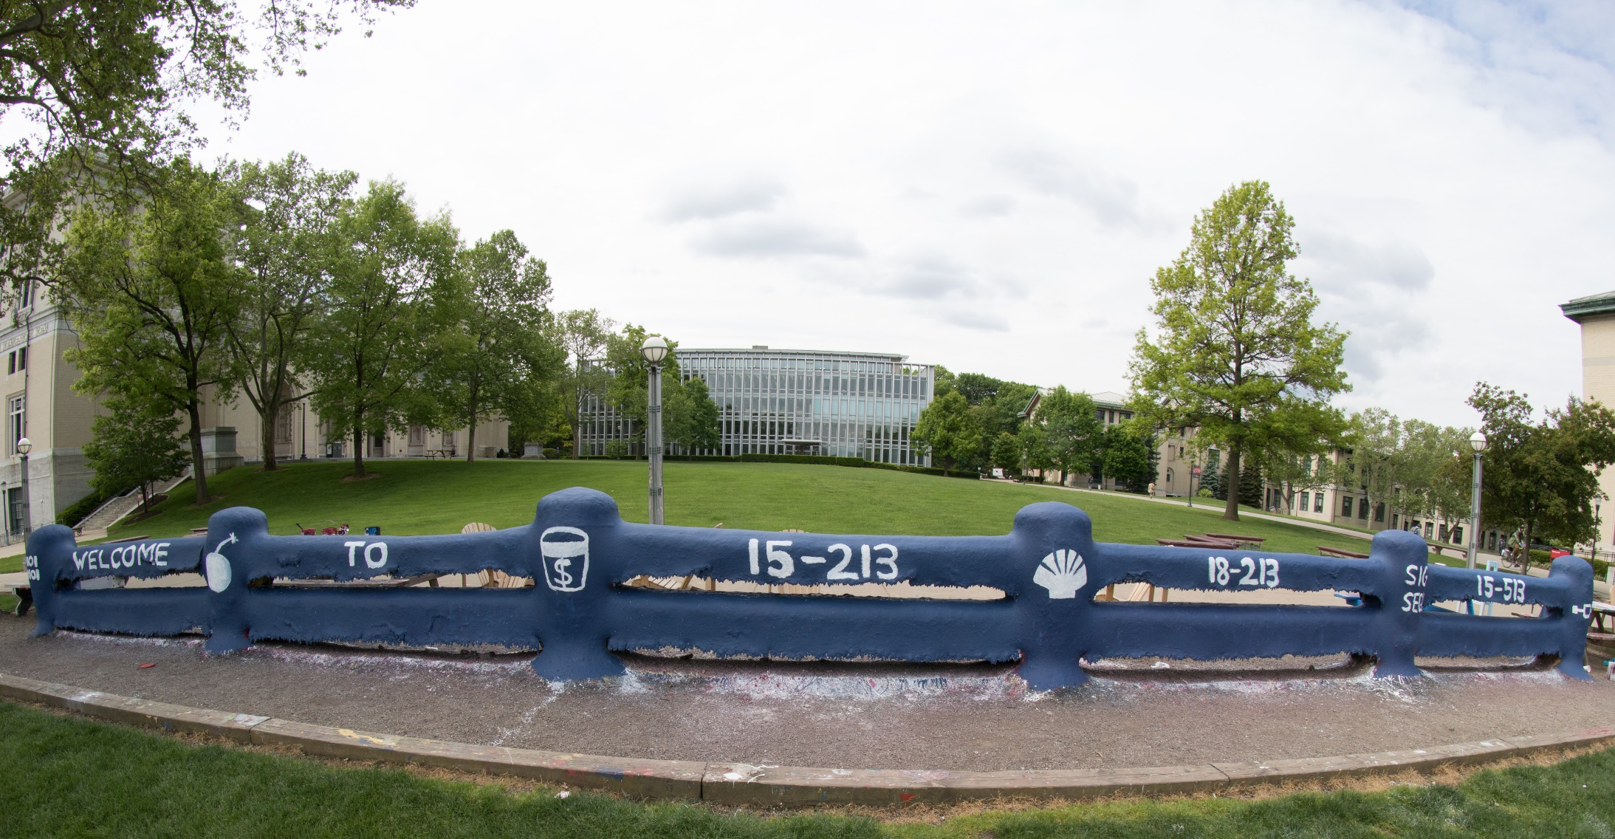
Thanks for a Great Semester!
Good Luck on the Final!

