Slide 1
SEMICON INDIA HACKATHON 2026
Team AIvengers — PS01 Idea Submission
Institution: Vellore Institute of Technology, Vellore
Tiyas Das
Team Leader & ML/AI Lead
Architecture Design & Loss Refinement
Soumen Mondal
Model Training Engineer
EDSR2x Model Development & Training
Partha Protim Mondal
Data Evaluation Engineer
Degradation Forensics & Metrics Audit
Aryan Raj
Deployment & Presentation Lead
Inference Pipeline & Packaging
KLA SemiCon AI Hackathon 2026 | Team AIvengers — Track 2 Submission Slide 1 of 9

Slide 2
Problem Statement Addressed
AI-Based Restoration of Degraded Images for Semiconductor Inspection_KLA
Semiconductor Inspection & Quality Control Challenge:
• Microscopic inspection images are critical for chip defect detection and yield optimization.
• Low-dose Scanning Electron Microscopy (SEM) suffers from severe coupled image degradations.
• Conventional image filters smooth out critical micro-textures, hiding real wafer defects.
Three Official Degradation Categories (Joint Restoration Challenge):
• 1. Speckle Noise: Random pixel-level noise pushing intensity beyond standard signal bounds
• 2. Gaussian Noise: Reduces edge sharpness, blurring fine line/space grating structures
• 3. Resolution Reduction: Spatial downsampling (128x128 -> 256x256 2x Super-Resolution)
KLA SemiCon AI Hackathon 2026 | Team AIvengers — Track 2 Submission Slide 2 of 9

Slide 3
Idea Description: EDSR2x + L1 Loss
Lightweight, dataset-driven single-stage residual deep learning model
Model Architecture Specifications:
• Architecture: EDSR2x Residual CNN (Single-Stage)
• Residual Depth: 8 Residual Blocks (64 Feature Channels)
• Upsampling: 2x PixelShuffle Sub-Pixel Convolution
• Global Skip Connection: bicubic_2x(input) + learned_residual
• Parameters: 776,705 (~0.78M parameters)
• Training Loss: Pure L1 Reconstruction Loss
• Inference Latency: 2.95 ms / image (88.1 FPS on RTX 3050 GPU)
Why EDSR2x Was Selected (Controlled Research):
✔ Systematic evaluation across 6 distinct architecture candidates.
✔ Proved that complex window attention (SwinIR/HAT) amplified low-SNR noise.
✔ Proved that pre-denoising LR images lost high-frequency details.
✔ EDSR2x achieved the highest overall PSNR (27.42 dB) and SSIM (0.7357).
KLA SemiCon AI Hackathon 2026 | Team AIvengers — Track 2 Submission Slide 3 of 9

Slide 4
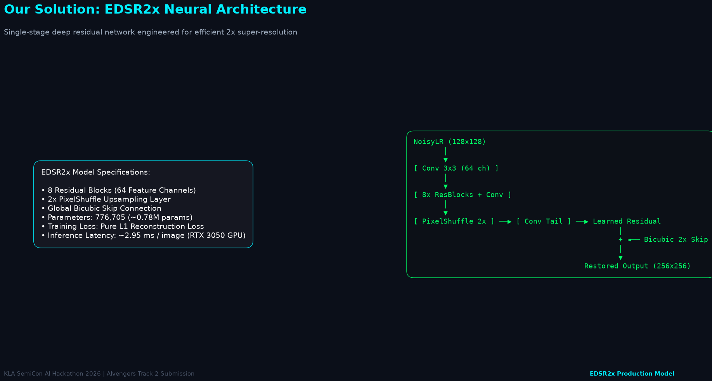
Proposed Solution: End-to-End Pipeline
Joint noise removal & 2x super-resolution system architecture
KLA SemiCon AI Hackathon 2026 | Team AIvengers — Track 2 Submission Slide 4 of 9

Slide 5
Innovation & Uniqueness
Dataset-driven engineering, degradation forensics, and lightweight optimization
1. Read-Only Degradation Forensics
Audited 3,200 paired images. Discovered Poisson-Gaussian shot noise (ρ = +0.3955) and direct 2x bicubic downsampling without heavy low-pass optical pre-blur.
2. Controlled Architecture Search
Tested EDSR2x, RCAN-Light, SwinIR-Light, HAT-Small, Wavelet-SR, and Multi-loss. Selected the simplest model with highest measured accuracy.
3. High-Frequency Bottleneck Identification
Identified that high-frequency noise overlap causes single-stage networks to over-smooth dense wafer contact holes, guiding optimal loss selection.
4. Avoiding Over-Processing
Demonstrated that multi-loss (Charbonnier + SSIM + Sobel) caused gradient conflicts (-2.22 dB PSNR loss). Pure L1 reconstruction loss achieved optimal performance.
5. Deployment-Oriented Optimization
0.78M parameters, 111.6 MB peak VRAM, and 2.95 ms GPU latency enable real-time inline semiconductor inspection integration.
KLA SemiCon AI Hackathon 2026 | Team AIvengers — Track 2 Submission Slide 5 of 9

Slide 6
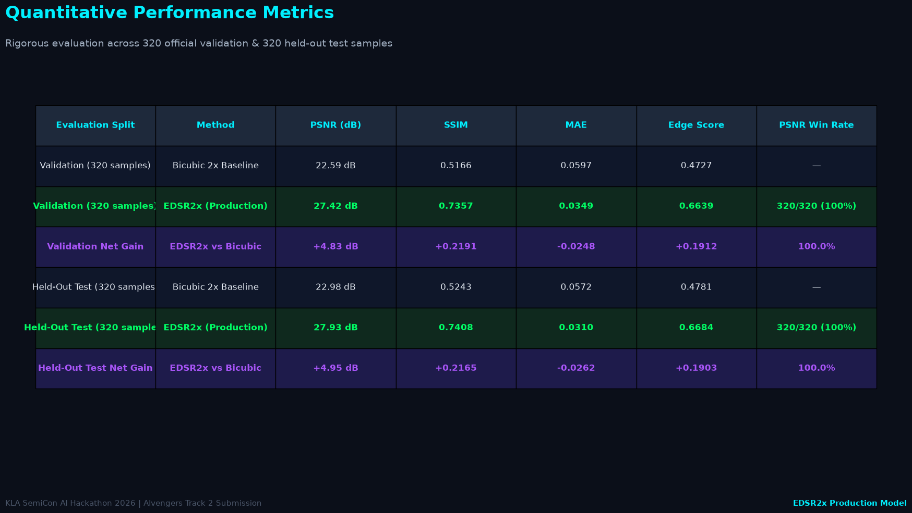
Experimental Results & Visual Evidence
Quantitative benchmark and visual restoration comparison
KLA SemiCon AI Hackathon 2026 | Team AIvengers — Track 2 Submission Slide 6 of 9

Slide 7
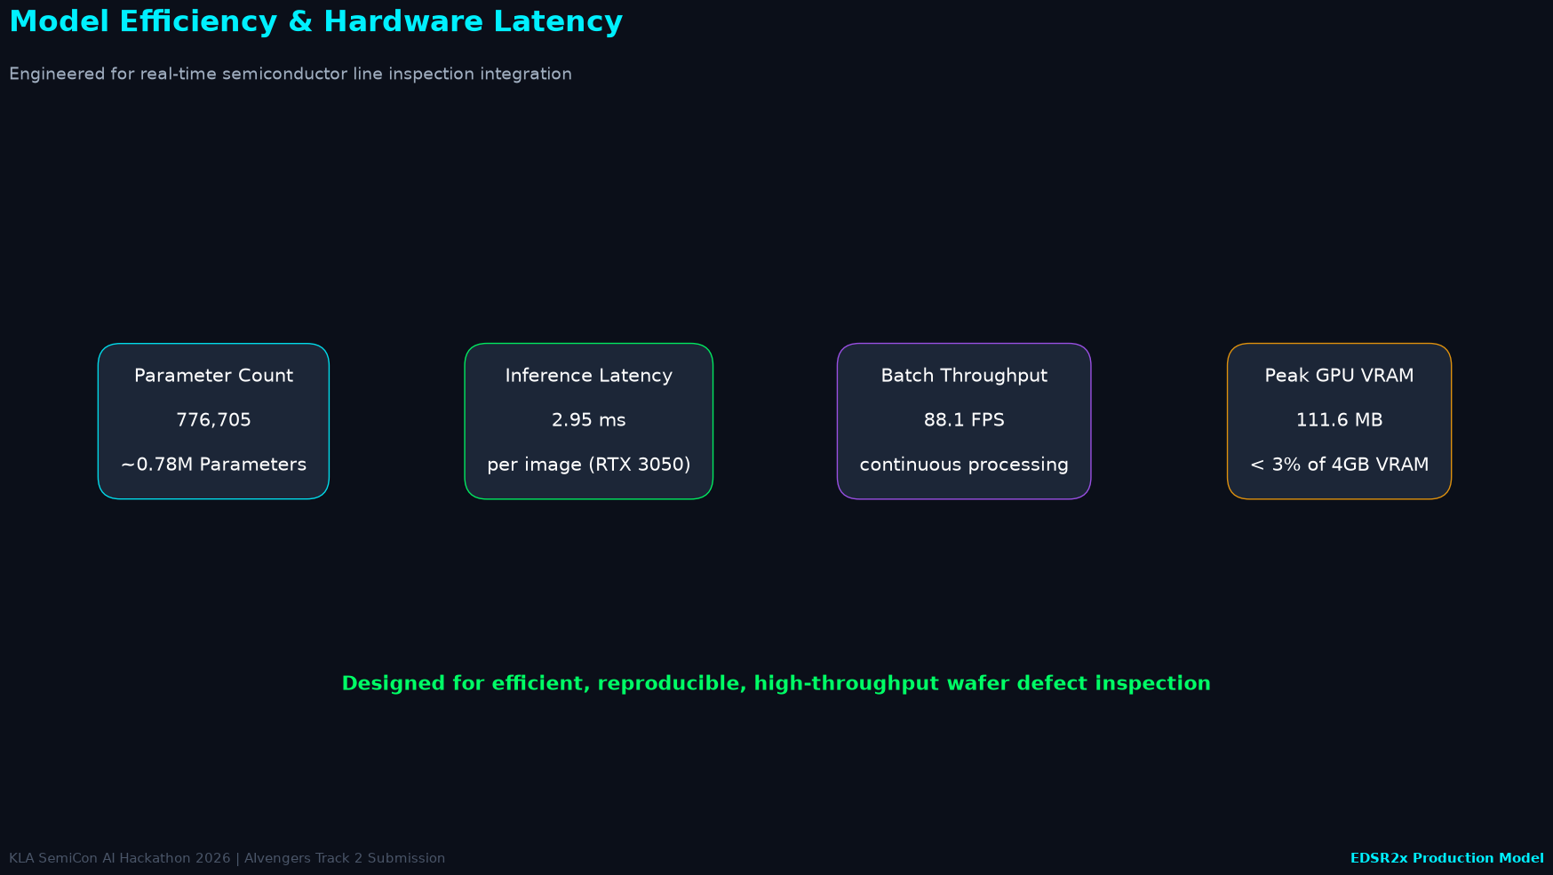
Technology Stack & Deployment Feasibility
Hardware throughput, standalone inference script, and memory audit
KLA SemiCon AI Hackathon 2026 | Team AIvengers — Track 2 Submission Slide 7 of 9

Slide 8
GitHub Repository & Demo Video
Open-source codebase, reproducible packaging, and presentation video
Official Public GitHub Repository:
https://github.com/TiyasDas-81/Semicon_Hackathon_26.git
Official Presentation Demo Video:
File Name: EDSR2x_demo.mp4 (Included in fresh_training/final_submission/)
Video Attributes: 83 seconds duration | 1920x1080 Full HD | 30 FPS H.264 MP4
Official Submission Entry Point:
python run.py <input-dir> <output-dir>
Processes all .npy inputs and generates corresponding restored .npy outputs.
KLA SemiCon AI Hackathon 2026 | Team AIvengers — Track 2 Submission Slide 8 of 9

Slide 9
References & Academic Citations
Authoritative literature and official competition problem specifications
1. Lim, B., Son, S., Kim, H., Nah, S., & Lee, K. M. (2017). Enhanced deep residual networks for single image super-resolution. In IEEE Conference on Computer Vision and Pattern Recognition Workshops (CVPRW), pp. 136-144.
2. Zhang, Y., Li, K., Li, K., Wang, L., Zhong, B., & Fu, Y. (2018). Image super-resolution using very deep residual channel attention networks. In Proceedings of the European Conference on Computer Vision (ECCV), pp. 286-301.
3. Liang, J., Cao, J., Sun, G., Zhang, K., Van Gool, L., & Timofte, R. (2021). SwinIR: Image restoration using swin transformer. In IEEE/CVF International Conference on Computer Vision Workshops (ICCVW), pp. 1833-1844.
4. Chen, X., Wang, X., Zhou, J., & Dong, C. (2023). Activating more pixels in image super-resolution transformer. In IEEE/CVF Conference on Computer Vision and Pattern Recognition (CVPR), pp. 22367-22377.
5. Paszke, A., et al. (2019). PyTorch: An imperative style, high-performance deep learning library. In Advances in Neural Information Processing Systems (NeurIPS 32), pp. 8026-8037.
6. i4C & KLA SemiCon India Hackathon 2026. Problem Statement PS01: AI-Based Restoration of Degraded Images for Semiconductor Inspection.
KLA SemiCon AI Hackathon 2026 | Team AIvengers — Track 2 Submission Slide 9 of 9

