Slide 1
TEAM DEBUGGERS
Krushangini S
Dejassree S
Dhivyashri B V
Jeyavarsini N R
Hemanth M
Gowrisanker P
Gokul V

Slide 2


Slide 3
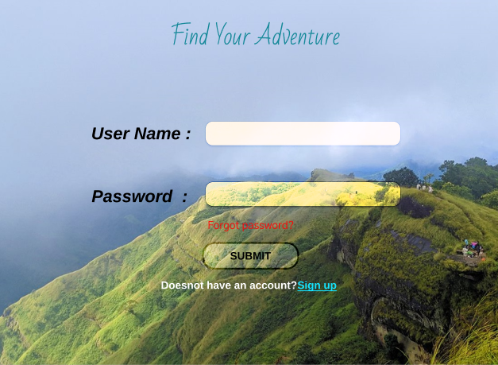

Slide 4
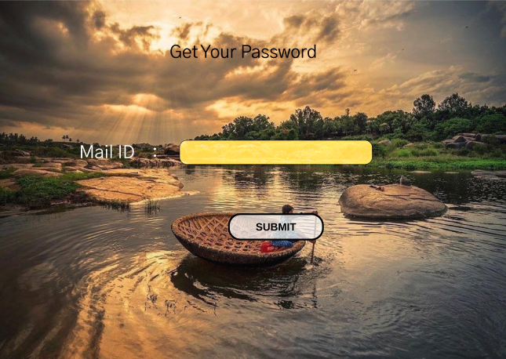

Slide 5
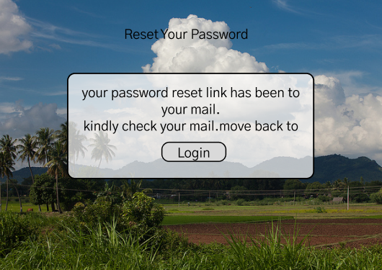

Slide 6
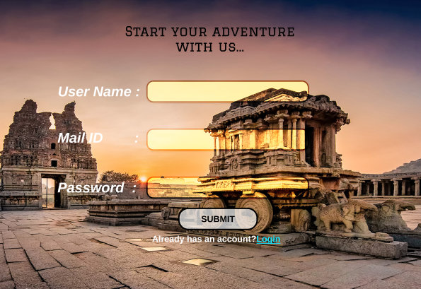

Slide 7
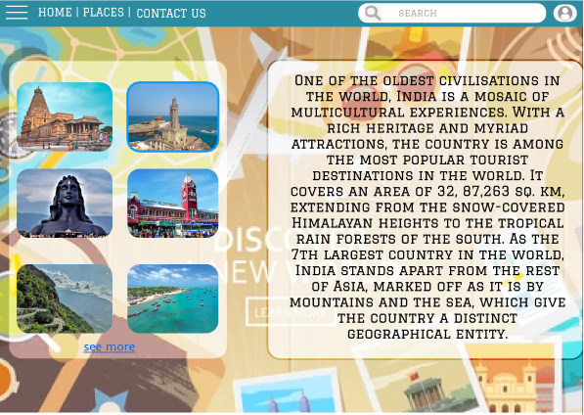

Slide 8


Slide 9
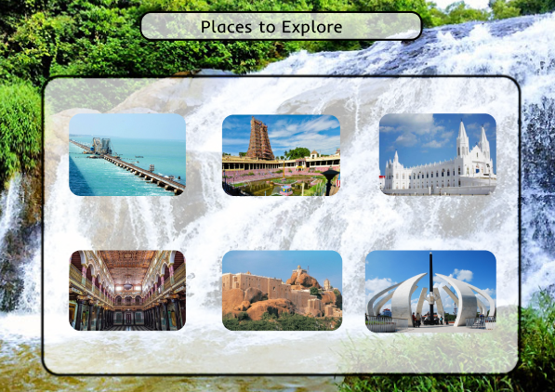

Slide 10
Reference link
Git hub: https://github.com/TizIsDejassree
Figma: https://www.figma.com/file/QP50ga6PC9NeZ96iotCIv3/Travel-and-Tourism?node-id=0%3A1

