Slide 1






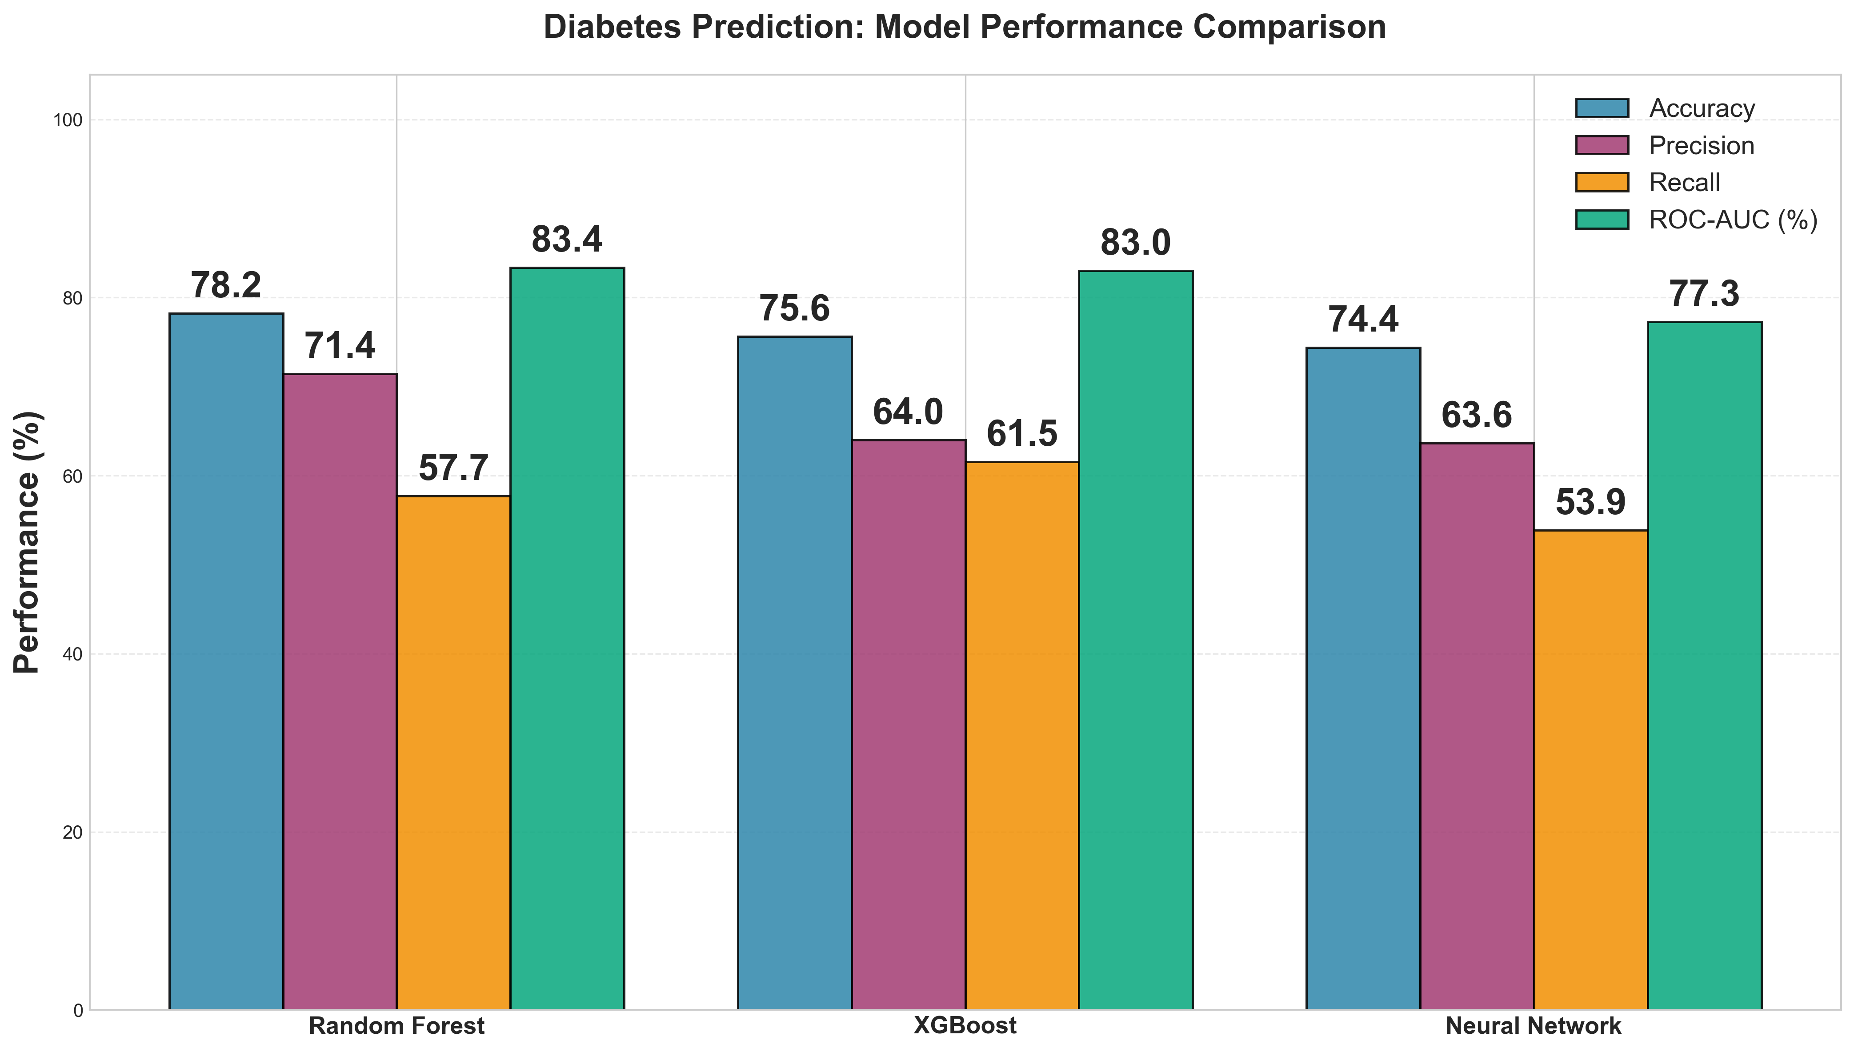
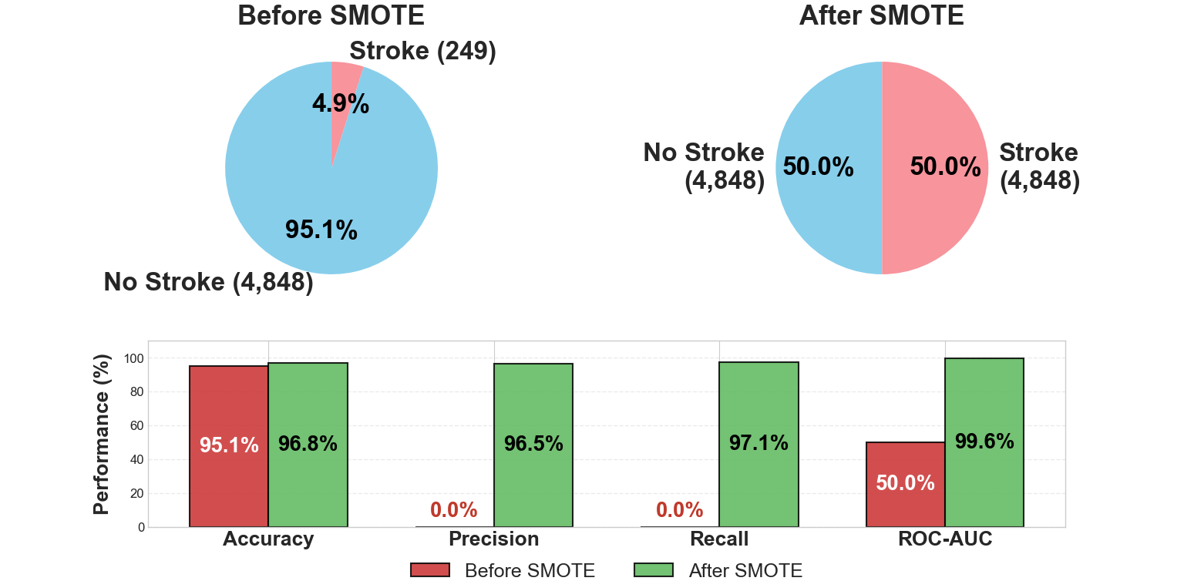
HippoMedica – Health Risk Prediction System
TJ Grewal, Gia Phat Do, Quang Anh Pham, Karmanya Khanna
CMPT310 – D100 Introduction to Artificial Intelligence, Fall 2025
DATASET OVERVIEW
AI PIPELINE
Dataset | Samples | Features | Class Ratio
Diabetes | 768 | 8 | 2.02:1
Heart Disease | 303 | 13 | 1.18:1
Stroke (Raw) | 5110 | 10 | 19.47:1
Stroke (SMOTE) | 9696 | 10 | 1.00:1
RAW
DATA
Downloaded as .csv files
SMOTE (Stroke)
Web App
EDA
RF, XGB, NN
Save models
Imbalance in “Stroke”
DATA PREP
MODEL TRAINING
DEPLOY-MENT
MODEL COMPARISON (DIABETES)
SMOTE COMPARISON (STROKE)
Notes:
Diabetes, heart diseases, and stroke are among the leading causes of illness worldwide, and many of their risk factors develop gradually over time. The early identification of people at higher risk is thus important for prevention and treatment.
The purpose of this project is to build and compare three machine learning models to predict the probability that a patient has diabetes, heart disease, or will experience a stroke. The project aims to evaluate the same three techniques across all disease types to examine which models work best for basic medical risk prediction and demonstrates practical applications of AI in healthcare.
Each of our models are trained on 3 datasets on diabetes, heart disease, and stroke patients:
Diabetes from the Pima Indians Diabetes Database (Native Americans)
Coronary artery disease (CAD) from the Heart Disease Database from the UCI Machine Learning Repository
Stroke Prediction dataset from kaggle.com
We have used 3 machine-learning models: Neural network, Random Trees, and XGBoost
After the user put in the necessary information to make the prediction in one of the 3 categories above, our best model will give a Prediction Result which includes:
The Risk factor: Low, Moderate, or High Risk
The Model’s Confidence Score
Recommendation for the user based on their Risk factor.

