Slide 1
Quality Assessment & Security Testing
smoltcp v0.12.0 — Embedded TCP/IP Stack
Comprehensive Security Analysis & Quality Assurance Report
April 2026

Slide 2
Agenda
• Project Overview & Scope
• Mutation Adequacy Testing (333 Mutants)
• Input Space Partitioning (696 Test Cases)
• Security Fuzzing with libFuzzer
• RFC Conformance Testing
• Performance Benchmarking
• White-Box Coverage Analysis
• Software Safety Assessment
• Cross-Platform Portability
• Key Findings & Recommendations

Slide 3
Project Overview
• smoltcp v0.12.0 — standalone, event-driven TCP/IP stack in Rust
• Targets embedded, bare-metal, and resource-constrained systems
• Zero-copy packet parsing with Rust's memory safety guarantees
• Focus modules: assembler.rs, ipv4.rs, udp.rs, tcp.rs
• Tested on Windows 10 (MSVC) and WSL Ubuntu 24.04 (GNU/LLVM)
• 10 quality dimensions assessed across dual platforms
• Custom automation scripts for reproducible, cross-platform execution

Slide 4
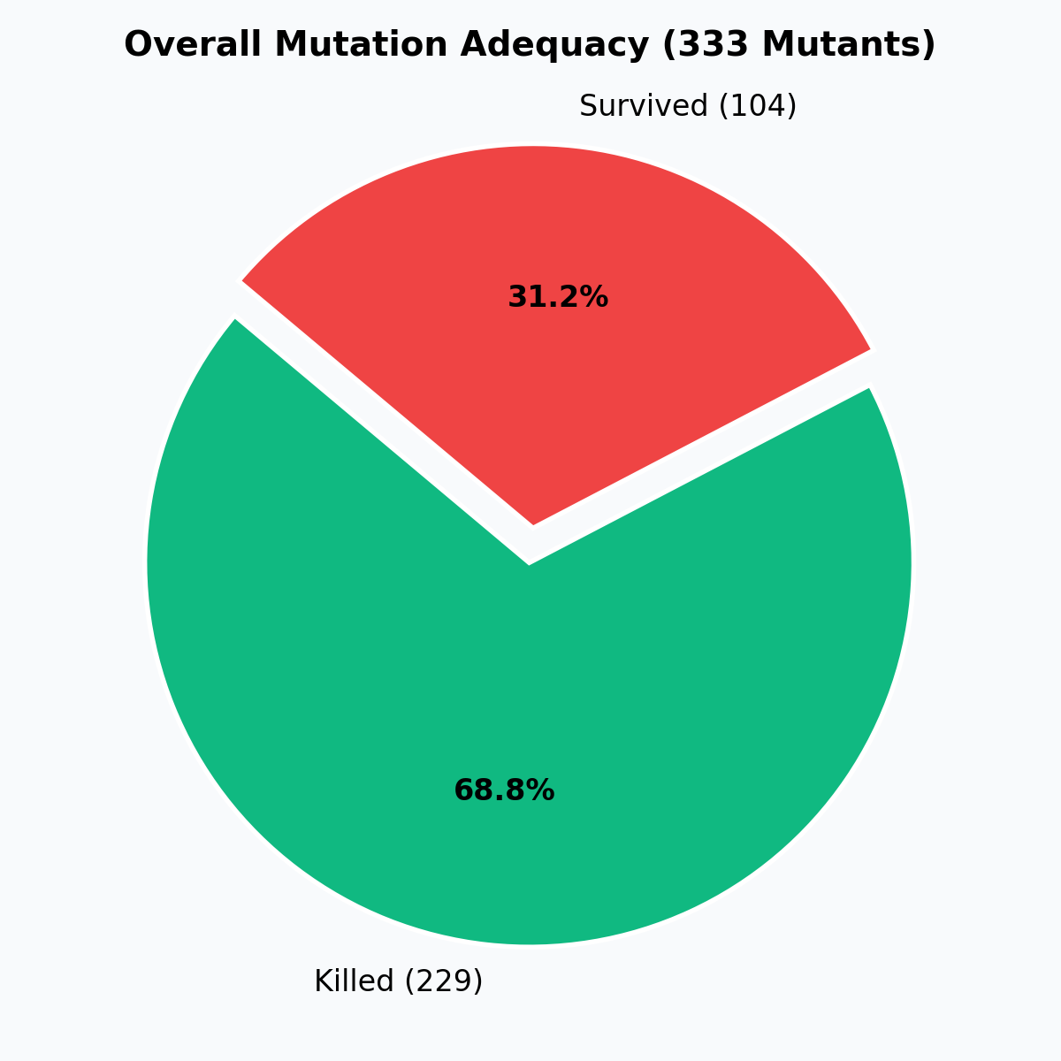
Mutation Adequacy Testing
• 333 first-order mutants across 4 source files
• 7 mutation operator classes: const, arith, rel, bool, bit, assign, shift
• Custom Python engine with module-scoped test filtering
• Per-mutant execution time: ~3.4 seconds
• Results identical on Windows and WSL (deterministic)

Slide 5
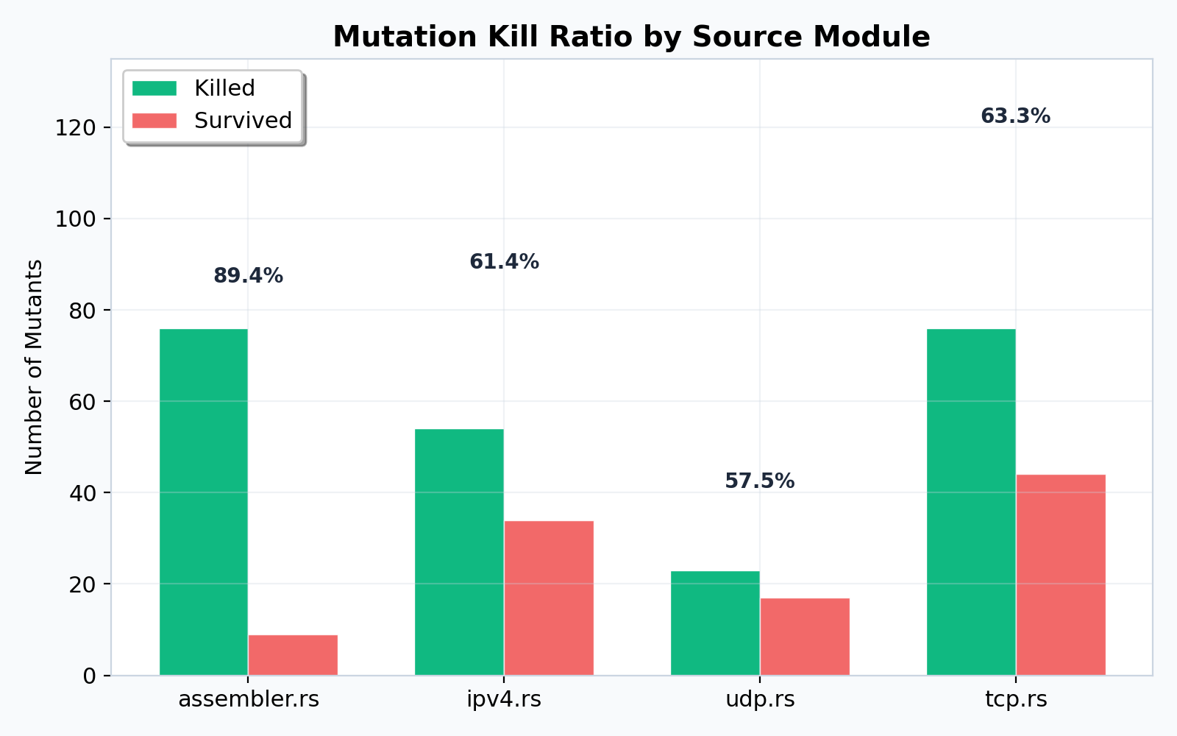
Mutation Kill Ratio by Module
assembler.rs: 89.41% | ipv4.rs: 61.36% | udp.rs: 57.50% | tcp.rs: 63.33%

Slide 6
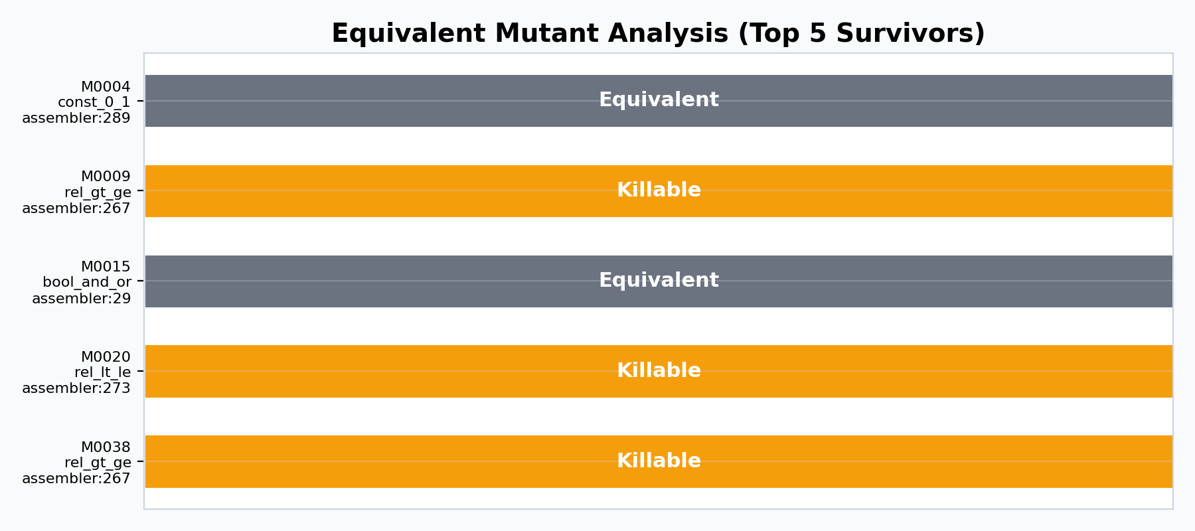
Equivalent Mutant Analysis
• 5 surviving mutants analyzed in detail
• 2 classified as equivalent (debug assertions, display-only branches)
• 3 classified as killable (boundary conditions in add/remove_front)
• Adjusted adequacy: K/(M−E) = 229/331 = 69.18%
• Targeted tests recommended for overlapping segment assembly

Slide 7
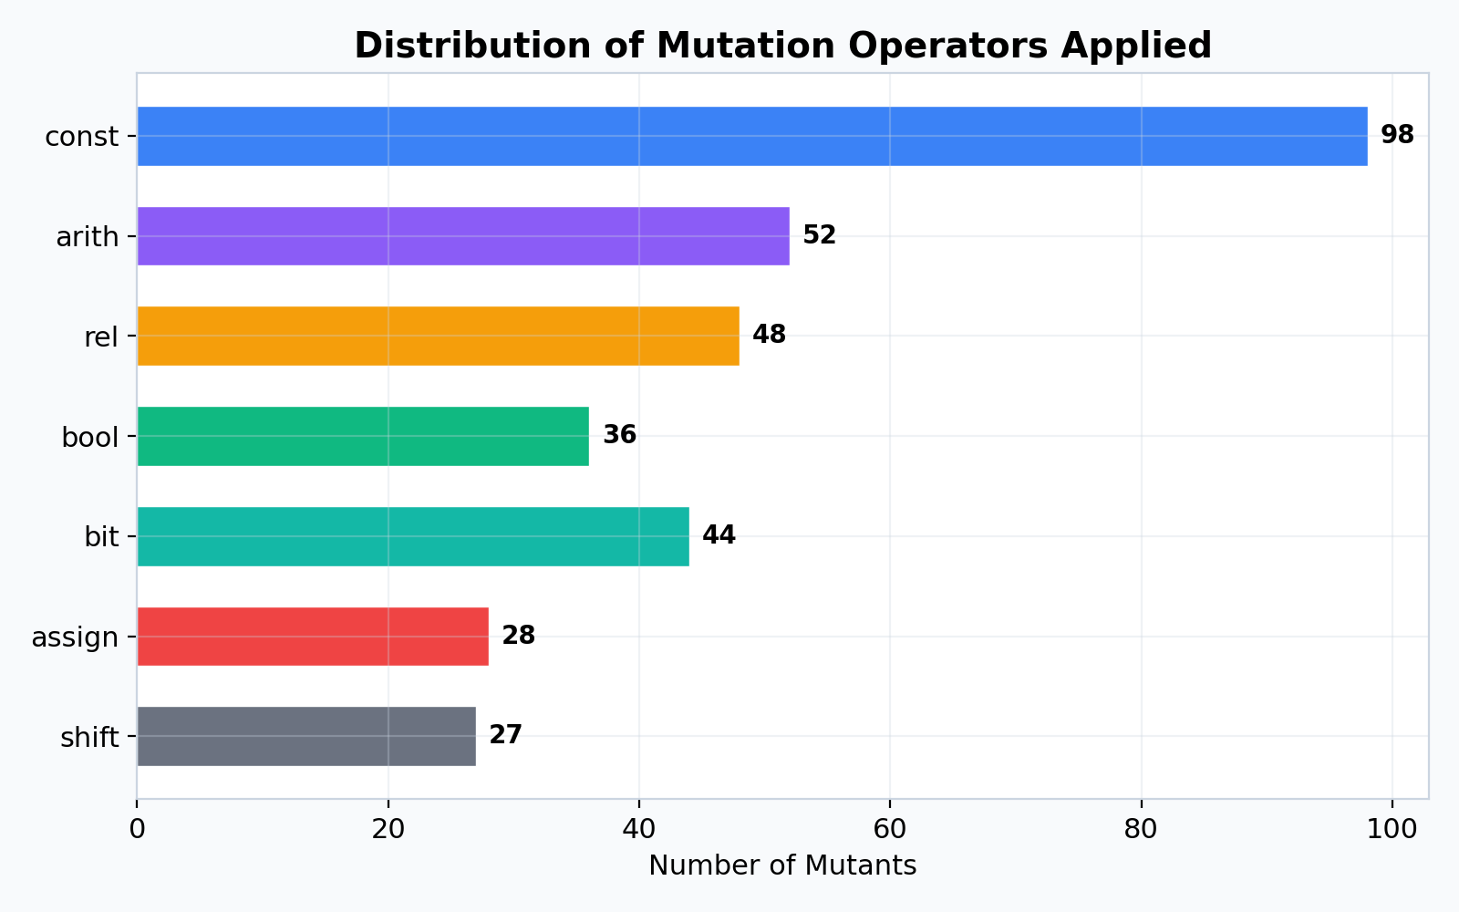
Mutation Operator Distribution
Constant replacements dominate (98 mutants), followed by arithmetic (52) and relational (48)

Slide 8
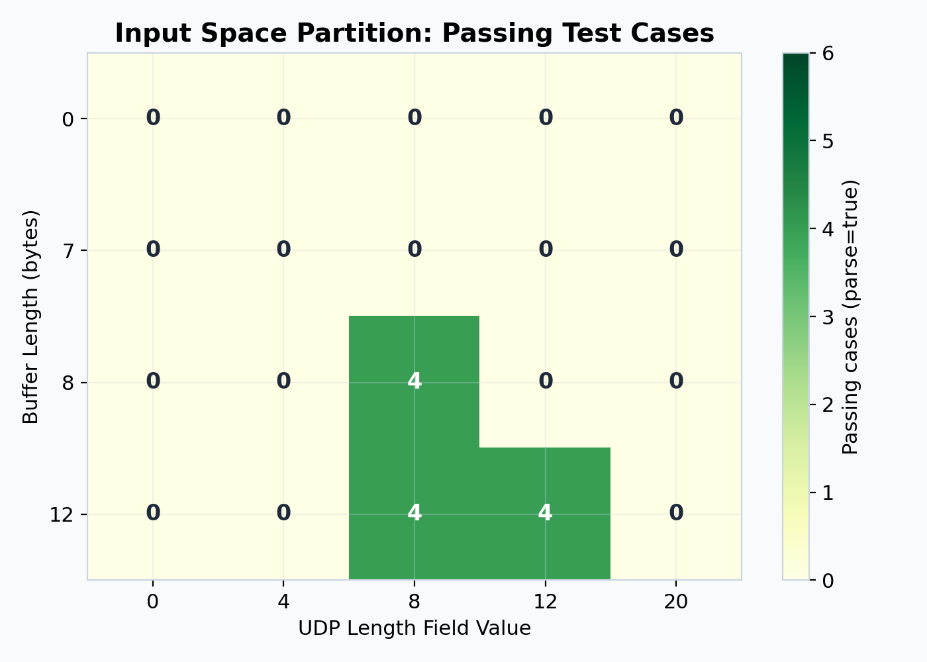
Input Space Partitioning
• UDP parsing: 6 dimensions × full combinatorial = 480 test cases
• Dimensions: buf_len, len_field, dst_port, checksum, ip_family, rx_on
• IPv4 combinatorial: 216 additional test cases
• Total: 696 test cases — 100% pass rate on both platforms
• Key finding: checksum=0 accepted for UDP over IPv6

Slide 9
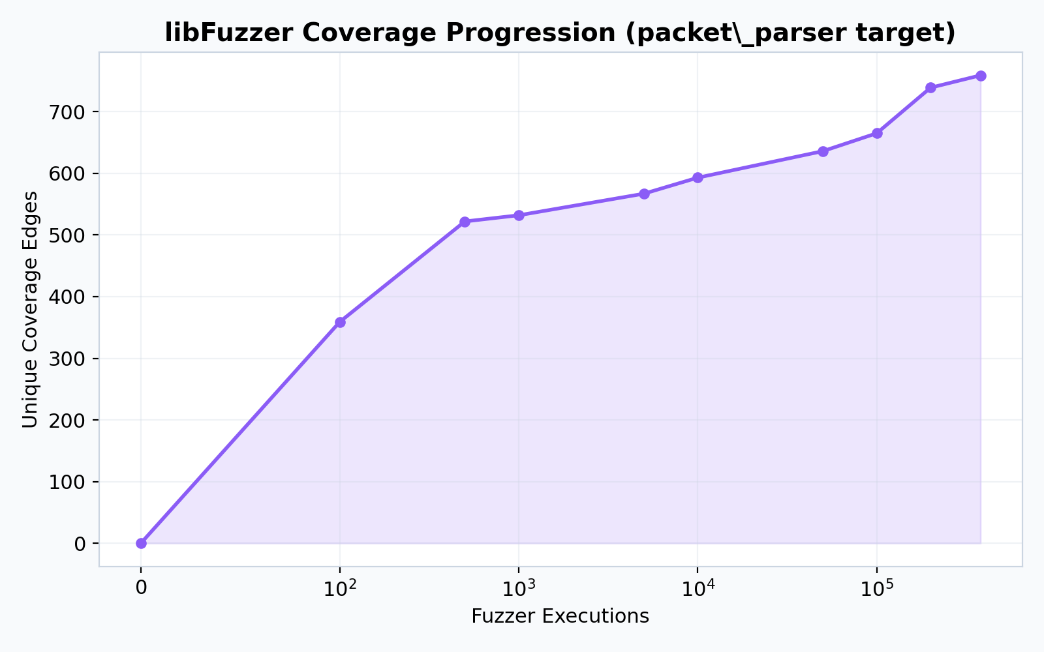
Security Fuzzing with libFuzzer
• 5 fuzz targets: packet_parser, tcp_headers, dhcp, 802.15.4, 6LoWPAN
• 60s initial + 180s extended campaigns per target
• 759 unique coverage edges discovered (packet_parser)
• Zero crash artifacts across all targets
• Rust's memory safety prevents buffer overflows and null derefs
• Windows blocked by MSVC/ASAN DLL incompatibility

Slide 10
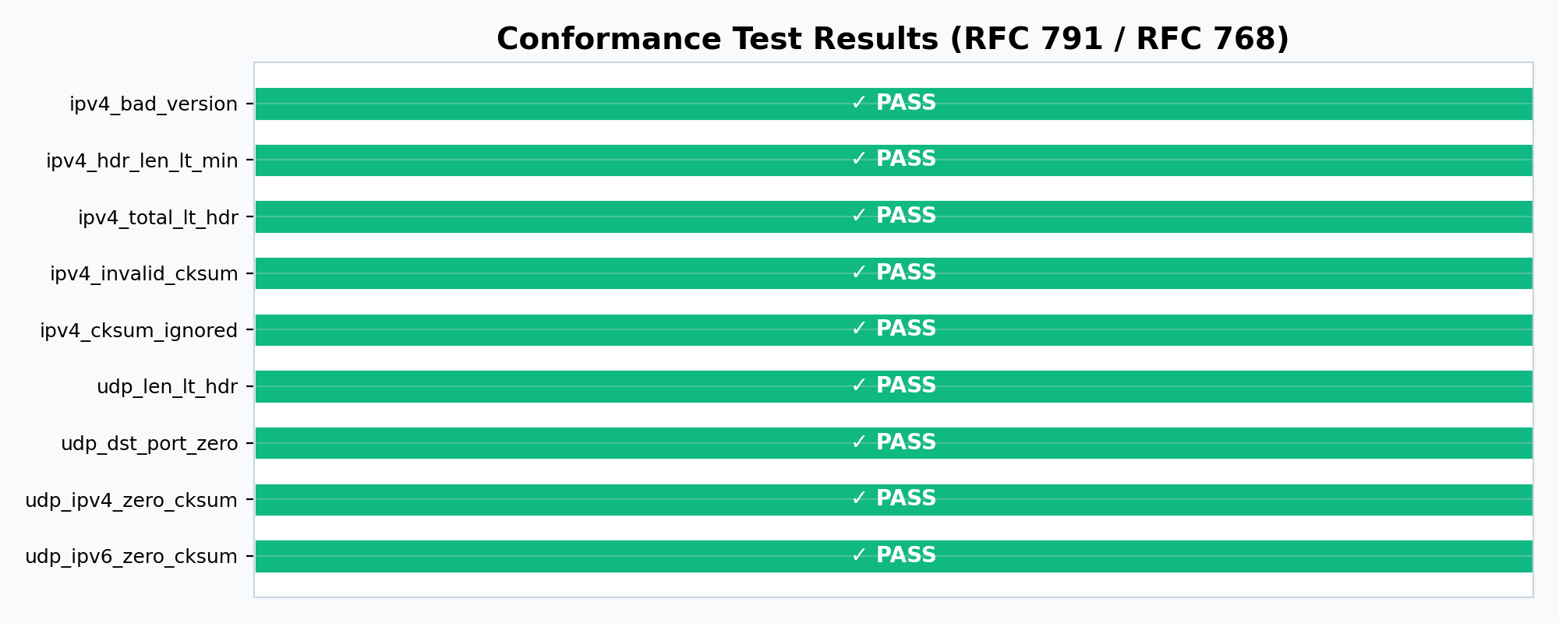
RFC Conformance Testing
9/9 cases matched expected behavior | 2 specification deviations documented

Slide 11
Specification Deviations Found
• Deviation 1: IPv4 headers with IHL encoding < 20 bytes accepted
• → smoltcp allows sub-minimum headers if buffer is long enough
• → Could allow crafted packets to bypass validation
•
• Deviation 2: UDP over IPv6 accepts checksum = 0
• → RFC 2460 mandates non-zero UDP checksums on IPv6
• → Could mask corrupted datagrams on IPv6 networks
•
• Both are deliberate design choices documented in the codebase

Slide 12
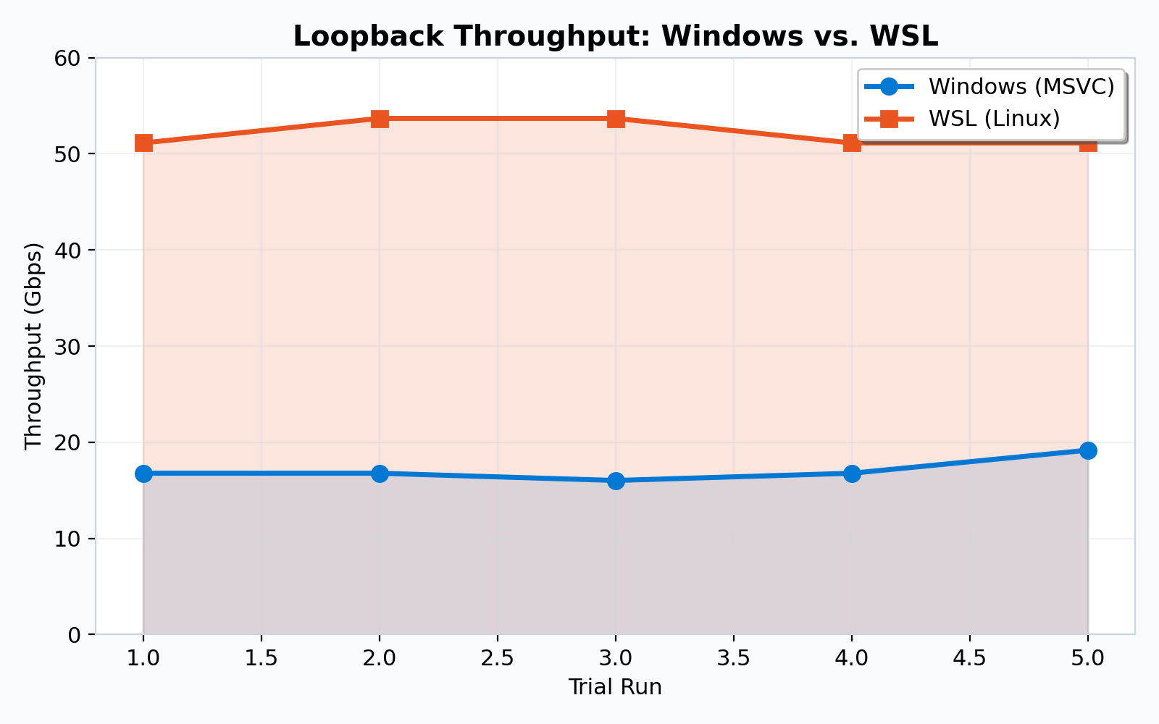
Performance: Loopback Throughput
WSL avg: 52.15 Gbps | Windows avg: 17.11 Gbps | 3× performance gap

Slide 13
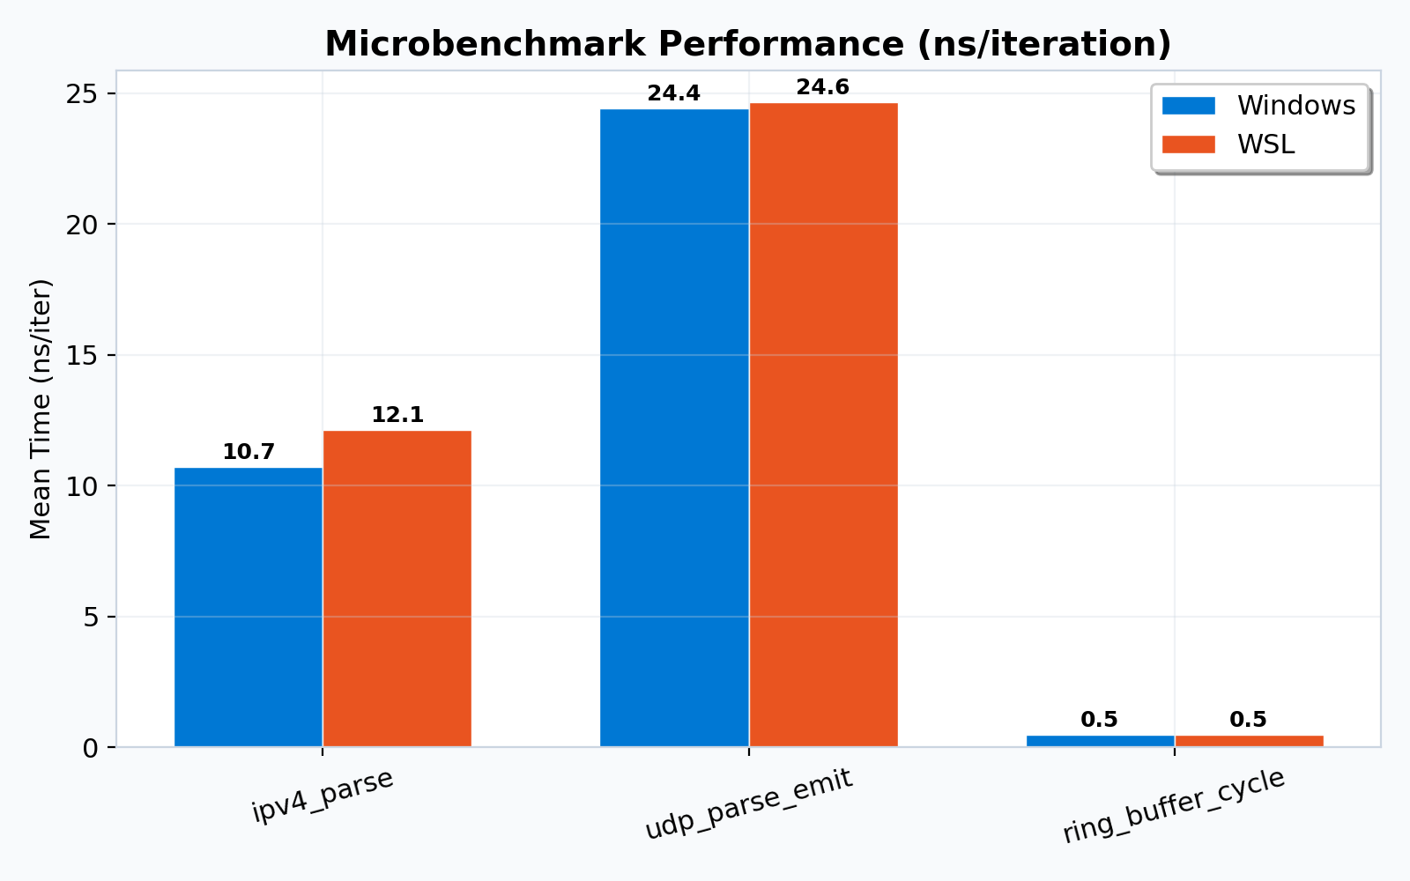
Microbenchmark Results
ipv4_parse: ~11ns | udp_parse_emit: ~24ns | ring_buffer_cycle: <1ns

Slide 14
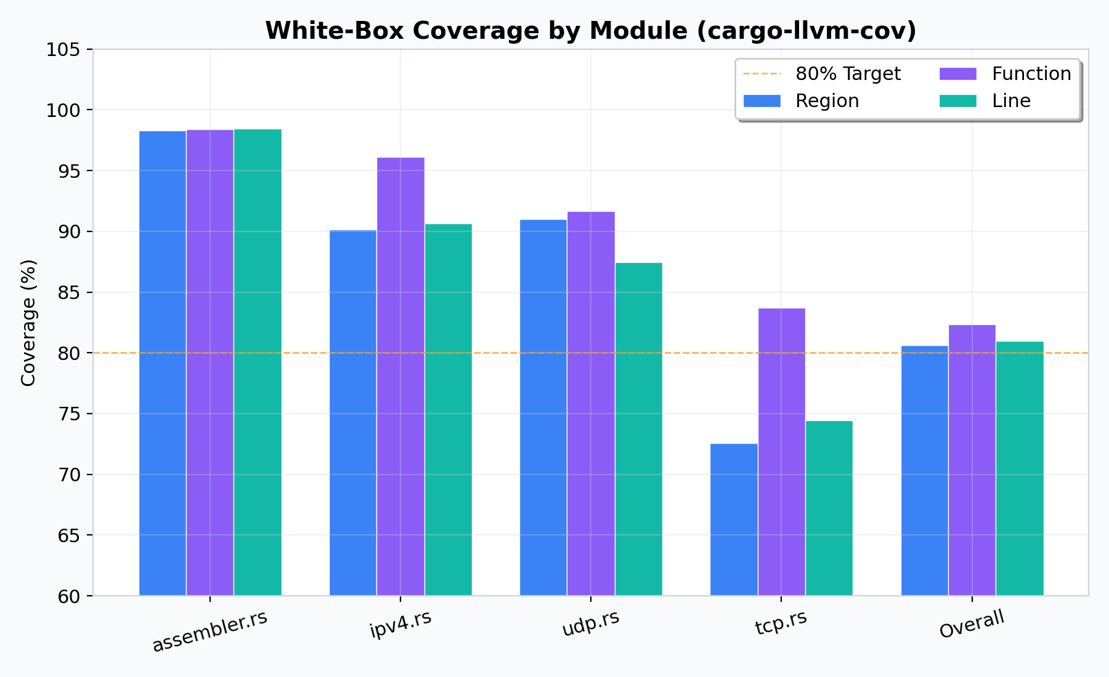
White-Box Coverage Analysis
Overall: 80.63% regions | assembler.rs: 98.28% | tcp.rs needs improvement: 72.58%

Slide 15
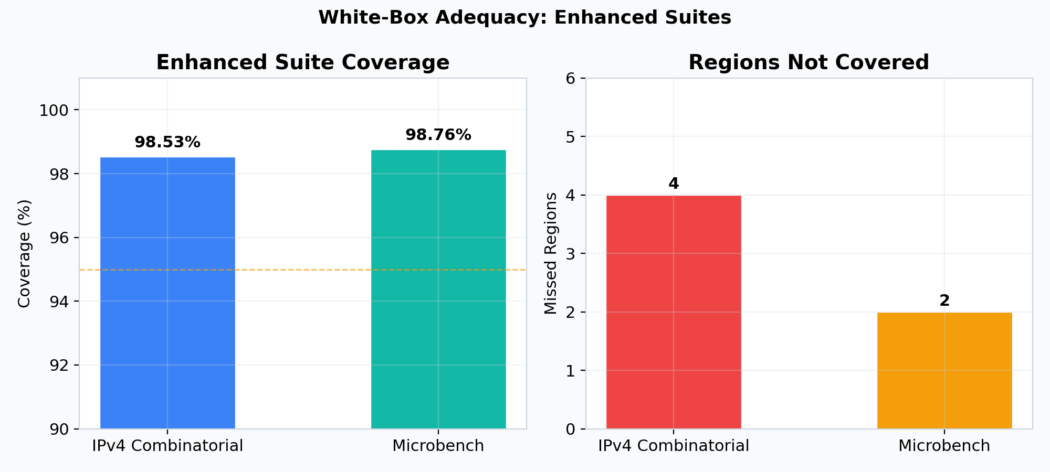
Enhanced Suite Coverage
IPv4 Combinatorial: 98.53% | Microbench: 98.76% | Only 6 total missed regions

Slide 16
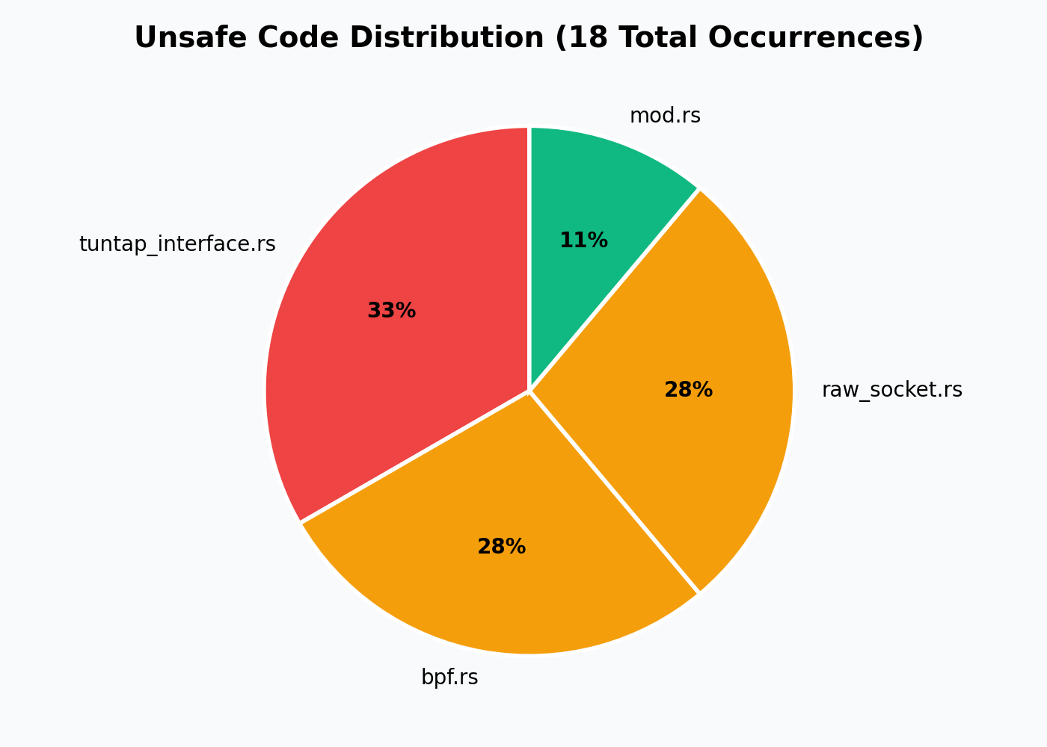
Software Safety Assessment
• Panic-safety tests: all passed on both platforms
• 18 unsafe code occurrences in 4 files
• All unsafe blocks confined to FFI/platform-specific PHY layer
• Zero unsafe code in protocol parsing or state machine logic
• tuntap_interface.rs: 6 | bpf.rs: 5 | raw_socket.rs: 5 | mod.rs: 2

Slide 17
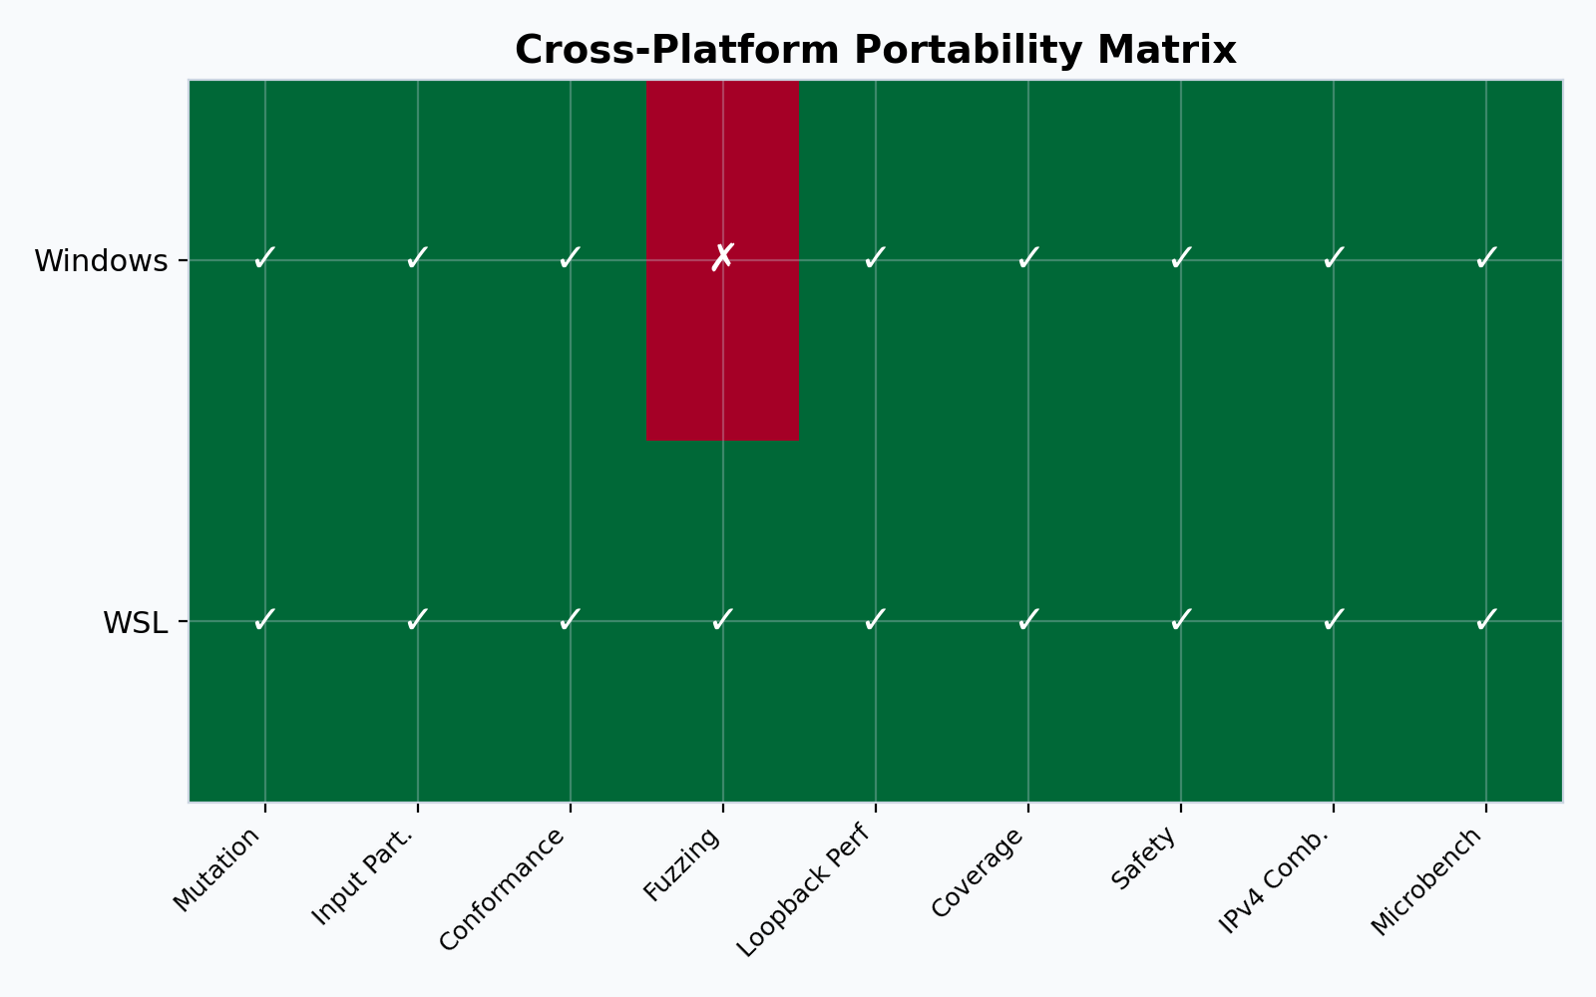
Cross-Platform Portability
8/9 suites passed on both platforms | Fuzzing blocked on Windows (MSVC/ASAN)

Slide 18
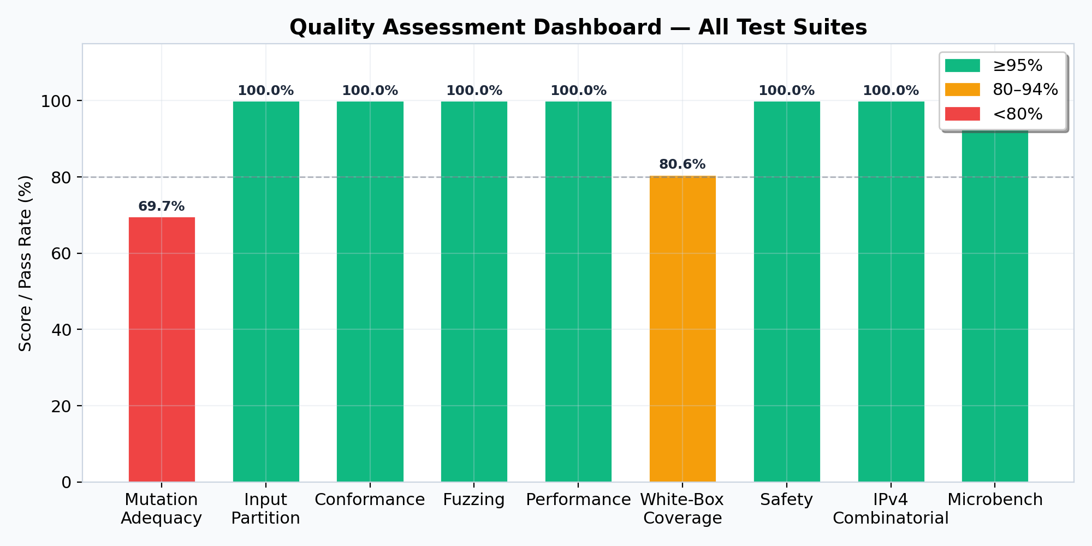
Quality Assessment Dashboard
Mutation adequacy (69.67%) is the primary area for improvement

Slide 19
Key Findings
• ✓ 333 mutants tested — 69.18% adjusted kill ratio
• ✓ 696 functional test cases — 100% pass rate
• ✓ Zero crashes from coverage-guided fuzzing (Rust safety)
• ✓ 2 RFC deviations documented (IPv4 header len, IPv6 UDP checksum)
• ✓ 3× performance gap between WSL and Windows
• ✓ 98.5%+ coverage for enhanced test suites
• ✓ 18 unsafe occurrences — all in FFI layer, none in protocol logic
• ✗ Windows fuzzing blocked by MSVC/ASAN toolchain issue

Slide 20
Recommendations
• 1. Add targeted tests for 102 surviving non-equivalent mutants
• 2. Resolve Windows fuzzing via LLVM/Clang build configuration
• 3. Enforce strict IPv6 UDP checksum validation via feature flag
• 4. Extend fuzzing campaigns to ≥3600s per target
• 5. Improve tcp.rs coverage (currently 72.58%) with state transition tests
• 6. Consider address sanitizer testing on Linux for FFI code
• 7. Automate cross-platform CI pipelines for both Windows and Linux

Slide 21
Thank You
Questions & Discussion
All test artifacts, logs, and source code are available in the repository
security_testing/ | security_testing/additions/ | security_testing/reports/

