Slide 1
Design of an Automated Warehouse Ventilation System
Presented by: Tabitha Tabb and Terrence Parham
Tennessee State University
College of Engineering
EECE 4101 - Electrical Systems Design Lab
Fall 2026
Department of Electrical and Computer Engineering

Slide 2
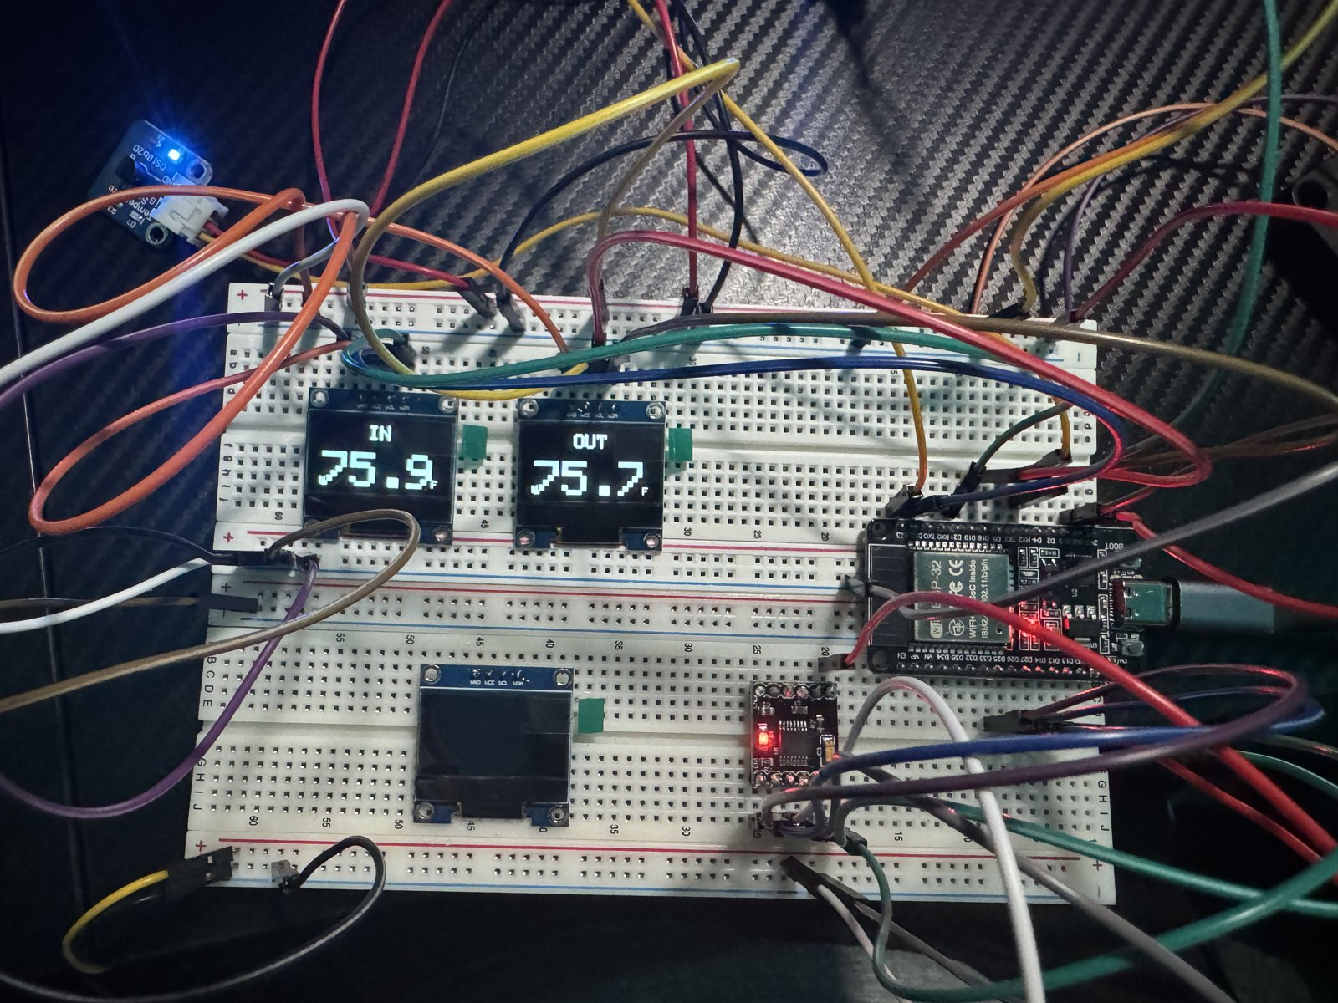
Outline
Problem, Need and Goal
Objectives and Constraints
Design Specifications
Alternative Solutions and Selection
System Decomposition
System Flowchart
System Schematic
Completed System and Test Results
Cost Analysis
Conclusion
Early prototype on the bench
2

Slide 3
Problem, Need and Goal
Problem
Warehouses gain heat from equipment and sunlight. Fans on a timer or a single indoor thermostat cannot tell whether outside air is cooler, so they can pull in hotter air and raise the indoor temperature.
Need Analysis
An automated system that compares indoor and outdoor temperature, runs the fans only when outside air will help, limits manual checks, and alerts the user to a sensor fault.
Design Goal
Design and prototype a dual-fan ventilation controller that removes heat by air exchange when conditions allow, and shows live readings and operating status.
3

Slide 4
Objectives and Constraints
Objectives
Monitor Temperature
Automate Ventilation
Display and Alert
Two probes compare inside and outside air.
Pick the fan state automatically, without chatter.
Three OLEDs show live values; the buzzer alerts.
Constraints
3.3 V logic, with a separate 5 V fan supply
ESP32, driver and fan supply share a common ground
Firmware stays non-blocking during sensor conversions
Outside probe kept clear of the exhaust plume
No refrigeration, so it cannot cool below outside air
4
Notes:
Three objectives: measure both temperatures with independent probes, choose the fan state automatically with hysteresis and a minimum dwell so the fans never chatter, and show live values on three OLEDs with buzzer alerts: three chirps on every state change and a continuous alarm only on a sensor fault. The constraints shaped the design: 3.3 V logic with a separate 5 V fan supply and a common ground, non-blocking firmware, the outside probe kept out of the exhaust plume, and no refrigeration, so the system cannot cool below outside air.

Slide 5
Design Specifications
1. The system shall measure inside and outside temperature independently.
2. The system shall activate heat demand at 80 °F and release it at 77 °F.
3. Cross ventilation shall enter when outside air is at least 2 °F cooler,
with an exit deadband of 1 °F.
4. Normal state transitions shall use a minimum dwell time of 10 seconds.
5. Three consecutive invalid sensor reads shall trigger the FAULT state.
6. Three OLED panels shall show inside temperature, outside temperature
and system state.
Thresholds come from sensor accuracy (±0.9 °F), so the fans don’t chatter.
5
Notes:
All six specifications were verified on hardware. The thresholds are not arbitrary: the DS18B20 is accurate to about 0.9 F either way, so the 3 F on/off band and the 2 F cooler-air margin are wider than sensor noise. A fault is declared within 7.5 seconds at the 2.5-second sensor period. The firmware works in Celsius internally.

Slide 6
Alternative Solutions
and Selection
Design criterion | Scheduled | Indoor only | Indoor– outdoor
Responds to indoor heat | No | Yes | Yes
Compares outside air | No | No | Yes
Control complexity | Low | Moderate | Higher
Supports current goal | Limited | Partial | Best match
Selected: indoor–outdoor monitoring with automatic fan control.
6
Notes:
Three approaches were considered. Scheduled ventilation runs the fans on a timer: simple, but blind to temperature. Indoor sensing alone starts the fans when the chamber is hot, but can pull in even hotter outside air. Indoor-outdoor comparison needs more control logic, but it is the only option that knows when outside air will actually help, so it was selected.

Slide 7
System Decomposition
Sensing
2 DS18B20 probes
Inside and outside
Actuation
DRV8833 driver
Intake + exhaust fans
Temperature data
Processing
ESP32 controller
Five-state logic
Control signals
Display and alarm
Power
USB-C logic supply
5 V fan supply
User Interface
3 OLED displays
Buzzer module
Common ground connects both power paths.
7
Notes:
Five blocks: sensing, processing, actuation, user interface and power. The intake sits low on one wall and the exhaust high on the opposite wall, so air crosses the chamber diagonally. The controller runs from USB-C and the fans from a separate 5 V supply, joined by a common ground.

Slide 8
System Flowchart
Read both probes
YES
3 consecutive invalid reads?
FAULT
Exhaust ON, alarm
No heat demand
NO
STANDBY
Both fans OFF
Apply 80 / 77 °F hysteresis
Compare inside and outside
CROSS_VENT
Both fans ON
EXHAUST_ONLY
Exhaust ON
SEALED
Both fans OFF
≥ 2 °F cooler
Similar temperatures
≥ 3 °F hotter
Repeat each sensor period. Normal control uses hysteresis and a 10 s dwell.
8
Notes:
Sensor validity is checked first, so a missing reading can never fall through to an idle state. The 80/77 F hysteresis then decides whether there is heat demand. If there is, the inside-outside comparison picks the state: CROSS_VENT when outside is at least 2 F cooler, SEALED when it is at least 3 F hotter, and EXHAUST_ONLY when they are close. The loop repeats every sensor period, with a 10-second minimum dwell.

Slide 9
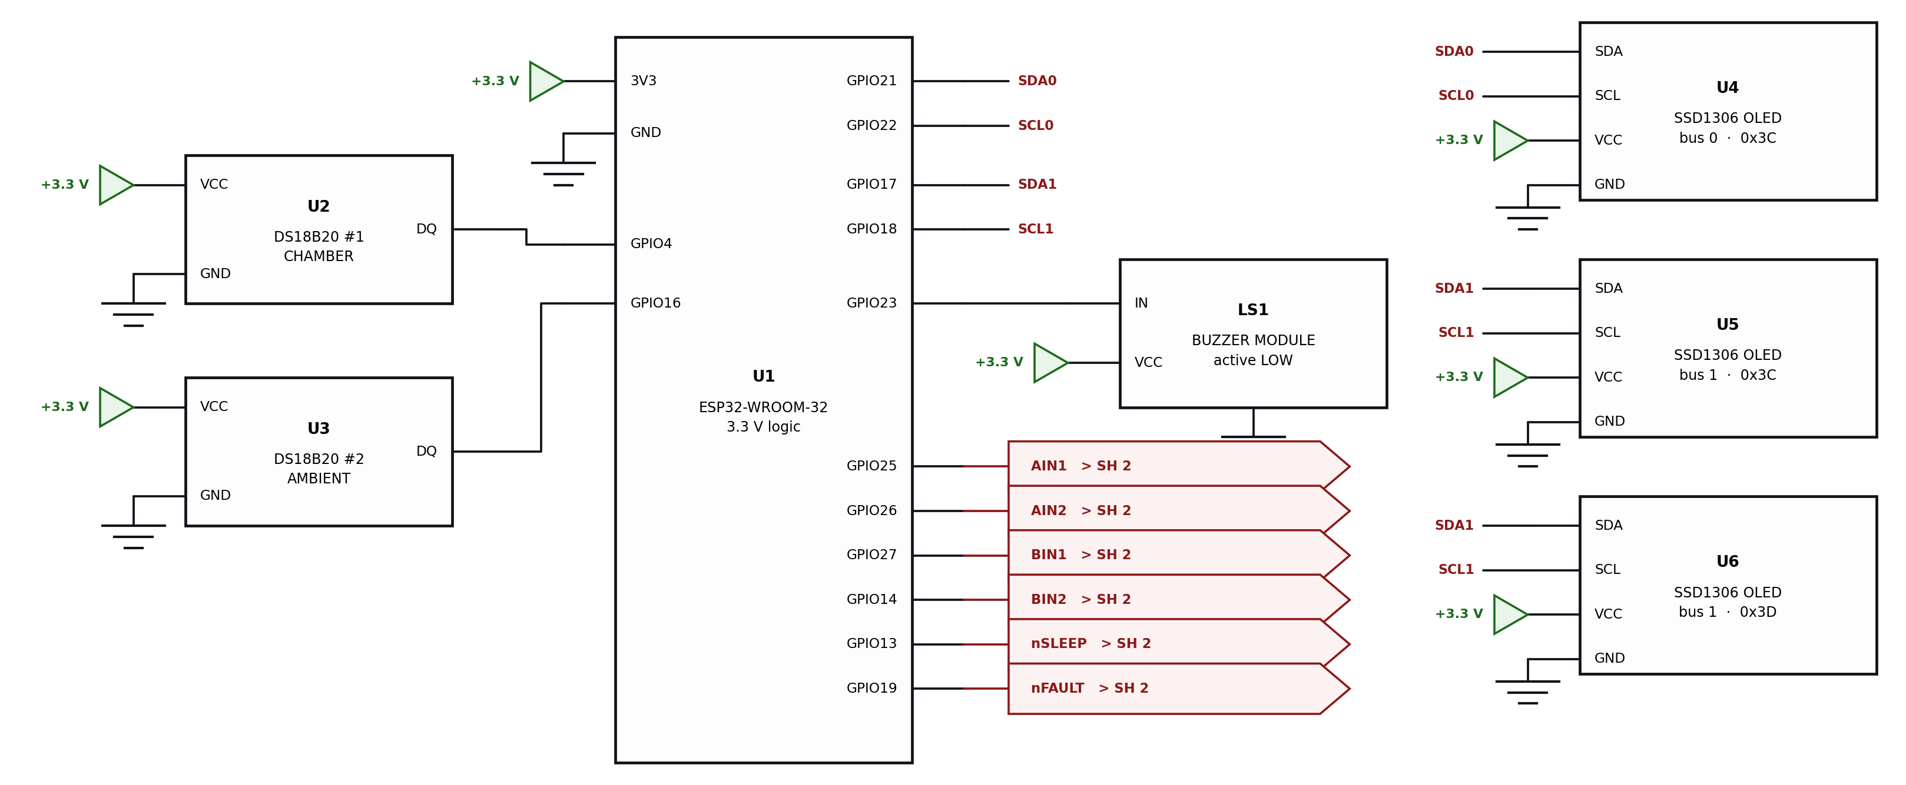
System Schematic
Current ESP32 design: two probes, three OLEDs and an active-low buzzer.
9
Notes:
Sheet 1 of the schematic: two DS18B20 probes on GPIO 4 and 16, three SSD1306 OLED panels across two I2C buses, and the active-low buzzer on GPIO 23. Every part is 3.3 V native, so there is no level shifter. The six lines on the right go to the fan driver.

Slide 10
Completed System and Test Results
Finished product photo
Test | Measured result
72 / 65 °F inside / outside | STANDBY, both fans OFF
85 / 65 °F | CROSS_VENT, both fans ON
85 / 84 °F | EXHAUST_ONLY, exhaust ON
85 / 95 °F | SEALED, both fans OFF
Probe disconnected | FAULT after 3 invalid reads
Live probe warmed and released | Fans ON at 80.8 °F, OFF at 76.9 °F
Finished product
Measured on the assembled hardware, 24 Sept 2026. Enclosure cooling test still to come.
10
Notes:
Everything here was measured on the assembled hardware on 24 September 2026. The first four rows were reached by setting test temperatures through the firmware console, with the real fans and buzzer as outputs. The last row used real heat: the inside probe was warmed by hand, and the fans started at 80.8 F and stopped at 76.9 F without chattering. Unplugging a probe gave FAULT after three bad reads, and it recovered on its own when reconnected. The enclosure cooling test is still to come.

Slide 11
Cost Analysis
Component | Quantity | Purchase cost
ESP32 | 1 | $7.30
DS18B20 probe modules | 2 | $8.00
OLED panels | 3 | $10.00
DRV8833 driver | 1 | $3.38
80 mm, 5 V brushless fans | 2 | $8.00
Buzzer and 5 V 2 A supply | 1 each | $5.21
Enclosure, wiring and fasteners | 1 set | $5.00
Total | — | $46.89
Estimated steady power budget: 1.58 W. Actual power consumption is unmeasured.
11
Notes:
The parts cost $46.89 in total. The buzzer was $1.09 and the 5 V 2 A supply $4.12, shown together in one row. The 1.58 W power figure is a calculated estimate, not a measurement.

Slide 12
Conclusion
Compares inside and outside air and picks one of five states on its own.
Verified on hardware: all five states, the 80 / 77 °F hysteresis and sensor-fault recovery.
Cools by air exchange only, so outside temperature is its limit.
Next: the cooling test in the finished enclosure.
Questions and Feedback
12

Slide 13
References
1. Analog Devices / Maxim, DS18B20 Programmable Resolution
1-Wire Digital Thermometer, datasheet.
2. Texas Instruments, DRV8833 Dual H-Bridge Motor Driver, datasheet.
3. Solomon Systech, SSD1306 128×64 Dot Matrix OLED Driver, datasheet.
4. Espressif Systems, ESP32-WROOM-32 Datasheet.
13
Notes:
Backup slide, hidden during the presentation. Manufacturer datasheets used in the design.

