Slide 1
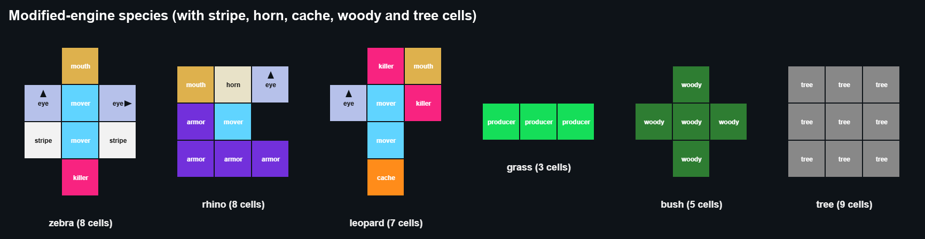
Reproducing Evolutionary Suicide in a Digital Savanna
Zebras, rhinos, leopards, grass and bushes in the Life Engine · 115 runs, base vs modified engine
Notes:
We seeded a savanna in the Life Engine and asked whether a species can adapt its way into extinction. We ran the unmodified engine and our modified savanna: 115 runs in total, including 18 follow-ups.

Slide 2
Suicide needs four things to happen in order
Evolutionary suicide: a trait spreads because it helps individuals, and the same trait removes what the population depends on. Failure to adapt: the species lacks the traits it needs and declines without succeeding first.
1
2
3
4
It grew
A trait spread
Its food fell
It killed itself
Population reached at least 1.5x its start
Mouths per animal +0.4, or killer share +0.3
Grass plus bush plants down 25% from the peak
Decline from starvation, ageing or its own killers, not other species
All four: evolutionary suicide. Three, with growth and a trait: suicide candidate. No growth: failure to adapt. Mostly killed by another species: predation.
Notes:
This is the evidence rule we committed to in Assignment 3, now applied automatically by our analysis script to every run.

Slide 3
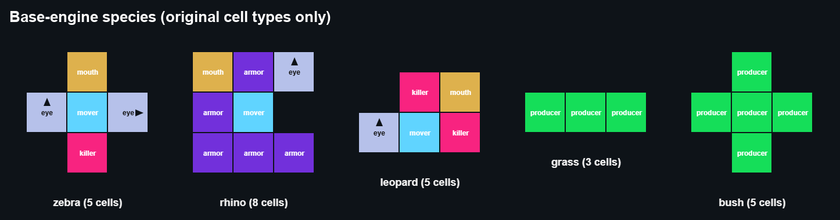
Two versions of each species: base and modified
About movers. In the original Life Engine one mover is enough and extra movers add nothing: every animal moves one cell per tick. So base zebras and leopards have one mover. Sprinting with extra movers is our own rule, used only in the modified engine.
Zebra
Rhino
Leopard
Herd grazer with a rear kick. Modified: stripes for herd camouflage, sprint
Armoured grazer. Modified: horn, armour adds health
Jaws beside the mouth. Modified: meat-only, strong bite, cache near trees
Weakness One mouth; in the base engine its kick also hurts its own herd
Weakness Slow; modified armour costs food, so calves are expensive
Weakness Base: no faster than prey. Modified: no armour, kicked and gored
Notes:
Base species use only original cells. Grass is 3 producers, bush 5 (producers in the base engine, woody cells in the modified one). Trees exist only in the modified engine.

Slide 4
Part 1: the base engine
What it can and cannot do, how we tried to get suicide or failure to adapt, and what happened

Slide 5
What the base engine can and cannot do
It allows
It cannot do
Killer cells hurt everything they touch: plants, other species and their own kind
Anything that dies becomes food, so killing is rewarded with a meal
Uneaten food blocks births
Mutation can add, change or remove any cell
Starvation: animals only die of age or damage
Worse food: grass and bush food are identical
Predator dependence: leopards eat plant food too
Overgrazing: mouths cannot hurt plants
Speed: every animal moves one cell per tick
So in the base engine the only road to collapse runs through killer cells, and our grazing hypothesis cannot be tested.
Notes:
Base runs: original rules plus our Assignment 2 plant-reproduction change. Every new setting off; mutation cannot create our new cells.

Slide 6
How we tried to get suicide or failure to adapt
1
2
3
Default
Plant-kill control
Plant-kill, seeded
Original settings as shipped: does anything collapse on its own?
Route 1: zebras start without a killer; insta-kill on. Will a plant-killing trait evolve, spread and destroy the food?
The same route with the killer given at the start
4
5
6
Harsh food
No mutation
Clogging
Food production 2: does anyone fail, or adapt?
Food production 2 and no mutation: the failure-to-adapt baseline
Route 2: fast plants, few grazers. Can plants choke on their own food?
Notes:
Each condition: 3 seeds of 40,000 ticks, screenshots at fixed ticks and at every collapse.

Slide 7
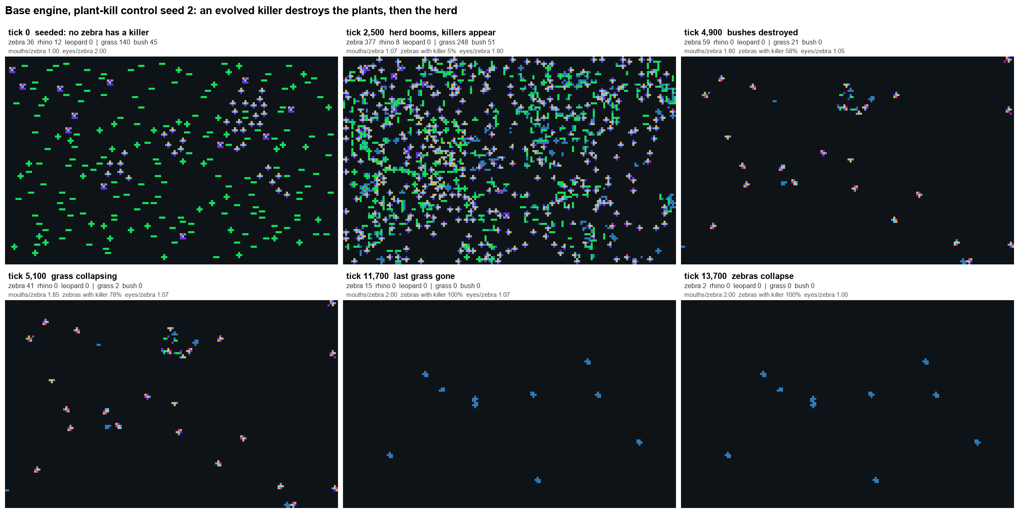
When the killer had to evolve, the herd ate its world
1 of 3
seeds met all four criteria; the other 2 collapsed but kept their grass
528
zebras at the peak, seed 2; killers then on 89-100% of the herd
14,005
tick the last zebra died; the last grass went at 11,700
Notes:
Seed 2: a killer evolved and spread because every plant or zebra it killed became food. Bushes gone by 4,900, grass by 11,700, zebras by 14,005. Seeds 1 and 3: killers mostly hit other zebras; carcasses piled up as food and blocked births, so the herd died out while grass survived.

Slide 8
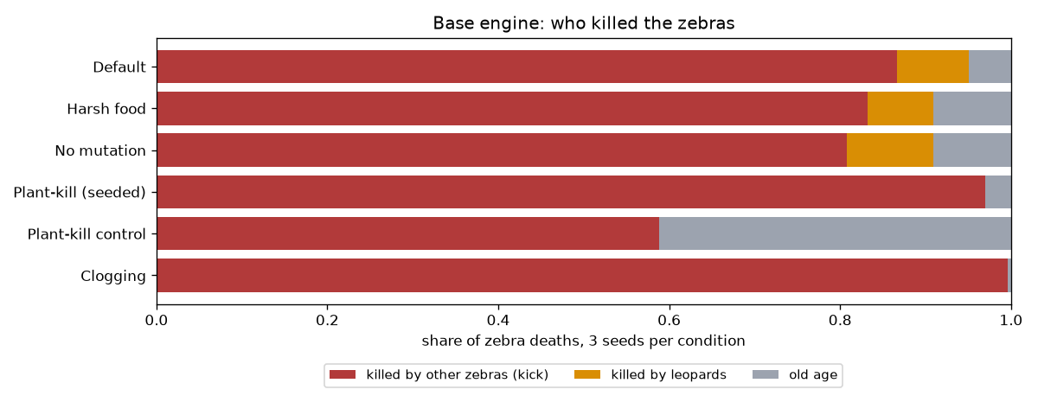
With the kick seeded, zebras destroyed their own world
81-97%
of zebra deaths caused by other zebras' kicks (leopards 0-10%)
tick 6,100
latest point by which all grass was gone; bushes by 1,500
The kick was given, not evolved, so this is a self-destroying design, not evolutionary suicide.
tick 8,000
latest zebra extinction in every condition with the kick
Notes:
Default, harsh, no-mutation and seeded plant-kill. The seeded plant-kill runs had no leopards, so zebra kicks alone destroyed the plants. Kicks also killed most rhinos (69 of 90 deaths in default seed 1).

Slide 9
Base engine verdict, and why we had to change it
Suicide: yes, once, when the killer evolved
Failure to adapt: zebras with no mutation; leopards in every condition (no speed advantage), extinct by tick 1,300
Clogging failed: grass never choked; the zebras kicked each other to death first
Why change the engine: the base engine can only collapse through killers. To test overgrazing we needed grazing, worse food, hunger and real predators

Slide 10
Part 2: what we changed
Each change answers a base-engine limit and adds an escape. All default to off.

Slide 11
Each change answers a base-engine limit
Mouths cannot hurt plants
→
Grazing damages grass plants
Grass and bush food identical
→
Bush browse worth 0.35 of grass
Nothing starves
→
Hunger: 1 food per 80 ticks, 10 misses and it dies
Leopards eat plants
→
Meat, jaws (killer beside mouth), feeding at the kill
Killers hurt plants and kin
→
Killers spare plants and own lineage; weapons strike only predators
Everyone moves 1 cell per tick
→
Our sprint rule: extra movers add steps, only when chasing or fleeing
Plant growth unlimited, map uniform
→
Soil water, river, trees and fire
Sprinting is our invention: in the original engine extra movers do nothing. At equal speed, leopards almost never caught zebras.

Slide 12
Each member feature opens a route and an escape
Horn cell
Vimbai
Stripe cell
Moreblessing
Route Horned rhinos trample plants and food around them
Route More surviving zebras means more grazing pressure
Escape Immune to killers; gores attackers 50% per tick
Escape Leopard eyes miss a striped zebra 25% per striped neighbour, up to 85%
Cache cell
Ashley
Soil water
Fourth member
Route Banking food delays breeding
Route Grass needs water to produce; dry soil recovers slowly
Escape Surplus banked near trees, spent automatically to stave off starvation
Escape Rain refills soil; deep-rooted bushes take over freed water

Slide 13
Part 2: did we achieve it?
Not evolutionary suicide. Failure to adapt and predator boom-bust, yes.

Slide 14
Modified engine verdict
Zebra overgrazing suicide
No
Second mouth spread (up to 2.8) but grass never collapsed: water regrowth, bush fallback and the river kept up
Rhino failure to adapt
Yes
Died out in every seed, mostly of old age: 16 food per calf was too slow
Zebra failure to adapt
Yes
Where no second mouth evolved, herds faded with food still on the map
Leopard collapse
Yes, not suicide
Boom-bust every time; 48 leopards ate every zebra then starved, set up by density, not an evolved trait
Horn or fire collapse
No
Rhinos stayed rare; fires never passed 160 cells on patchy, wet ground
Notes:
The modifications closed the base engine road (killers destroying plants and herds) and opened the grazing road. That road needed grass to regrow slower than it was eaten, and in every setting we tried, regrowth or the fallbacks kept up.

Slide 15
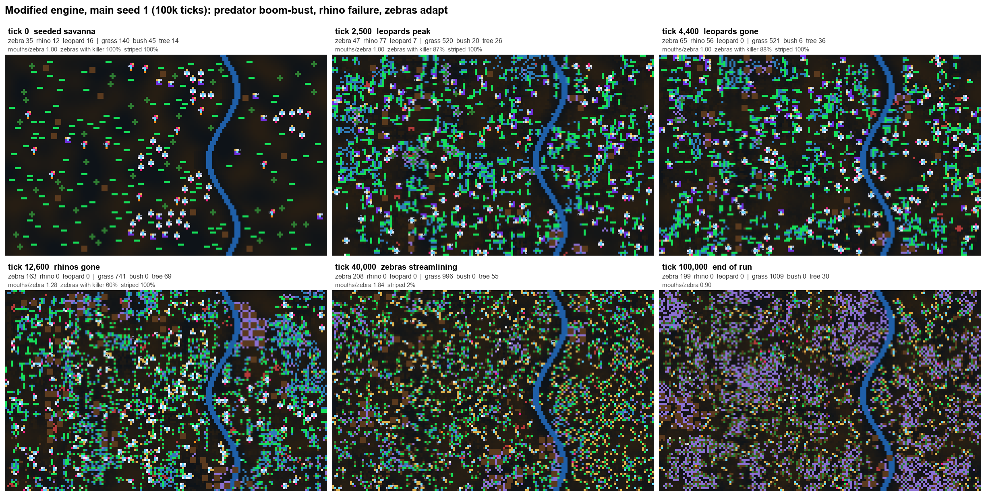
Seed 1: predators boom and vanish, zebras adapt
Notes:
Leopards rose from 16 to 35 by eating the herd, then died out by tick 4,400. Rhinos faded by 12,600. Zebras evolved a second mouth and held at about 200 to 290 to tick 100,000.

Slide 16
Every leopard and rhino population died out
26 to 35
leopard peak, then extinct by tick 3,600 to 12,800
5 of 5
rhino populations faded out by tick 17,300
1 of 5
zebra lineages alive at 100k: the one that evolved a second mouth

Slide 17
Three different ways to disappear
Leopards
Rhinos
Zebras
Boom then bust
Failure to adapt
Adapt or fade
Killed 57 to 144 zebras per run, then aged out or were kicked to death. Zebras never crashed first: a predator that failed to persist, not over-predation.
Rose to 27 to 80, then died of old age (54 to 358 per run, versus 17 to 66 killed). At 16 food per calf they could not keep up with zebras.
Where a second mouth spread, zebras thrived. Where it did not, they faded over tens of thousands of ticks with food still on the map.

Slide 18
Without the river or soil water, every zebra lineage died
Notes:
3 seeds per condition, so only 0% or 100% is a clear signal. No river, no soil water, weak camouflage and harsh hunger: 0 of 3. No cache: 3 of 3, because leopards died sooner. Mouth cap: 1 of 3, so the extra mouth helped zebras.

Slide 19
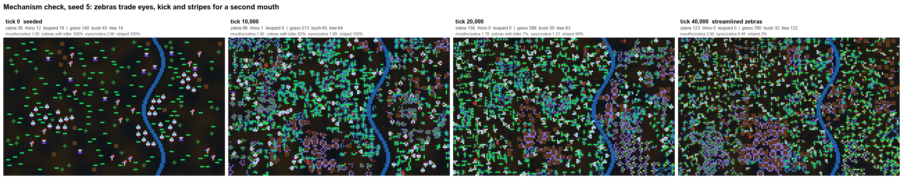
Zebras streamlined instead of overgrazing
Once leopards are gone, eyes, stripes and the kick are dead weight. A smaller body breeds on less food and a second mouth eats faster. Grass food never crashed (500 to 2,000 cells), so the trait never destroyed its own food: adaptation, not suicide.

Slide 20
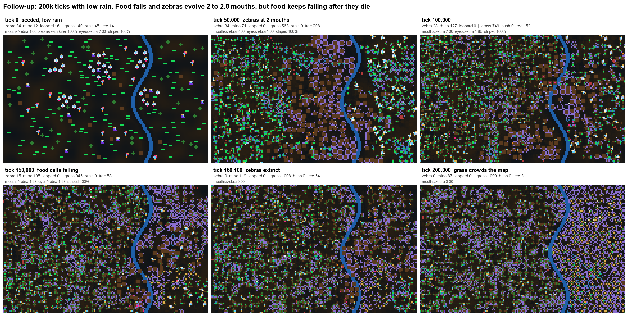
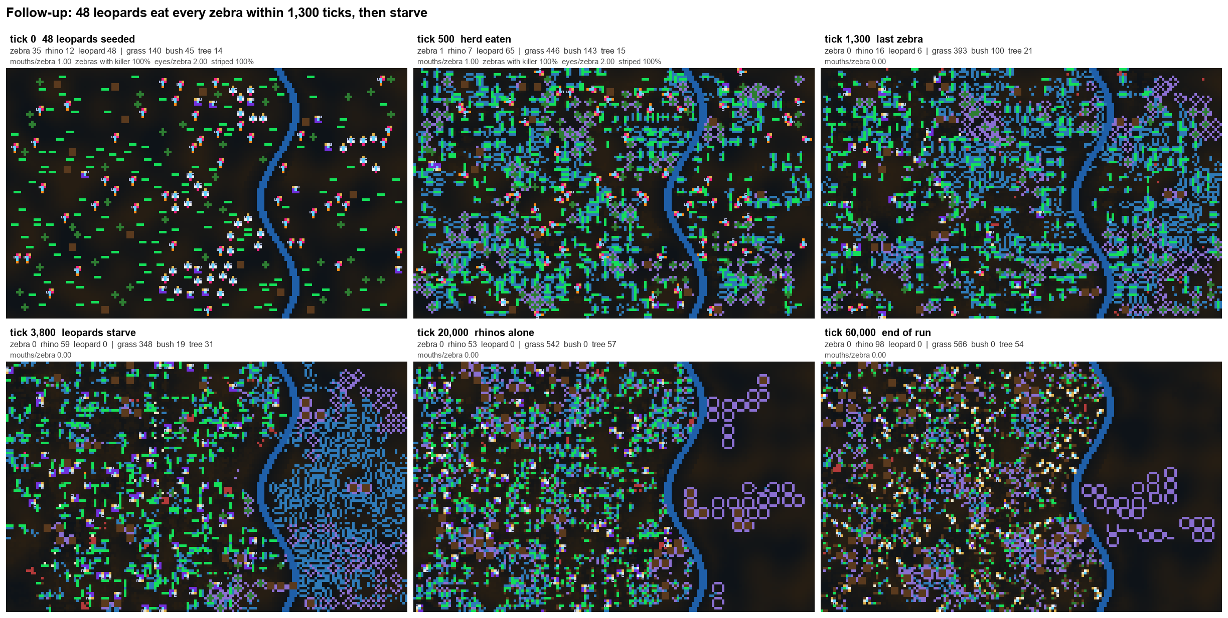
Longer, drier, more predators, more fire: same verdict
200k ticks, 40% rain
32 and 48 leopards
10x fire chance
Zebras evolved up to 2.8 mouths as food fell, then died out. Food kept falling after they were gone: grass crowding, not grazing.
48 leopards ate the whole herd in about 1,300 ticks, then starved: over-exploitation from density, not an evolved trait.
Burning rose only 2.6x and no fire passed 160 cells. Patchy plants on wet soil starve fires of fuel.
Notes:
18 follow-up runs, 3 seeds each: 200k default, 200k dry, 32 and 48 leopards, strong and extreme fire. None produced zebra overgrazing suicide or a persistent predator.

Slide 21
Answers to the brief
1
Did extinction occur?
2
Suicide or failure?
Yes: zebras in every base condition; every leopard and rhino population in the main modified runs.
Suicide in the base engine when a killer evolved (1 of 3 meets all criteria). Failure to adapt: base leopards, modified rhinos and non-adapting zebras.
3
Environment or species?
4
Instrumental traits
The engine decided the road: killers in the base engine, grazing in ours. Removing the river or soil water was as decisive as removing a trait.
Toward collapse: evolved killers, costly armour, single-prey diet. Away: river, water regrowth, stripes, kick, the second mouth.

Slide 22
What we can and cannot claim
Limits
No outcome is hard-coded
3 seeds per ablation and sweep: one seed of difference is noise
Rules were rebalanced during testing (leopard body, sprint, armour, weapons) before the final runs
Base runs redone with one-mover species after checking that extra movers do nothing
Our overgrazing hypothesis was not observed in 100k ticks
Fires stayed small and leopards never persisted, even with 10x fire and 3x leopards
Every death comes from per-organism rules: age, cell damage or hunger
Variants only change starting organisms and settings
Seeds of one condition reach different outcomes
Code: src/Organism/Cell/BodyCells, savanna-experiments/

Slide 23
The trait that wins is not always the trait that kills
In the base engine, a killer that paid in food destroyed the plants and the herd. In our savanna, with water, refuges and fallbacks, the same pressure produced adaptation instead.
Report, logs, screenshots and code: savanna-experiments/ in the project repository

