Slide 1
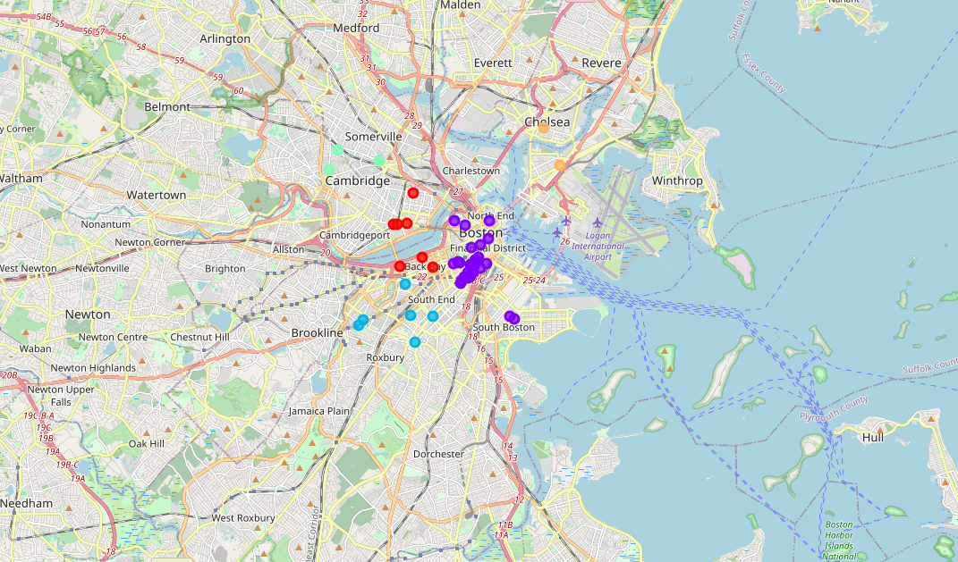
The Battle of Neighborhoods
Final Project
Business Clustering in
Downtown Boston

Slide 2
Introduction
Finding an appropriate location to launch a business or a location to launch a marketing campaign can be cumbersome. This project seeks to mitigate some of the problems involved in a pre-launch research business process.
I have used a dataset of central Boston venues to locate appropriate cluster locations to launch a business, or launch a marketing campaign. Specifically, I have tried to locate clusters that are absent of Chinese businesses to identify areas where a Chinese oriented business can be implemented. Likewise, I have tried to locate cluster areas that are dense in Chinese venues to identify areas where a Chinese marketing campaign could be effective.

Slide 3
Data & Methodology
The dataset used in the project originates from the Foursquare API service. Venues in and around downtown Boston have been pooled, and then filtered by "Chinese" indicators. This process has resulted in numerous locations found in and around downtown Boston.
Data has been pulled from the Foursquare API. The starting point for the research has been at latitude and longitude: 42.35860195 -71.06387508501135. From there, I have selected a radius of 5000 to locate venues nearby. The keyword “Chinese” has been used to identify venues that can be connected to a Chinese orientation, which is the target demographic of the business plan.
Chinese venues have then been identified and clustered through a k-means algorithm. Every value will be subjected to the cluster with the closest mean. We have set k=5 and therefore formed five clusters to identify and separate Chinese venues in downtown Boston.

Slide 4
Result & Conclusion
Cluster | Count
0 - West | 7
1 - Central | 31
2 - South West | 6
3 - North West | 4
4 - North East | 2
With the use of the K-mean algorithm, five clusters have been identified in and around downtown Boston. As seen in the table below, the density of Chinese venues is highest in Cluster 1, or the Central part of Boston. Furthermore, the density is the lowest in the North Eastern part of Boston, the Chelsea region.
For a business launch with Chinese orientation, it would be appropriate to launch in a cluster area not already dense with Chinese business. However, if targeting the Chinese community is a part of the business plan or an advertisement plan, then a low-density cluster might be more effective.
Downtown Boston may be an appropriate area for launching a Chinese oriented business. A business user who wants to launch in a low-dense area with less competition should consider the western region of Boston, cluster 0, 2, 3, and also 4. A business user who needs a broad Chinese target demographic should instead consider central Boston and cluster 1.

