Slide 1

COMS W4111: Introduction to Databases, Section 002, Spring 2021
Lecture 1: Introduction, Course Overview, Foundational Concepts
Donald F. Ferguson (dff@cs.columbia.edu)
© Donald F. Ferguson, 2021

Slide 2

We will start in a couple of minutes
2 | COMS W4111_002_2021_1: Lecture 1: Introduction, Course Overview, Foundational Concepts © Donald F. Ferguson, 2021

Slide 3
Contents
3 | COMS W4111_002_2021_1: Lecture 1: Introduction, Course Overview, Foundational Concepts © Donald F. Ferguson, 2021

Slide 4
Contents
Introduction
Logistics, about your instructor, OHs, TAs
Homework, exams.
Introductory concepts
Motivating examples.
Introductory concepts: data, databases, database management systems.
Application, application architectures, roles.
Database design, Entity-Relationship Model (Part 1)
Database design process.
ER-Model and diagrams.
The theory: The Relational Model (Part 1)
Relational model, schema, keys, schema diagrams
Basics of relational algebra.
The realization: Structure Query Language (SQL) (Part 1)
Basics of Data Definition Language
Basics of Data Manipulation Language (Query)

Slide 5
Introduction
Logistics
Exams, Homework
5 | COMS W4111_002_2021_1: Lecture 1: Introduction, Course Overview, Foundational Concepts © Donald F. Ferguson, 2021

Slide 6

Introduction
Waitlist
About your instructor
The course
Lecture structure
Objectives
Logistics
Assignments and grading
Course and reference material
Syllabus outline
6 | Introduction to Databases (F20): Lecture 12 – Big Data and Analytics

Slide 7
Waitlist
The administrative staff of the Dept. of Computer Science directly manages enrollment in the W4111 sections and the wait lists.
COMS W4111 is ALWAYS oversubscribed and has huge wait lists.
The course is a requirement for several majors and tracks.
There are complex rules about prioritizing students for course enrollment, and also which students can take the hybrid section.
Section 002, Spring 2021 supports students in Data Science Institute.
In place of required COMS 4121, which is not taught this year.
DSI students have first priority, followed by CS Dept. prioritization.
Faculty follow department policies and do not manage waitlists, despite the list that identifies the waitlist as “Instructor Managed.”
Contacts: You must work with administrative leaders on enrollment:
Computer Science: Cynthia Meekins, cynthia@cs.columbia.edu)
Data Science Institute: Brianne Cortese (bc2640@columbia.edu)

Slide 8
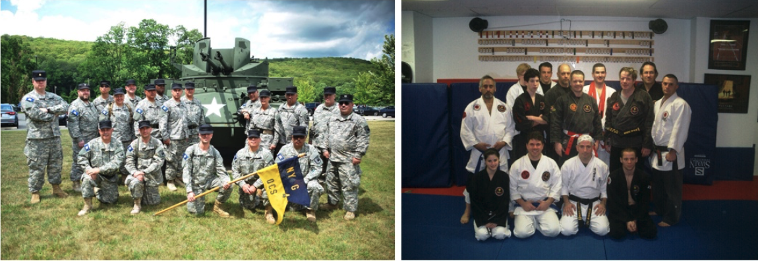
About your Instructor
35 years in computer science industry:
IBM Fellow
Microsoft Technical Fellow.
Chief Technology Officer, CA technologies.
Dell Senior Technical Fellow.
CTO, Co-Founder, Seeka.tv.
Ansys Fellow
Academic experience:
BA, MS, Ph.D., Columbia University.
Approx. 10 semesters as an Adjunct Professor.
Professor of Professional Practice in CS (2018)
Courses:
E1006: Intro. to Computing
W4111: Intro. to Databases
E6998, E6156: Advanced Topics in SW Engineering (Cloud Computing)
Approx. 65 technical publications; Approx. 12 patents.
Personal:
Two children:
College freshman (Ithaca College).
2019 Barnard Graduate.
Hobbies:
Black Belt in Kenpo Karate
1LT, New York Guard.
Bicycling.
Astronomy.
Languages:
Proficient in Spanish.
Learning Arabic.

Slide 9
The Course
From the new/pending Columbia University Bulletin "Prerequisites: COMS W3134, COMS W3136, or COMS W3137; or the instructor's permission. The course covers what a database system is, how to design databases effectively and in a principled manner, how to query databases, and how to develop applications using databases: entity-relationship modeling, logical design of relational databases, relational algebra, SQL, database application development, database security, and an overview of query optimization and transaction processing. Additional topics generally include NoSQL, graph, object-relational, and cloud databases, as well as data preparation and cleaning of real-world data. The course offers both programming and non-programming paths for homework and projects, to accommodate students with different programming skills and backgrounds."
Prerequisites:
COMS W3134, COMS W3136, or COMS W3137 are data structures classes. All of these courses require extensive programming, in Java.
A course in data structures is helpful for this section of W4111 but not essential. I waive the requirement.
We will help you with any data structures knowledge you lack.
Programming in/for this class:
There will be a "non-programming" option, which we will discuss below.
For students who want to take the programming track, we will use Python. I will provide motivation for choosing Python below.

Slide 10
Lecture Format, Recitation, Office Hours
Lecture: Friday, 10:10 to 12:40 – This is a hybrid section, like many classes this fall.
There will be optional, in-person lectures.
I will hold as many lectures in-person as possible but may hold some lectures online only.
I will announce in advance if I plan to hold a lecture online only.
Lectures are streamed and also recorded.
Students can attend in-person, watch the stream or watch the recording.
There are limitations on how many students can attend in person due to social distancing. I will provide a sign-up method to reserve seats.
Recitation: Optional recitation on Saturday, 10:10 to 12:00
Either in-person/online or just online. Will announce in advance.
Will hold when there is student interest.
Office hours:
I will hold on-campus and online offices hours.
I will be on campus when possible for students that want to speak with me or need more focused help.
I will publish in-person OH when I plan them.
I will provide a sign-up mechanism for in person office hours.
Note: Your health, safety and well-being are ALWAYS my primary concern. These are bizarre, stressful times. Speak to me if you need special considerations and I will do the best that I can.

Slide 11
Assignments, Exams, Grading
Point value of assignments and exams
50%: Homework assignments: Approximately one HW every two weeks. Each is work 10 points.
Homework format:
Questions requiring written answers and diagrams.
Implement/execute/test of various database operations required to solve a use case/question.
Format will be an iPython/Jupyter Notebook.
Incremental development of a project:
Programming track – web application.
Non-programming track – data analysis/visualization.
Exams:
20% of grade is midterm exam score.
30% is final exam score.
A perfect sore of 97-100 points is an A. There are opportunities to get extra-credit.

Slide 12
Some Examples
(There are many, many online)
12 | Introduction to Databases (F20): Lecture 12 – Big Data and Analytics

Slide 14
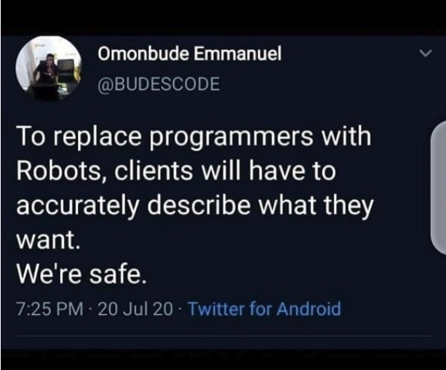
Homework Assignments

