Slide 1
MY DREAM TRIP
By Roenko D.E.
PI261

Slide 2
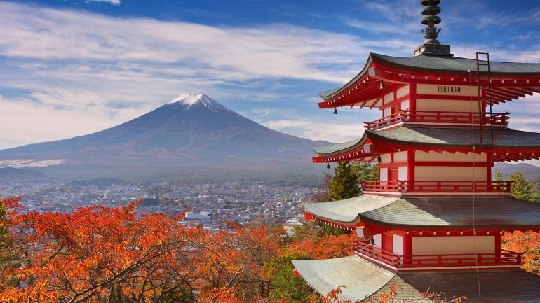
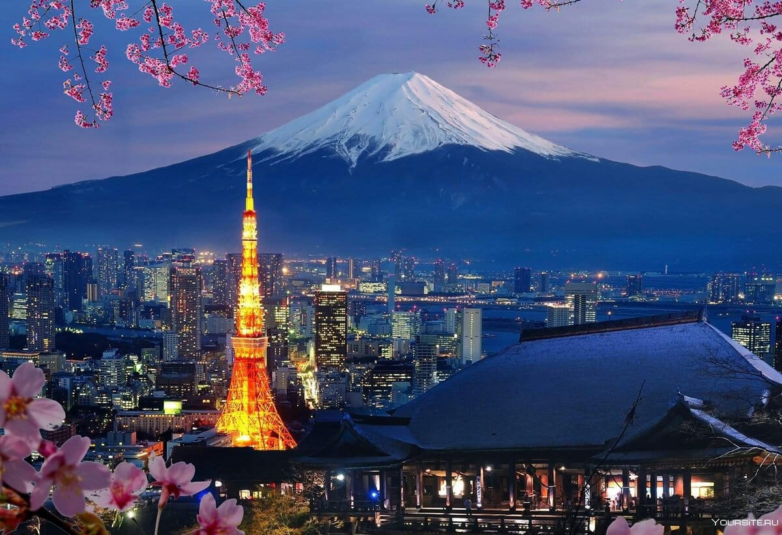
A PLACE I WANT TO VISIT : JAPAN
Where traditions meets technology

Slide 3

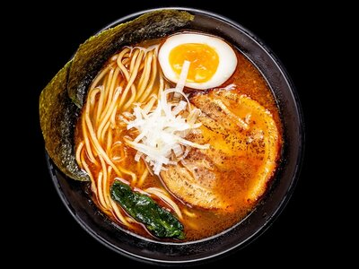
JAPANESE FOOD
Result of a living on a isolated island

Slide 4
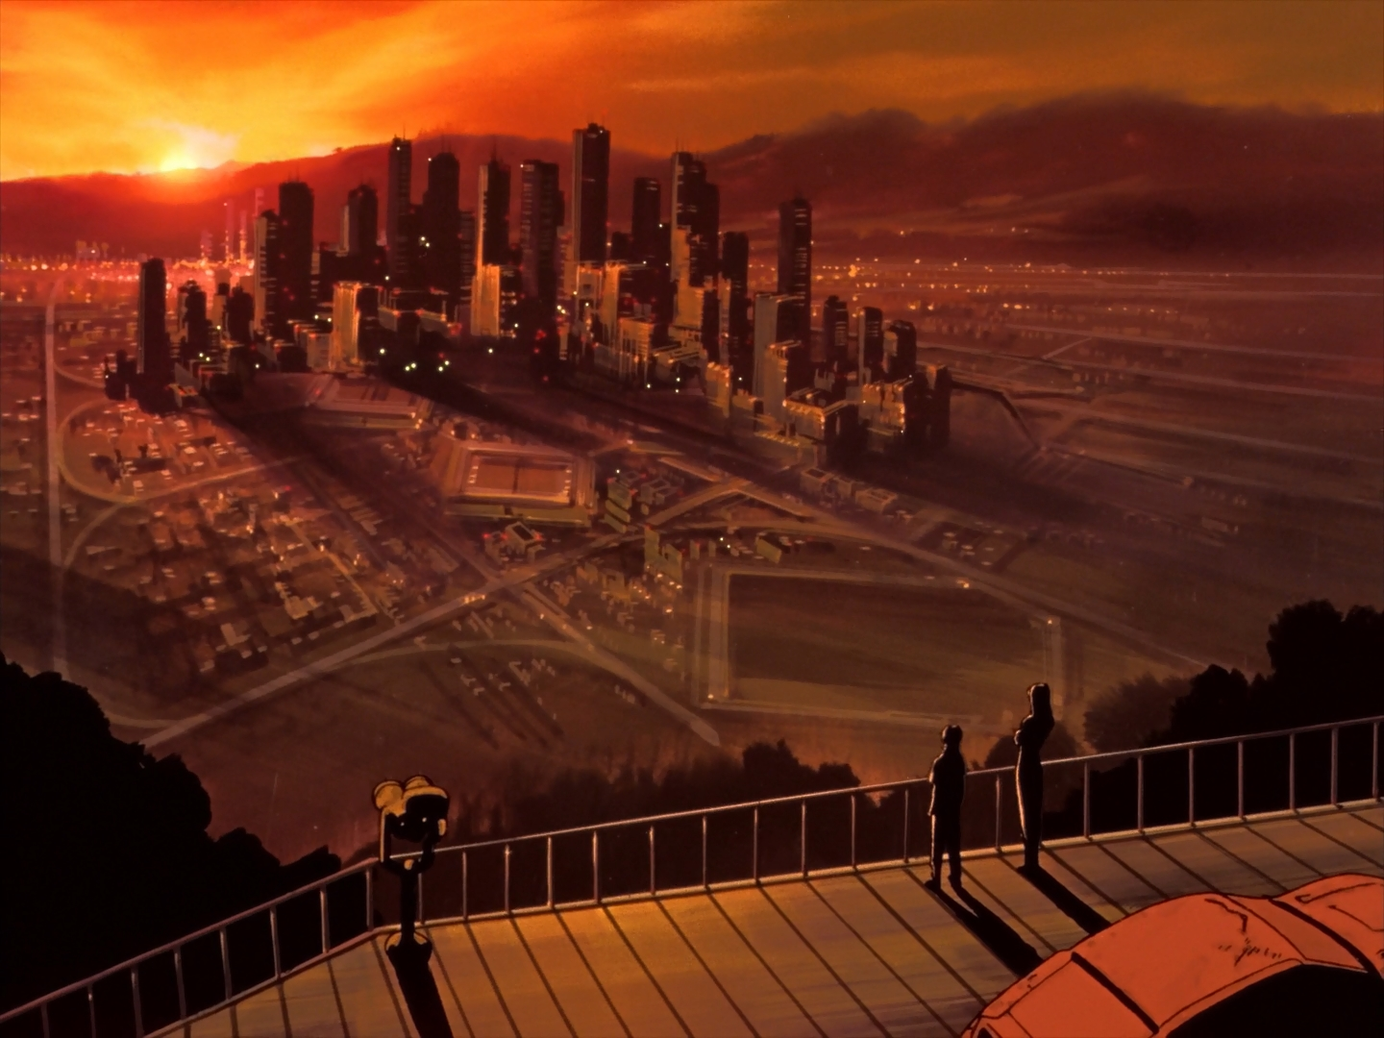
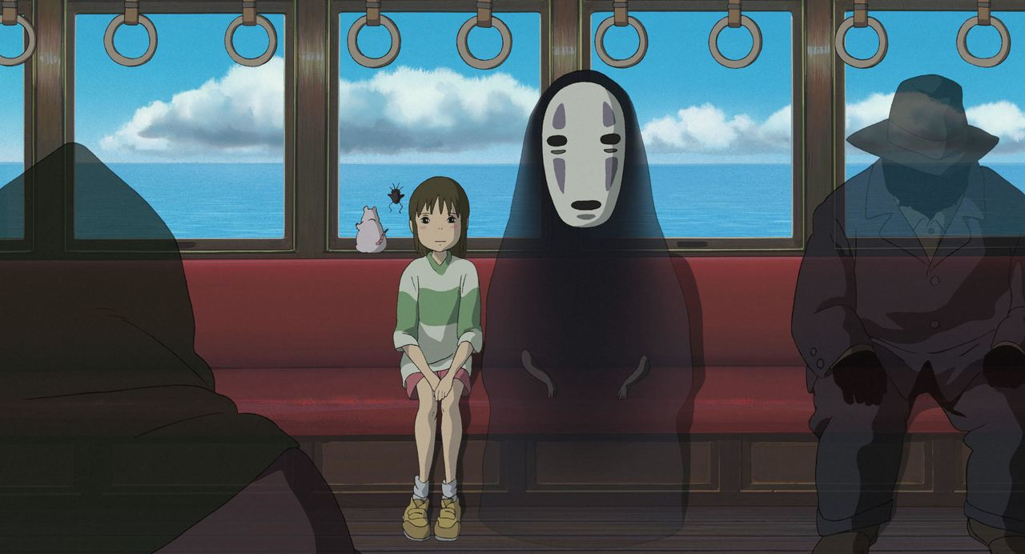

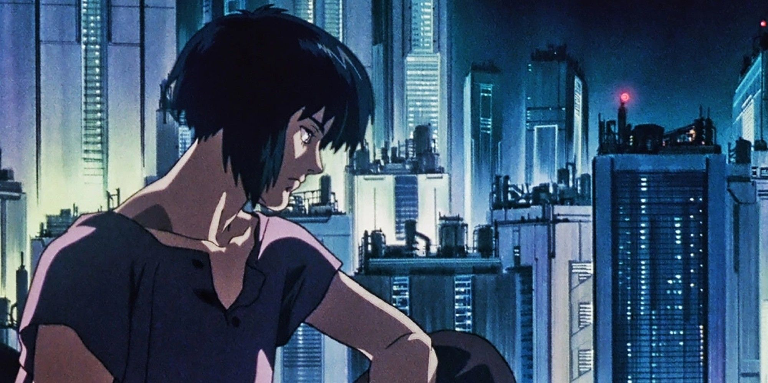
ANIME AS A PART OF JAPANESE CULTURE

Slide 5
THX A LOT

