Slide 1

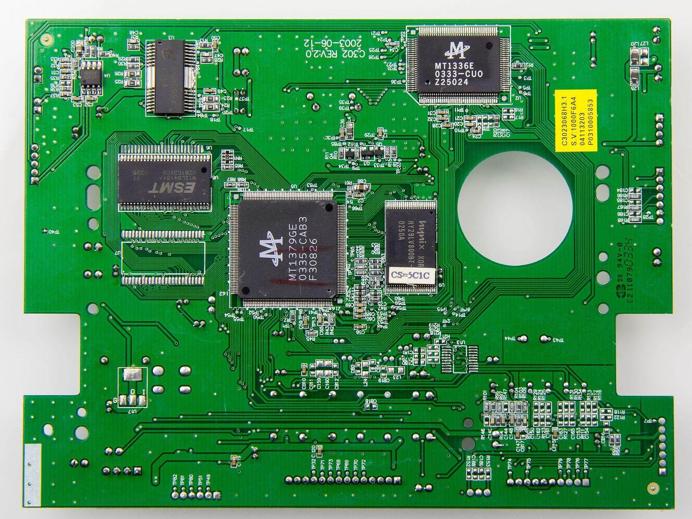

Cursus Kicad
How to go from idea to product

Slide 2

A bit of history

Slide 3
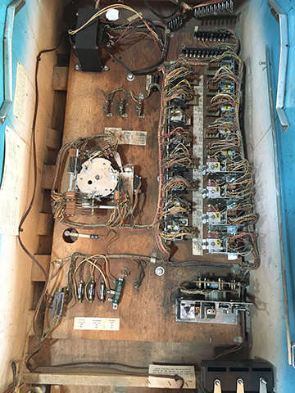
A bit of history
This contains logic

Slide 4
A bit of history
That includes these

Slide 5
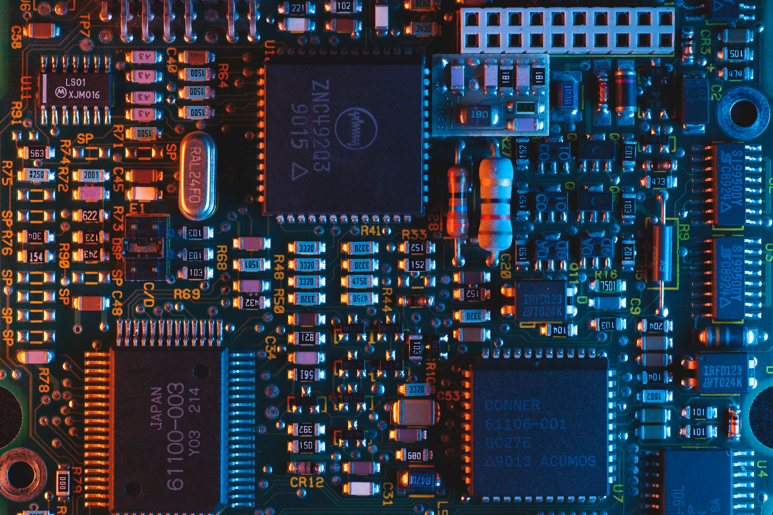
Chips replaced the logic

Slide 6
Let start with your idea

Slide 7
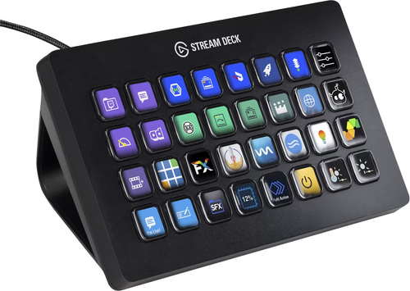
Let start with your idea

Slide 8
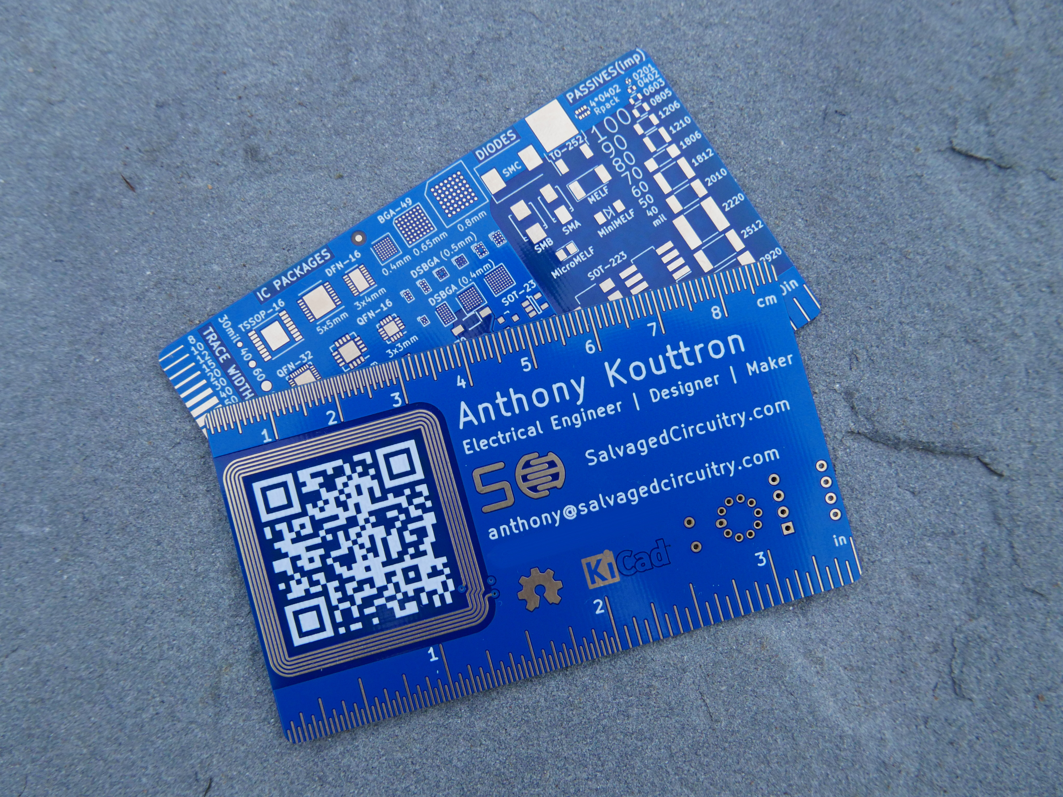
Let start with your idea

Slide 9
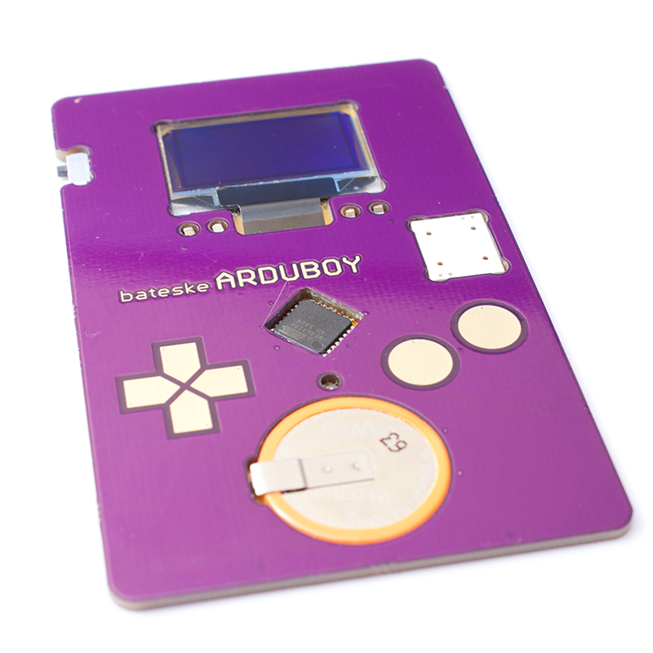
Let start with your idea

Slide 10
Let start with your idea
What does it needs?
Usb?
Leds?
Sensors?
Motors?
Touch sensors?

Slide 11
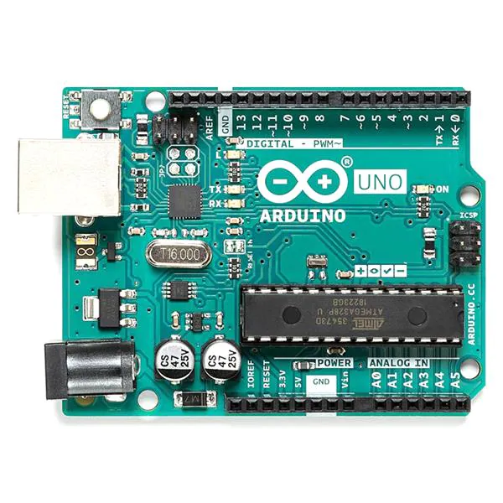
Find a microcontroller that suits your needs
What does it needs?
Usb?
Leds?
Sensors?
Motors?
Touch sensors?

Slide 12
Find a microcontroller that suits your needs
What does it needs?
Usb → USB compatible
Leds → GPIO / PINout
Sensors → ADC / digital in
Motors → motor controller
Touch sensors → Pin input

Slide 13
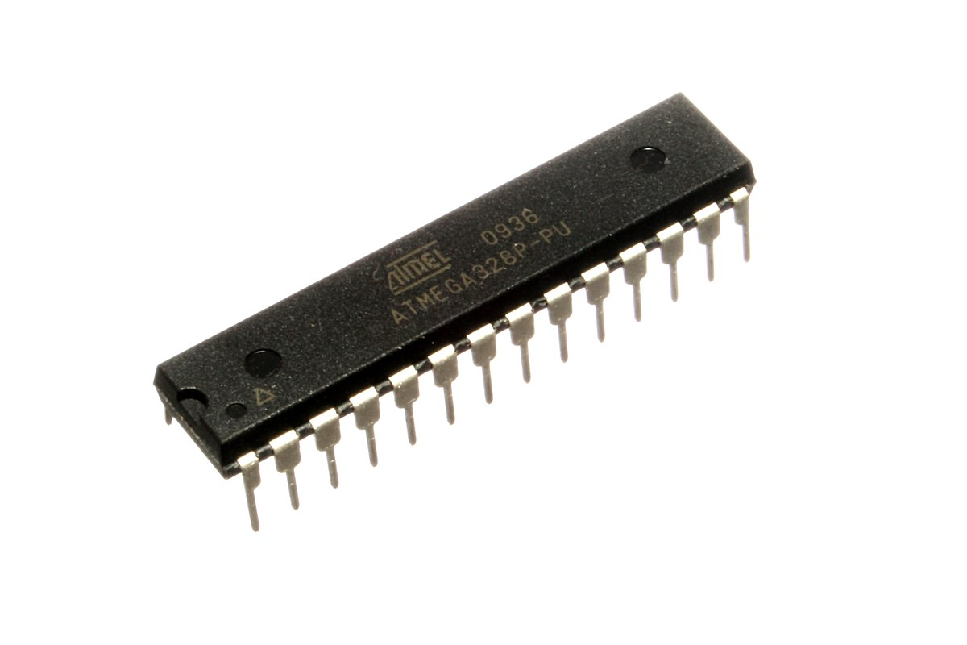
Find a microcontroller that suits your needs

Slide 14
Find a microcontroller that suits your needs

Slide 15
Step 1: prototyping
Easy to program
Easy to prototype with

Slide 16
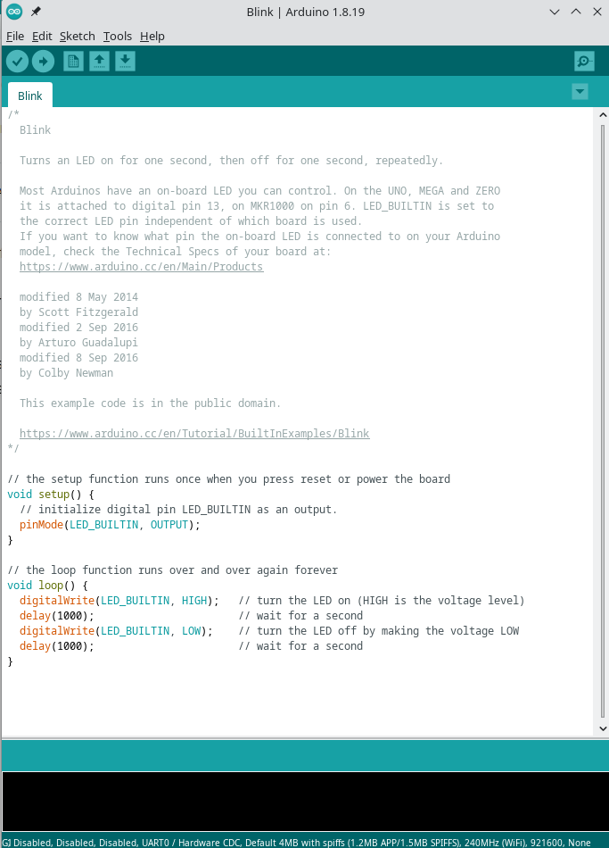
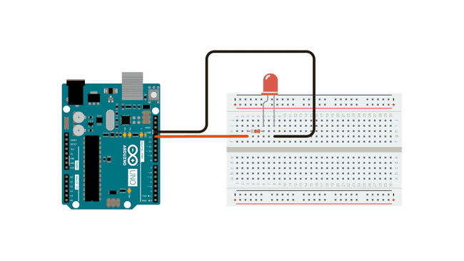
Step 1: prototyping

Slide 17
Step 1: prototyping

Slide 18
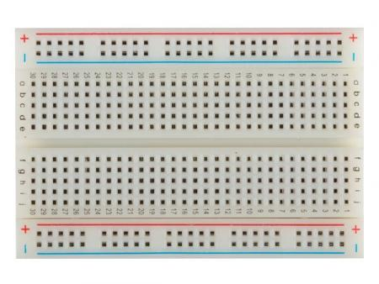
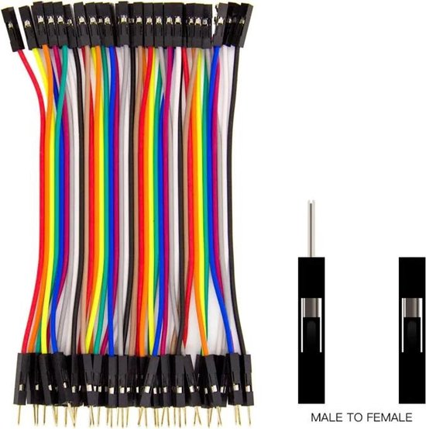
Step 1: prototyping

Slide 19
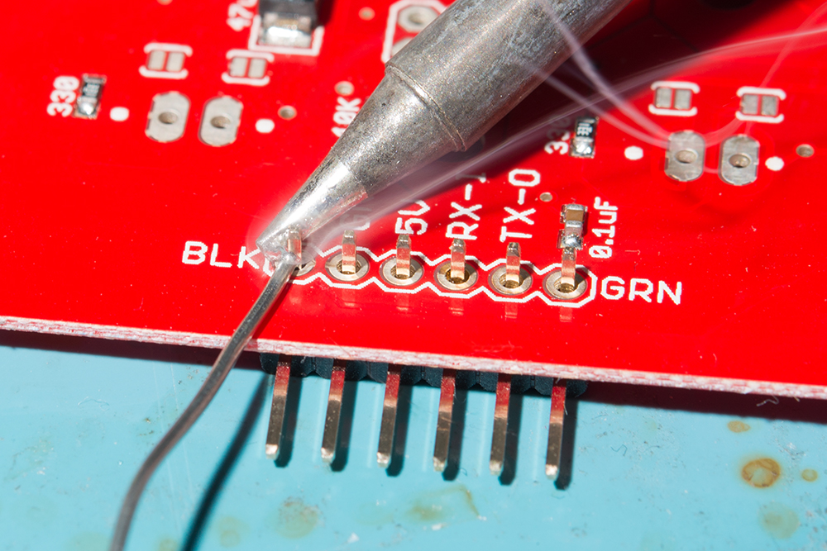
Step 1: prototyping

Slide 20
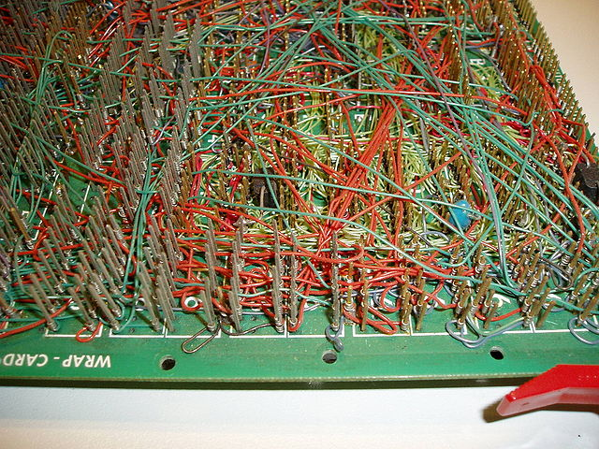
Step 1: prototyping

Slide 21
Step 1: prototyping

Slide 22
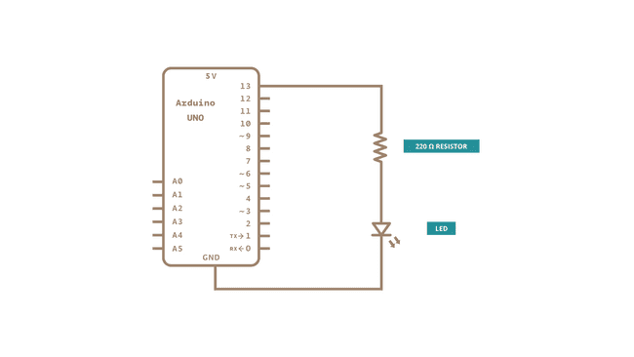
Step 1: prototyping

Slide 23
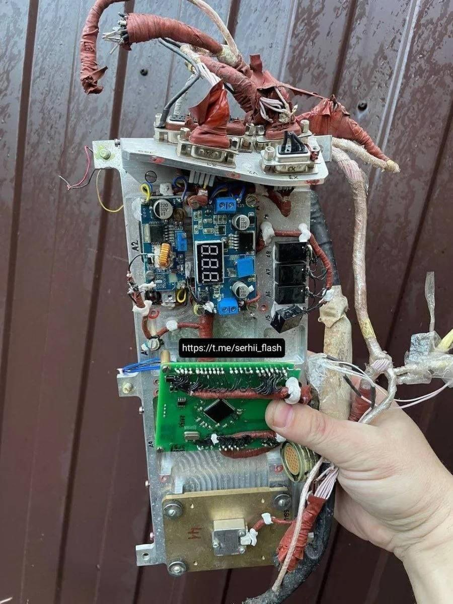
Product of prototyping

Slide 24

Product of prototyping

Slide 25
Product of prototyping
Working schematic
Working code

Slide 26
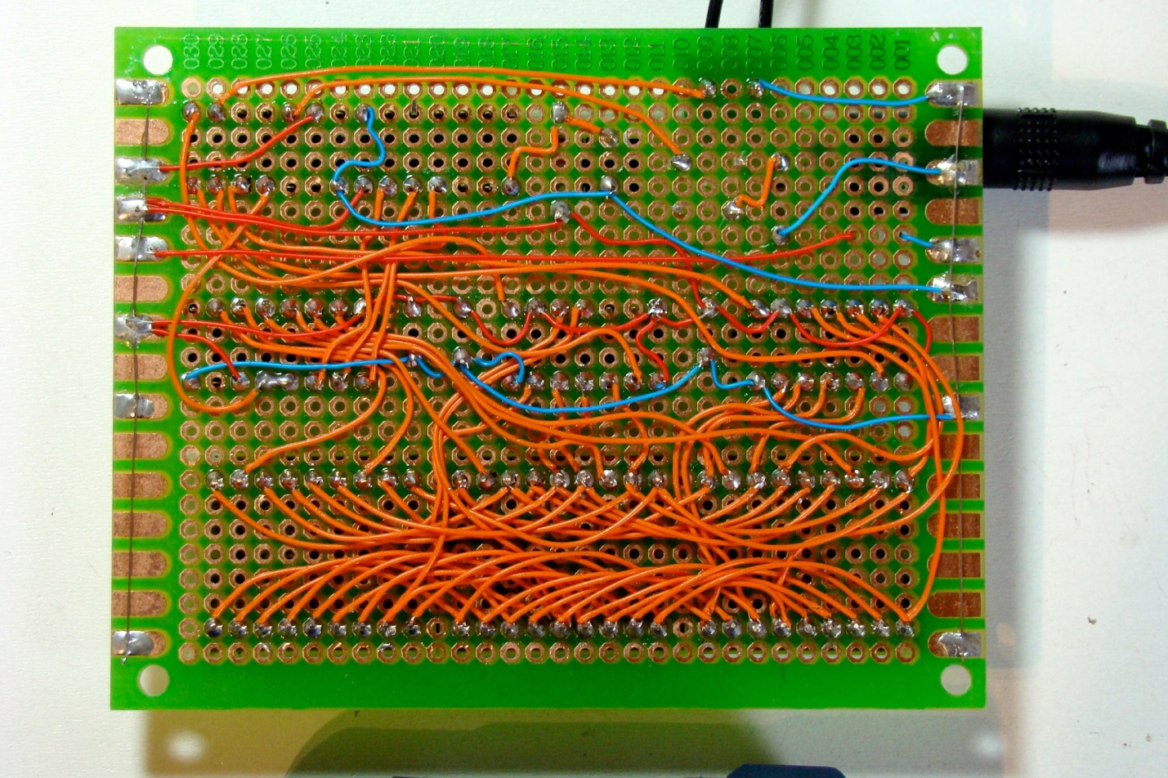
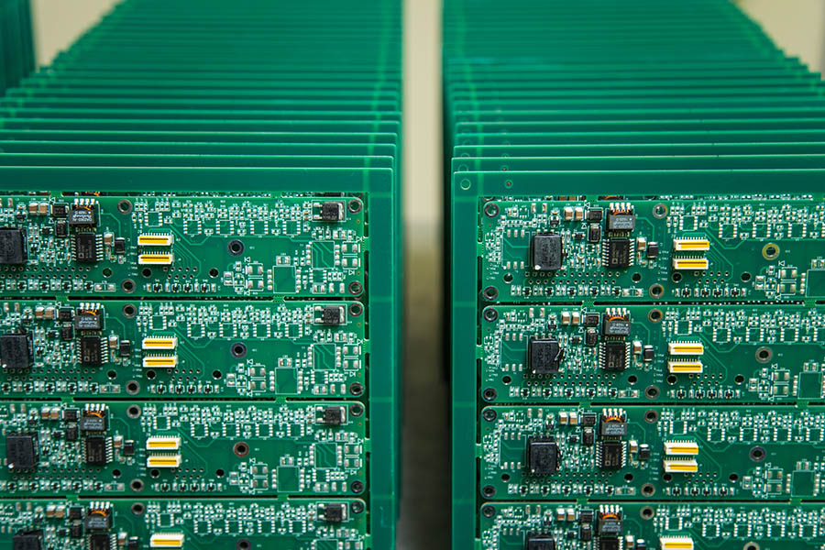

Slide 27
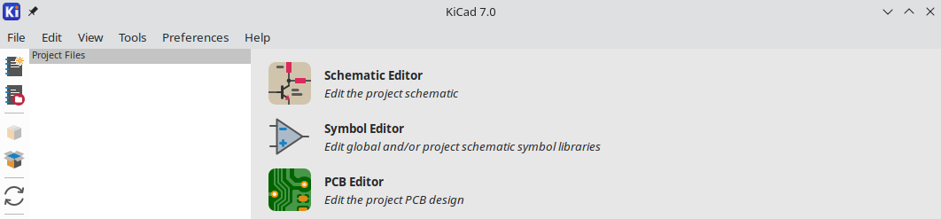
Step 2: Kicad

Slide 28
Step 2: Schemetic editor

Slide 29
Step 2: Symbol / Footprint Editor

Slide 30
Step 2: PCB Editor
Import from schemetic
Layers(enter schrek meme here)

Slide 31
Step 3: Export
Gerberfiles
Pick and place
Bom
Kicad PCB file

Slide 32
Order
JLC PCB
Handsolder vs Let it be produced for you

Slide 33
Beautify your pcb
SVG Magic
As layer
Layer used for other designs
Use the back of PCB
Gold plating

Slide 34
Features
Text based, só git compatible
Kibot

