Slide 1
Echarts
徐培成

Slide 2
Echarts
下载
http://echarts.baidu.com/dist/echarts.js

Slide 3
Echarts使用
网页中引入js库文件
<!DOCTYPE html>
<html>
<head>
<meta charset="utf-8">
<!-- 引入 ECharts 文件 -->
<script src="echarts.min.js"></script>
</head>
</html>

Slide 4
Echarts使用
准备div存放图表容器
<body>
<div id="main" style="width:600px;height:400px;">
</div>
</body>

Slide 5
Echarts使用
使用脚本加载图表
<body>
<div id="main" style="width:600px;height:400px;"></div>
<script>
var myChart = echarts.init(document.getElementById('main'));
...
myChart.setOption(option);
</script>
</body>
具体代码见备注。
Notes:
<script type="text/javascript">
// 基于准备好的dom，初始化echarts实例
var myChart = echarts.init(document.getElementById('main'));
// 指定图表的配置项和数据
var option = {
title: {
text: 'ECharts 入门示例'
},
tooltip: {},
legend: {
data:['销量']
},
xAxis: {
data: ["衬衫","羊毛衫","雪纺衫","裤子","高跟鞋","袜子"]
},
yAxis: {},
series: [{
name: '销量',
type: 'bar',
data: [5, 20, 36, 10, 10, 20]
}]
};
// 使用刚指定的配置项和数据显示图表。
myChart.setOption(option);
</script>

Slide 6
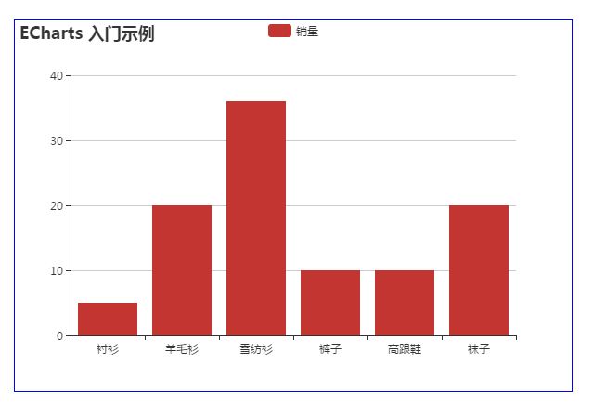
Echarts使用
柱状图.

Slide 7
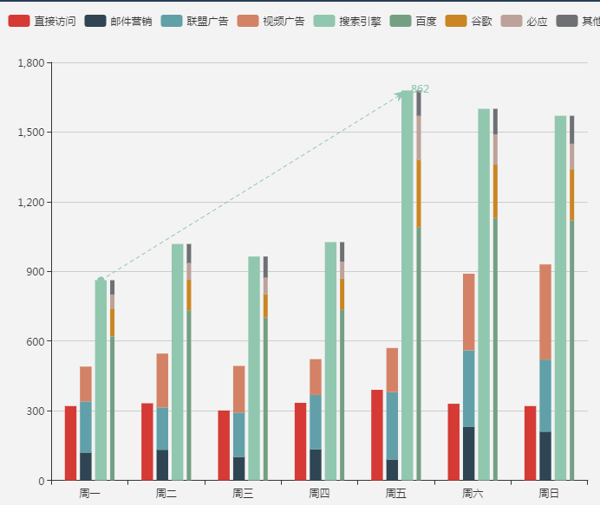
Echarts使用
柱状图(2)
Notes:
option = {
tooltip : {
trigger: 'axis',
axisPointer : { // 坐标轴指示器，坐标轴触发有效
type : 'shadow' // 默认为直线，可选为：'line' | 'shadow'
}
},
legend: {
data:['直接访问','邮件营销','联盟广告','视频广告','搜索引擎','百度','谷歌','必应','其他']
},
grid: {
left: '3%',
right: '4%',
bottom: '3%',
containLabel: true
},
xAxis : [
{
type : 'category',
data : ['周一','周二','周三','周四','周五','周六','周日']
}
],
yAxis : [
{
type : 'value'
}
],
series : [
{
name:'直接访问',
type:'bar',
data:[320, 332, 301, 334, 390, 330, 320]
},
{
name:'邮件营销',
type:'bar',
stack: '广告',
data:[120, 132, 101, 134, 90, 230, 210]
},
{
name:'联盟广告',
type:'bar',
stack: '广告',
data:[220, 182, 191, 234, 290, 330, 310]
},
{
name:'视频广告',
type:'bar',
stack: '广告',
data:[150, 232, 201, 154, 190, 330, 410]
},
{
name:'搜索引擎',
type:'bar',
data:[862, 1018, 964, 1026, 1679, 1600, 1570],
markLine : {
lineStyle: {
normal: {
type: 'dashed'
}
},
data : [
[{type : 'min'}, {type : 'max'}]
]
}
},
{
name:'百度',
type:'bar',
barWidth : 5,
stack: '搜索引擎',
data:[620, 732, 701, 734, 1090, 1130, 1120]
},
{
name:'谷歌',
type:'bar',
stack: '搜索引擎',
data:[120, 132, 101, 134, 290, 230, 220]
},
{
name:'必应',
type:'bar',
stack: '搜索引擎',
data:[60, 72, 71, 74, 190, 130, 110]
},
{
name:'其他',
type:'bar',
stack: '搜索引擎',
data:[62, 82, 91, 84, 109, 110, 120]
}
]
};

Slide 8
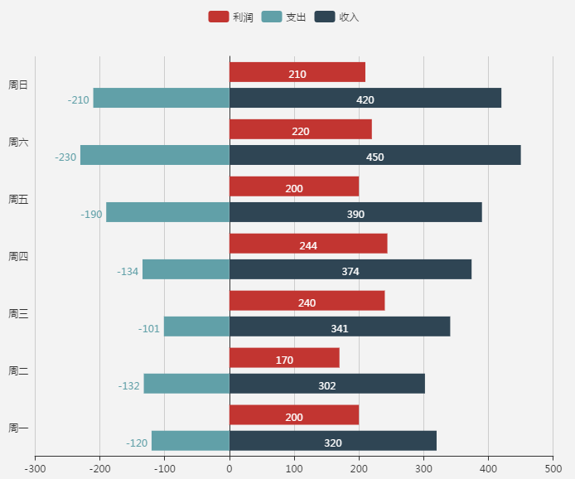
Echarts使用
柱状图
代码加备注。
Notes:
app.title = '正负条形图';
option = {
tooltip : {
trigger: 'axis',
axisPointer : { // 坐标轴指示器，坐标轴触发有效
type : 'shadow' // 默认为直线，可选为：'line' | 'shadow'
}
},
legend: {
data:['利润', '支出', '收入']
},
grid: {
left: '3%',
right: '4%',
bottom: '3%',
containLabel: true
},
xAxis : [
{
type : 'value'
}
],
yAxis : [
{
type : 'category',
axisTick : {show: false},
data : ['周一','周二','周三','周四','周五','周六','周日']
}
],
series : [
{
name:'利润',
type:'bar',
label: {
normal: {
show: true,
position: 'inside'
}
},
data:[200, 170, 240, 244, 200, 220, 210]
},
{
name:'收入',
type:'bar',
stack: '总量',
label: {
normal: {
show: true
}
},
data:[320, 302, 341, 374, 390, 450, 420]
},
{
name:'支出',
type:'bar',
stack: '总量',
label: {
normal: {
show: true,
position: 'left'
}
},
data:[-120, -132, -101, -134, -190, -230, -210]
}
]
};

Slide 9
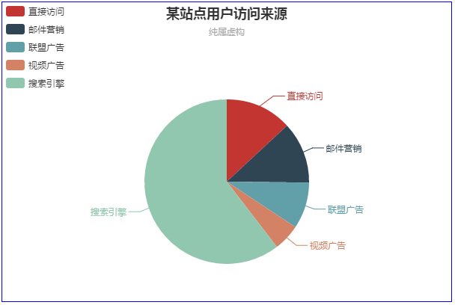
Echarts使用
饼图(1)
代码加备注。
Notes:
<!DOCTYPE html> <html lang="en"> <head> <meta charset="UTF-8"> <title>Title</title> <script src="echarts.js"></script> <style> #div2{ margin: 5px 200px; height: 400px ; width: 600px ; border: blue 1px solid ; } </style> </head> <body> <div id="div2"> </div> <script type = "text/javascript"> // 基于准备好的dom，初始化echarts实例 var myChart = echarts.init(document.getElementById('div2')); // 指定图表的配置项和数据 option = { title: { text: '某站点用户访问来源', subtext: '纯属虚构', x: 'center' }, tooltip: { trigger: 'item', formatter: "{a} <br/>{b} : {c} ({d}%)" }, legend: { orient: 'vertical', left: 'left', data: ['直接访问', '邮件营销', '联盟广告', '视频广告', '搜索引擎'] }, series: [ { name: '访问来源', type: 'pie', radius: '55%', center: ['50%', '60%'], data: [ {value: 335, name: '直接访问'}, {value: 310, name: '邮件营销'}, {value: 234, name: '联盟广告'}, {value: 135, name: '视频广告'}, {value: 1548, name: '搜索引擎'} ], itemStyle: { emphasis: { shadowBlur: 10, shadowOffsetX: 0, shadowColor: 'rgba(0, 0, 0, 0.5)' } } } ] }; // 使用刚指定的配置项和数据显示图表。 myChart.setOption(option); </script> </body> </html>

Slide 10
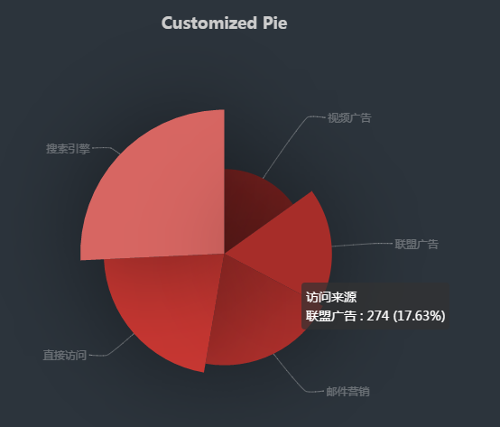
Echarts使用
饼图(2)
代码加备注。
Notes:
<!DOCTYPE html> <html lang="en"> <head> <meta charset="UTF-8"> <title>Title</title> <script src="echarts.js"></script> <style> #div2{ margin: 5px 200px; height: 400px ; width: 600px ; border: blue 1px solid ; } </style> </head> <body> <div id="div2"> </div> <script type = "text/javascript"> // 基于准备好的dom，初始化echarts实例 var myChart = echarts.init(document.getElementById('div2')); // 指定图表的配置项和数据 option = {
backgroundColor: '#2c343c',
title: {
text: 'Customized Pie',
left: 'center',
top: 20,
textStyle: {
color: '#ccc'
}
},
tooltip : {
trigger: 'item',
formatter: "{a} <br/>{b} : {c} ({d}%)"
},
visualMap: {
show: false,
min: 80,
max: 600,
inRange: {
colorLightness: [0, 1]
}
},
series : [
{
name:'访问来源',
type:'pie',
radius : '55%',
center: ['50%', '50%'],
data:[
{value:335, name:'直接访问'},
{value:310, name:'邮件营销'},
{value:274, name:'联盟广告'},
{value:235, name:'视频广告'},
{value:400, name:'搜索引擎'}
].sort(function (a, b) { return a.value - b.value}),
roseType: 'angle',
label: {
normal: {
textStyle: {
color: 'rgba(255, 255, 255, 0.3)'
}
}
},
labelLine: {
normal: {
lineStyle: {
color: 'rgba(255, 255, 255, 0.3)'
},
smooth: 0.2,
length: 10,
length2: 20
}
},
itemStyle: {
normal: {
color: '#c23531',
shadowBlur: 200,
shadowColor: 'rgba(0, 0, 0, 0.5)'
}
},
animationType: 'scale',
animationEasing: 'elasticOut',
animationDelay: function (idx) {
return Math.random() * 200;
}
}
]
}; // 使用刚指定的配置项和数据显示图表。 myChart.setOption(option); </script> </body> </html>

Slide 11
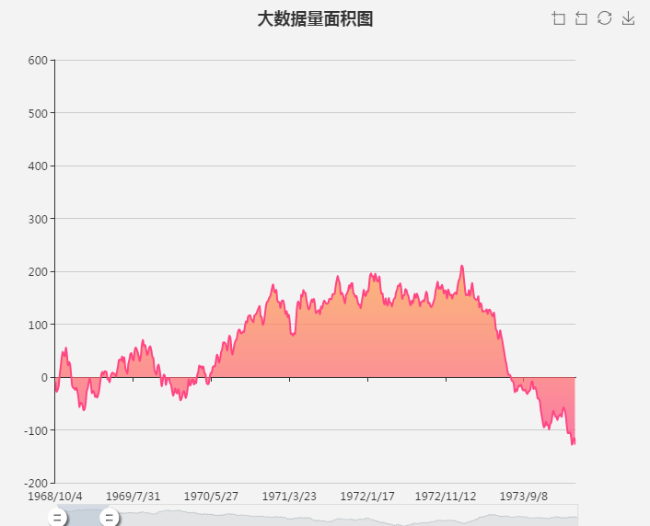
Echarts使用
折线图
Notes:
var base = +new Date(1968, 9, 3);
var oneDay = 24 * 3600 * 1000;
var date = [];
var data = [Math.random() * 300];
for (var i = 1; i < 20000; i++) {
var now = new Date(base += oneDay);
date.push([now.getFullYear(), now.getMonth() + 1, now.getDate()].join('/'));
data.push(Math.round((Math.random() - 0.5) * 20 + data[i - 1]));
}
option = {
tooltip: {
trigger: 'axis',
position: function (pt) {
return [pt[0], '10%'];
}
},
title: {
left: 'center',
text: '大数据量面积图',
},
toolbox: {
feature: {
dataZoom: {
yAxisIndex: 'none'
},
restore: {},
saveAsImage: {}
}
},
xAxis: {
type: 'category',
boundaryGap: false,
data: date
},
yAxis: {
type: 'value',
boundaryGap: [0, '100%']
},
dataZoom: [{
type: 'inside',
start: 0,
end: 10
}, {
start: 0,
end: 10,
handleIcon: 'M10.7,11.9v-1.3H9.3v1.3c-4.9,0.3-8.8,4.4-8.8,9.4c0,5,3.9,9.1,8.8,9.4v1.3h1.3v-1.3c4.9-0.3,8.8-4.4,8.8-9.4C19.5,16.3,15.6,12.2,10.7,11.9z M13.3,24.4H6.7V23h6.6V24.4z M13.3,19.6H6.7v-1.4h6.6V19.6z',
handleSize: '80%',
handleStyle: {
color: '#fff',
shadowBlur: 3,
shadowColor: 'rgba(0, 0, 0, 0.6)',
shadowOffsetX: 2,
shadowOffsetY: 2
}
}],
series: [
{
name:'模拟数据',
type:'line',
smooth:true,
symbol: 'none',
sampling: 'average',
itemStyle: {
normal: {
color: 'rgb(255, 70, 131)'
}
},
areaStyle: {
normal: {
color: new echarts.graphic.LinearGradient(0, 0, 0, 1, [{
offset: 0,
color: 'rgb(255, 158, 68)'
}, {
offset: 1,
color: 'rgb(255, 70, 131)'
}])
}
},
data: data
}
]
};

Slide 12
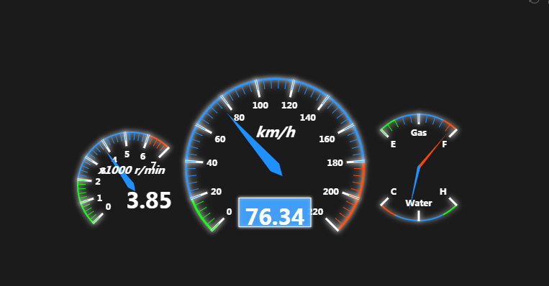
Echarts使用
仪表盘
Notes:
option = {
backgroundColor: '#1b1b1b',
tooltip : {
formatter: "{a} <br/>{c} {b}"
},
toolbox: {
show : true,
feature : {
mark : {show: true},
restore : {show: true},
saveAsImage : {show: true}
}
},
series : [
{
name:'速度',
type:'gauge',
min:0,
max:220,
splitNumber:11,
radius: '50%',
axisLine: { // 坐标轴线
lineStyle: { // 属性lineStyle控制线条样式
color: [[0.09, 'lime'],[0.82, '#1e90ff'],[1, '#ff4500']],
width: 3,
shadowColor : '#fff', //默认透明
shadowBlur: 10
}
},
axisLabel: { // 坐标轴小标记
textStyle: { // 属性lineStyle控制线条样式
fontWeight: 'bolder',
color: '#fff',
shadowColor : '#fff', //默认透明
shadowBlur: 10
}
},
axisTick: { // 坐标轴小标记
length :15, // 属性length控制线长
lineStyle: { // 属性lineStyle控制线条样式
color: 'auto',
shadowColor : '#fff', //默认透明
shadowBlur: 10
}
},
splitLine: { // 分隔线
length :25, // 属性length控制线长
lineStyle: { // 属性lineStyle（详见lineStyle）控制线条样式
width:3,
color: '#fff',
shadowColor : '#fff', //默认透明
shadowBlur: 10
}
},
pointer: { // 分隔线
shadowColor : '#fff', //默认透明
shadowBlur: 5
},
title : {
textStyle: { // 其余属性默认使用全局文本样式，详见TEXTSTYLE
fontWeight: 'bolder',
fontSize: 20,
fontStyle: 'italic',
color: '#fff',
shadowColor : '#fff', //默认透明
shadowBlur: 10
}
},
detail : {
backgroundColor: 'rgba(30,144,255,0.8)',
borderWidth: 1,
borderColor: '#fff',
shadowColor : '#fff', //默认透明
shadowBlur: 5,
offsetCenter: [0, '50%'], // x, y，单位px
textStyle: { // 其余属性默认使用全局文本样式，详见TEXTSTYLE
fontWeight: 'bolder',
color: '#fff'
}
},
data:[{value: 40, name: 'km/h'}]
},
{
name:'转速',
type:'gauge',
center : ['25%', '55%'], // 默认全局居中
radius : '30%',
min:0,
max:7,
endAngle:45,
splitNumber:7,
axisLine: { // 坐标轴线
lineStyle: { // 属性lineStyle控制线条样式
color: [[0.29, 'lime'],[0.86, '#1e90ff'],[1, '#ff4500']],
width: 2,
shadowColor : '#fff', //默认透明
shadowBlur: 10
}
},
axisLabel: { // 坐标轴小标记
textStyle: { // 属性lineStyle控制线条样式
fontWeight: 'bolder',
color: '#fff',
shadowColor : '#fff', //默认透明
shadowBlur: 10
}
},
axisTick: { // 坐标轴小标记
length :12, // 属性length控制线长
lineStyle: { // 属性lineStyle控制线条样式
color: 'auto',
shadowColor : '#fff', //默认透明
shadowBlur: 10
}
},
splitLine: { // 分隔线
length :20, // 属性length控制线长
lineStyle: { // 属性lineStyle（详见lineStyle）控制线条样式
width:3,
color: '#fff',
shadowColor : '#fff', //默认透明
shadowBlur: 10
}
},
pointer: {
width:5,
shadowColor : '#fff', //默认透明
shadowBlur: 5
},
title : {
offsetCenter: [0, '-30%'], // x, y，单位px
textStyle: { // 其余属性默认使用全局文本样式，详见TEXTSTYLE
fontWeight: 'bolder',
fontStyle: 'italic',
color: '#fff',
shadowColor : '#fff', //默认透明
shadowBlur: 10
}
},
detail : {
//backgroundColor: 'rgba(30,144,255,0.8)',
// borderWidth: 1,
borderColor: '#fff',
shadowColor : '#fff', //默认透明
shadowBlur: 5,
width: 80,
height:30,
offsetCenter: [25, '20%'], // x, y，单位px
textStyle: { // 其余属性默认使用全局文本样式，详见TEXTSTYLE
fontWeight: 'bolder',
color: '#fff'
}
},
data:[{value: 1.5, name: 'x1000 r/min'}]
},
{
name:'油表',
type:'gauge',
center : ['75%', '50%'], // 默认全局居中
radius : '30%',
min:0,
max:2,
startAngle:135,
endAngle:45,
splitNumber:2,
axisLine: { // 坐标轴线
lineStyle: { // 属性lineStyle控制线条样式
color: [[0.2, 'lime'],[0.8, '#1e90ff'],[1, '#ff4500']],
width: 2,
shadowColor : '#fff', //默认透明
shadowBlur: 10
}
},
axisTick: { // 坐标轴小标记
length :12, // 属性length控制线长
lineStyle: { // 属性lineStyle控制线条样式
color: 'auto',
shadowColor : '#fff', //默认透明
shadowBlur: 10
}
},
axisLabel: {
textStyle: { // 属性lineStyle控制线条样式
fontWeight: 'bolder',
color: '#fff',
shadowColor : '#fff', //默认透明
shadowBlur: 10
},
formatter:function(v){
switch (v + '') {
case '0' : return 'E';
case '1' : return 'Gas';
case '2' : return 'F';
}
}
},
splitLine: { // 分隔线
length :15, // 属性length控制线长
lineStyle: { // 属性lineStyle（详见lineStyle）控制线条样式
width:3,
color: '#fff',
shadowColor : '#fff', //默认透明
shadowBlur: 10
}
},
pointer: {
width:2,
shadowColor : '#fff', //默认透明
shadowBlur: 5
},
title : {
show: false
},
detail : {
show: false
},
data:[{value: 0.5, name: 'gas'}]
},
{
name:'水表',
type:'gauge',
center : ['75%', '50%'], // 默认全局居中
radius : '30%',
min:0,
max:2,
startAngle:315,
endAngle:225,
splitNumber:2,
axisLine: { // 坐标轴线
lineStyle: { // 属性lineStyle控制线条样式
color: [[0.2, 'lime'],[0.8, '#1e90ff'],[1, '#ff4500']],
width: 2,
shadowColor : '#fff', //默认透明
shadowBlur: 10
}
},
axisTick: { // 坐标轴小标记
show: false
},
axisLabel: {
textStyle: { // 属性lineStyle控制线条样式
fontWeight: 'bolder',
color: '#fff',
shadowColor : '#fff', //默认透明
shadowBlur: 10
},
formatter:function(v){
switch (v + '') {
case '0' : return 'H';
case '1' : return 'Water';
case '2' : return 'C';
}
}
},
splitLine: { // 分隔线
length :15, // 属性length控制线长
lineStyle: { // 属性lineStyle（详见lineStyle）控制线条样式
width:3,
color: '#fff',
shadowColor : '#fff', //默认透明
shadowBlur: 10
}
},
pointer: {
width:2,
shadowColor : '#fff', //默认透明
shadowBlur: 5
},
title : {
show: false
},
detail : {
show: false
},
data:[{value: 0.5, name: 'gas'}]
}
]
};
setInterval(function (){
option.series[0].data[0].value = (Math.random()*100).toFixed(2) - 0;
option.series[1].data[0].value = (Math.random()*7).toFixed(2) - 0;
option.series[2].data[0].value = (Math.random()*2).toFixed(2) - 0;
option.series[3].data[0].value = (Math.random()*2).toFixed(2) - 0;
myChart.setOption(option);
},2000)

Slide 13
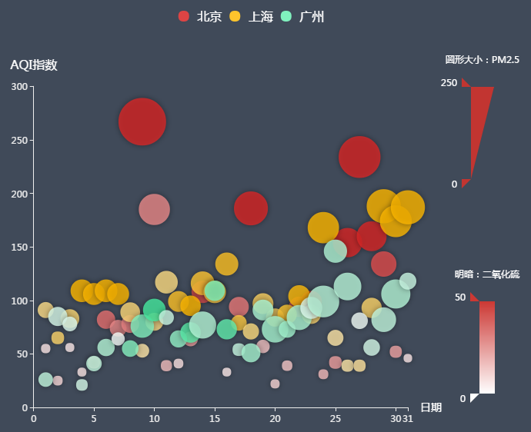
Echarts使用
散点图
Notes:
var dataBJ = [
[1,55,9,56,0.46,18,6,"良"],
[2,25,11,21,0.65,34,9,"优"],
[3,56,7,63,0.3,14,5,"良"],
[4,33,7,29,0.33,16,6,"优"],
[5,42,24,44,0.76,40,16,"优"],
[6,82,58,90,1.77,68,33,"良"],
[7,74,49,77,1.46,48,27,"良"],
[8,78,55,80,1.29,59,29,"良"],
[9,267,216,280,4.8,108,64,"重度污染"],
[10,185,127,216,2.52,61,27,"中度污染"],
[11,39,19,38,0.57,31,15,"优"],
[12,41,11,40,0.43,21,7,"优"],
[13,64,38,74,1.04,46,22,"良"],
[14,108,79,120,1.7,75,41,"轻度污染"],
[15,108,63,116,1.48,44,26,"轻度污染"],
[16,33,6,29,0.34,13,5,"优"],
[17,94,66,110,1.54,62,31,"良"],
[18,186,142,192,3.88,93,79,"中度污染"],
[19,57,31,54,0.96,32,14,"良"],
[20,22,8,17,0.48,23,10,"优"],
[21,39,15,36,0.61,29,13,"优"],
[22,94,69,114,2.08,73,39,"良"],
[23,99,73,110,2.43,76,48,"良"],
[24,31,12,30,0.5,32,16,"优"],
[25,42,27,43,1,53,22,"优"],
[26,154,117,157,3.05,92,58,"中度污染"],
[27,234,185,230,4.09,123,69,"重度污染"],
[28,160,120,186,2.77,91,50,"中度污染"],
[29,134,96,165,2.76,83,41,"轻度污染"],
[30,52,24,60,1.03,50,21,"良"],
[31,46,5,49,0.28,10,6,"优"]
];
var dataGZ = [
[1,26,37,27,1.163,27,13,"优"],
[2,85,62,71,1.195,60,8,"良"],
[3,78,38,74,1.363,37,7,"良"],
[4,21,21,36,0.634,40,9,"优"],
[5,41,42,46,0.915,81,13,"优"],
[6,56,52,69,1.067,92,16,"良"],
[7,64,30,28,0.924,51,2,"良"],
[8,55,48,74,1.236,75,26,"良"],
[9,76,85,113,1.237,114,27,"良"],
[10,91,81,104,1.041,56,40,"良"],
[11,84,39,60,0.964,25,11,"良"],
[12,64,51,101,0.862,58,23,"良"],
[13,70,69,120,1.198,65,36,"良"],
[14,77,105,178,2.549,64,16,"良"],
[15,109,68,87,0.996,74,29,"轻度污染"],
[16,73,68,97,0.905,51,34,"良"],
[17,54,27,47,0.592,53,12,"良"],
[18,51,61,97,0.811,65,19,"良"],
[19,91,71,121,1.374,43,18,"良"],
[20,73,102,182,2.787,44,19,"良"],
[21,73,50,76,0.717,31,20,"良"],
[22,84,94,140,2.238,68,18,"良"],
[23,93,77,104,1.165,53,7,"良"],
[24,99,130,227,3.97,55,15,"良"],
[25,146,84,139,1.094,40,17,"轻度污染"],
[26,113,108,137,1.481,48,15,"轻度污染"],
[27,81,48,62,1.619,26,3,"良"],
[28,56,48,68,1.336,37,9,"良"],
[29,82,92,174,3.29,0,13,"良"],
[30,106,116,188,3.628,101,16,"轻度污染"],
[31,118,50,0,1.383,76,11,"轻度污染"]
];
var dataSH = [
[1,91,45,125,0.82,34,23,"良"],
[2,65,27,78,0.86,45,29,"良"],
[3,83,60,84,1.09,73,27,"良"],
[4,109,81,121,1.28,68,51,"轻度污染"],
[5,106,77,114,1.07,55,51,"轻度污染"],
[6,109,81,121,1.28,68,51,"轻度污染"],
[7,106,77,114,1.07,55,51,"轻度污染"],
[8,89,65,78,0.86,51,26,"良"],
[9,53,33,47,0.64,50,17,"良"],
[10,80,55,80,1.01,75,24,"良"],
[11,117,81,124,1.03,45,24,"轻度污染"],
[12,99,71,142,1.1,62,42,"良"],
[13,95,69,130,1.28,74,50,"良"],
[14,116,87,131,1.47,84,40,"轻度污染"],
[15,108,80,121,1.3,85,37,"轻度污染"],
[16,134,83,167,1.16,57,43,"轻度污染"],
[17,79,43,107,1.05,59,37,"良"],
[18,71,46,89,0.86,64,25,"良"],
[19,97,71,113,1.17,88,31,"良"],
[20,84,57,91,0.85,55,31,"良"],
[21,87,63,101,0.9,56,41,"良"],
[22,104,77,119,1.09,73,48,"轻度污染"],
[23,87,62,100,1,72,28,"良"],
[24,168,128,172,1.49,97,56,"中度污染"],
[25,65,45,51,0.74,39,17,"良"],
[26,39,24,38,0.61,47,17,"优"],
[27,39,24,39,0.59,50,19,"优"],
[28,93,68,96,1.05,79,29,"良"],
[29,188,143,197,1.66,99,51,"中度污染"],
[30,174,131,174,1.55,108,50,"中度污染"],
[31,187,143,201,1.39,89,53,"中度污染"]
];
var schema = [
{name: 'date', index: 0, text: '日'},
{name: 'AQIindex', index: 1, text: 'AQI指数'},
{name: 'PM25', index: 2, text: 'PM2.5'},
{name: 'PM10', index: 3, text: 'PM10'},
{name: 'CO', index: 4, text: '一氧化碳（CO）'},
{name: 'NO2', index: 5, text: '二氧化氮（NO2）'},
{name: 'SO2', index: 6, text: '二氧化硫（SO2）'}
];
var itemStyle = {
normal: {
opacity: 0.8,
shadowBlur: 10,
shadowOffsetX: 0,
shadowOffsetY: 0,
shadowColor: 'rgba(0, 0, 0, 0.5)'
}
};
option = {
backgroundColor: '#404a59',
color: [
'#dd4444', '#fec42c', '#80F1BE'
],
legend: {
y: 'top',
data: ['北京', '上海', '广州'],
textStyle: {
color: '#fff',
fontSize: 16
}
},
grid: {
x: '10%',
x2: 150,
y: '18%',
y2: '10%'
},
tooltip: {
padding: 10,
backgroundColor: '#222',
borderColor: '#777',
borderWidth: 1,
formatter: function (obj) {
var value = obj.value;
return '<div style="border-bottom: 1px solid rgba(255,255,255,.3); font-size: 18px;padding-bottom: 7px;margin-bottom: 7px">'
+ obj.seriesName + ' ' + value[0] + '日：'
+ value[7]
+ '</div>'
+ schema[1].text + '：' + value[1] + '<br>'
+ schema[2].text + '：' + value[2] + '<br>'
+ schema[3].text + '：' + value[3] + '<br>'
+ schema[4].text + '：' + value[4] + '<br>'
+ schema[5].text + '：' + value[5] + '<br>'
+ schema[6].text + '：' + value[6] + '<br>';
}
},
xAxis: {
type: 'value',
name: '日期',
nameGap: 16,
nameTextStyle: {
color: '#fff',
fontSize: 14
},
max: 31,
splitLine: {
show: false
},
axisLine: {
lineStyle: {
color: '#eee'
}
}
},
yAxis: {
type: 'value',
name: 'AQI指数',
nameLocation: 'end',
nameGap: 20,
nameTextStyle: {
color: '#fff',
fontSize: 16
},
axisLine: {
lineStyle: {
color: '#eee'
}
},
splitLine: {
show: false
}
},
visualMap: [
{
left: 'right',
top: '10%',
dimension: 2,
min: 0,
max: 250,
itemWidth: 30,
itemHeight: 120,
calculable: true,
precision: 0.1,
text: ['圆形大小：PM2.5'],
textGap: 30,
textStyle: {
color: '#fff'
},
inRange: {
symbolSize: [10, 70]
},
outOfRange: {
symbolSize: [10, 70],
color: ['rgba(255,255,255,.2)']
},
controller: {
inRange: {
color: ['#c23531']
},
outOfRange: {
color: ['#444']
}
}
},
{
left: 'right',
bottom: '5%',
dimension: 6,
min: 0,
max: 50,
itemHeight: 120,
calculable: true,
precision: 0.1,
text: ['明暗：二氧化硫'],
textGap: 30,
textStyle: {
color: '#fff'
},
inRange: {
colorLightness: [1, 0.5]
},
outOfRange: {
color: ['rgba(255,255,255,.2)']
},
controller: {
inRange: {
color: ['#c23531']
},
outOfRange: {
color: ['#444']
}
}
}
],
series: [
{
name: '北京',
type: 'scatter',
itemStyle: itemStyle,
data: dataBJ
},
{
name: '上海',
type: 'scatter',
itemStyle: itemStyle,
data: dataSH
},
{
name: '广州',
type: 'scatter',
itemStyle: itemStyle,
data: dataGZ
}
]
};

