Slide 1
CANADIAN EDGE CONFERENCE · 2026
Open Agronomy
Agent
Local-first, evidence-governed answers for Canadian fields
Tyler Knecht · Final development round
Notes:
Timing: 0:00–0:40
Open with the practical goal: a farmer should be able to ask the same system a question in a disconnected field or at home with live services. The project treats the language model as replaceable; trust comes from field context, governed evidence, deterministic tools and a trace that survives the conversation.
[Sources]
- README.md
- docs/public/architecture.md
[/Sources]

Slide 2
A useful field answer needs more than a fluent model
Agronomy is
situated.
A real field question
“My canola is pale in patches after a wet start. What should I do?”
The same symptom can imply a different next step when crop stage, soil, weather, field history, jurisdiction or product label changes.
Where and when?
What pattern?
What tests or observations?
What current authority applies?
Open Agronomy Agent
02
02
Notes:
Timing: 0:40–1:35
Use the canola example to make the system problem concrete. A model can produce a fluent answer immediately, but it does not possess the missing field measurement, current label or provincial calibration. Our design keeps those unknowns visible and turns the answer into a bounded next step rather than an invented diagnosis or rate.
[Sources]
- docs/public/architecture.md
- Lee and See (2004), https://doi.org/10.1518/hfes.46.1.50_30392
[/Sources]

Slide 3
The model sits inside an evidence and trust pipeline
A field question becomes a versioned evidence packet, answer and trace
1
2
3
4
5
6
Frame
Route
Retrieve
Generate
Validate
Trace
Field, crop, place, time
Choose evidence and tools
Admit only governed sources
Run a replaceable model
Check support and boundaries
Store evidence with the field
Offline core: model + evidence + field history + tools
Connected: live weather + authority
Open Agronomy Agent
03
03
Notes:
Timing: 1:35–2:50
Walk left to right. The key design choice is that retrieval and validation are not hidden prompts around a chatbot. They are explicit pipeline stages with stable identifiers. The offline core remains useful without network access; when connected, live adapters add current weather and authority rather than pretending a stale local document is current.
[Sources]
- docs/public/architecture.md
- Lewis et al. (2020), https://doi.org/10.48550/arXiv.2005.11401
[/Sources]

Slide 4
The knowledge base is governed
Sources retain role, scope, currency and authority boundaries
718
334
1,784
32,624
Canadian guidance
Canadian regional context
SoilWise graph records
NRCS ecological analogues
Provincial and federal material; 706 context-only, 12 require live authority
Statistics, scouting context and data-product descriptions
Soil-health concepts and graph relations—not a soil test
US ecological-site context only; never Canadian authority
Prairie spatial pack
Field truth
Live services
Detailed soil survey + erosion-risk layers; optional offline install
Grower observations, measurements, lab results and management history
Weather, current labels and regulations only when connected
Open Agronomy Agent
04
04
Notes:
Timing: 2:50–4:00
Emphasize governance over volume. Every row has a role: field truth, decisive guidance, context or quarantine. SoilWise helps the model reason about soil processes, but it cannot turn a map polygon into a current soil test. Saskatchewan applied-guidance depth is still thinner than Alberta and Manitoba, so the system exposes that gap instead of smoothing it over.
[Sources]
- docs/public/knowledge-and-data.md
- SoilWise KG v0.2.3, https://doi.org/10.5281/zenodo.15593868
[/Sources]

Slide 5
A model-agnostic harness makes the generator replaceable
Inference
One evidence system.
Different model sizes.
Same answer contract.
MLX + MLX-LM
4-bit Hugging Face snapshots on Apple silicon
Knowledge orchestration
Custom Python kernel + Agno runtime
Local lexical/coverage retrieval, SoilWise KG and policy gates
Service + persistence
FastAPI + SQLite + HTTPX
Model profiles control decoding and formatting. Evidence policy, tools, field context, validation and trace schemas remain shared.
API, answer traces, field history and online adapters
Interface + spatial build
React/Vite/Leaflet + GeoPandas
Map-first UI; Shapely/PyProj prepare offline layers
Open Agronomy Agent
05
05
Notes:
Timing: 4:00–5:05
Keep this non-technical. MLX is the local engine that makes Apple-silicon inference practical. Agno provides the serving knowledge-runtime shape, while the project supplies its own governed local index, routing, evidence rules and verifier. FastAPI and React provide the app surface; SQLite carries field history and traces. The model is deliberately only one replaceable layer.
[Sources]
- pyproject.toml
- requirements.txt
- configs/rag_governed_runtime_v1.yaml
- frontend/package.json
- https://mlx-framework.org/
[/Sources]

Slide 6
Each model faces the same four conditions
Questions stay fixed while the harness adds one layer at a time
241 questions × 3 models × 4 conditions = 2,892 stored answers
Every answer keeps its exact prompt, field context, evidence packet, execution trace and separate judgment record.
Four matched conditions isolate where any change enters
1
2
3
4
Raw model
+ Instructions
+ Field context
+ Governed evidence
Question only
Kernel + answer contract
Crop, region, jurisdiction
+ management history
Retrieval, validation
+ output processing
Question set: 90 Canadian field decisions • 31 advisory-transfer cases • 120 interface and regression checks
Semantic scores are advisory; 16 calculation cases use deterministic numeric tolerances.
Open Agronomy Agent
06
06
Notes:
Timing: 5:05–6:20
Explain the controlled comparison before showing any scores. Each candidate receives the same 241 questions under four matched conditions. The first arm measures the model alone. The next adds only the stable instruction kernel, then structured field context, and finally governed retrieval, validation and output processing. This progression lets us attribute changes to the surrounding system rather than treating every gain as model intelligence. The 90 primary field-decision cases, 31 advisory-transfer cases and 120 interface or regression checks are reported as separate lanes rather than collapsed into one intelligence score.
[Sources]
- docs/public/evaluation.md
- docs/public/final-benchmark-20260812/source_data/protocol.md
[/Sources]

Slide 7
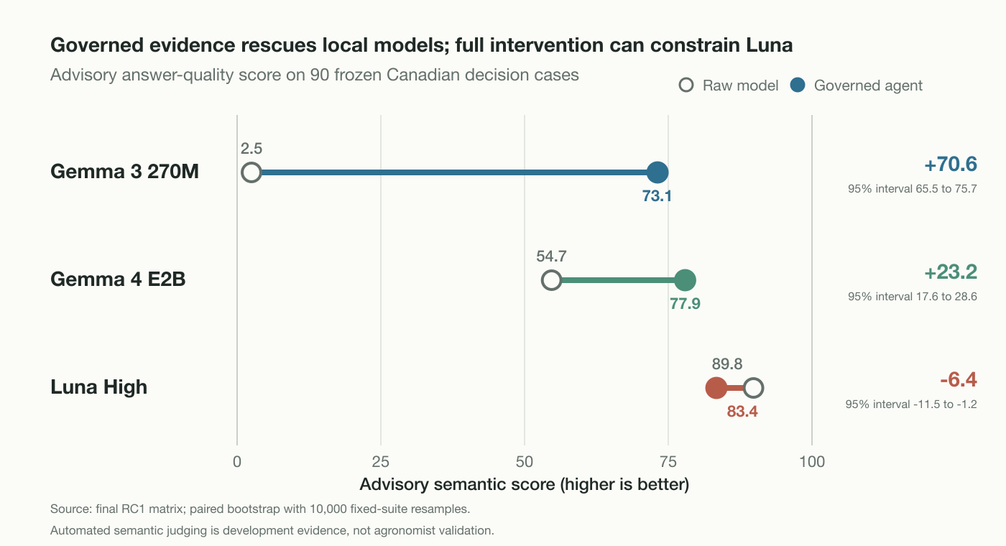
Notes:
Timing: 6:20–7:45
This is the central result. The harness turns a nearly unusable tiny-model baseline into a much stronger bounded answer system, and it materially improves Gemma 4. But it reduces Luna High. The conclusion is not that retrieval always helps. It is that weak local models benefit from structured evidence, while a strong model needs a lighter-touch intervention policy.
[Sources]
- docs/public/final-benchmark-20260812/source_data/arm_lane_summary.csv
- docs/public/final-benchmark-20260812/source_data/paired_semantic_deltas.csv
- Zheng et al. (2023), https://doi.org/10.52202/075280-2020
- Wataoka et al. (2024), https://doi.org/10.48550/arXiv.2410.21819
[/Sources]

Slide 8
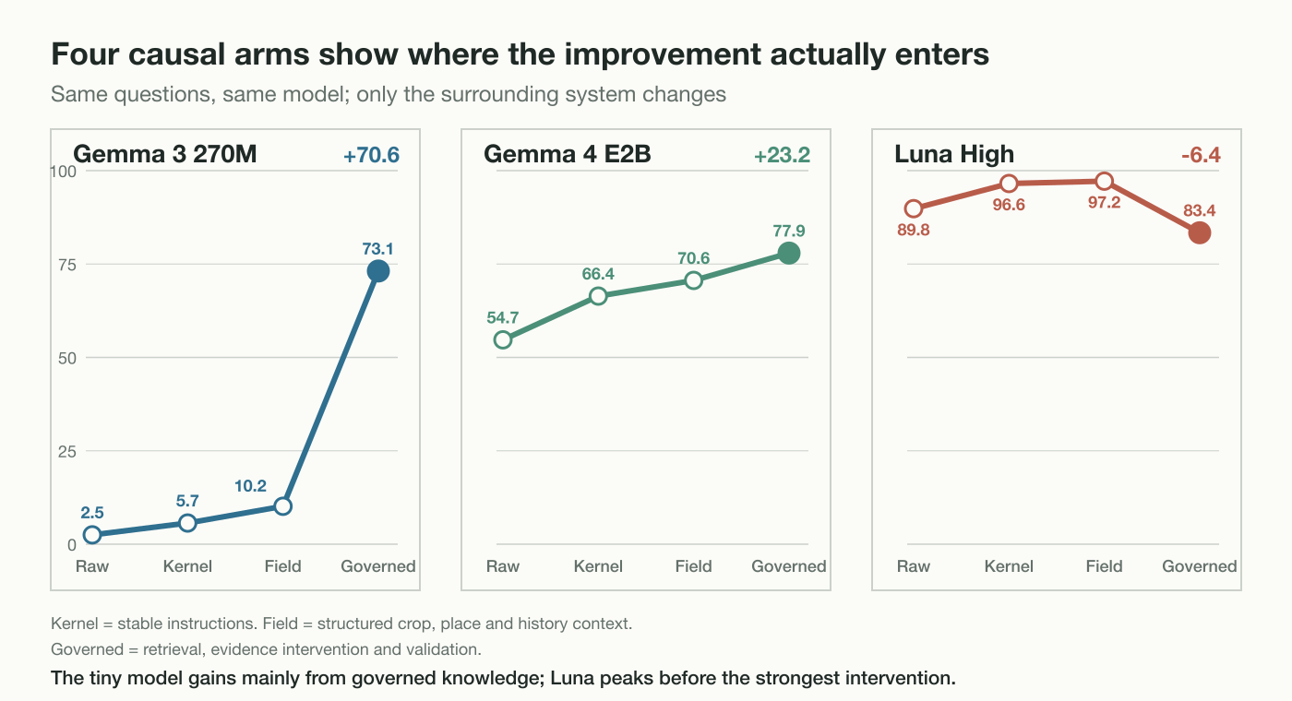
Notes:
Timing: 7:45–8:55
The arm progression explains the model interaction. Gemma 3 barely moves with instructions or field context alone; the governed evidence path produces the major gain, often through bounded fallbacks. Gemma 4 improves step by step. Luna is strongest with the kernel and field facts, then loses quality when the full intervention replaces too much of an already capable draft.
[Sources]
- docs/public/final-benchmark-20260812/source_data/arm_lane_summary.csv
- docs/public/final-benchmark-20260812/source_data/orchestration_summary.csv
[/Sources]

Slide 9
The benchmark tests six distinct capabilities
Only two lanes assess written agronomy advice; four test whether the surrounding system behaves correctly
Agronomic answer quality
System behaviour
90
Canadian field decisions
32
Field history + lineage
Ten cases each across diseases, horticulture, nutrition, pests, seed and hybrids, soils, water, weather and weeds.
Keeps observations, samples, corrections and answer reviews attached to the correct field.
39
Source + answer boundaries
Tests completeness, practical next steps, uncertainty and evidence boundaries.
Checks current versus historical, regional versus field, and whether unsafe precision is withheld.
31
Advisory transfer
33
Retrieval lineage
Checks that expected Canadian sources are found, admitted and traceable without wrong-jurisdiction substitution.
Different provinces, crops and question formats—including mobile, map, lab/table and bilingual prompts.
16
Objective calculations
Tests whether the answer discipline transfers beyond the primary set.
Checks values, units and tolerances deterministically—not with the language-model judge.
The lanes stay separate: the suite does not produce one “agronomy intelligence” score.
Open Agronomy Agent
09
09
Notes:
Timing: 8:55–10:05
This slide explains what the 241 questions actually measure. Ninety primary cases assess written field-decision answers across nine agronomy domains. Thirty-one additional cases probe transfer across provinces, crops and interface-like question styles. The remaining 120 cases test system contracts: field-history lineage, source and answer boundaries, retrieval lineage and objective calculations. Those lanes use different evidence and scoring rules, so we do not average them into a single intelligence score.
[Sources]
- configs/open_agronomy_canadian_performance_v1.json
- data/eval/open_agronomy_canadian_performance_v1_construct_audit.md
- configs/open_agronomy_system_interface_v1.json
[/Sources]

Slide 10
Field records become bounded context packets
For each question, the system admits only authorized and relevant data
Persistent field record
Per-turn preparation
Bounded context packet
Place, province/RM and generalized geometry
1
Authorize the field binding
Benchmark field arm
crop · region · province · management notes
Current crop and crop year
2
Minimize private data
→
→
Full agent adds—within budget
Soil, drainage, irrigation and soil-test summary
3
Check context quality
Safety and jurisdiction boundaries
Rotation, management notes and known constraints
Merge question signals
Decision route and guard state
4
Primary, boundary and regional evidence
Append-only observations, samples, operations and corrections
Route and select evidence
5
SoilWise vocabulary hints
Answer contract and trace identifiers
Model → validation → answer + evidence trace stored against the field
Open Agronomy Agent
10
10
Notes:
Timing: 10:05–11:15
Distinguish the persistent field record from the per-question prompt. The field record can hold place, crop and year, soil and water attributes, test summaries, rotation, management constraints and an append-only event history. Before each turn, the service authorizes the field binding, minimizes private data, rates context quality, merges signals from the current question and selects relevant evidence. The benchmark field-context arm deliberately exposes only crop, region, province and management notes. The full agent adds governed evidence and control slots inside a versioned token budget, then stores the answer and trace back against the field. Missing facts remain missing, and a field profile never authorizes a product or rate decision by itself.
[Sources]
- src/agronomy_agent/server/schemas.py FieldContextCreate
- src/agronomy_agent/server/storage/runtime.py create_phase4_field_context
- src/agronomy_agent/server/services/field_context_quality.py
- src/agronomy_agent/query_context.py analyze_query_context
- src/agronomy_agent/context_packer.py
- src/agronomy_agent/server/services/chat_service.py _append_field_context_prompt and _field_lineage_record
- configs/context_policy_v1.yaml
- configs/open_agronomy_canadian_performance_interface_v1.json
[/Sources]

Slide 11
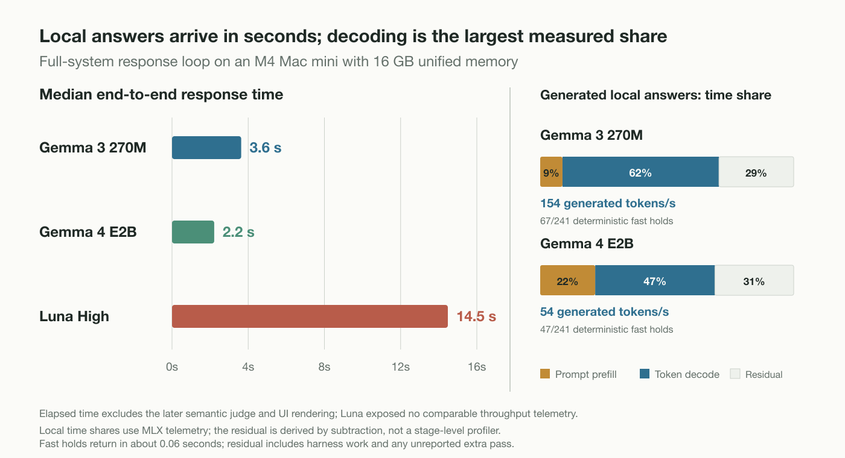
Notes:
Timing: 11:15–12:25
Separate latency from model throughput. Gemma 3 generates about 154 tokens per second, but often writes more; Gemma 4 generates about 54 tokens per second yet returns the shorter governed answer faster. On locally generated rows, decoding is the largest measured share. Deterministic evidence holds return in about six hundredths of a second. The chart excludes later semantic judging and UI rendering.
[Sources]
- docs/public/final-benchmark-20260812/source_data/resource_summary.csv
- outputs/open_agronomy_canadian_performance_v1_rc1/full_system_benchmark.sqlite3 generation_stats_json
[/Sources]

Slide 12
The benchmark found both gains and repair targets
01
02
Small local models can be useful
Intervention must match capability
The surrounding evidence system—not model size alone—drives much of the result.
The full harness helped local models but over-constrained Luna High.
03
04
Registered is not integrated
External validation still matters
The typed calculator existed, but the benchmark path never invoked it: 0/16.
Automated judging and Uganda-source transfer do not establish Canadian agronomic reliability.
Held-out transfer diagnostic: Gemma 4 normalized reference-token F1 moved 0.0508 → 0.0595. Useful signal; not Canadian validation; no same-version retest.
Open Agronomy Agent
12
12
Notes:
Timing: 12:25–13:40
Do not hide the negative findings. The calculator result uncovered an orchestration defect, not a weak calculator. The external AgroQA score moved slightly in the right direction, but the questions originate in Uganda and the metric has no directly comparable published system result. The next benchmark version must remain frozen until the calculator path and intervention policy are repaired elsewhere.
[Sources]
- docs/public/evaluation.md
- docs/public/final-benchmark-20260812/source_data/external_finalist_summary.json
- docs/public/final-benchmark-20260812/source_data/final_validation_receipt.json
[/Sources]

Slide 13
WHAT THE DEMO SHOULD PROVE
Local inference becomes more useful when evidence, tools and traceability surround the model.
Demonstrate now
Earn next
The system is inspectable enough to improve honestly.
Offline answer + evidence lineage
Model swap inside one harness
Reconnect for live services
Calculator routing repair
Blinded agronomist review
Prospective field evaluation
Notes:
Timing: 13:40–15:00
Close on the measured proposition, not a claim of autonomous agronomy. The demo can show a private local answer that cites its evidence, carries field history and uses the same harness across models. What remains is equally clear: route calculations through the typed tool, calibrate intervention by model capability, and obtain blinded Canadian agronomist review followed by prospective field testing.
[Sources]
- docs/public/final-benchmark-20260812/main.tex
- docs/public/architecture.md
[/Sources]

