Slide 1

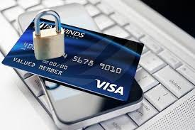
Credit card fraud detection on e-commerce website
By: Kazeem tijani

Slide 2
Introduction:
Imagine the pains that one goes through when his credit card details are stolen and used for transactions, this will incur unexpected debts and recurrent difficulties for the credit card owner as well as the credit card issuing company since the customer will definitely get fed up of continuing transactions with them due to the rate of dissatisfaction if he eventually gets out of the debts. Hence, It is important that credit card companies are able to recognize fraudulent credit card transactions so that customers are not charged for items that they did not purchase.

Slide 3
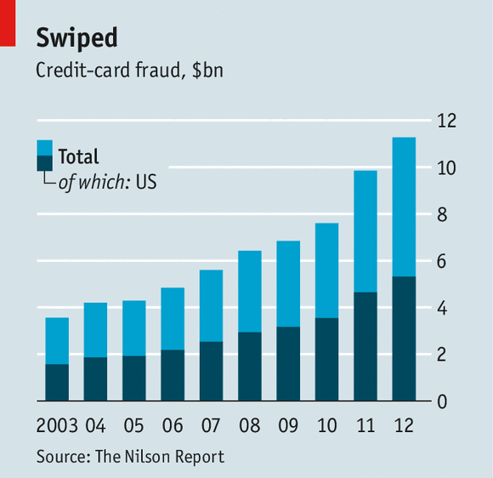
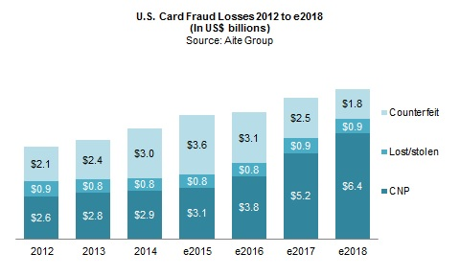
CREDIT CARD FRAUD RATE

Slide 4
Dataset content
The datasets contains transactions made by credit cards in September 2013 by European cardholders. This dataset presents transactions that occurred in two days, where we have 492 frauds out of 284,807 transactions. The dataset is highly unbalanced, the positive class (frauds) account for 0.172% of all transactions.
It contains only numerical input variables which are the result of a PCA transformation. Unfortunately, due to confidentiality issues, we cannot provide the original features and more background information about the data. Features V1, V2, ... V28 are the principal components obtained with PCA, the only features which have not been transformed with PCA are 'Time' and 'Amount'. Feature 'Time' contains the seconds elapsed between each transaction and the first transaction in the dataset. The feature 'Amount' is the transaction Amount, this feature can be used for example-dependant cost-sensitive learning. Feature 'Class' is the response variable and it takes value 1 in case of fraud and 0 otherwise.

Slide 5

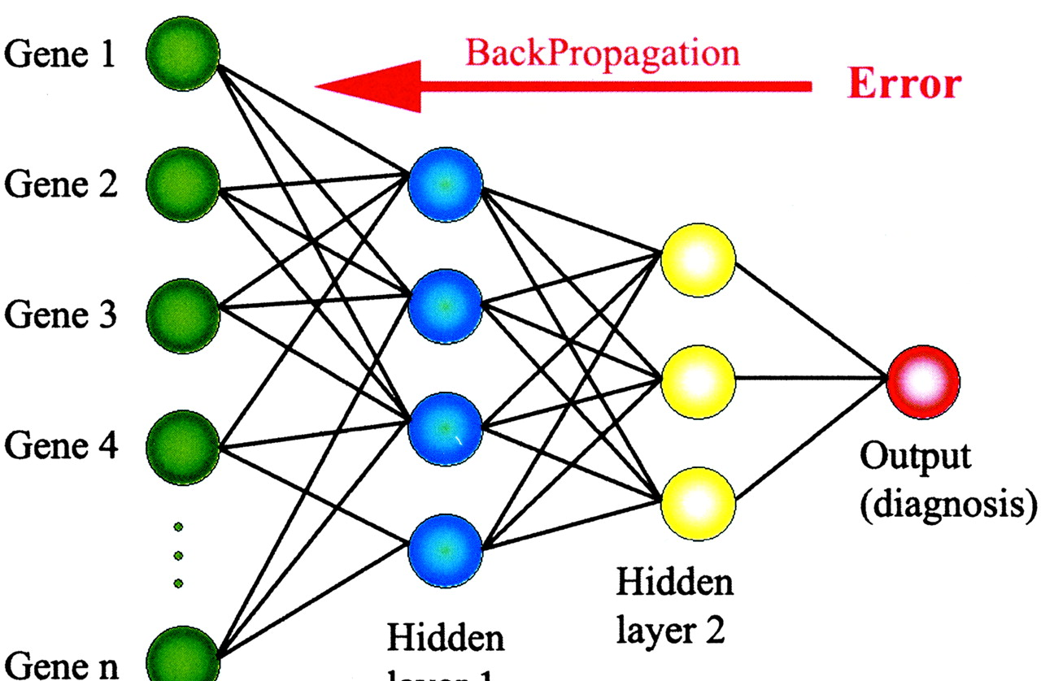
Methodology
I used both Deep learning method and machine learning algorithms to build my model to make predictions, the deep learning method used was Keras using Tensor Flow as backend and I used Random Forest for my binary classification, other methods I could have used was Logistic regression, decision trees, SVM because the problem is a case of binary classification as the end result was to check if the transaction is fraudulent.

Slide 6
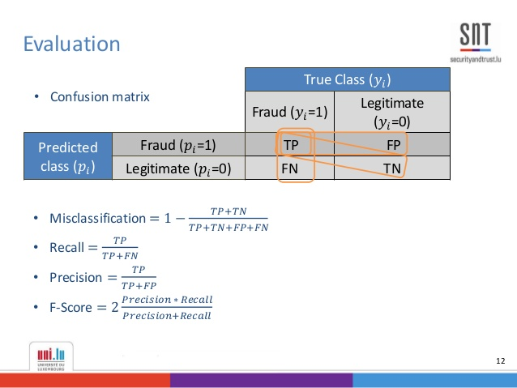
Results
The results of the models are in this format of the confusion matrix where we calculated the Accuracy and the recall to know how well our model is doing, and since we have an unbalanced data we also used the SMOTE-Synthetic Minority Oversampling Technique

Slide 7
ACKNOWLEDGEMENT
The dataset has been collected and analysed during a research collaboration of Worldline and the Machine Learning Group (http://mlg.ulb.ac.be) of ULB (Université Libre de Bruxelles) on big data mining and fraud detection. More details on current and past projects on related topics are available on http://mlg.ulb.ac.be/BruFence and http://mlg.ulb.ac.be/ARTML
https://www.kaggle.com/mlg-ulb/creditcardfraud/kernels
https://superdatascience.com
Dr. Mayo machine learning 1 class

Slide 8


