Slide 1
A Collaborative Approach for Large-scale Electricity Consumption Using Federated Learning
Canberk Özen, Computer Science MSc Student, University of Tartu

Slide 2
Intro
Importance of Energy Forecasting
Problems with centralized learning
Security
Scalability
Federated Learning
Statistical Heterogeneity problem in FL
Clustered Federated Learning
Experiments
Conclusion

Slide 3
Why Forecast Energy Supply or Demand?
Increasing Renewables’ share on grid requires much more precise forecasts both on supply side and demand side, both of which having high uncertainty
Inaccurate Forecasts >
Low Renewable penetration, higher fossil usage
Possible Grid instability even without renewables

Slide 4
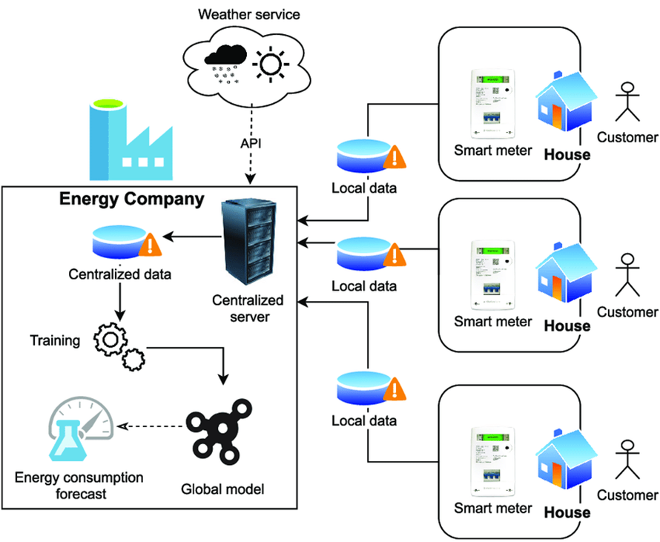
Traditional(Centralized) Deep Learning
If data is abundant, deep learning models are generally the best choice for modeling the highly non-linear energy data
Yet centralized deep learning is neither
Scalable > Storage & Computation costs
Nor Secure > One hack can compromise the whole network
Source

Slide 5
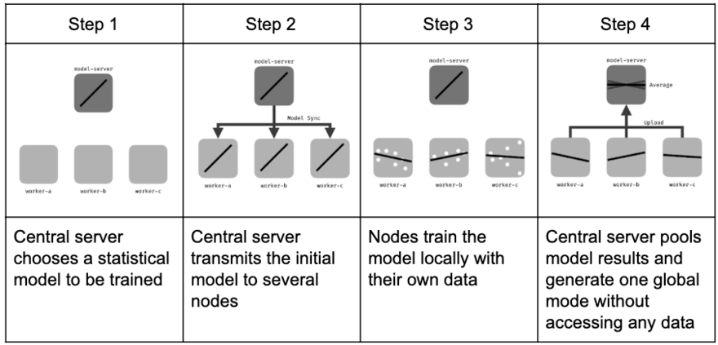
Federated Learning
A new training paradigm, Federated Learning, can solve both issues
Source

Slide 6
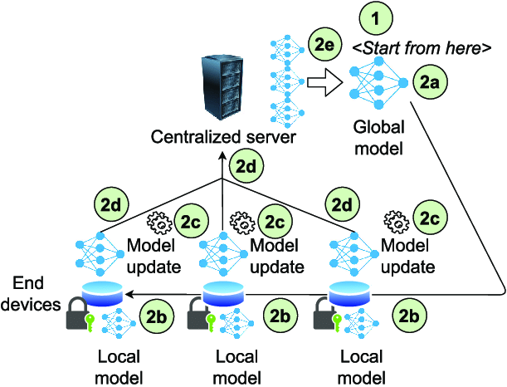
Federated Learning
Source

Slide 7
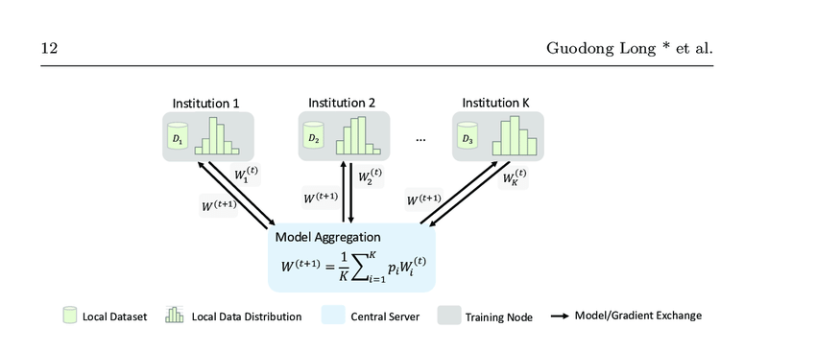
Statistical Heterogeneity in FL
The simplest Federated Learning(FL) algorithm, FedAVG, blows up if the clients have highly dissimilar data
Source

Slide 8
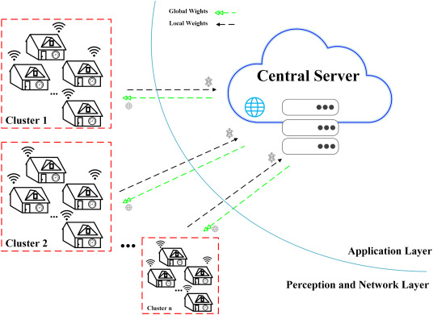
Clustered Federated Learning
One easy way out of this conundrum:
Cluster similar clients
Use one model per cluster instead of one model for all clients
Source

Slide 9
Experiments: Introduction
I used a dataset which include energy consumption data of ~5000 households in London, between 2012 and 2014
Data preprocessing steps:
Selected houses billed with standard tariffs in 2013
Resampled the recordings from half-hourly samples to hourly samples
Eliminated clients which had less than 90% of the yearly coverage
Selected a random sample of 50 clients
Trimmed the client datasets to this range: January 1st – July 2nd

Slide 10
Experiments: Introduction
Training scenarios:
Centralized ML Baseline
Distributed ML Baseline
FedAVG Baseline
2 Clustered Federated Learning(CFL) Models: FLHC & IFCA
In all scenarios a 2-layer LSTM with 0.1 dropout rate, followed by a dense layer was used.
Time window: 12, task was to predict the 13th hour.

Slide 11
Centralized & Distributed ML Baselines
Centralized Baseline: All data are put into one server. Multi-input > Multi-output predictions. MSE: 0.1169
Distributed Baseline: No household data nor model weights are transferred to the server. Clients were fully separated from each other, and training took place in them. MSE: 0.1874.

Slide 12
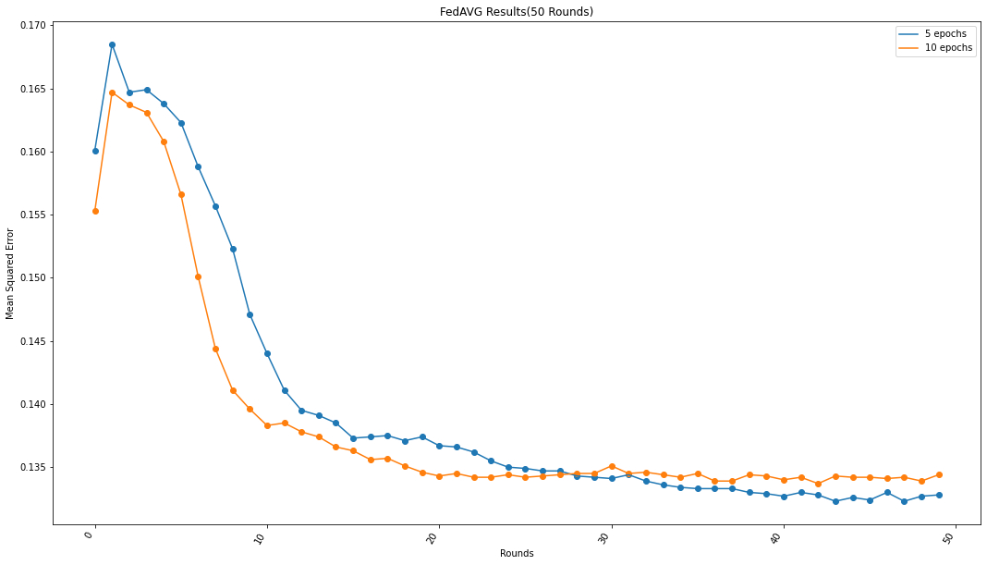
FedAVG Baseline

Slide 13
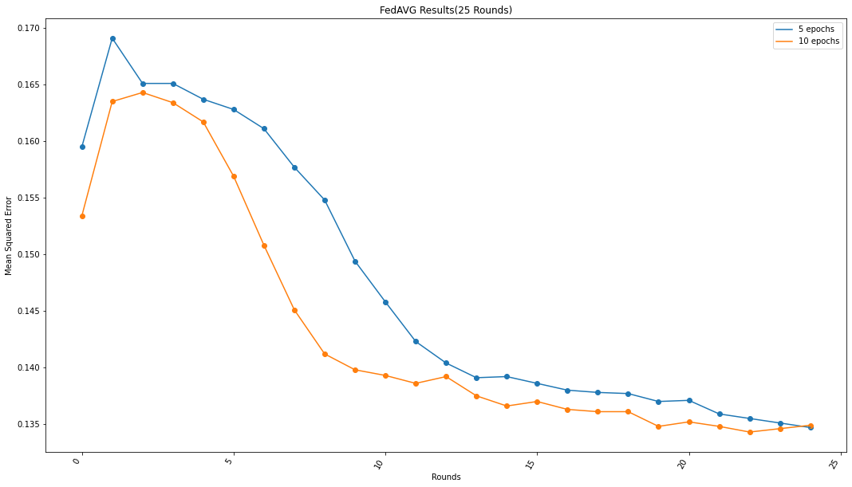
FedAVG Baseline

Slide 14
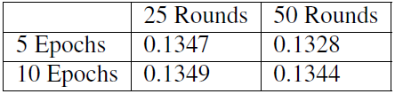
FedAVG Baseline
FedAVG Results:
Takeaways:
5 epochs of training was better in both cases
50 rounds of training was only 1.4% better than 25 rounds.
For the remaining experiments, 25 FL rounds with 5 training epochs was selected.

Slide 15
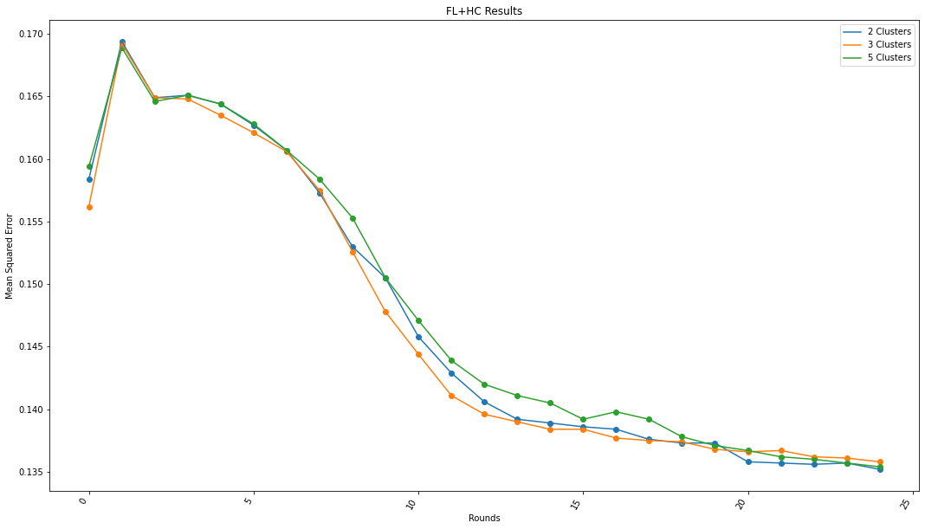
FL+HC(Federated Learning with Hierarchical Clustering)
6 warmup rounds with FedAVG
Hierarchical clustering of clients based on their model losses at the end of 6th round
19 rounds of FedAvg per every cluster
Scores:
2 clusters:0.1352
5 clusters:0.1354
3 clusters:0.1358

Slide 16
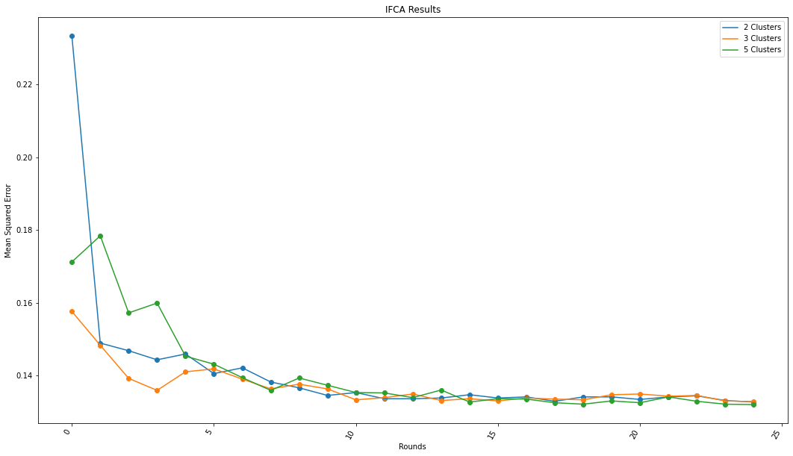
IFCA(Iterative Federated Clustering Algorithm)
Server randomly initializes cluster models.
At the start of every round these models are tested on clients.
The model with the lowest loss determined the cluster identity of clients.
The rest is local training+FedAVG per cluster.
Scores
5 clusters: 0.1320
2 clusters: 0.1327
3 clusters: 0.1328

Slide 17
Conclusion
All FL algorithms had worse yet very similar performance to Centralized baseline(0.1169 vs 0.13xx)
Sacrificing a little bit of performance can greatly enhance system security
CFL algorithms failed to improve FedAVG results, but IFCA converged much sooner. Takeaways:
It is likely that dataset is too heterogenous for CFL algorithms to deal with
Experiments with more datasets are needed to get a better understanding of performance comparison
Further Research
More datasets from different geographical regions
More algorithms that can deal with heterogeneity(not only new CFL algos)
Experiments with additional security measures such as differential privacy
Experiments with an additional focus on server-client communication costs/possible network failures

