Slide 1
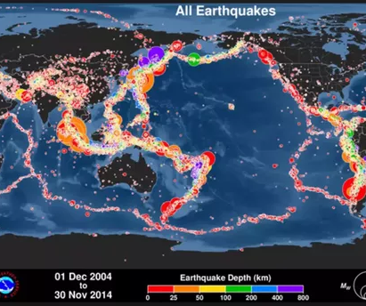
Earthquakes: Analysis of the Impact of epicenter location on depths earthquakes have historically occurred

Slide 2
Agenda
Overview
Correlation 1
Correlation 2
Correlation 3
T-test
Conclusion & Recommendations

Slide 3
Overview & Problem Statement
Earthquakes can strike suddenly and without warning. An earthquake is a violent and abrupt shaking of the ground, caused by movement between tectonic plates along a fault line in the earth’s crust.
Prediction of natural hazards is the key to reducing the risks. Government, private sector, and NGOs can all benefit from understanding the relationship of how deep earthquakes occur according to their location so they can mitigate their risks until future earthquakes can be predicted

Slide 4
Data Analyzed
The data used in this analysis comes from Kaggle | Significant Earthquakes, 1965-2016
Data from the National Earthquake Information Center (NEIC) includes 23412 records of every earthquake with a reported magnitude 5.5 or higher from 1965 to 2016.
There are 21 columns in the original dataset, of which only ('Date', 'Latitude', 'Longitude', 'Depth', 'Magnitude') will be used for this analysis
This research will look at historical earthquake data worldwide (1965 to 2016) to determine if correlations, or differences in statistical means exist between earthquake locations, depths, and magnitudes to provide insight into future risks.

Slide 5
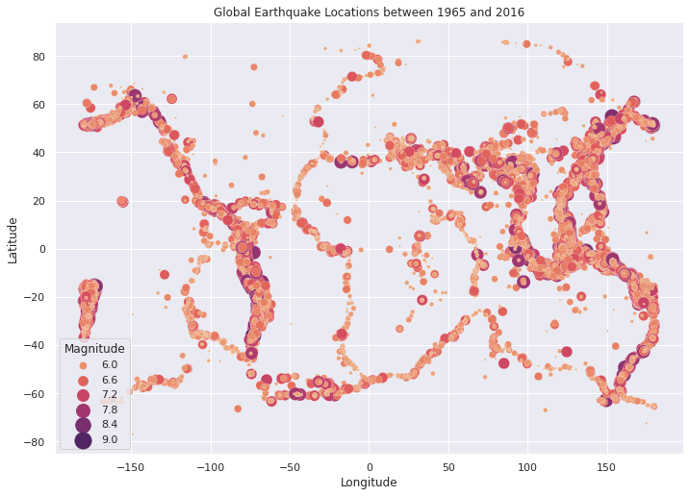
Pearson r correlation testing between Earthquake Latitude and Longitude
Null Hypothesis 1 (H0):
The Latitude of historical earthquakes are not correlated with the Longitudes they occur.
Alternate Hypothesis 1 (Ha):
The Latitude of historical earthquakes are correlated with the Longitudes they occur.
A Pearson product-moment correlation coefficient was computed to assess the relationship between Latitude and Longitude of historical earthquakes in the dataset. There was a weak positive correlation between the two variables, r = 0.203.
The test is significant (p= 6.68e-214) therefore the Null hypothesis is rejected, proving the Alternate hypothes True.
The Latitude of an earthquake is correlated with the Longitude at which it occurs. Although the correlation is not linear, there is a definite pattern that outlines the tectonic plates of the Earth.

Slide 6
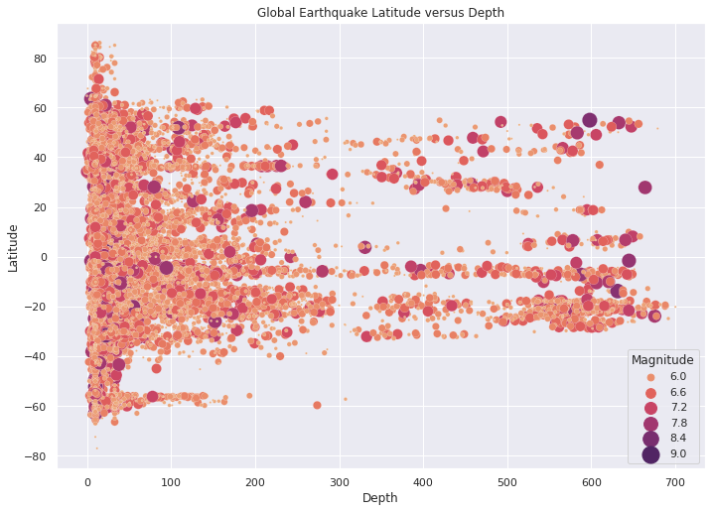
Pearson r correlation testing between Earthquake Depth and Latitude
Null Hypothesis II (H0):
The depths of historical earthquakes are not correlated with Latitude
Alternate Hypothesis II (Ha):
The depths of historical earthquakes are correlated with Latitude
A Pearson product-moment correlation coefficient was computed to assess the relationship between Latitude and Depth of historical earthquakes in the dataset. There was a weak negative correlation between the two variables, r = -0.076.
The test is significant (p = 2.44e-31), therefore the Null hypothesis is rejected, proving the Alternate hypothes True.
The Depth of an earthquake is correlated with the Latitude at which it occurs. There are some specific Latitudes where the depths have a much wider range. There is also an interesting sparser occurrence of earthquakes around the 300 feet depth for all Latitudes.

Slide 7
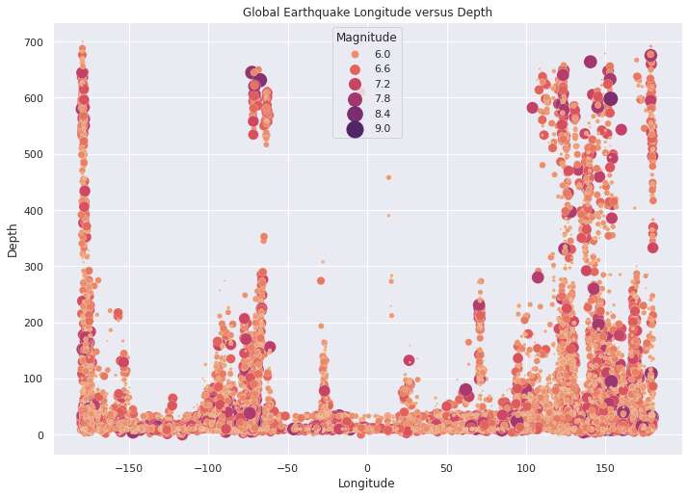
Pearson r correlation testing between Earthquake Depth and Longitude
Null Hypothesis III (H0):
The depths of historical earthquakes are not correlated with Longitude
Alternate Hypothesis III (Ha):
The depths of historical earthquakes are correlated with Longitude
A Pearson product-moment correlation coefficient was computed to assess the relationship between Longitude and Depth of historical earthquakes in the dataset. There was a weak negative correlation between the two variables, r = -0.087.
The test is significant (p = 6.09e-40), therefore the Null hypothesis is rejected, proving the alternate hypothesis true.
The Longitude of an earthquake is correlated with the depth at which it occurs. Although not a linear correlation, the scatterplot shows that specific Longitudes have earthquakes with a much larger range of depths than others.

Slide 8
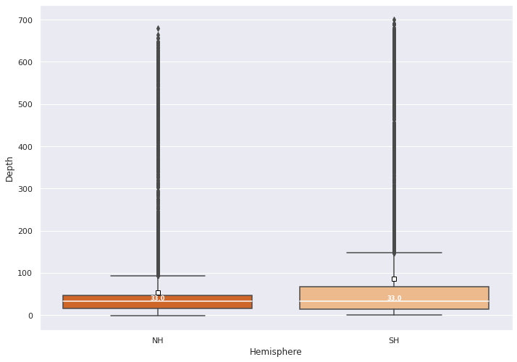
Depths of Historical Earthquakes by Northern Hemisphere and Southern Hemisphere
Null Hypothesis IIII (H0):
The depths of historical earthquakes are the same for the Northern Hemisphere and Southern Hemisphere
Alternate Hypothesis IIII (Ha):
The depths of historical earthquakes are different for the Northern Hemisphere and Southern Hemisphere.
The analysis shows p-value < 0.05, therefore the Null hypothesis is rejected, proving the Alternate hypothesis True. There is a statistically significant difference between depths of historical earthquakes in the Northern Hemisphere and the Southern Hemisphere.
With 95% confidence, Depths of Northern Hemisphere earthquakes are between 28.2 and 34.3 feet shallower than the depths in the Southern Hemisphere.

Slide 9
Statistics As Means To An End
The statistical analysis showed that:
The Latitude of an earthquake is correlated with the Longitude at which it occurs. Although the correlation is not linear, there is a definite pattern that outlines the tectonic plates of the Earth.
The Latitude of an earthquake is correlated with the depth at which it occurs. There are some specific Latitudes where the depths have a much wider range. There is also an interesting sparser occurrence of earthquakes around the 300 feet depth for all Latitudes.
The Longitude of an earthquake is correlated with the depth at which it occurs. Although not a linear correlation, the scatterplot shows that specific Longitudes have earthquakes with a much larger range of depths than others.
There is a statistically significant difference between depths of historical earthquakes in the Northern Hemisphere and the Southern Hemisphere.
Notes:
https://pixabay.com/photos/travel-pinned-pinning-maps-atlas-2650303/
After you’ve conducted your analysis, consider the “so what” for your audience -- what kinds of quantifiable recommendations could you provide? The confidence interval is rife for use here.
With research, we want to continue to explore. Once we’ve mapped the relationship between these variables, we want to keep exploring. So we use what we’ve learned as the basis for exploring other interesting things.

Slide 10

Recommendations
Although earthquakes cannot be prevented, the risks can be mitigated. Ultimately, scientists would be able to predict when and where an earthquake was going to occur with enough time to move people out of harm’s way. Until that is possible, governments, NGOs, and the population of the world can use the information in this analysis to narrow down their individual risks for an earthquake occurring in their location.
There are certain Latitudes and Longitudes that are at higher risks than others. Most significantly, an accumulation of earthquakes tends to occur along the tectonic boundaries. There is also an interesting sparser occurrence of earthquakes around the 300 foot depth for all Latitudes an all Longitudes.
Based upon individual locations, a more detailed risk analysis should be considered to drive decisions of local building codes, prioritize preparedness for emergency responders to respond to consequences, and have a recovery plan in place.

Slide 11

QUESTIONS?

