Slide 1

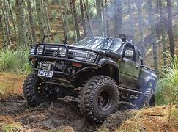
Analysis of the Impact Vehicle Drive Train Type has on Fuel Economy
Do you really need this?

Slide 2
Overview & Problem Statement
Fuel prices at the pump have historically been reasonable…….until now
With the current rate of inflation, what types of vehicles could we recommend to customers to improve their fuel economy?
How much could be saved today? What about in the future?
Notes:
We are framing this problem in terms of a clear business need. And asking the question, what is this analysis actually going to do for our business, right? Remember, it’s our world, the statistics are just living in it!

Slide 3
Data Analyzed
The data used in this analysis originally comes from Kaggle
Vehicle Fuel Economy Estimates, 1984-2017
The file includes the EPA’s fuel economy estimates produced during vehicle testing at the Environmental Protection Agency's National Vehicle and Fuel Emissions Laboratory in Ann Arbor, Michigan, and by vehicle manufacturers with EPA oversight
The annual fuel costs included in the data set was assuming $2.33/gallon for regular unleaded gasoline
Due to the volatility of fuel prices (current average $4.96/gallon as of June 9, 2022), this analysis is based upon TOTAL estimated annual consumption instead of estimated fuel costs.

Slide 4
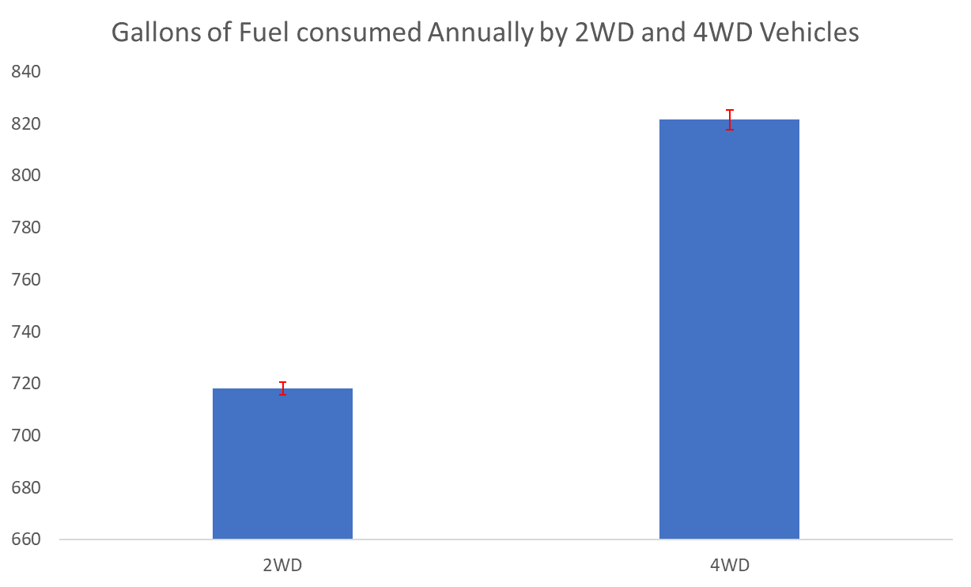

Gallons of Fuel consumed annually by 2WD and 4WD vehicles
Null Hypothesis 1 (H0):
2WD & 4WD vehicles have the same annual fuel consumption
Alternate Hypothesis 1 (Ha):
2WD & 4WD vehicles have different annual fuel consumption
The analysis shows p-value < 0.05, therefore the Null hypothesis is rejected, proving the Alternate hypothesis True. There is a statistically significant difference exists between fuel consumption of 2WD and 4WD vehicles
With 95% confidence, the fuel consumption is between 99 and 108 gallons lower annually for 2WD vehicles
In 1970, with gas at $0.36/Gal. This would have meant an average savings of $37/year
Today, at $4.96/Gal a front wheel drive vehicle would save on average, $513/year

Slide 5
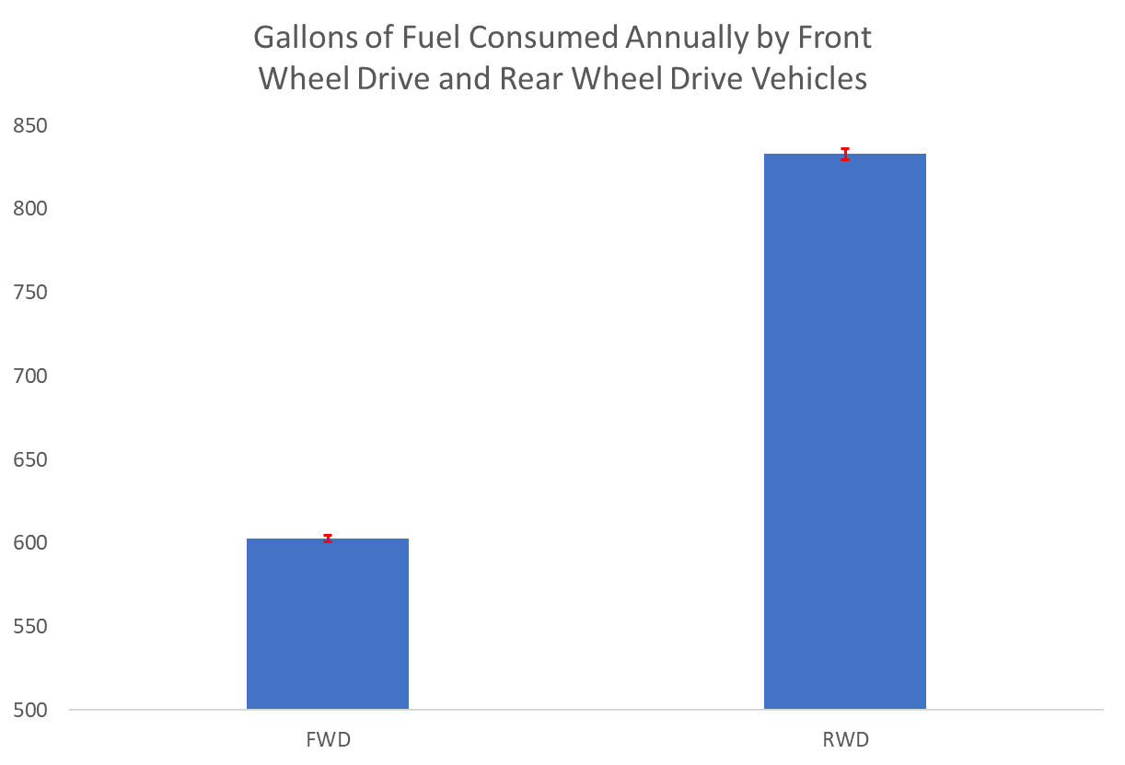
Gallons of Fuel consumed annually by Front Wheel Drive and Rear Wheel Drive vehicles
Null Hypothesis 1 (H0):
FWD and RWD vehicles have the same annual fuel consumption
Alternate Hypothesis 1 (Ha):
FWD & RWD vehicles have different annual fuel consumption
The analysis shows p-value < 0.05, therefore the Null hypothesis is rejected, proving the Alternate hypothesis True. There is A statistically significant difference exists between fuel consumption of Front Wheel Drive and Rear Wheel Drive vehicles
With 95% confidence, the fuel consumption for Front Wheel Drive vehicles is between 226 and 234 gallons lower annually than Rear Wheel Drive vehicles
In 1970, with gas at $0.36/Gal. This would have meant an AVG savings of $83/year
Today, at $4.96/Gal a front wheel drive vehicle would save on average, $1,141/year

Slide 6
Statistics As Means To An End
The statistical analysis showed that:
Whether a vehicle is front or rear wheel drive does have a significant impact on annual fuel consumption
Whether a vehicle is 4WD or 2WD also has a significant impact on annual fuel consumption
Notes:
https://pixabay.com/photos/travel-pinned-pinning-maps-atlas-2650303/
After you’ve conducted your analysis, consider the “so what” for your audience -- what kinds of quantifiable recommendations could you provide? The confidence interval is rife for use here.
With research, we want to continue to explore. Once we’ve mapped the relationship between these variables, we want to keep exploring. So we use what we’ve learned as the basis for exploring other interesting things.

Slide 7

Recommendations
With the cost of fuel rising exponentially, customers are asking which vehicles get better fuel economy.
Unless 4WD is necessary, a 2WD vehicle should be recommended
Front wheel drive vehicles should be recommended over rear wheel drive.
An extra advantage is that front wheel drive vehicles perform better in slick conditions

Slide 8

With a more current data set that includes more observations on electric or Hybrid vehicles, additional comparisons could be made
QUESTIONS?

