Slide 1


Car Rental Fleet Analysis
Prepared specially for:
Lariat Rent-A-Car, Inc.
by DA Consultants, LLC

Slide 2
Background
Lariat Rent-A-Car, Inc. has contracted with DA Consultants, LLC, to analyze the costs and revenue generated by their rental car fleet between January 1, 2018 to November 11, 2018.
The company owns a fleet of 4000 vehicles operating from 50 branch locations in 22 states.

Slide 3
Goals
Review strategies to make better decisions to decrease costs and increase sales profits based upon their national fleet
Provide an Excel model that can be used to help make decisions

Slide 4
The Data
Lariat Rent-A-Car has provided the following dataset covering January 1, 2018 to November 11, 2018 operations information. The dataset includes four data files:
Car ID mapping (unique ID to car make, model, and model year)
Car costs (costs associated with each vehicle)
Car revenue (individual rental transactions, and revenue data related to each transaction)
Branch locations (branch ID mapped to city and state)

Slide 5
The Process
Make Observations on data
Data period: January 1, 2018 - November 11, 2018 = 315 days
Combine data
Data was combined 2 ways.
Analyze
data
Key findings concentrating on fleet management were found to both decrease costs and increase revenue, thereby giving a maximum profit increase
rental transactions = 81,318
rental units = 4000
car makes = 73
branch locations = 50
operates in 22 states. 9 States have profit >1M
1. Based upon revenue to analyze locations
2. Based upon car ID to analyze the fleet

Slide 6
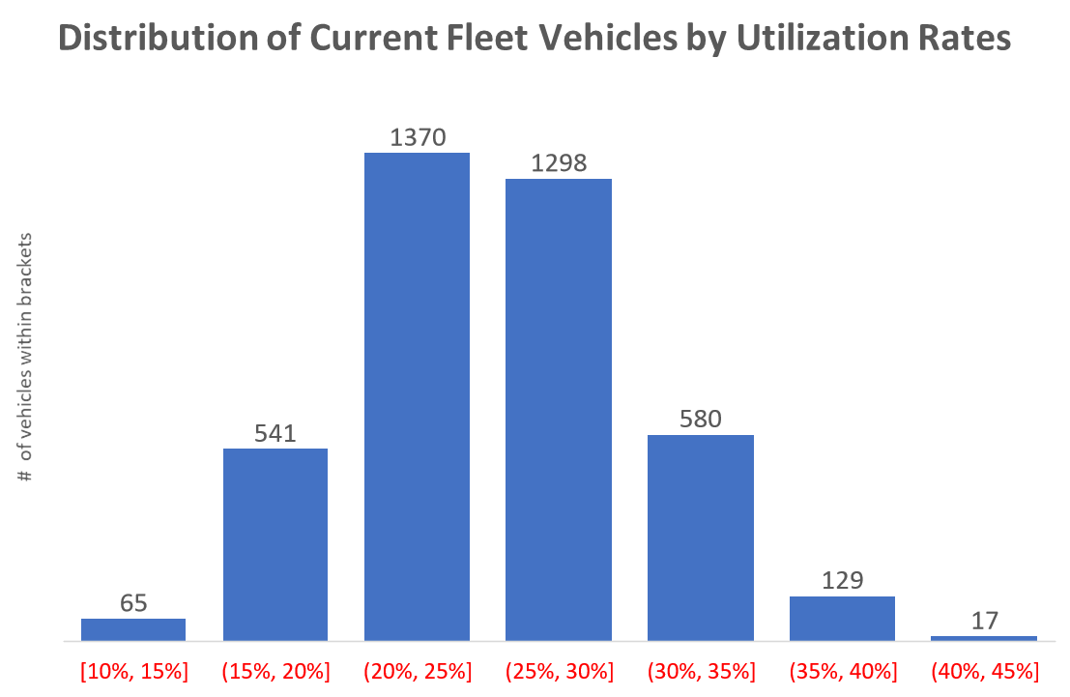
Key Findings
Inventory turnover is an integral part of managing a fleet of vehicles. In order to make informed data-driven decisions of which vehicles to eliminate and replace each year, three metrics were found to affect costs and revenue. The first observation is that:
The existing inventory includes cars that are underutilized

Slide 7
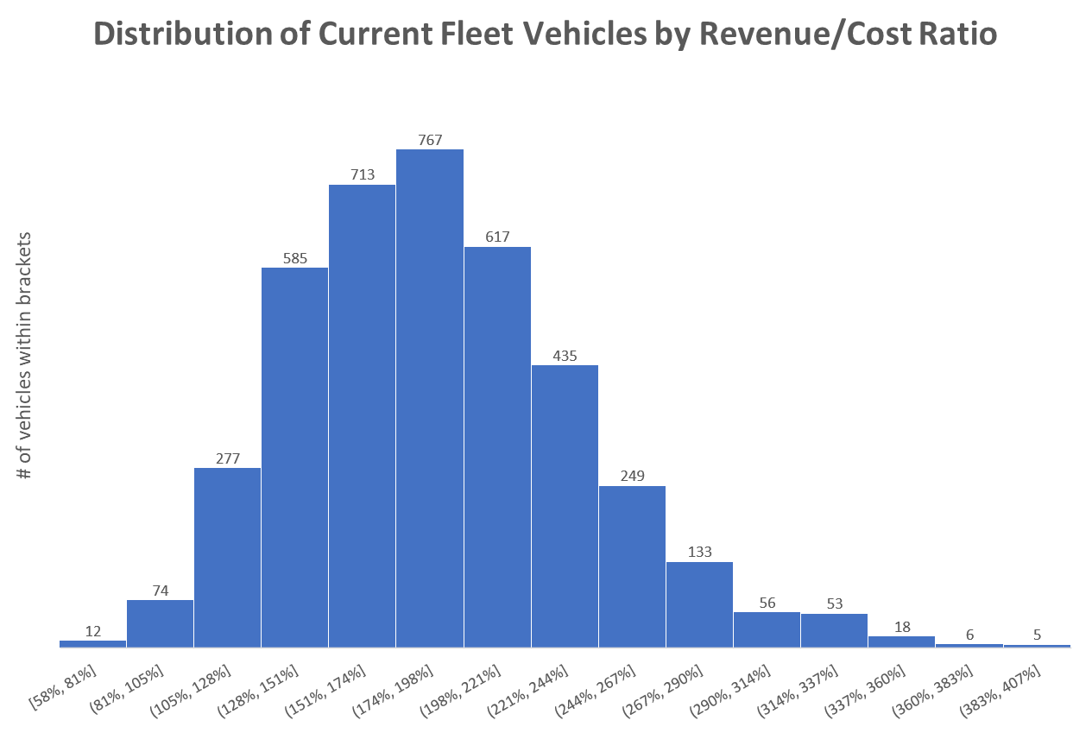
Key Findings
The second observation is that:
The existing inventory includes cars whose Revenue/Cost Ratio is too low

Slide 8
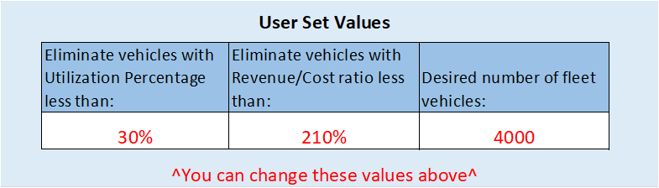



Three Metrics Affecting Strategies
Experiment with changing the minimum utilization rate of fleet vehicles to keep:
Experiment with changing minimum Revenue/Cost Ratio fleet vehicles to keep:
Experiment with changing the final number of fleet vehicles to have in inventory:

Slide 9
Approach
Strategy 1 | Part 1: Eliminate vehicles below a chosen Utilization Rate
 | Part 2: Purchase # of new vehicles to increase total number of fleet vehicles to the desired number (assume new vehicles have similar Cost & Revenue as remaining vehicles)
Strategy 2 | Part 1: Eliminate vehicles below a chosen Revenue/Cost ratio
 | Part 2: Purchase # of new vehicles to increase total number of fleet vehicles to the desired number (assume new vehicles have similar Cost & Revenue as remaining vehicles)
Strategy 3 | Part 1: Combination of eliminating cars based on Strategy 1 Utilization Rate AND Strategy 2 Revenue/Cost ratio
 | Part 2: Purchase # of new vehicles to increase total number of fleet vehicles to the desired number (assume new vehicles have similar Cost & Revenue as remaining vehicles)
Reinvestment multiplier Calculated to purchase new vehicles to increase inventory back to input desired number. Assumes that new vehicles will have the same costs and revenue as the remaining vehicles after elimination

Slide 10
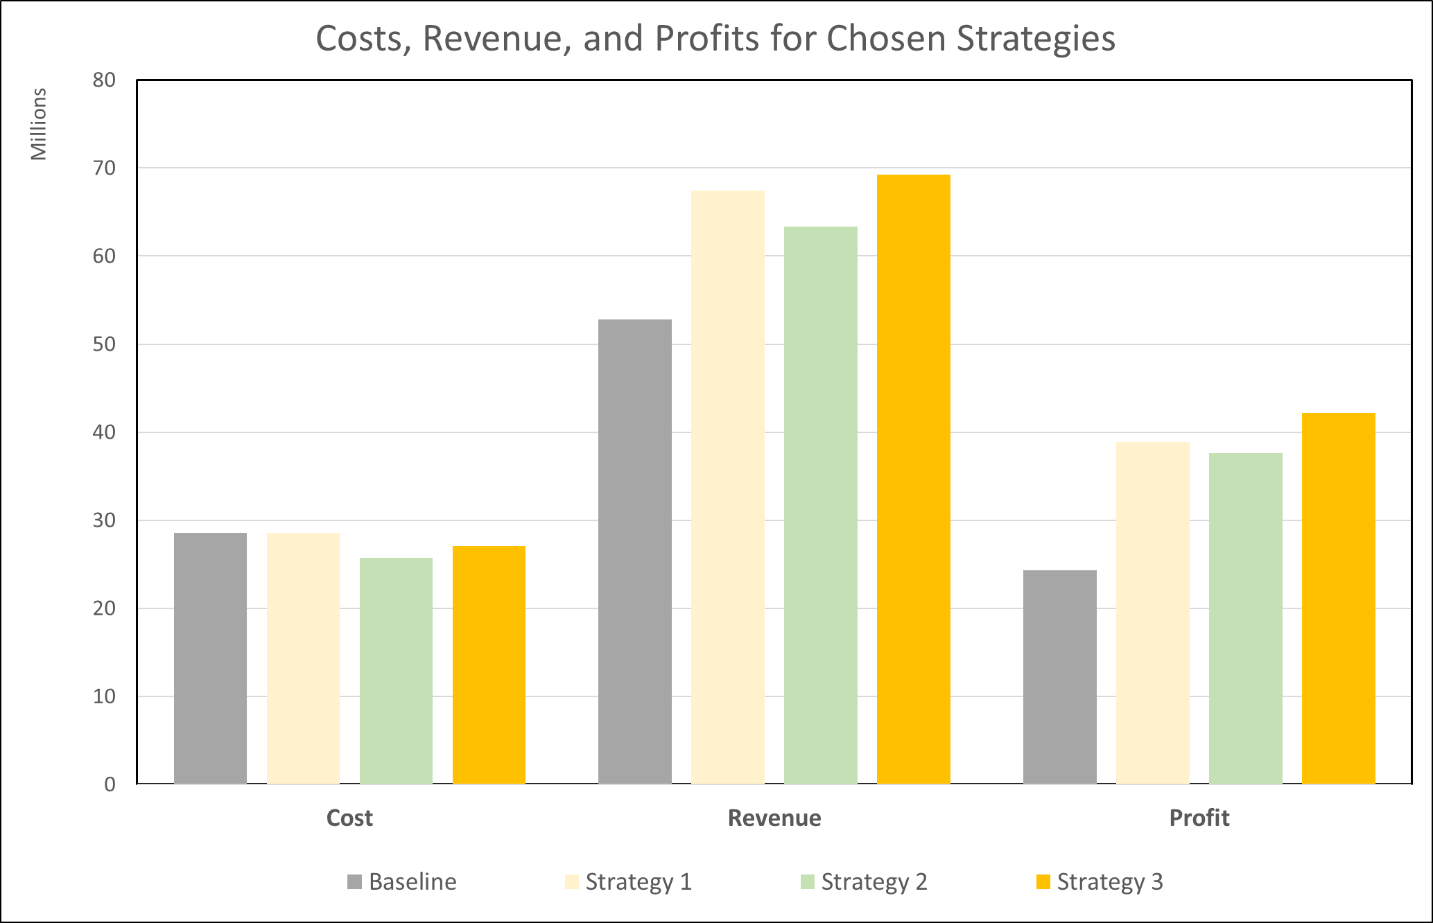
Recommendations
The chart below shows the effects on profits after eliminating vehicles with less than 30 Utilization Rate AND less the 210% Revenue/Cost Ratio and reinvesting in new vehicles assumed to meet the same criteria to achieve a fleet of 4000 vehicles.
Strategy 1 | Part 1: Eliminate cars that have less than 30% utilization rate (% of days being rented during the 315 days) and (Keep cars leased more than 30% of the time)
 | Part 2: Reinvest in 3144 additional vehicles with new vehicles of similar qualities to the remaining vehicles (assume new vehicles have similar Cost & Revenue as remaining vehicles)
Strategy 2 | Part 1: Eliminate cars that have less than 210% profit/cost ratio and (Keep cars >=210%)
 | Part 2: Reinvest in 2779 additional new vehicles of similar qualities to the remaining vehicles (assume new vehicles have similar Cost & Revenue as remaining vehicles)
Strategy 3 | Part 1: Combination of eliminating cars that have < 30% utilization AND <210% revenue/cost ratio
 | Part 2: Reinvest in 3370 additional new vehicles of similar qualities to the remaining vehicles (assume new vehicles have similar Cost & Revenue as remaining vehicles)
Strategy 3 combining 30% & 210% is the clear winner

Slide 11
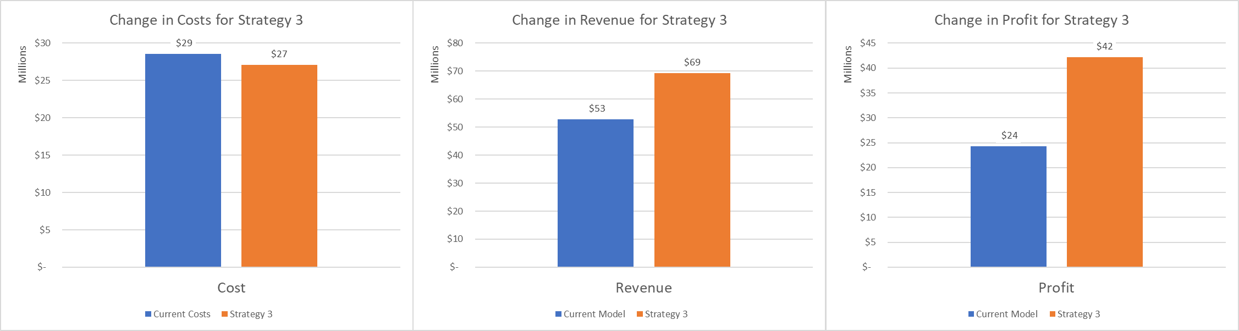
Call to Action
DA Consultants suggests following Strategy 3 by eliminating vehicles with less than 30% utilization rate AND less than 210% Revenue/Cost Ratio along with keeping total number of vehicles in the fleet at 4000. This maximizes both cost savings and revenue, achieving the highest final profit.

Slide 12
Next Steps
Company management could consider other approaches to analysis that may also accomplish decreasing costs and increasing profits, such as:
Analyze by branch location and consider closing branches and/or opening new ones
Analyze impact airport locations
These option are out of the scope of this project but could be considered as a next step for analyzing profit models.
Please contact DA Consultants, LLC for your future analytics needs!

Slide 13
Thank you!

