Slide 1
A Gesture-based Tool for Sterile Browsing of Radiology Images
Prepared by: Dorsaf Tlili

Slide 2
Plan
I
II
III
IV
Realisation
Process
Live Demo
Purpose

Slide 3
Purpose
I

Slide 4




Slide 5



Objectif: avoid infection
How? Make the action gesture based

Slide 6
Realisation
II

Slide 7

Data Collection

Slide 8
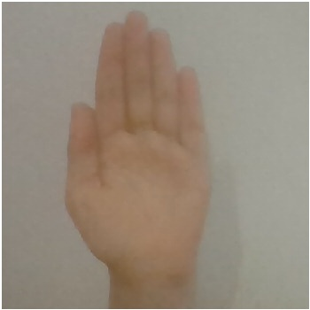
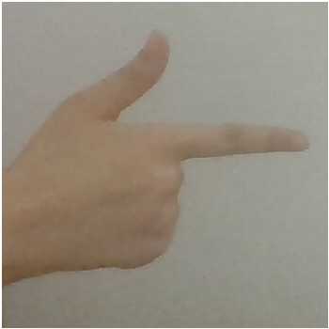
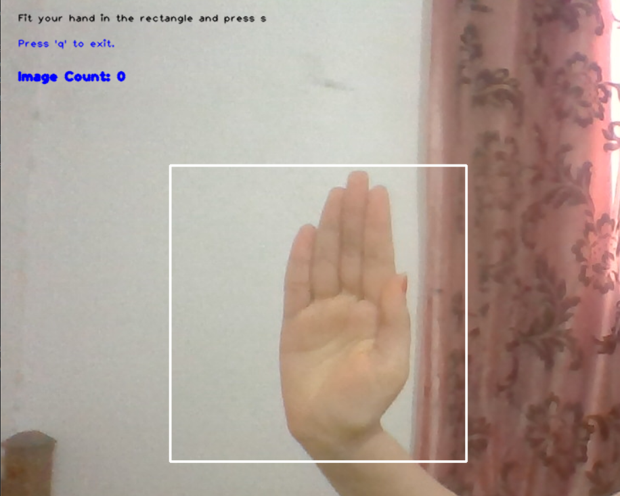
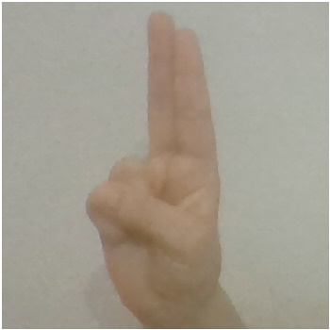
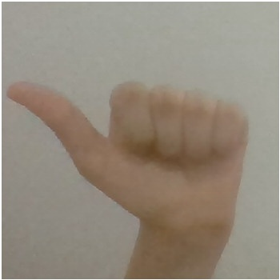
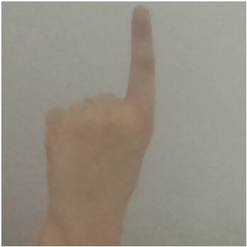
Browse
rotatecw
rotateccw
zoomin
zoomout

Slide 9


Model Training

Slide 10

Model testing
F1-score : 96%
Recall : 95%
Precision : 98%
Tested the model with various images from computer

Slide 11
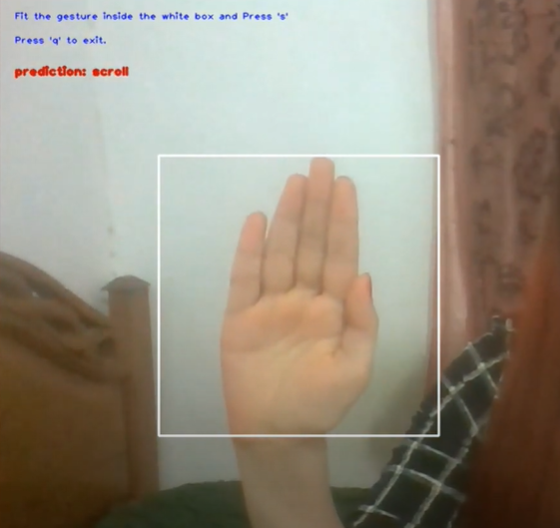
Gesture prediction

Slide 12
Actions implementation
Scroll: Browse through images
Zoom in: 1.5 zoom on a specific image
Zoom out: 0.5 zoom on image
Rotatecw: rotate 90
rotateccw : rotate -90

Slide 13
Process
III

Slide 14
Video Capture
Predict gesture from image
1
2
3
4
Image capture
Perform an action based on gesture

Slide 15
Live Demo
IV

Slide 16
THANKS!
Any questions?

