Slide 1
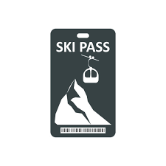
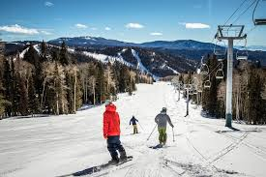
Key challenges for Big Mountain Resort: Optimizing Pricing and Investment
What ticket price can we charge based on our market position, versus
all other competing US resorts?
What facilities investment choices can be forecasted to result in the best ROI?

Slide 2
Recommendations
Based on our analysis, a higher adult weekend ticket price of $92.50 (an increase of $11.50) is in line with the current market
Best investment: increase vertical drop by 150 feet and add a chair lift (allows a further $1.36 in price/$2.3 million in annual revenue)
One run could be closed without impacting revenue, to further reduce operating costs
This would increase operating profit by $800k, if operating costs are comparable to the recently installed lift

Slide 3
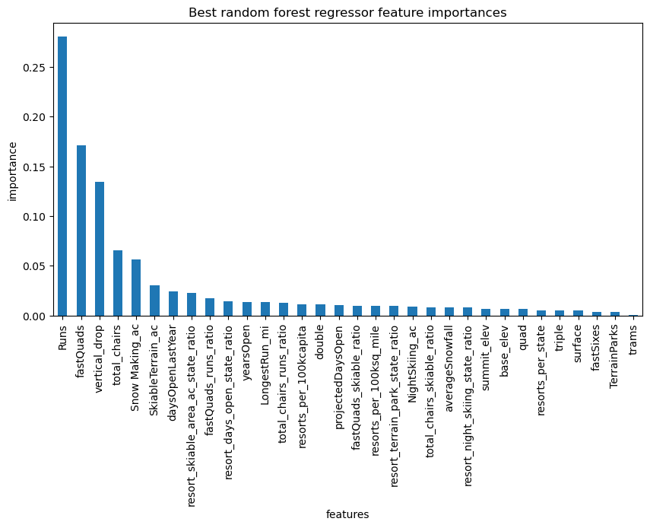
Value drivers for Big Mountain
Our model ranks which aspects of the resort drive price (and many are subject to management’s discretion)
Model benefits:
Clear set of priorities
Quantified impact of changes
Less impact on price
Key features

Slide 4
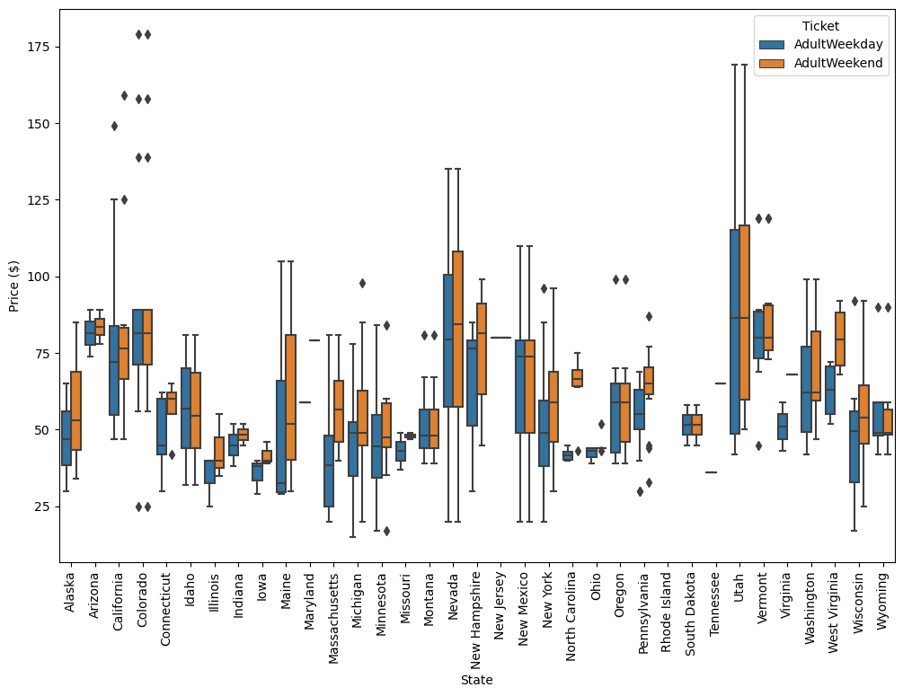
The US market shows wide variance in prices, with room to adjust*
The modeled price increase keeps Big Mountain within the upper tier of resorts, but not excessively high
Target price $92.50
Current price $81.00
*Based on 330 US ski resorts

Slide 5
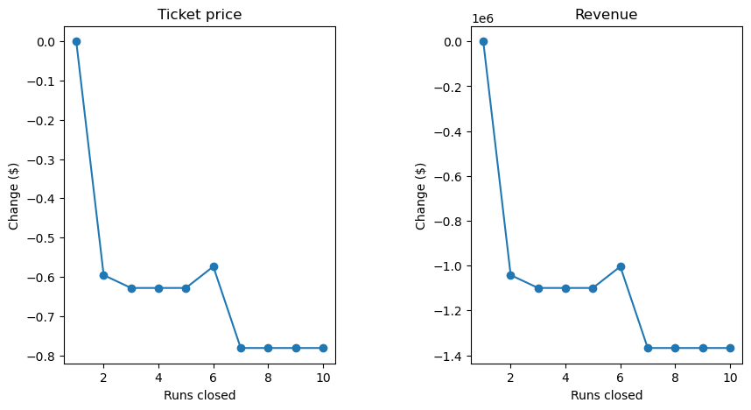
Model Ranking of Investment scenarios
Scenario
Impact
Increasing the vertical drop by 150 feet and adding a chair lift would support an increase in price of $1.36 and $2.3 million in annual revenue.
Adding 2 acres of snow-making on top of the above changes does not result in any further price or revenue increase
Increasing the length of the longest run has no impact on price
Closing one run should have no impact on revenue; closing 2 or 3 has the same impact as closing 4-5 (about a 60-cent drop), beyond which the price drops more sharply.
Large positive
Net negative
Possible cost reductions
(if run operating cost is high)

Slide 6
Final observations and recommendations
Big Mountain has ample opportunity to increase revenue with modest lift price increases, and strategic facilities investments
Existing model may be run by Big Mountain personnel to examine impact of other investment scenarios*
Model may also guide marketing, advertising messaging
Future modeling work might include:
Understanding how proximity/travel to competing resorts could impact pricing
If data is available, competition from Canadian resorts
*A user guide will be provided along with model examples

