Slide 1



Predicting manufacturing defects for 3D printed parts
The growth in 3D parts has been dramatic—can we really rely on suppliers for critical components?
Pick a supplier…
Order complex parts…
Did these really come out right?
The additive manufacturing services sector (or 3D printing contract manufacturers) grew 20% in 2023, and will grow 22.7% in 2024 to reach $7.5 billion.
“Because 3D printing is so versatile, covering plastics and metals, it has not only cornered the prototype market but is becoming more popular for bridge manufacturing and medium-volume end-use parts”*
*Source: https://www.forbes.com/sites/carolynschwaar/2024/05/29/3d-printing-the-bright-spot-in-us-based-manufacturing/
Final presentation and analysis for GC2. Author: Tom Keating

Slide 2

How do we best rate suppliers in order to avoid defective part shipments?
Defective incoming parts for JIT manufacturers can cause costly disruptions and delays
Problems facing purchasers
Goals of this analysis
Supplier ratings don’t always reflect defect rates*
Suppliers don’t always share defect rates (but do share indirect metrics)
Numerous suppliers in the market, and many different techniques for 3D printing
Create a model which enables better supplier ratings by predicting defect rates
If possible, use the model to flag shipments with high defect rates
*In fact, the ‘supplier quality’ rating in this dataset lacked any meaningful relationship to actual defect rates.

Slide 3
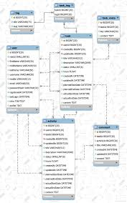
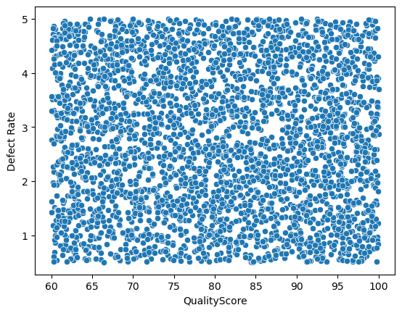
We have a dataset, but can we build a successful predictive model with it?
We are using the Predicting Manufacturing Defects dataset* from Kaggle
Dataset strengths
Scatterplot showing defect rate vs dataset variable (most plots were very similar)
3240 3D records of part shipments
Measured actual defect rates (parts/1000)
44% with high defects
Numerous other metrics supplied
Dataset weaknesses
Low correlation, noisy data
Unclear linkage between certain supplier metrics and defect rates
Can we find a signal in this noise?
*Dataset Usage and Attribution Notice: This dataset, shared by Rabie El Kharoua, is original and is made available under the CC BY 4.0 license.

Slide 4
The database contains a rich set of manufacturing-related metrics
Summary of metrics and key characteristics
Metric | Range | Comments
Production Volume | 100-1000 units/day | relatively uniform (but noisy)
Production Cost | $5000-20000
Supplier Quality | 80%-100% | Rating criteria unknown—excluded from model
Quality Score | 60-100% | Rating criteria unknown (“overall quality assessment”)
Maintenance Hours | 0-24 hours/week | Relatively uniform
Stockout Rate | 0-10%
Inventory Turnover | 2-10 (ratio of turnover)
Worker Productivity | 80-100% | (low predictive value; excluded from model)
Safety Incidents | 0-10 incidents (per month) | Somewhat bimodal
Energy Consumption | 1000-5000 kWh
Energy Efficiency | 0.1 to .5
Additive Process Time | 1-10 hours | (low predictive value; excluded from model)
Additive Material Cost | $100-500
Delivery Delay | 0-5 days
Downtime Percentage | 0-5%
Defect Status |  | Author-supplied labels (not used in the model)
Defect Rate | 0.5 to 5 defects/thousand parts | Target variable
Analysis involved selecting the most informative among these
Further data processing was required

Slide 5
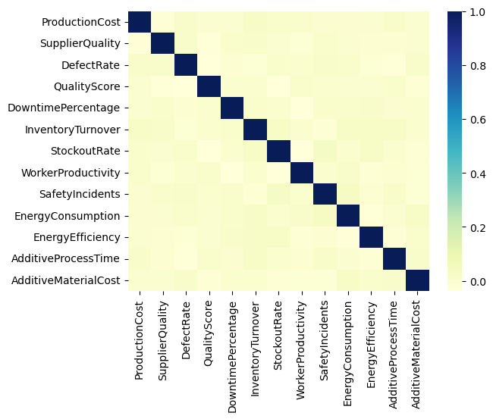
Finding patterns in the data was not easy
The solution was to divide the dataset into high/low defects
The correlation heat map showed only weak relationships between the metrics and the defect rate

Slide 6
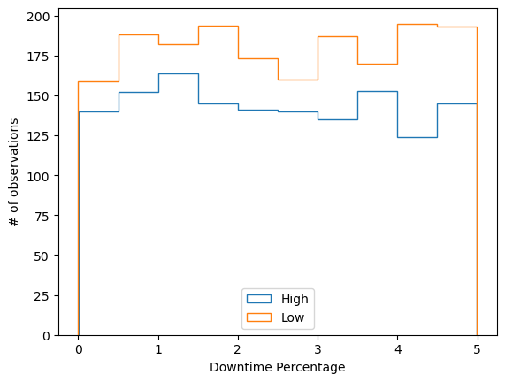
A better approach was to divide the data into shipments with high or low defect rates
Patterns began to emerge at this stage: ‘High’ defects mean > 3/thousand parts
Trends:
Low defect shipments follow an increasing trend as downtime increases (the opposite is true for high defect shipments)
Rationale:
Very low downtime could mean insufficient time spent inspecting/calibrating printers
Finding a trend and a plausible rationale usually meant we kept the variable for modeling.
Accordingly, Downtime Percentage was used in the models.*
*The final model used all variables except supplier quality, worker productivity, and additive process time, which did not meet the above criteria.

Slide 7
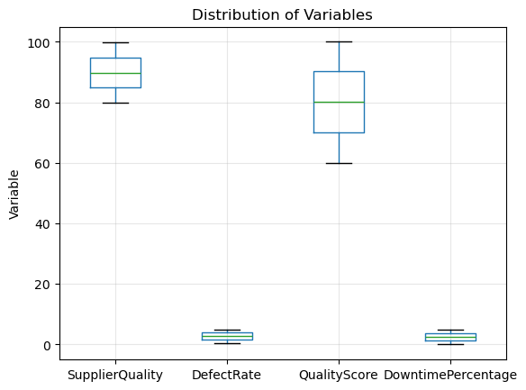
Additional processing was necessary before modeling
Variables kept for use in the model needed further cleaning
While the dataset did not require special treatments for outliers or missing data, nevertheless:
Rescaling and normalization was needed
Some features were treated as categorical (e.g., maintenance hours) rather than integer or continuous
Note the markedly different means and ranges for selected variables.

Slide 8
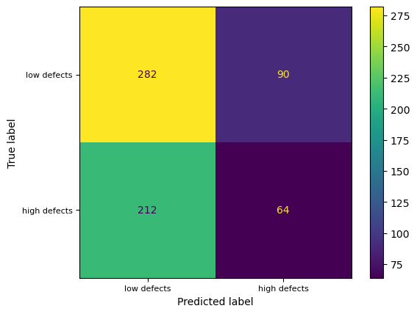
Initial models showed some promise in predicting low-defect shipments
But even with tuning and optimization, logistic regression models’ performance was limited
Problems to be resolved
44% of shipments have high defects, but the model is only finding about half of these (23%).
The accuracy* was 53.4%, only slightly better than random guessing
Logistic regression model, after parameter optimization, found 76% of low defect shipments
*Accuracy is measuring how many shipments are labeled correctly as high or low out of the total.

Slide 9
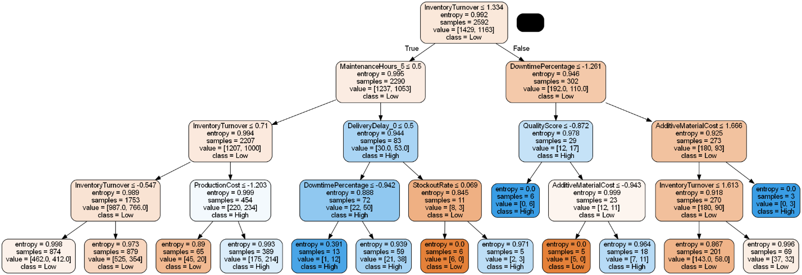
Decision tree models provided insights for further improvements
The short decision tree model below utilized only the most informative variables.
Key takeaways
The model shown relied heavily on: inventory turnover, maintenance hours, downtime percentage, delivery delay, and quality score; each of which can be connected to defect rate with some plausible rationale.
Decision tree model metrics - max depth 4
Accuracy: 54.3%
Balanced accuracy: 50.0%
Precision score for "High" 42.6%
Precision score for "Low" 57.4%
Recall score for "High" 21.0%
Recall score for "Low" 79.0%
Results for a single tree showed modest improvement over random guessing
Given the noisy data, averaging over many trees looked promising for the next modeling step

Slide 10
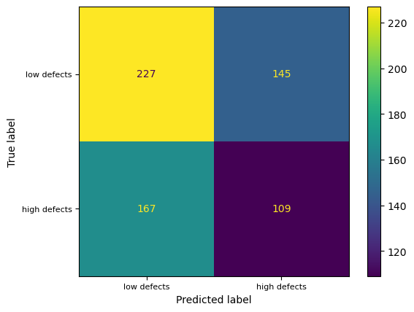
Random forests led to more balanced results than other models
Competing models could identify low-defect shipments well but often mislabeled or missed high defects
Model results and performance trade-offs
Accuracy was still low for the final Random Forest model (52%), but better than random guessing
Use model results to augment existing supplier rating models
Models with higher accuracy are possible but come at the expense of missing a higher percentage of high-defect shipments
All models were extensively optimized and validated for best performance
Tested but set aside: logistic regression, support vector machines
Confusion matrix for the (gradient boosted) random forest model: among all the models, this was the best at identifying high defect shipments

Slide 11
Overall results are modest, but there is potential for improvement
Some modeling decisions could be re-visited depending on performance required for final application
Proposed experiments
Rationale and potential benefits
Change the target: set the threshold for ‘high defects’ to >4% , for example
The choice to label a shipment as ‘high’ in defects was somewhat arbitrary; the choice could instead be driven by a threshold chosen by the end user. Subsequent models may work better in finding outliers, rather than picking lots that are somewhere in the middle range of defect rate.
Introduce engineered variables
There may be ways to combine variables that add value; e.g., ratio of additive cost to shipment cost, etc. Any improvement in explanatory variables would be useful, considering the lack of strong correlations to the target
Try other variations of SVM models
Not all variations were exhaustively tested (e.g. different kernels, SMVs versus SVCs, etc.)

