Slide 1
Team 04: Trainingstracker
Egorow Timothy
Schifferl Kilian
Al Ghazzawi Badee
Friedrich Jeremias
Evangelou Katerina

Slide 2
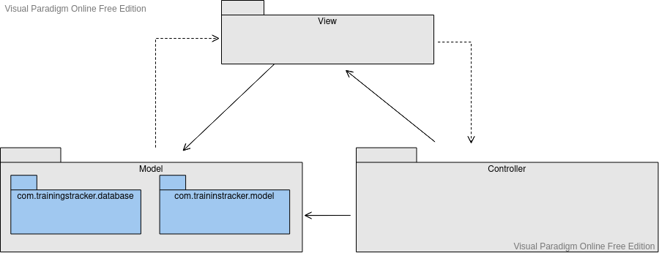

Slide 3
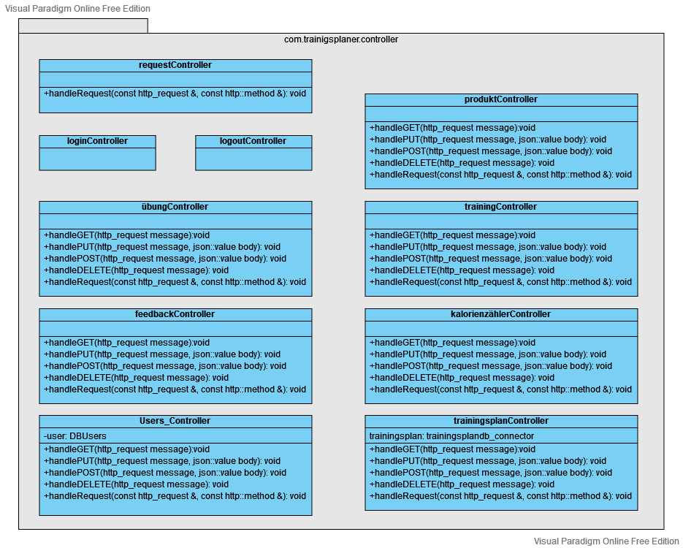

Slide 4
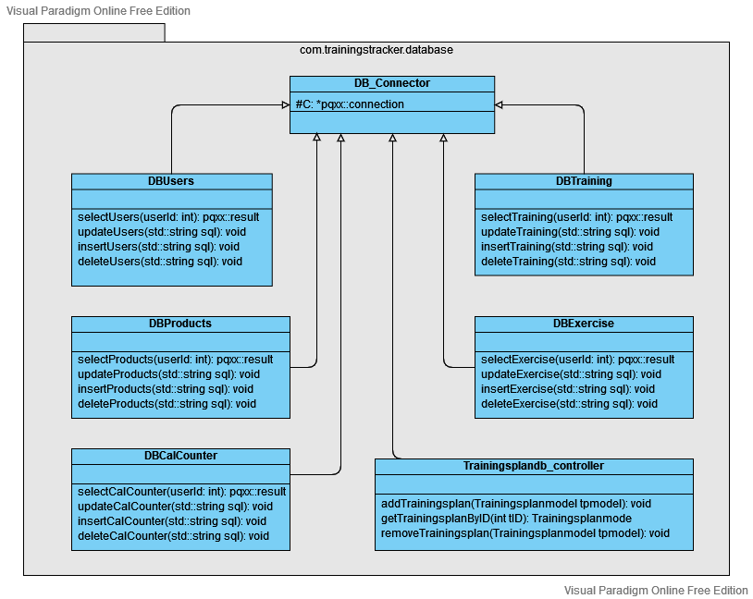

Slide 5
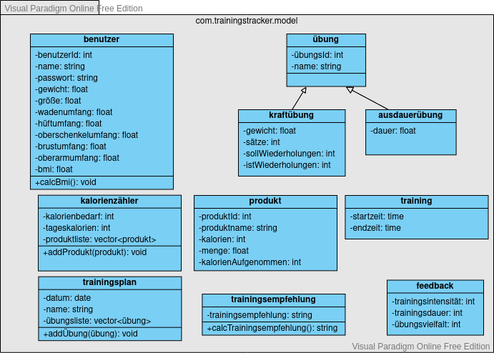

Slide 6
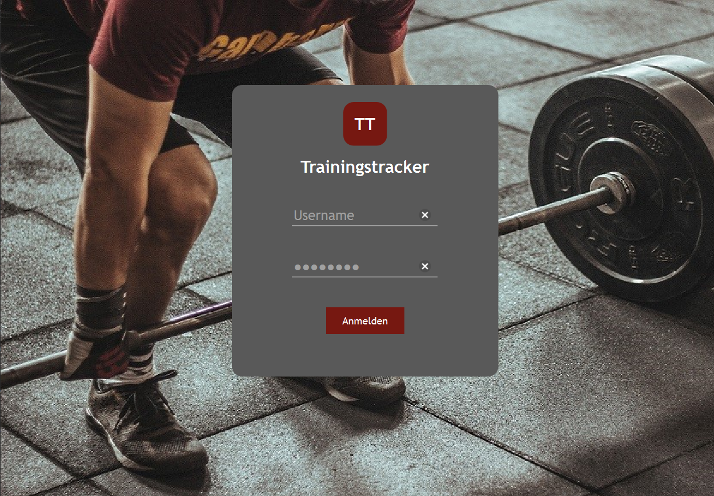

Slide 7
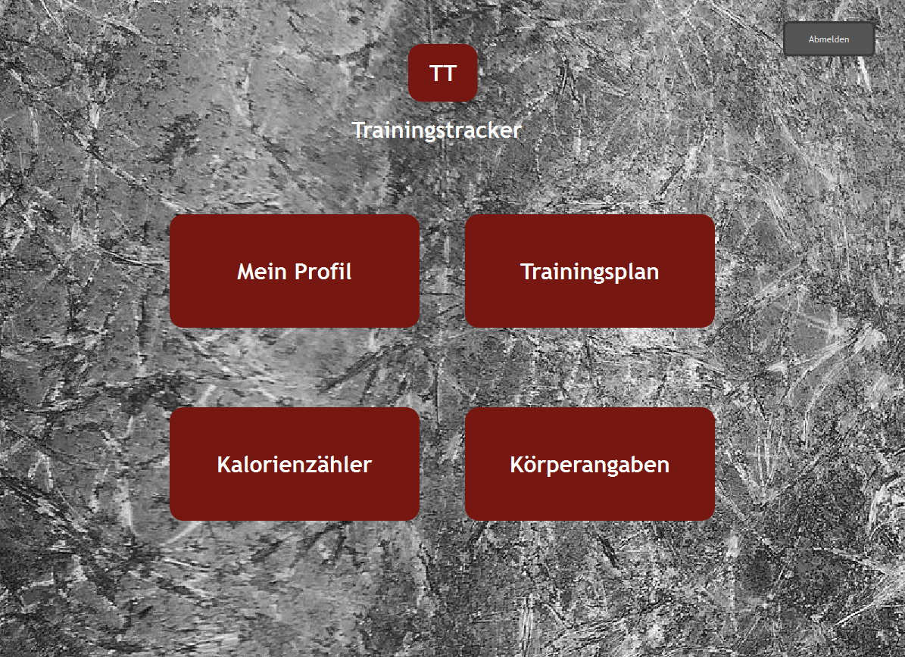

Slide 8
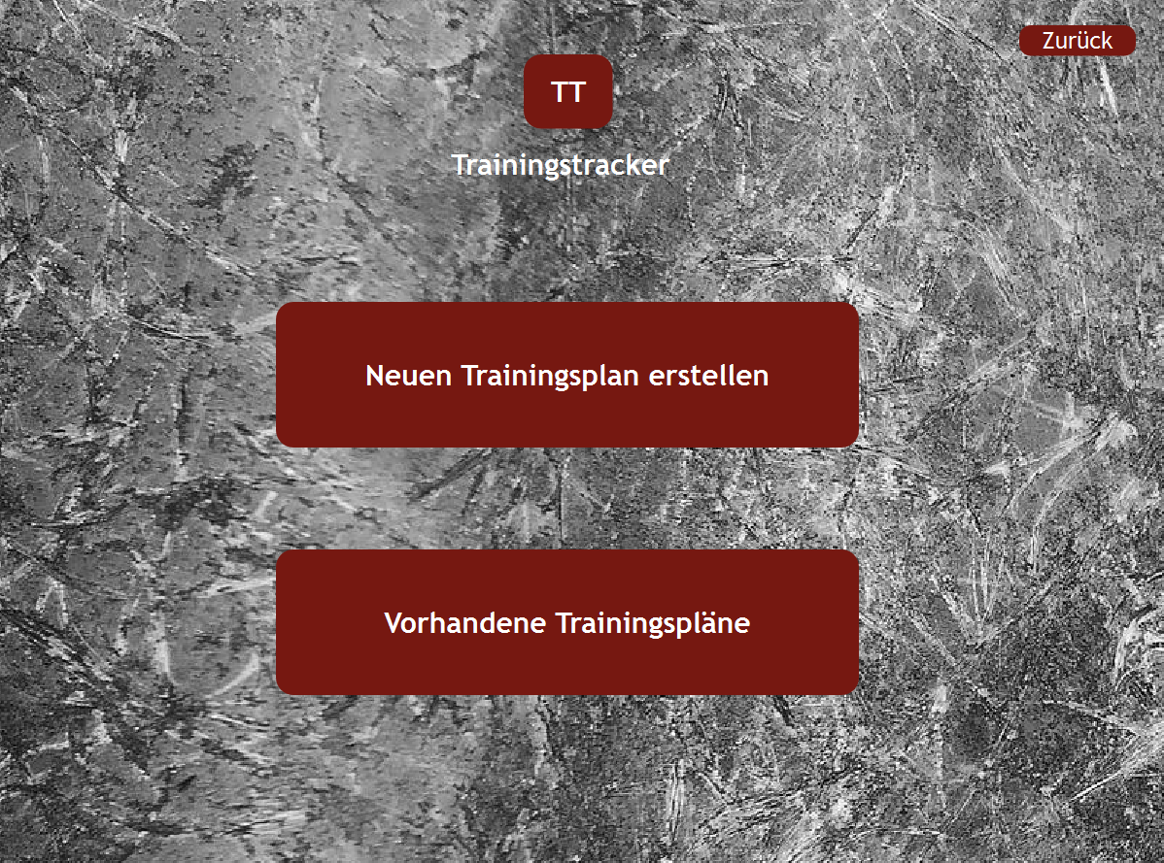

Slide 9
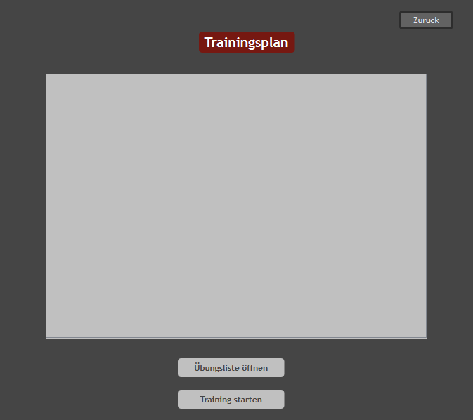

Slide 10
