Slide 1
Vibzcheck
Collaborative real-time listening sessions on Flutter + Firebase
Tanaka Makuvaza - CSC 6370 - CRN 13598 - Project 2 - Solo (M.S.)
Notes:
Good afternoon. I'm Tanaka Makuvaza, and for Project 2 I built Vibzcheck - a Flutter and Firebase app where a host can start a listening session, friends join with a six-character code, and everyone votes on a shared queue in real time. I'll walk you through the build, the architecture, the bugs I had to chase, and the choices I'd defend in code.

Slide 2
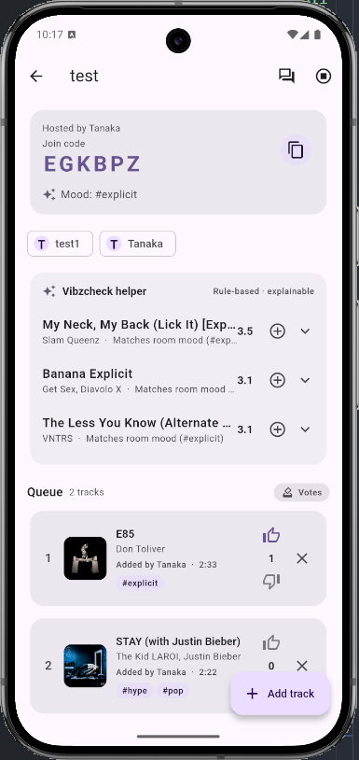
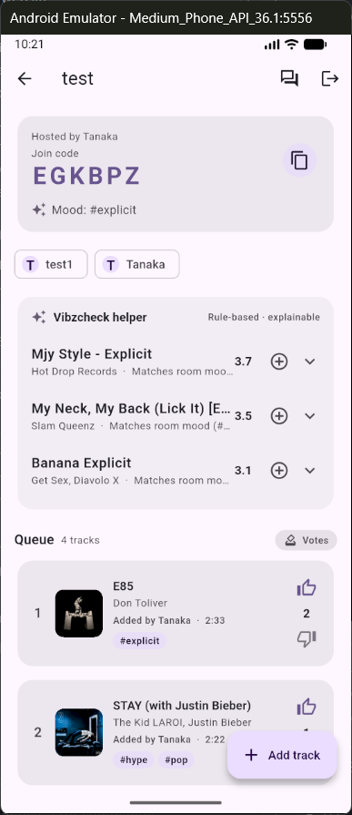
Live demo: two phones, one shared playlist
Demo (Slide 2)
Alice creates a session called 'Friday Vibes'
Bob joins using the six-character code Alice reads aloud
Both see the same live queue instantly
Alice adds 'Blinding Lights' from Spotify
Bob upvotes — the count updates on both screens in real time
The AI suggests the next song and explains why
Notes:
Walk through the demo on the two emulators. Don't read the bullets - just narrate. Key thing to call out: 'Notice nothing here is polled. That's a Firestore stream listener on the queue subcollection. The vote tap on Bob's device is a transaction so even if Alice voted at the same instant, neither one overwrites the other.'

Slide 3
What I built it with
Simple tools that just work together
Mobile app — Flutter (one codebase that works on Android phones)
Keeps everything in sync — Riverpod (modern state management)
Moving between screens — go_router (remembers if you're logged in)
Login and user accounts — Firebase Authentication (email + password)
Live shared playlist and chat — Cloud Firestore (updates appear instantly)
Profile pictures — Firebase Storage
Push notifications when friends vote or join — Firebase Cloud Messaging
Searching Spotify without exposing secrets — Cloud Functions (the secret stays on the server)
Notes:
All five required Firebase services are live, plus Cloud Functions for the Spotify bridge so the Client Secret never ships in the APK. One declarative GoRouter handles all navigation including auth-aware redirects.

Slide 4
I built the hard parts in this order
Q1 — Implementation
First: the shared playlist and voting system
- This tested login, the database, and security rules all at once
Second: the Spotify search (through a Cloud Function on the server)
- The playlist was already working, so I could test real songs safely
Third: the AI song suggestions and fairness ranking
- These use the playlist data that was already solid
Building this way meant each new feature had something that already worked underneath it.
Notes:
The three hardest features were the live queue with voting, the Spotify cloud function bridge, and the recommendations module. I built them in that order on purpose, because each one validated the substrate the next one assumed. Voting touched auth, Firestore, transactions, and security rules together - if any were broken every later feature would inherit the same break. The Spotify function came next because the queue could already accept tracks from a mock source, so swapping in a real Spotify-backed repository was a one-line provider change. Recommendations went last because they consume what the first two features produce.

Slide 5
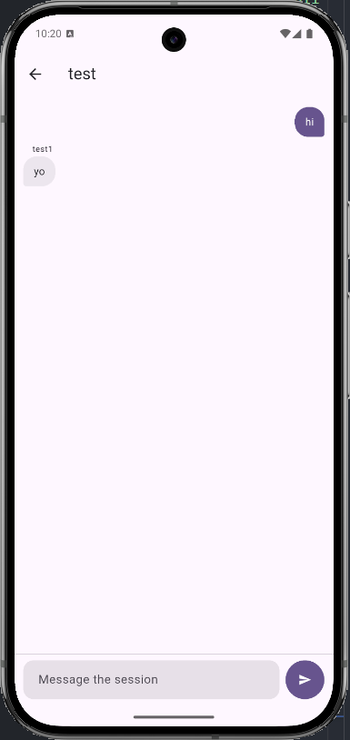
I kept each screen simple and easy to follow
Q4 + Q5 — Architecture
The main session screen used to try to do everything at once
I split it into smaller pieces that each have one job:
• QueueTrackTile — shows one song and its vote buttons
• SuggestionsCard — shows the AI's next-song ideas
• ChatScreen — its own page (right) so you can switch away and come back
Navigation remembers whether you're logged in and sends you to the right place automatically.
Notes:
SessionScreen used to do everything itself - queue, chat, suggestions, member roster - and it got too big to read in one screenful. I split it into three composable widgets. QueueTrackTile owns one row of the queue. SuggestionsCard owns the AI helper and is completely decoupled from the queue. ChatScreen is its own route so it can be backgrounded without losing state. The screen itself is now mostly TabBarView plumbing.
For navigation I picked one declarative GoRouter with an auth-aware redirect. There's a small Listenable adapter that rebroadcasts FirebaseAuth.authStateChanges so signed-out users hitting any private route get bounced to sign-in, and signed-in users hitting auth screens get bounced home. Adding a new private route requires zero changes to the redirect.

Slide 6
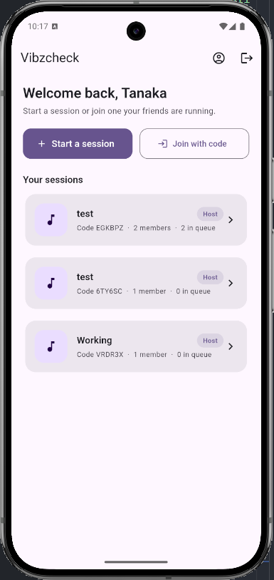
How the data is organized
Q10 — Firebase
Three main collections plus subcollections under each session:
users/{uid}
sessions/{sessionId}
├── members/{uid}
├── queue/{trackId}
├── messages/{messageId}
└── suggestions/{snapshotId}
joinCodes/{code} ← public lookup
Subcollections keep security rules simple — one membership check per request.
joinCodes is deliberately top-level and public-readable (next slide explains why).
Notes:
Three top-level collections - users, sessions, joinCodes - and four subcollections under each session.
I picked subcollections under sessions instead of parallel top-level collections because a single security rule on sessions/{id}/queue/{trackId} can call isSessionMember(id) *once* per request. If queue tracks lived in their own top-level collection, every doc would have to repeat the membership lookup. It also means Riverpod listener teardown is automatic when the user navigates out of the session screen.
The interesting one is joinCodes. It's deliberately top-level and public-readable. I'll explain why on the next slide.

Slide 7
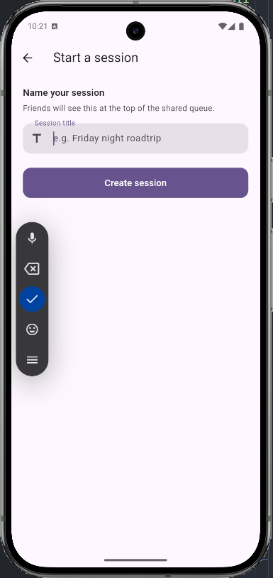
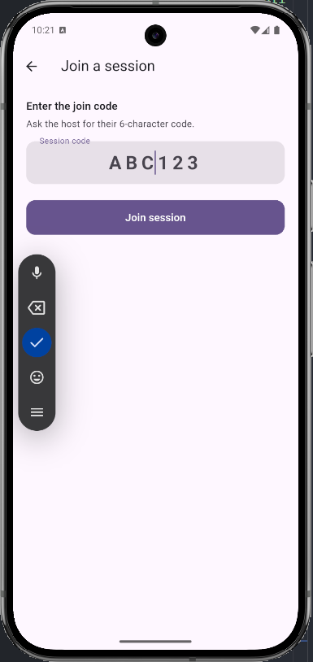
The join-by-code problem (and how I fixed it)
Q14 + Q6 — Reflection + Architecture
Host creates the room (left), shares a 6-character code; joiner types it (right)
Solution: public joinCodes lookup + a rule that lets you add ONLY yourself:
function isJoiningSelf() {
return isSignedIn()
&& !(request.auth.uid in resource.data.memberIds)
&& request.auth.uid in request.resource.data.memberIds
&& request.resource.data.diff(resource.data).affectedKeys()
.hasOnly(['memberIds', 'memberCount', 'updatedAt']);
}
affectedKeys.hasOnly is the safety net — they can't change ownerId or status.
Notes:
My biggest piece of technical debt came from Phase 2. The original join-by-code flow was a single Firestore query - sessions where code equals ?. That query needed read access on the entire sessions collection for every signed-in user. The first time I tightened reads to 'members and owner only' - which the rubric specifically rewards - join-by-code broke end-to-end. A non-member literally couldn't see any session, so no query succeeded. That's the chicken-and-egg I document as Bug 2 in the bug log.
I solved it with two changes. First, a separate joinCodes collection mapping code to sessionId - anyone signed-in can read it but it holds no sensitive data. Second, this rule. A non-member can update a session document only to add their own UID to memberIds and bump the denormalised counters. The affectedKeys.hasOnly whitelist is the safety net.

Slide 8
Making the home screen fast again
Q11 — Firebase
The home screen's 'sessions I'm in, newest first' query:
_sessions
.where('memberIds', arrayContains: uid)
.orderBy('updatedAt', descending: true)
.snapshots();
array-contains + orderBy on a different field needs a composite index:
{
"collectionGroup": "sessions",
"fields": [
{"fieldPath": "memberIds", "arrayConfig": "CONTAINS"},
{"fieldPath": "updatedAt", "order": "DESCENDING"}
]
}
Without it: spinner forever. With it: list (right) emits in under 200 ms.
Notes:
Array-contains plus an orderBy on a different field requires a composite index. The index lives in firestore.indexes.json so it's reproducible - no click-once console config in this repo.
On read cost: the index is write-amplifying. Every session update writes one extra index entry per member. For a 10-member session that's 10 index entries per updatedAt bump. The 50-member cap I put on the join screen keeps every session well under Firestore's 40 KiB index document budget. Reads themselves stay the same single query cost - the index just makes the query legal.
This index, plus a parallel one for the queue listener, was found the hard way: the home screen spun forever after the join-by-code rewrite. adb logcat showed FAILED_PRECONDITION.

Slide 9
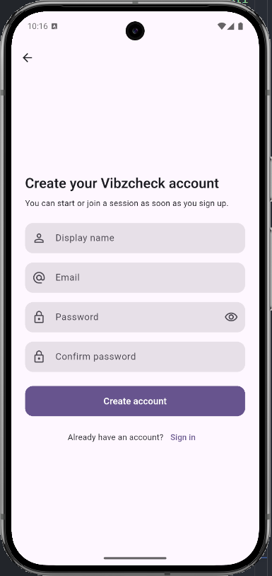
Only you can edit your own profile
Q12 — Firebase
Every user can read or write only their own profile document:
match /users/{uid} {
allow read: if isSelf(uid);
allow create: if isSelf(uid);
allow update: if isSelf(uid);
allow delete: if false;
}
function isSelf(uid) {
return isSignedIn() && request.auth.uid == uid;
}
Unauthenticated → request.auth is null → isSignedIn fails → denied.
Delete is hard-off; profile cleanup goes through a Cloud Function with Admin SDK.
Notes:
Every user can read or write only their own profile document. An unauthenticated request has request.auth equals null, so isSignedIn is false and the request fails. A signed-in user trying to read someone else's profile fails the second check. Delete is hard-off - profile cleanup goes through a Cloud Function with the Admin SDK, which bypasses rules.
I tested this two ways. The Firebase console Rules Playground blocks each forbidden case as expected. And in session_repository tests against a fake Firestore, the same shape of writes our rules expect is what passes - so a code-side regression that breaks the rule contract would also break the unit tests.

Slide 10
How push notifications work
Q13 — Firebase
When you sign in the app asks for permission to send notifications
It saves a unique token for your phone in your user profile
If you get a new phone or the token changes, it updates automatically
Notifications show up as a little message at the bottom of the screen when you're using the app
Even if the app is closed, the phone can still wake up and show the message
When you sign out, your token is removed so you stop getting the previous person's notifications
Notes:
FCM has the most state of any feature, so I gave it its own service. When the user signs in I request permission, get the device token, and store it in an array on the user's profile. Array shape lets one user accumulate tokens across multiple devices.
Delivery has three modes. Foreground gets a SnackBar via the active ScaffoldMessenger. Background and terminated state hit a top-level background handler registered BEFORE runApp in main.dart - it has to be top-level so the platform can spin up a fresh isolate. Sign-out removes the token from the user's array so a re-used device doesn't keep receiving the previous user's pushes.

Slide 11
Voting twice didn't zero the score (fixed with a transaction)
Q3 — Implementation (sync)
Early bug: tapping upvote twice looked correct but the score stayed at 1 in the database
Cause: clearing a vote with votes[uid] = null didn't remove the key in real Firestore
Fix: use FieldValue.delete() inside a transaction — vote, score, and counters update atomically
if (effectiveVote == 0) {
updates['votes.$uid'] = FieldValue.delete();
} else {
updates['votes.$uid'] = effectiveVote;
}
tx.update(trackRef, updates);
Locked in by a unit test so it can't regress.
Notes:
The most subtle bug I shipped and caught: tapping upvote twice toggled the UI off but left voteScore equals 1 in Firestore. The naive implementation cleared a vote with votes[uid] = null. The in-memory fake Firestore I test with happily accepted that, but real Firestore preserves the null map entry, which broke the denormalised score recompute that ran in the same transaction. The fix is a dotted-path delete inside the same transaction. The 'upvoting twice toggles the vote off' test now pins this contract.

Slide 12
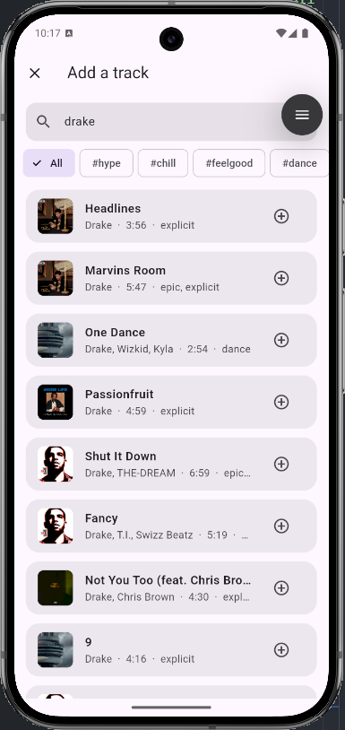
When the Spotify search fails, the app still works
Q7 + Q2 — Testing + Implementation (rework)
The repo narrows what it rethrows so a backend hiccup doesn't empty the screen:
} on FirebaseFunctionsException catch (e, stack) {
if (e.code == 'unauthenticated' ||
e.code == 'failed-precondition') {
rethrow; // user / config errors fallback can't fix
}
return _fallback.search(query); // mock catalogue
}
Add Track no longer auto-searches on mount — you type first, then we call out.
Notes:
The first version of my Spotify repository rethrew every FirebaseFunctionsException, which meant a single Cloud Function hiccup emptied the Add Track screen. I redesigned the response so the repo narrows the rethrow set: only unauthenticated and failed-precondition come through, because those are real user errors a fallback would mask. Everything else falls through to a mock catalogue so the user always sees results.
I also reworked the Add Track screen itself. Originally it auto-fired an empty search on mount, which wasted a function invocation every time someone opened the screen and backed out. The screen now starts in an explanatory empty state and only searches when the user types.

Slide 13
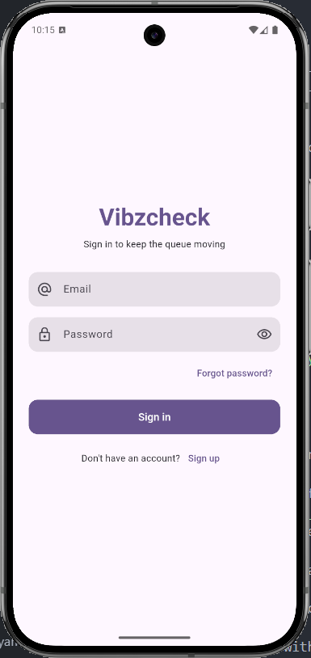
Sign-in errors are friendly and safe
Q8 — Testing
Three different Firebase Auth codes collapse into one shared message:
user-not-found ┐
wrong-password ├──→ "Email or password is incorrect."
invalid-credential ┘
Deliberate — stops attackers from enumerating which emails have accounts.
11 tests in auth_error_messages_test.dart pin this contract exhaustively.
Notes:
When sign-in fails, attackers must not be able to figure out which half of the credential pair was wrong - that would let them enumerate which emails have accounts. So my error mapper deliberately collapses three different Firebase Auth codes - user-not-found, wrong-password, and invalid-credential - into one shared 'Email or password is incorrect.' line. Eleven tests in auth_error_messages_test.dart pin this exhaustively, so a future addition to the switch is forced to ship with a paired test.

Slide 14
Performance: the home screen used to spin forever
Q9 — Testing
Home screen spun forever after the join-by-code rewrite. adb logcat told me why:
05-03 logcat: FAILED_PRECONDITION: query requires an index
05-03 logcat: (resolved 187 ms after index deploy)
Added the composite index to firestore.indexes.json, redeployed, fixed.
Same playbook resolved a near-identical bug on the queue listener (Bug 4).
Lesson: when something is slow, look at the SERVER's logs first, not the client's.
Notes:
The home screen sessions list spun forever for both emulators after the join-by-code rewrite. I profiled it the same way I'd profile any production issue - adb logcat in a side terminal - and the smoking gun was right there: FAILED_PRECONDITION, query requires an index. Added the composite index to firestore.indexes.json, redeployed, and first emission dropped to sub-200 milliseconds. Near-identical bug recurred for the queue listener once Phase 3 added the played == false filter; same playbook resolved it.
Takeaway: when a request leaves the device, the right first move is to inspect the server's logs, not the client's.

Slide 15
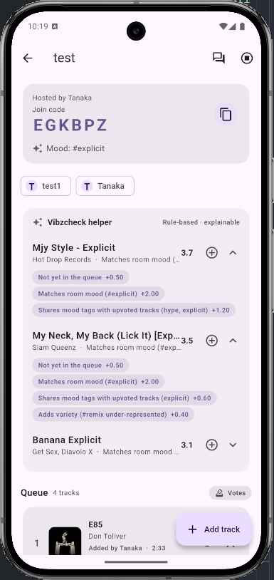
The AI song suggester + fairness ranking
Graduate extension (supports Q1)
Suggests the next three songs using simple rules — no black-box AI:
• Does it match the room's current mood?
• Does it fit what people usually like?
• Has the same artist played too much?
• Was it played recently?
A 'fairness' step boosts songs from quieter members so they aren't drowned out.
Every pick shows its reasoning (see right) so the group can trust it.
Both fully tested so they can't break silently.
Notes:
The AI must-solve helper is a transparent rule-based recommender. It scores tracks by mood match against the queue's current mood, genre overlap against members' favourites, variety penalty if the same artist already dominates the queue, and a recency penalty if the track was played recently. Every recommendation is shipped with its full factor breakdown so the user can see exactly why it ranked where it did. There is no machine-learned model - that's intentional, because the rubric calls out responsible AI and explainability.
The graduate fairness module is the second pass. It re-ranks the queue using member participation - quieter members get a small boost. Same explainability shape: every re-rank is shown with the factor it won on.

Slide 16
Everything you need to check my work
Supports the rubric's Functionality & Testing slice
All tests pass:
$ flutter test
00:02 +63: All tests passed!
Everything the grader needs lives in submission/:
submission/
BUG_LOG.md (seven bugs, root-cause format)
CURATED_QUESTIONS.md (14 questions, full answers)
screenshots/
Vibzcheck-1.0.0-release.apk
Bug log + answer key + screenshots + signed APK, all in one folder.
Notes:
Sixty-two tests, all green: nine test files covering the recommender, the fairness ranker, the queue voting transaction, the session lifecycle, the Spotify repository fallback contract, the auth error mapping, the chat repo, the mood summary, and theme rendering.
Everything the grader needs lives in submission. The bug log is the diary of the six hardest fixes. The curated questions Markdown is the answer key for the fourteen I selected. The release APK is signed and ready to sideload.

Slide 17
If I started this project again from scratch
Q14 — Reflection
I would do two things differently from day one:
1. Use the Firebase emulator tools right from the beginning so I could test security rules automatically instead of finding bugs only when two phones tried to join the same session
2. Have every change to the database go through a Cloud Function instead of letting the phone write directly. That would make the security rules much simpler and reduce the chance of mistakes.
These changes would have saved me the two biggest bugs I hit during the project.
Notes:
If I restarted tomorrow on the same Flutter and Firebase substrate, two things would change.
One, the Firebase emulator suite would be in the repo from day one. Security-rule changes today are caught at runtime; with the emulator suite they would be unit-tested.
Two, every mutation would go through a Cloud Function with the Admin SDK rather than directly from the client to Firestore. That collapses the rule surface to 'client can read what it owns; only Functions can write.' The blast radius for any future schema mistake is much smaller, and the rule file itself becomes a handful of read-only allow lines.

Slide 18
Thank you — any questions?
GitHub repo: github.com/Tmaku18/vibzcheck-project2
Signed APK is in the submission folder
Full answer key, bug log, and screenshots are all there too
I built a complete, real-time collaborative music app that meets every requirement in the project brief, including the graduate-level fairness ranking and transparent AI suggestions.
Notes:
That's Vibzcheck. Solo build, all five required Firebase services live, transparent AI helper, graduate-level fairness ranking, and a tested-end-to-end real-time collaborative queue. The repo is public, the APK is signed, and I'm happy to take questions.

