Slide 1
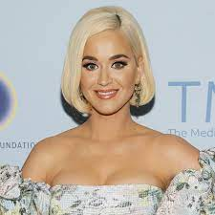
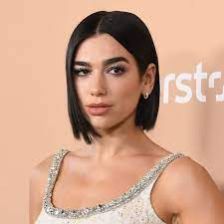
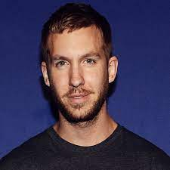
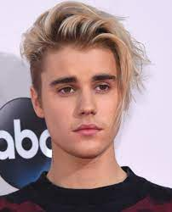
A Decade of Music
Shannan Sharp & Tommy Smith

Slide 2
Music Patterns from 2010-2019
Analysis based on database of songs from Spotify
•https://www.kaggle.com/leonardopena/top-spotify-songs-from-20102019-by-year
What were the trends through the years?
•What was the most popular genre overall? Each year?
•Who was the most popular artist overall? Each year?
Looking at a unique analysis:
•How do beats per minute correlate to “Dancibility”?

Slide 3
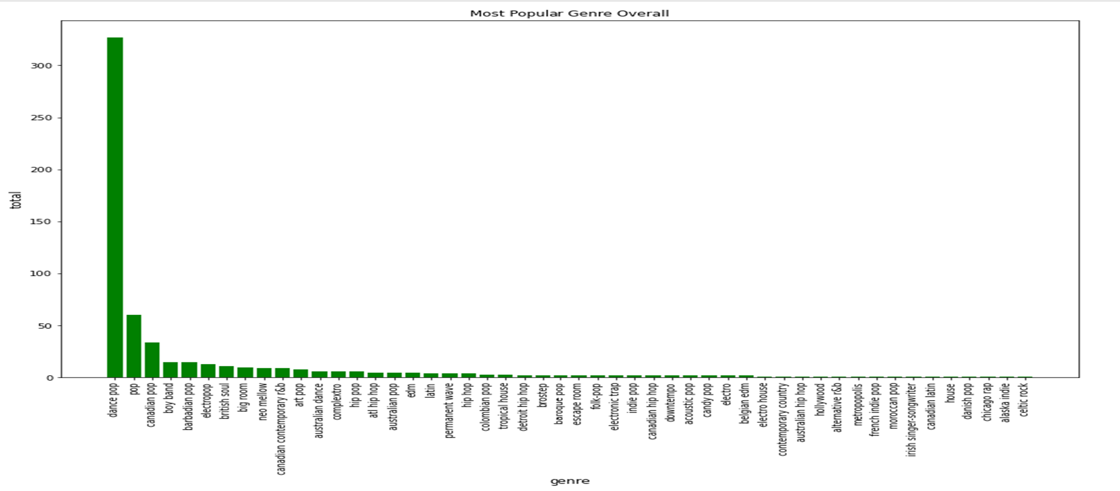
Most Popular Genre

Slide 4
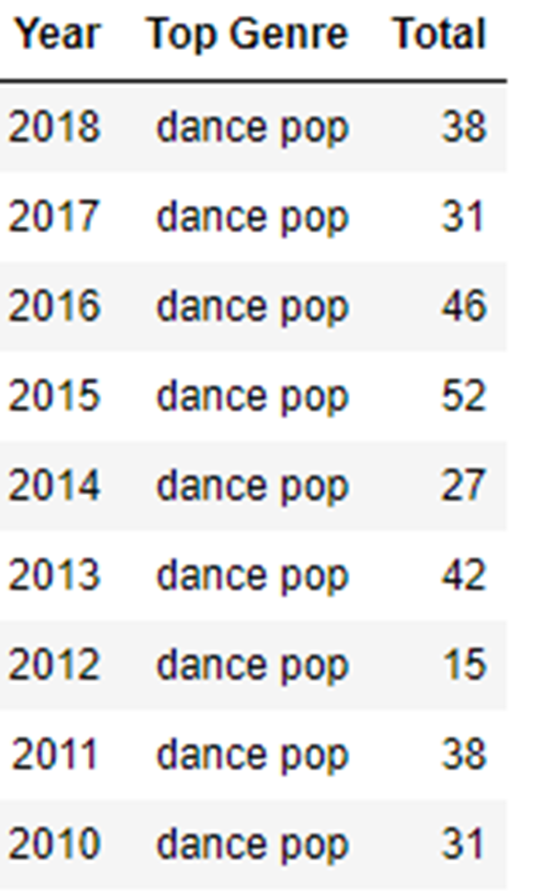
No surprise here…Dance pop was the most popular genre of the decade

Slide 5
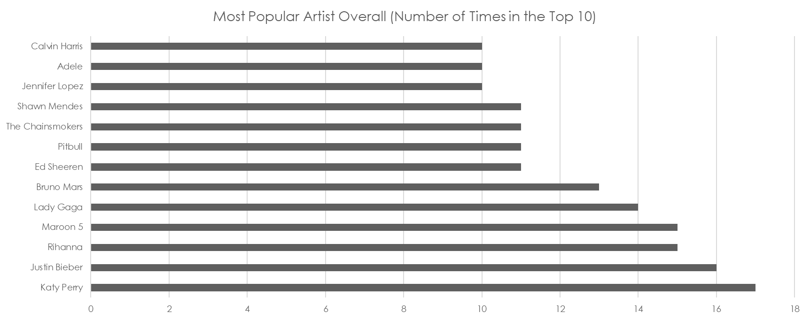
Most Popular Artist Overall

Slide 6
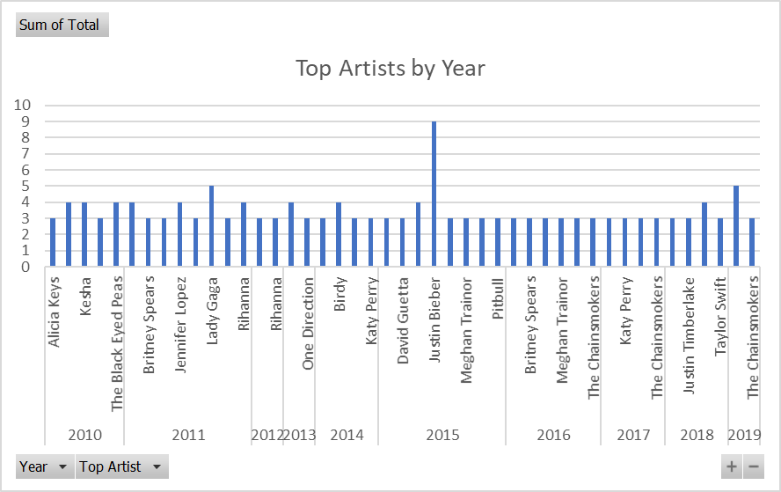
Most Popular Artist by Year

Slide 7
Statistical Analysis of Beats per Minute
Beats Per Minute
Count | 603
Mean | 118.54
Std (Standard Deviation) | 24.795
Min | 43.0
25% | 100.0
50% | 120.0
75% | 129.0
max | 206.0

Slide 8
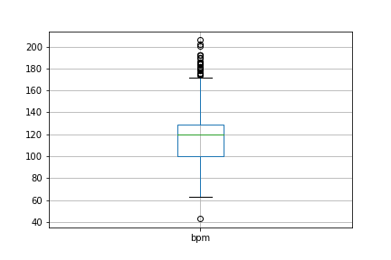
Were Any Songs Outliers?
Yes. Twenty-seven songs were outliers when analyzing BPM.

Slide 9
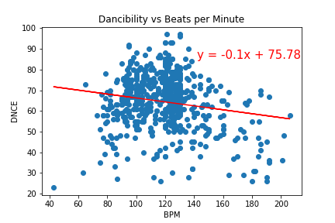
How do Beats per Minute Correlate to “Dancibility”?

